Slide 1
Practical multiple scattering in rough surface
Joo Ho Lee* Adrian Jarabo† Daniel S. Jeon* Diego Guttierez† Min H. Kim*
* KAIST † Universidad de Zaragoza
Notes:
Hi, everyone.
Today I will present our work, practical multiple scattering in rough surface.
This work is the result of collaboration between Visual computing lab at KAIST and Graphics and Imaging lab in Universidad (유니베르시다드) de Zaragoza
[TTS 10분32초]

Slide 2
Incoming light
Reflected light
Bidirectional Reflection Distribution Function (BRDF)
Surface
Notes:
When light hit the surface, the surface reflects the incident light in certain distribution.
We call it as a BRDF.
(내가 말하고자 하는 것: BRDF란 surface에 부딛히고 나서 퍼지는 것을 표현하는 함수이다)

Slide 3
Incoming light
Reflected light
Bidirectional Reflection Distribution Function (BRDF)
Multiple scattering
Micro-surface
Notes:
The current state of the art rendering describes a BRDF as reflections of micro-facets, called as a microfacet model.
[click]As you can see here, some reflections could be blocked by other microgeometry.
Interestingly, the current microfacet model treats these blocked rays as zero.
But, is the blocked ray really disappeared?
[click]No. After intersections, the rays will reflect and contribute the outgoing distribution.
We call these rays as multiple scattering.

Slide 4
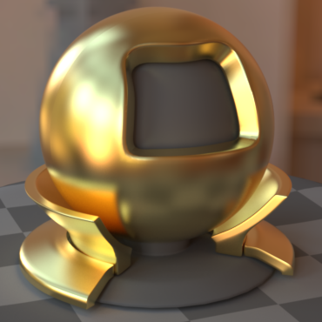
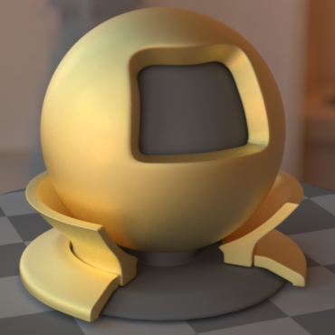
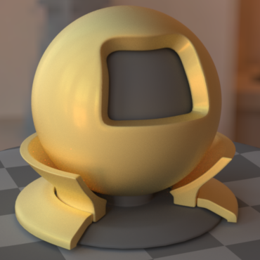
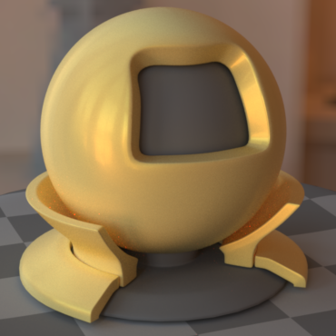
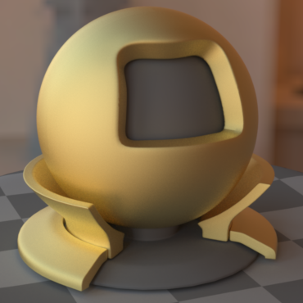
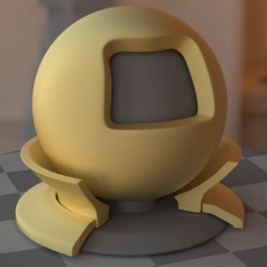
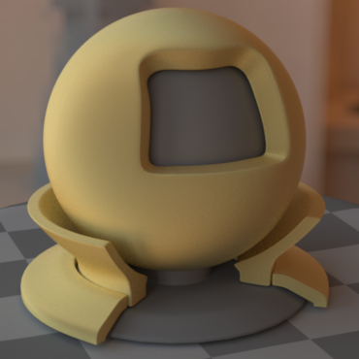
Our work
Our model
The current microfacet model
Roughness increase
Notes:
In this work, we demonstrate what happens if we consider multiple scattering.
As shown in this slide, our model do not suffer from energy loss and has saturated color compared to the current microfacet model while increasing roughness.
//Here we design multiple scattering in an analytic form.

Slide 5
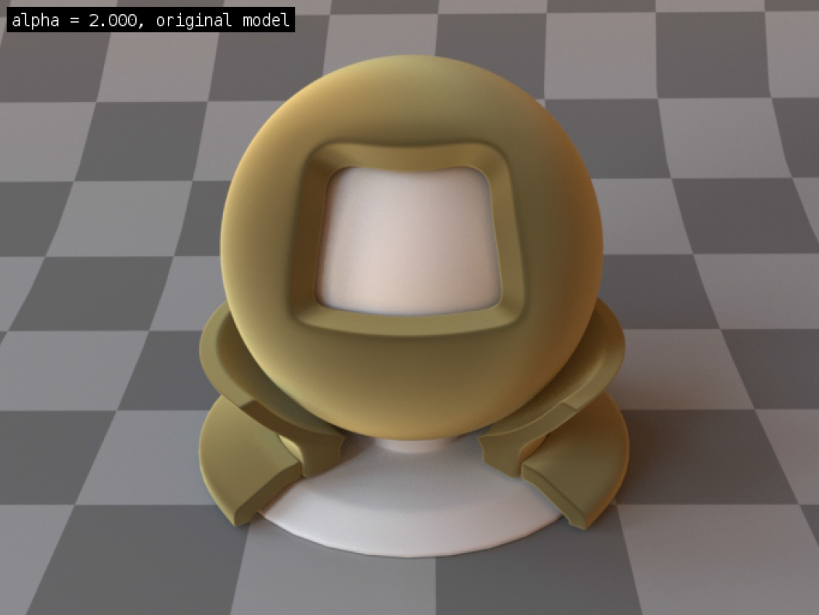
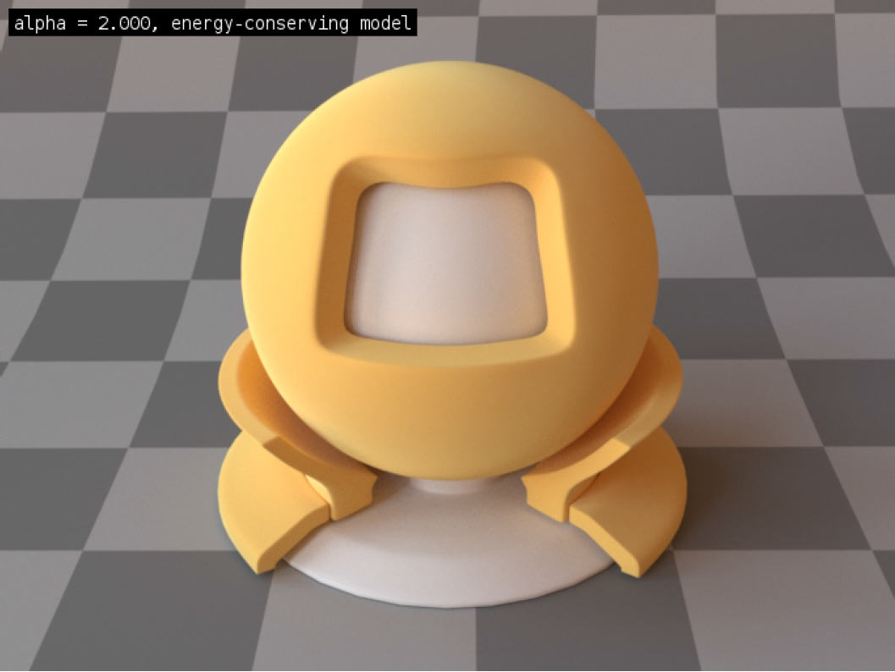
Related work: MULTIPLE scattering
Hiring the pseudo-diffuse term
Kelemen and Szimary-Kalos (2001)
Jakob, d’Eon, Jakob, and Marschner (2014)
No coupling with microgeometry
Multiple scattering
Single scattering
Single scattering
Multiple scattering
Notes:
Let look at some prior work about multiple scattering.
There are two approaches to deal with multiple scattering.
One of approach is to hire the pseudo-diffuse term to compensate the multiple-scattering energy loss.
However, the drawback of this approach is that the distribution of multiple scattering doesn’t cooperate with any microfacet geometry, it always gives us the diffuse appearance for multiple scattering.

Slide 6
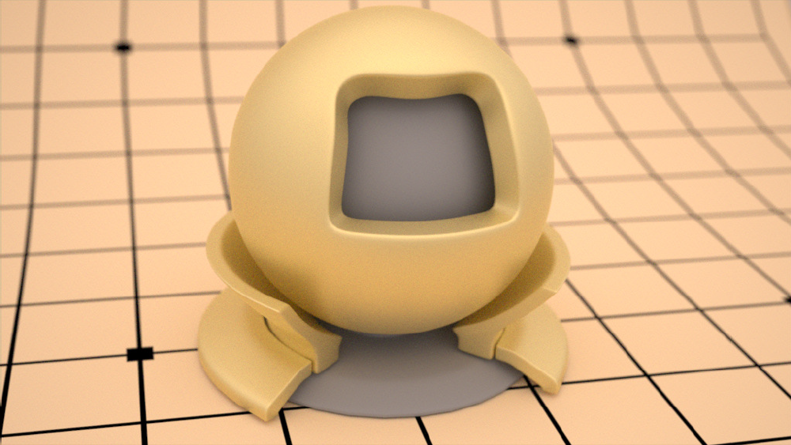
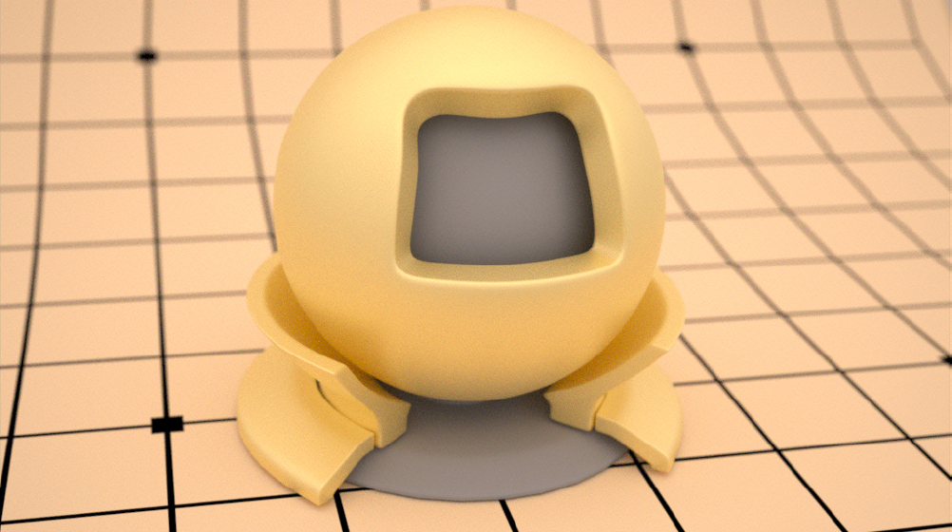
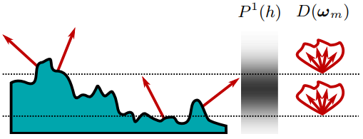
Related work: MULTIPLE scattering
Traveling in microgeometry
Heitz, Hanika, d’Eon, and Dachsbacher (2016)
Good agreement with the Gaussian surface
Stochastic approach
Smith model
Multiple scattering
Notes:
The other approach is to track the ray in the microfacet geometry.
Hetiz et al. propose the volumetric Smith model which enables us to track rays in microgeometry.
They show that their model has a good agreement (well matched) with simulation of Gaussian random surfaces.
However, their model is not a closed form and needs a stochastic process to compute the BRDF, so it incurs additional stochastic variances.
//Also, since they independently sample rays, sampled rays are incoherent with other sampled rays.

Slide 7
Our motivation
No analytic model exists for multiple scattering.
Notes:
So, with our best knowledge, there is No analytic BRDF for multiple scattering!
With this motivation we start our project.

Slide 8
Challenges
No explicit microgeometry
?
?
?
?
?
?
Micro-surface
Notes:
So what makes us difficult to model multiple scattering?
the fundamental problem is that we don’t have explicit micro geometry.
Without microgeometry, there is no way to understand multiple scattering.

Slide 9
Challenges
Visibility test & complex path space
?
?
?
Micro-surface
Notes:
Even we have a microgeometry, there is still a problem.
[Click]To sample a path, we have to check visibility of path.
[Click] Also, Since the path space is complex, we need a lot of samples to evaluate outgoing distribution.

Slide 10
V-groove world
Microgeometry = A set of 3D V-grooves
Ground
…
…
…
…
V-grooves, locality, mirror-reflection
Notes:
To resolve these issues, we assume that the microgeometry is a set of 3D V-grooves in our model.
[click] In the V-groove world, The top edges of V-grooves are on the same plane so that a ray go through one V-groove only.
[click] And we assume all surfaces have mirror reflection.
The benefit of the V-groove world is that we can derive microgeometry from normal histogram, instead of explicit geometry definition, and also we can compute a path in a deterministic way.

Slide 11
K-reflection BRDF
+
+
…
=
Single
scattering
Second
scattering
Third scattering
Total
scattering
Notes:
To design an analytic model for multiple scattering,
We model scattering for each number of reflection due to mathematical continuity.
We will call it as K-reflection BRDF.
We compute the total BRDF as sum of series of K-reflection BRDFs.

Slide 12
K-reflection BRDF evaluation
Light source
Camera
100%
What % after k=2 reflections
…
…
…
…
Notes:
So let us evaluate a BRDF value for a given light and camera direction with the certain number of reflections.

Slide 13
K-reflection BRDF evaluation
Light source
Camera
100%
What % after k=2 reflections
…
…
…
…
…
…
…
…
Notes:
We first find V-grooves which contain a path from light to camera with k bounces.

Slide 14
Reflection geometry
Object normal
Surface orientation
Outgoing direction
Light direction
Perpendicular
Plane
V-groove axis
Top view
Notes:
To find the V-groove, we have to know how a ray bounce in a V-groove.
[click]When a ray hit a microfacet, [click]the microfacet constructs a V-groove by mirroring itself .
[click]The ray reflects by two surfaces of the V-groove and finally go out.
[click]The important thing is that the outgoing direction and the light direction have the same V-groove axis component.
So, we try to find a V-groove axis which satisfy this constraint.

Slide 15
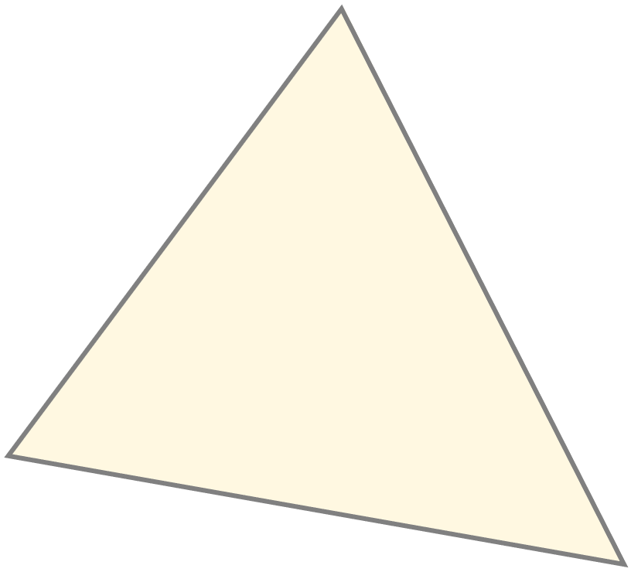
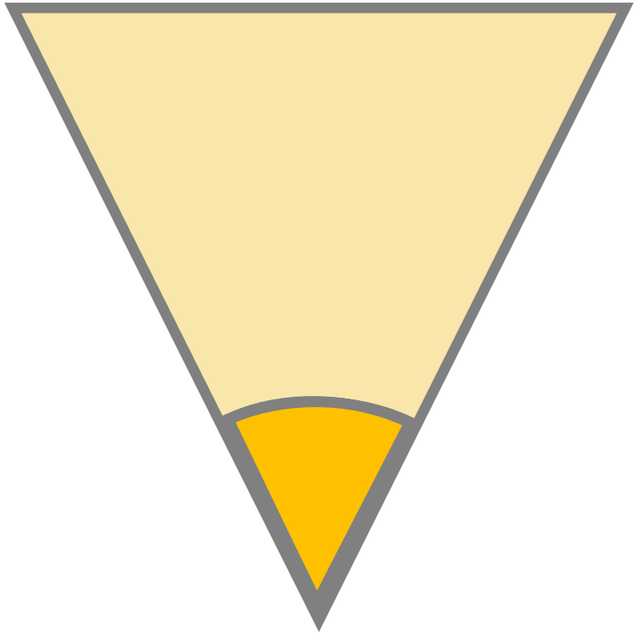
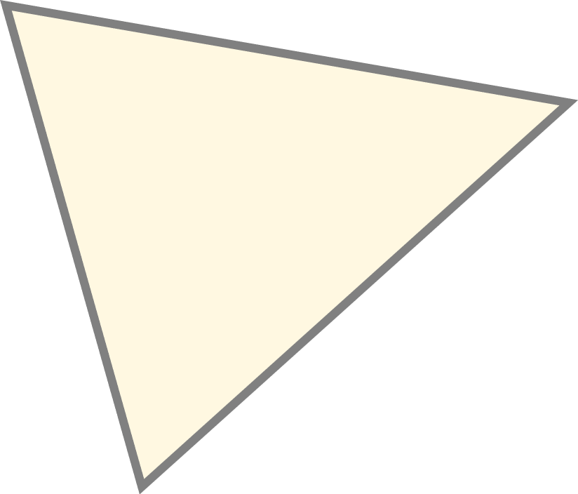
Light transport
Outgoing direction
1st virtual V-groove
2nd virtual V-groove
k^{th} virtual
V-groove
Outgoing direction
[Zipin 1967]
Notes:
after the V-groove axis is fixed, the angle between two surfaces changes the outgoing direction.
Here is the interesting geometric analysis for multiple scattering in a V-groove.
[click] By generating virtual V-grooves by reflecting V-grooves sequentially, the outgoing direction after k bounces becomes the incident direction in the kth virtual V-groove coordinate.
So, for a given camera direction and light direction, we find a V-groove angle which makes the view direction on the k-th virtual axis and the light direction be on the same line.

Slide 16
Reflection geometry
Object normal
2 possible V-grooves
Notes:
Summing up, there are at most two possible 3D V-grooves which bounce a ray from light to the camera.
If the light source is on the mirror direction of the camera direction, the solutions are infinity. So we will ignore this case now.

Slide 17
K-reflection BRDF
Light source
Camera
100%
What % after k=2 reflections
…
…
…
…
…
…
…
…
Notes:
Then we compute a BRDF value for each V-groove.
[click]We compute a incident region, the yellow region, from the microfacet distribution.
A ray which hits the yellow surface can go towards the camera after k bounces.

Slide 18
K-reflection BRDF
Light source
Camera
100%
What % after k=2 reflections
…
…
…
…
…
…
…
…
Notes:
[click] However, geometrically, some parts are shadowed and some parts reflect more or less than k reflections.
Here only green part reaches the camera with k bounces.
So we have to compute this effect called as geometric attenuation.

Slide 19
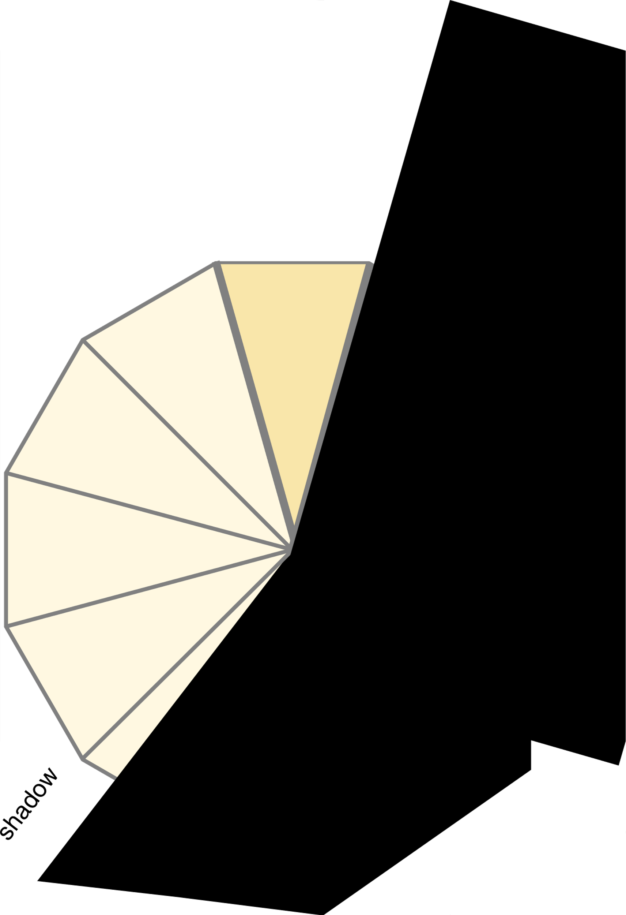
Geometric attenuation
Use line equation
4 reflections.
K-reflection region
Total region
Notes:
To compute geometric attenuation, we use line equation.
[click] By reflecting geometry, a ray path become a line and a total region becomes line distance between the top surface point and the peak of V-groove.
[click] And we compute the interesting region as the line distance of the interesting region.
By dividing the interesting region with total region, we evaluate how much portion of ray go to the camera with k bounces.

Slide 20
K-reflection BRDF
Light source
Camera
100%
What % after k=2 reflections
…
…
…
…
…
…
…
…
Notes:
For a conductor material, [click] the surface reflects a certain portion of energy with respect to the incoming direction.
We call it the Fresnel effect.
Multiple scattering is affected by these Fresnel effects and it is a significant role for saturated appearance.

Slide 21
Multiple Fresnel effect
Total reflections
Fresnel Effect
at j-th bounce
V-groove angle
Notes:
To compute multiple Fresnel effects,
[click] We just product all Fresnel effects.
to compute each Fresnel effect, We iteratively rotate virtual orientation around a V-groove axis.

Slide 22
K-reflection BRDF
Light source
Camera
100%
What % after k=2 reflections
…
…
…
…
…
…
…
…
Notes:
So, after compute a BRDF value for a V-groove, we also compute a BRDF value for the other V-groove.
By adding two BRDF values, finally, we evaluate a k reflection BRDF value.

Slide 23
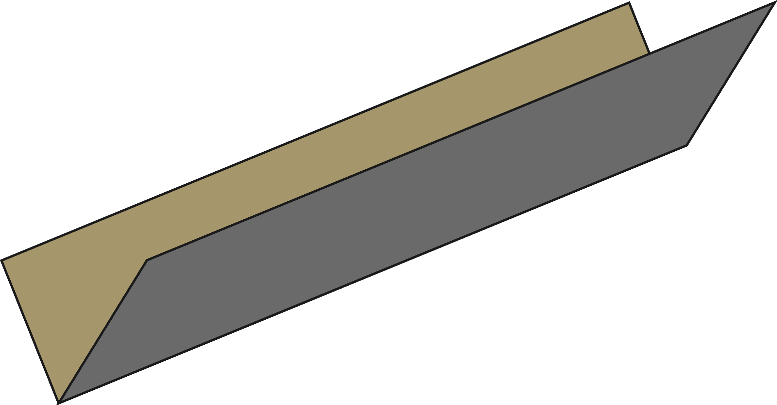
Projection factor
Distribution projection from the first-hit normal distribution to the outgoing distribution
Half-way vector h
Out going direction o
Light direction l
Surface orientation s
Notes:
the microfacet model is a sort of distribution projection from the first hit normal distribution to the outgoing distribution.
So we have to compensate the distortion by multiplying the differential ratio of them, so-called the projection factor.
We compute the projection factor between the first-hit surface orientation and the outgoing direction as follow.
Refer to our paper for more detail.

Slide 24
K-reflection BRDF model
Fresnel
effect
Geometric attenuation
Projection
factor
Incident energy
Notes:
Finally , here is our analytic mathematical form of our model.
We compute a BRDF value for each facet with multiple Fresnel effects and geometric attenuation.

Slide 25
Importance Sampling
Sample the first-hit surface
Sample the number of reflection
Notes:
For a ray tracer, we need importance sampling which tells which direction the ray have to bounce after hitting a surface.
We sample a first hit microfacet orientation according to the projected area of microfacet orientation .
[click] Then we sample the number of reflection by sampling 1D values in the V-groove aperture region.
If a sampled ray go under k th point, it reflects k times, Or it reflects k-1 times.

Slide 26
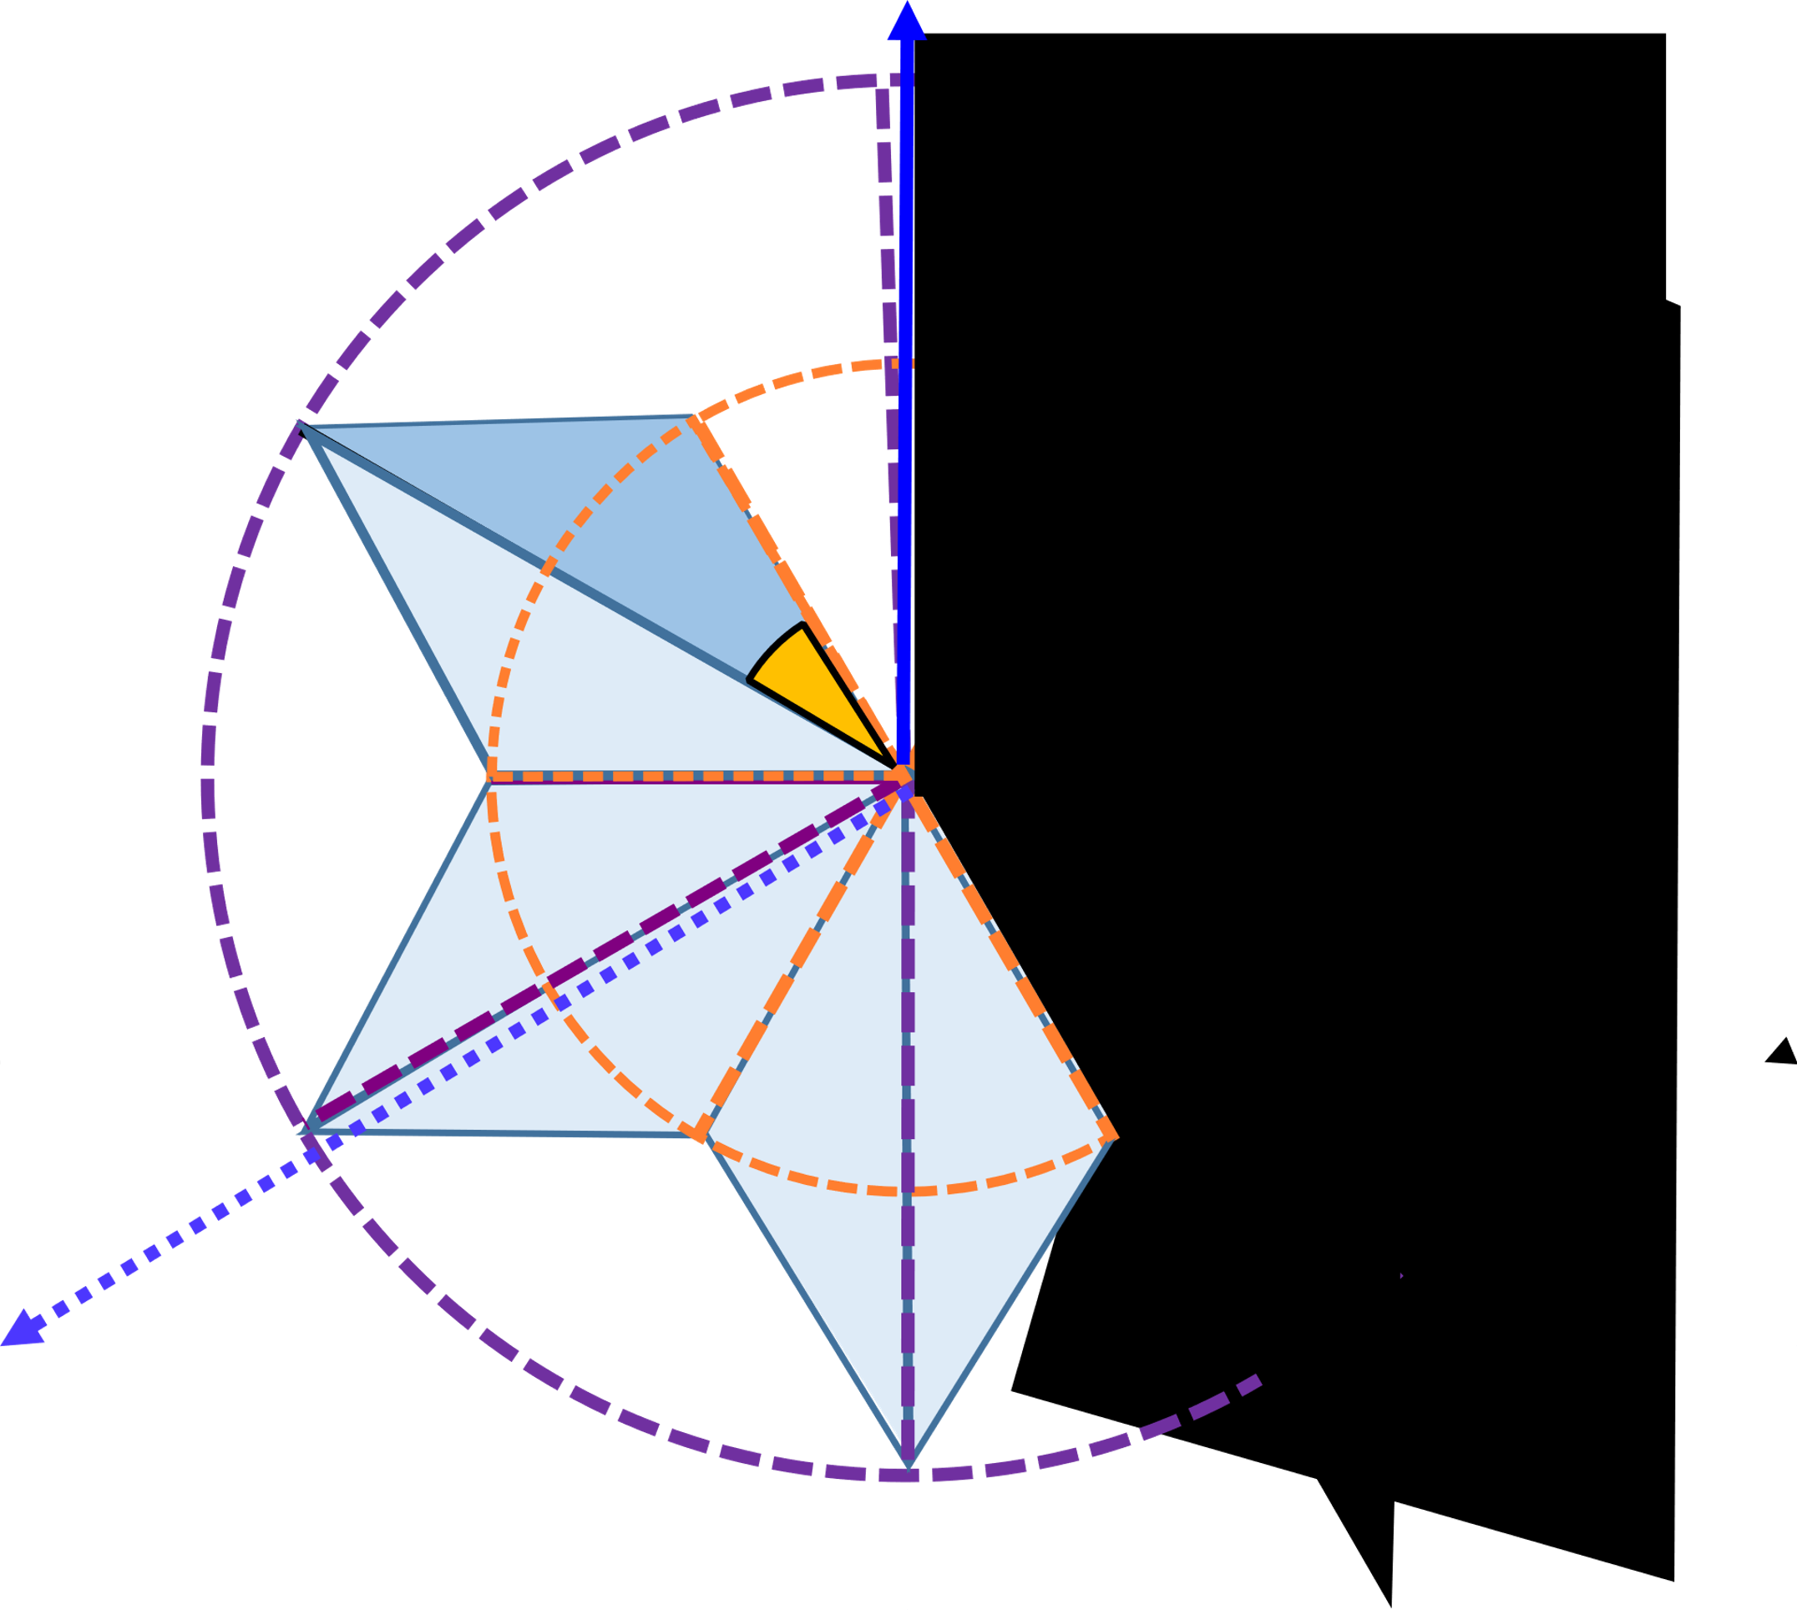
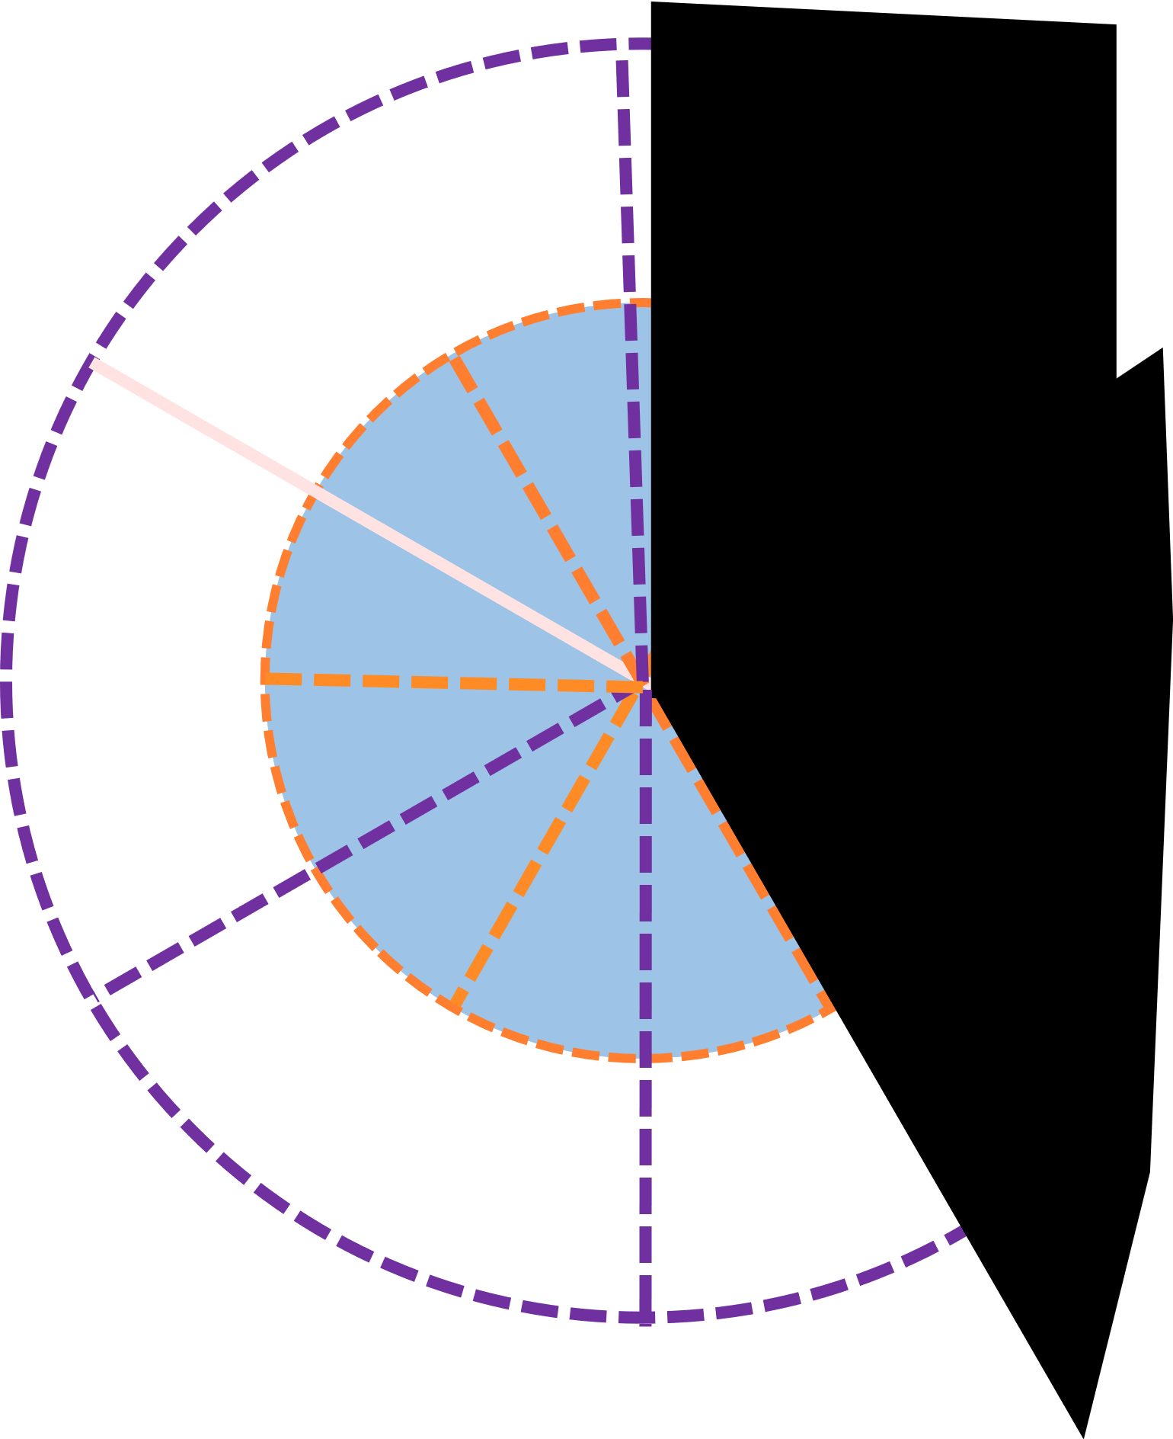
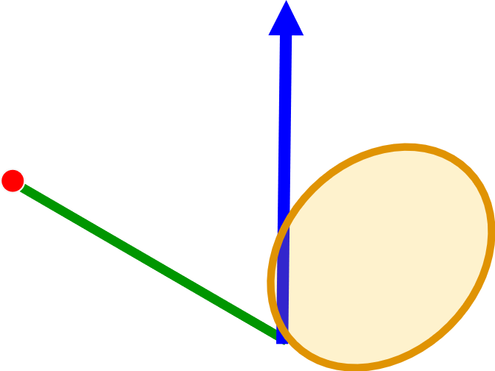
Nonsymmetric V-groove
Bivariate distribution
Reflection geometry in virtual geometry
Counterpart distribution
Notes:
We extend! this work to nonsymmetric V-grooves.
Even the nonsymmetric model is not analytic model, we try to explore more general V-groove’s world.
We define bivariate distribution of nonsymmetric V-grooves by hiring a probability function of the second-hit surface and do same approach to evaluate k-reflection BRDF in nonsymmetric V-grooves.
For further details, please see our paper.

Slide 27
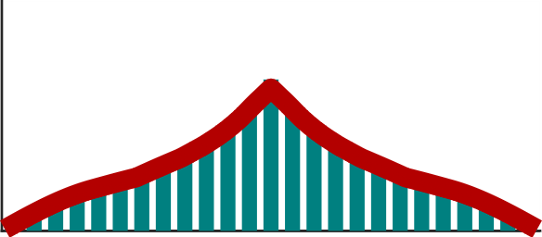
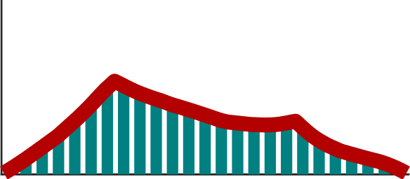
Validation
Comparison against 2D ray simulation
1.2
…
0
2D raytracing
Symmetric
1.2
Non-symmetric
Our total BRDF
0
Notes:
To demonstrate our model is valid, we compare our analytic model to 2D ray simulation.
We generate the 2D V-groove world which follows given normal distribution and do 2D ray simulation.
The red line is our analytic model and bar is the result of 2D ray simulation.
Our 2D analytic model has good agreement with 2D simulation.

Slide 28
Validation
Energy preservation
Single scattering
Multiple scattering
Symmetric
Nonsymmetric
Symmetric
Nonsymmetric
Notes:
To show energy conservation, we render a sphere of our models with no Fresnel effect under uniform environment illumination.
If there is some energy loss, the boundary between a sphere and the background becomes noticeable.
Since single scattering models ignore multiple scattering, the appearance become dark little.
In our model, we cannot observe energy loss because we consider multiple scattering and all energy is well considered.

Slide 29
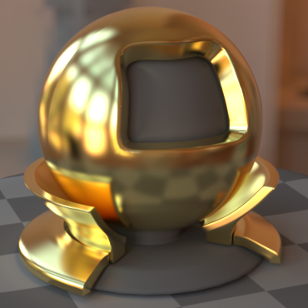
Results
Roughness
Single scattering microfacet model
Our model (15~20%)
Notes:
Here is our isotropic result for a nonsymmetric V-groove model.
We render gold material in Beckmann distribution with different roughness alpha.
As the roughness increases the effect of multiple scattering is noticeable.
With only 15~20% overhead, we can achieve this multiple scattering effect. (non-symmetric result)

Slide 30
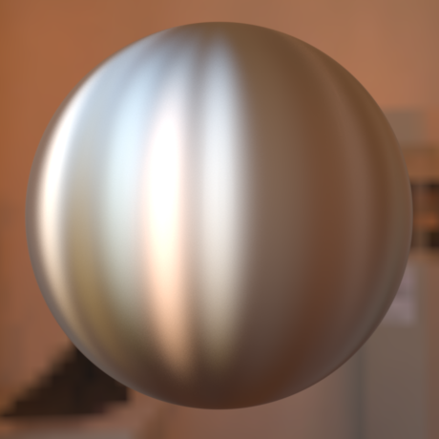
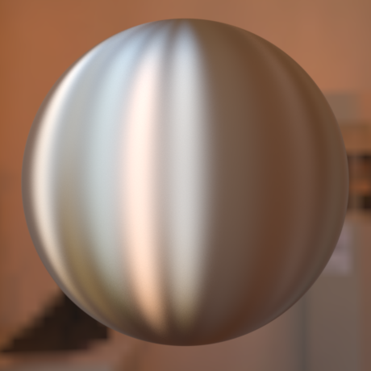
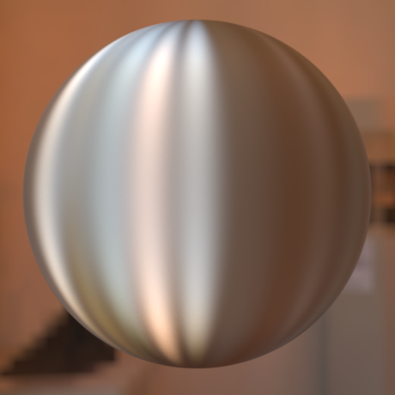
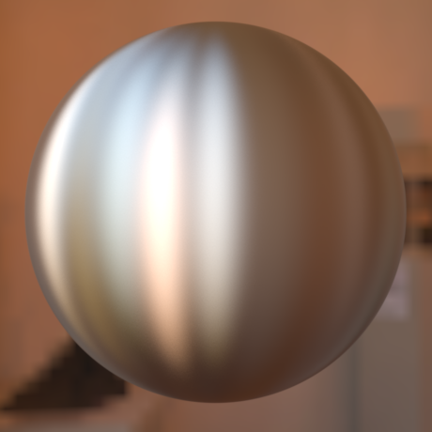
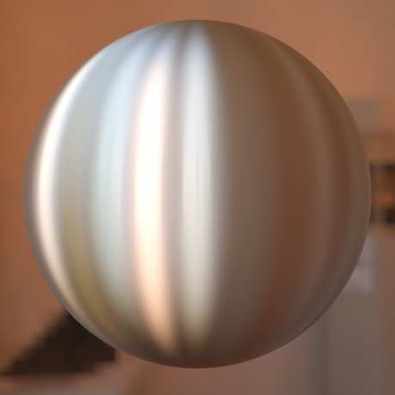
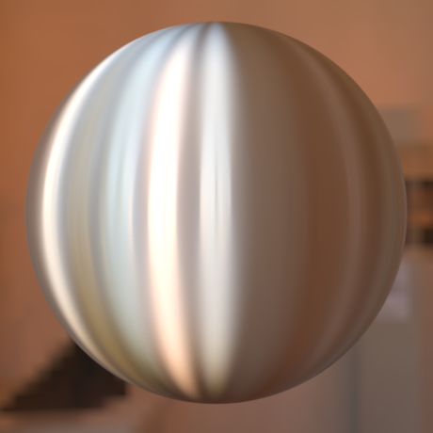
Results
Single scattering microfacet model
Our model
Notes:
Here we also implement our anisotropic model.
(symmetric result)

Slide 31
Results
78
1x difference
Our model (78 min)
Cook-Torrance (70 min)
Ours
Cook-Torrance
1x diff
Notes:
Another rendering result.
With multiple scattering, we can see the difference between two different materials, which cannot be distinguished in single scattering.
Also we can observe more saturated colors.

Slide 32
Conclusion & Future work
An analytic model for multiple scattering
Generalization of the Cook-Torrance model
Non-parallel V-grooves
Notes:
In conclusion,
we build an analytic model for multiple scattering.
And also we extend the microfacet theory not only to multiple scattering but also in nonsymmetric V-grooves.
To overcome singularity, light transport in non-parallel V-grooves could be studied.

Slide 33
Thank You
Joo Ho Lee
jhlee@vclab.kaist.ac.kr
33

Slide 34
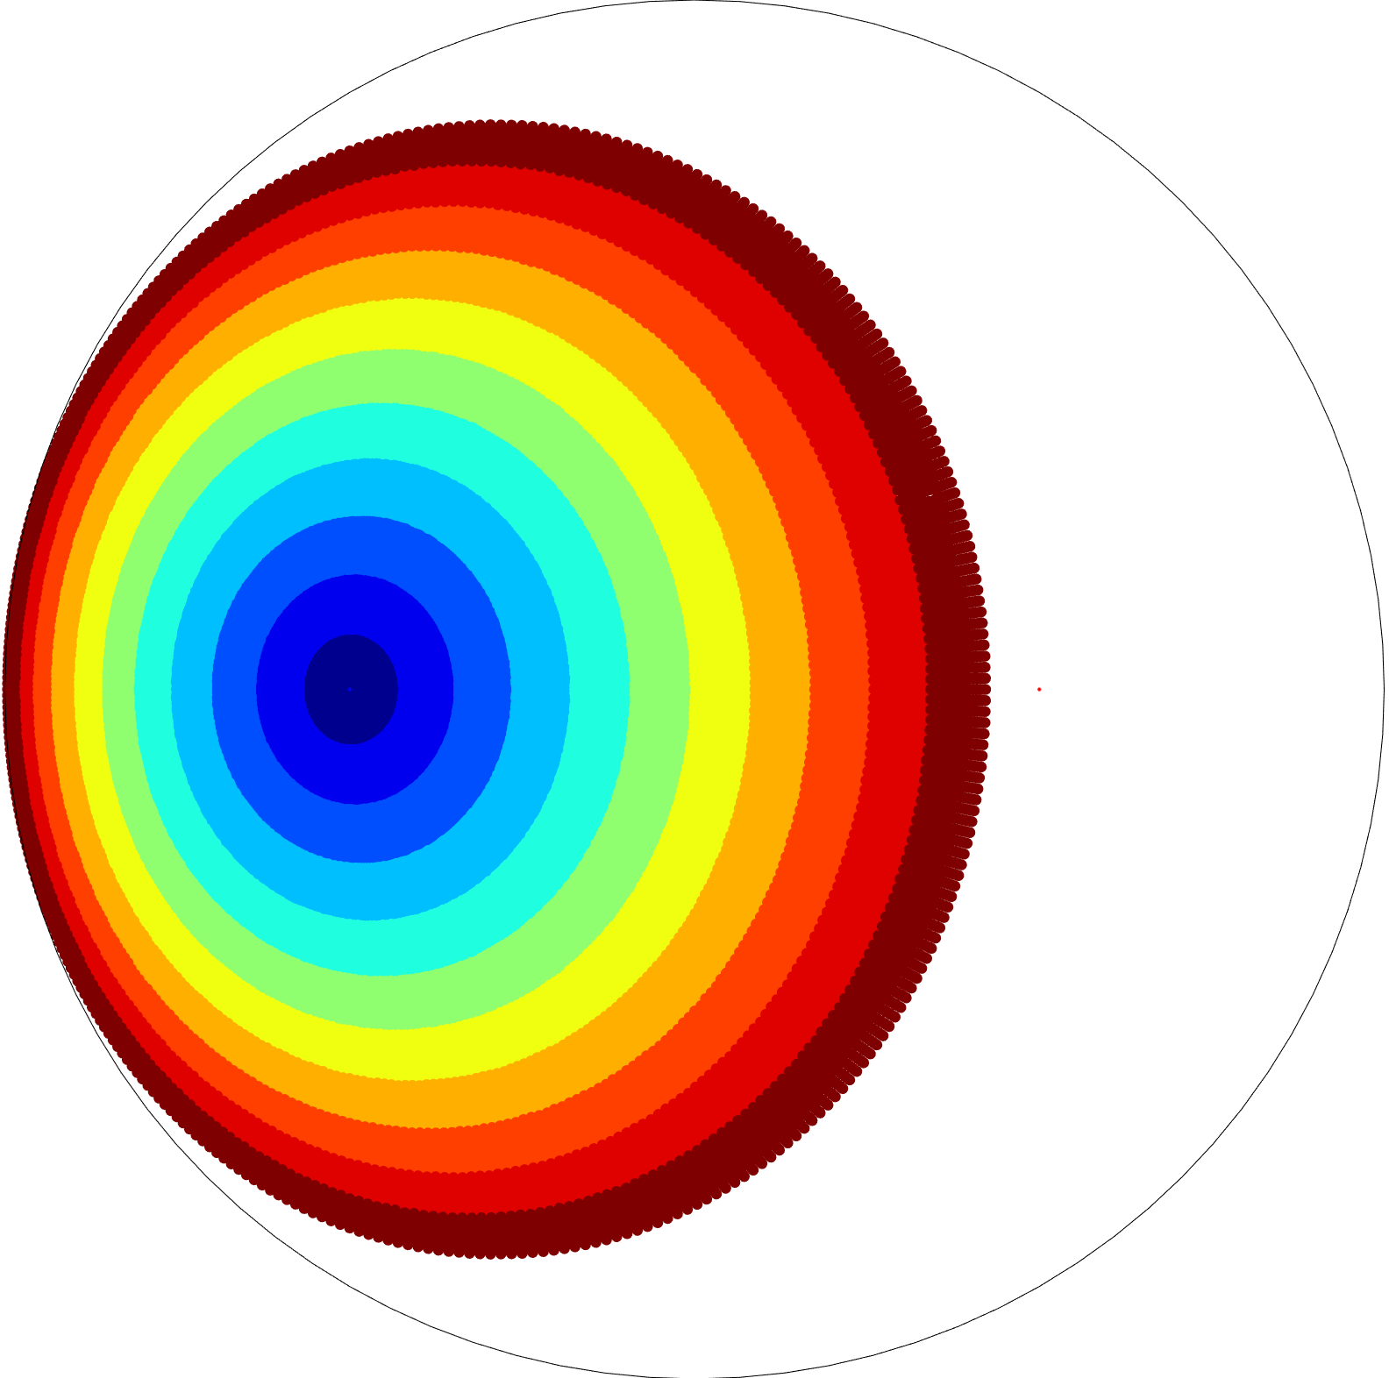
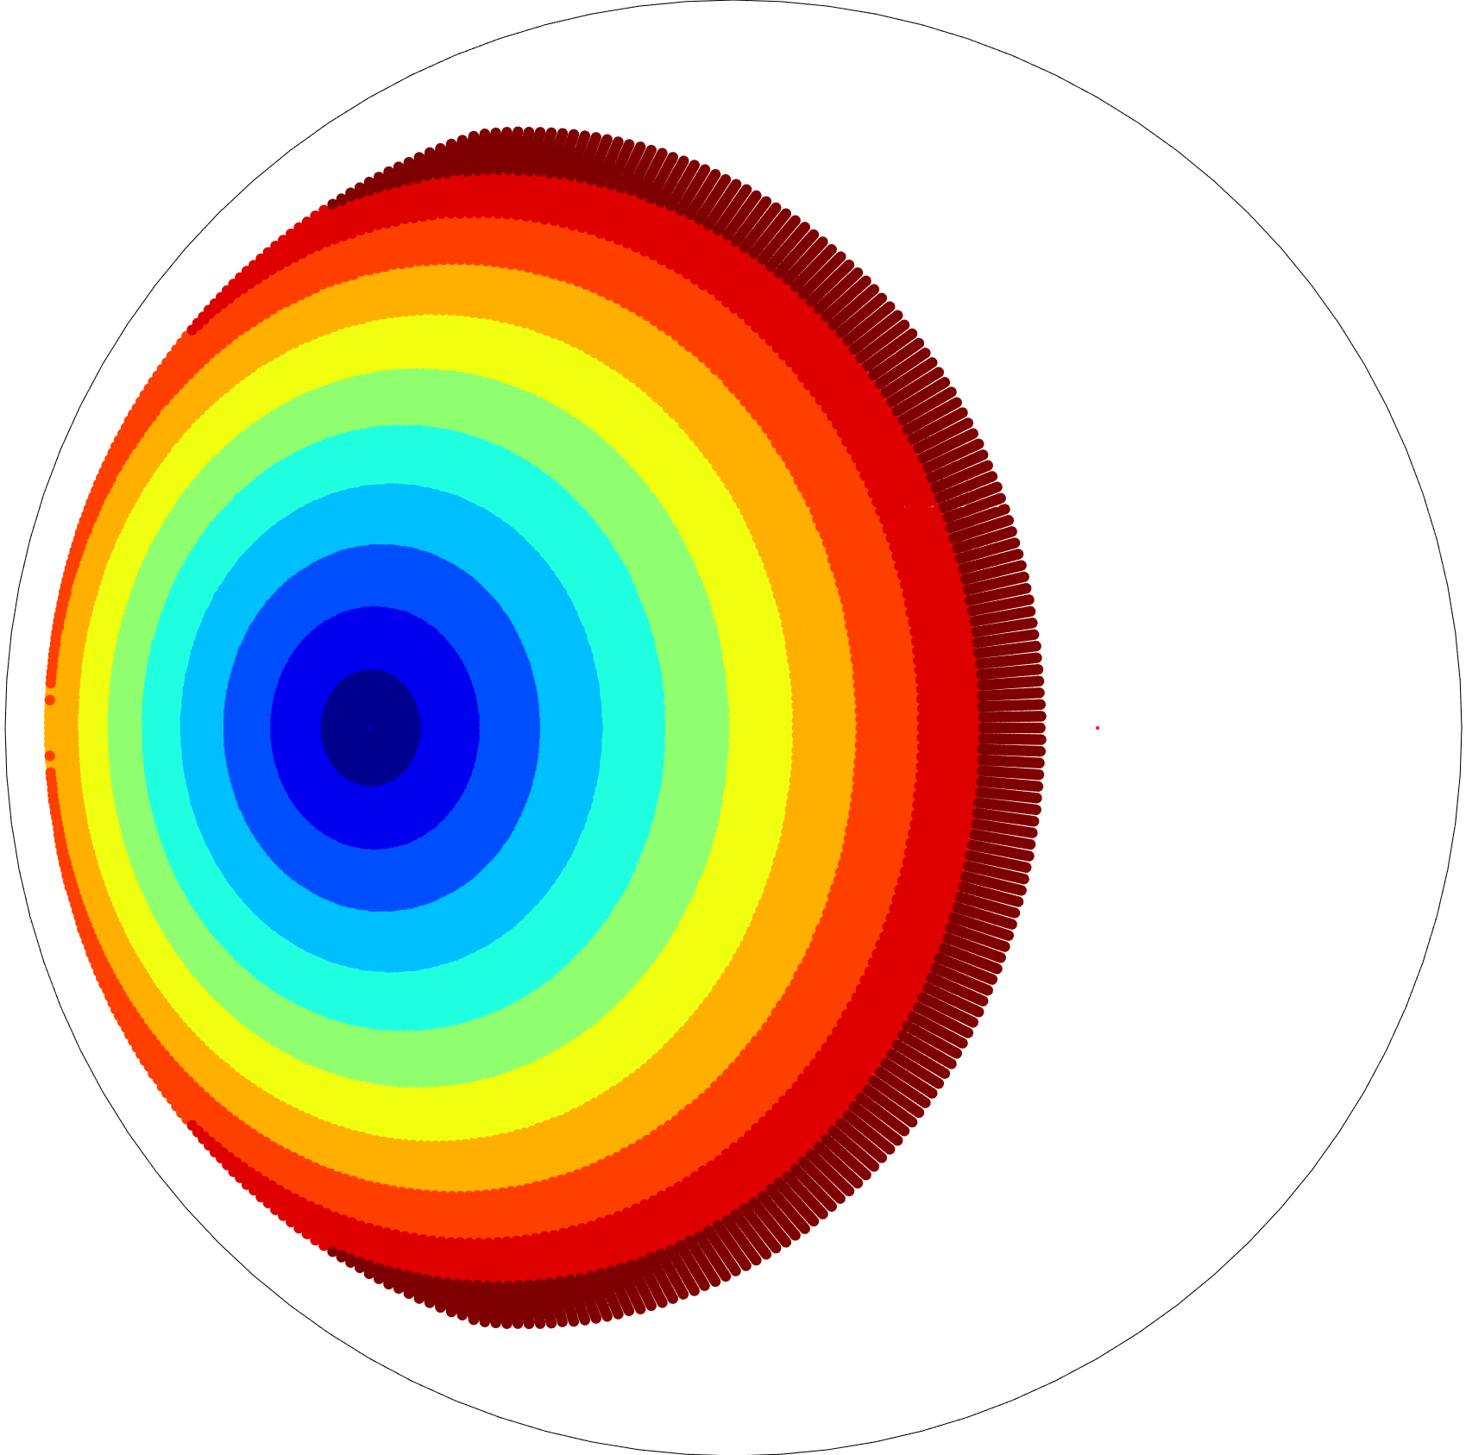
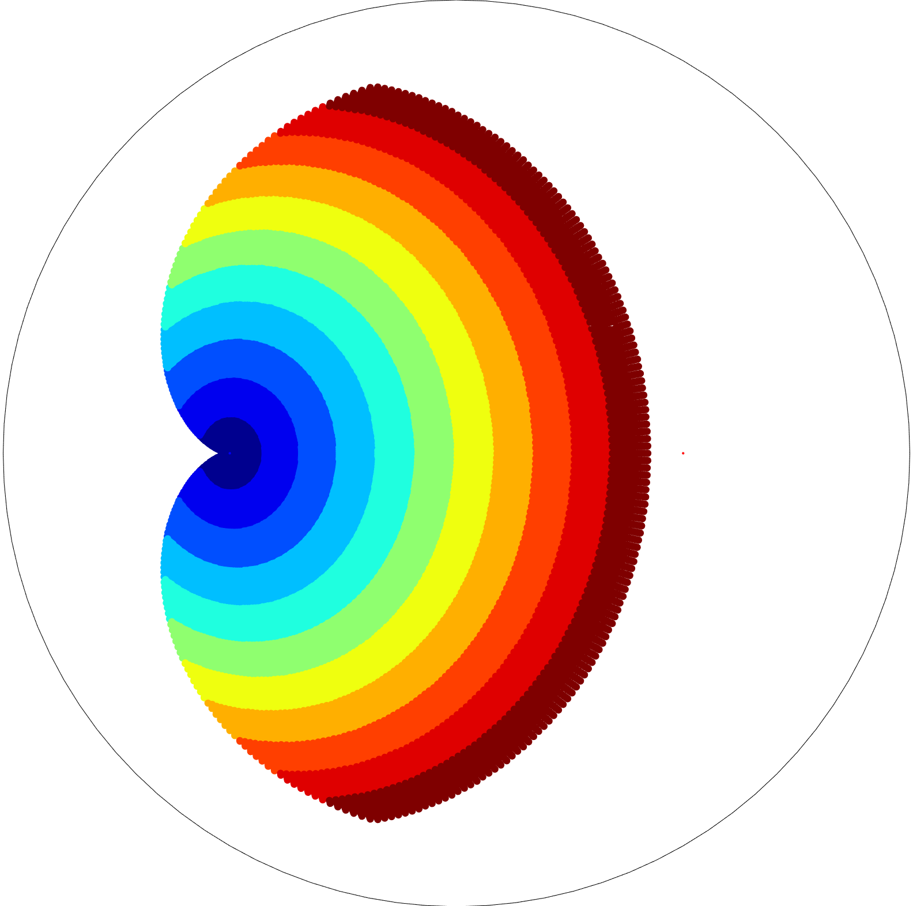
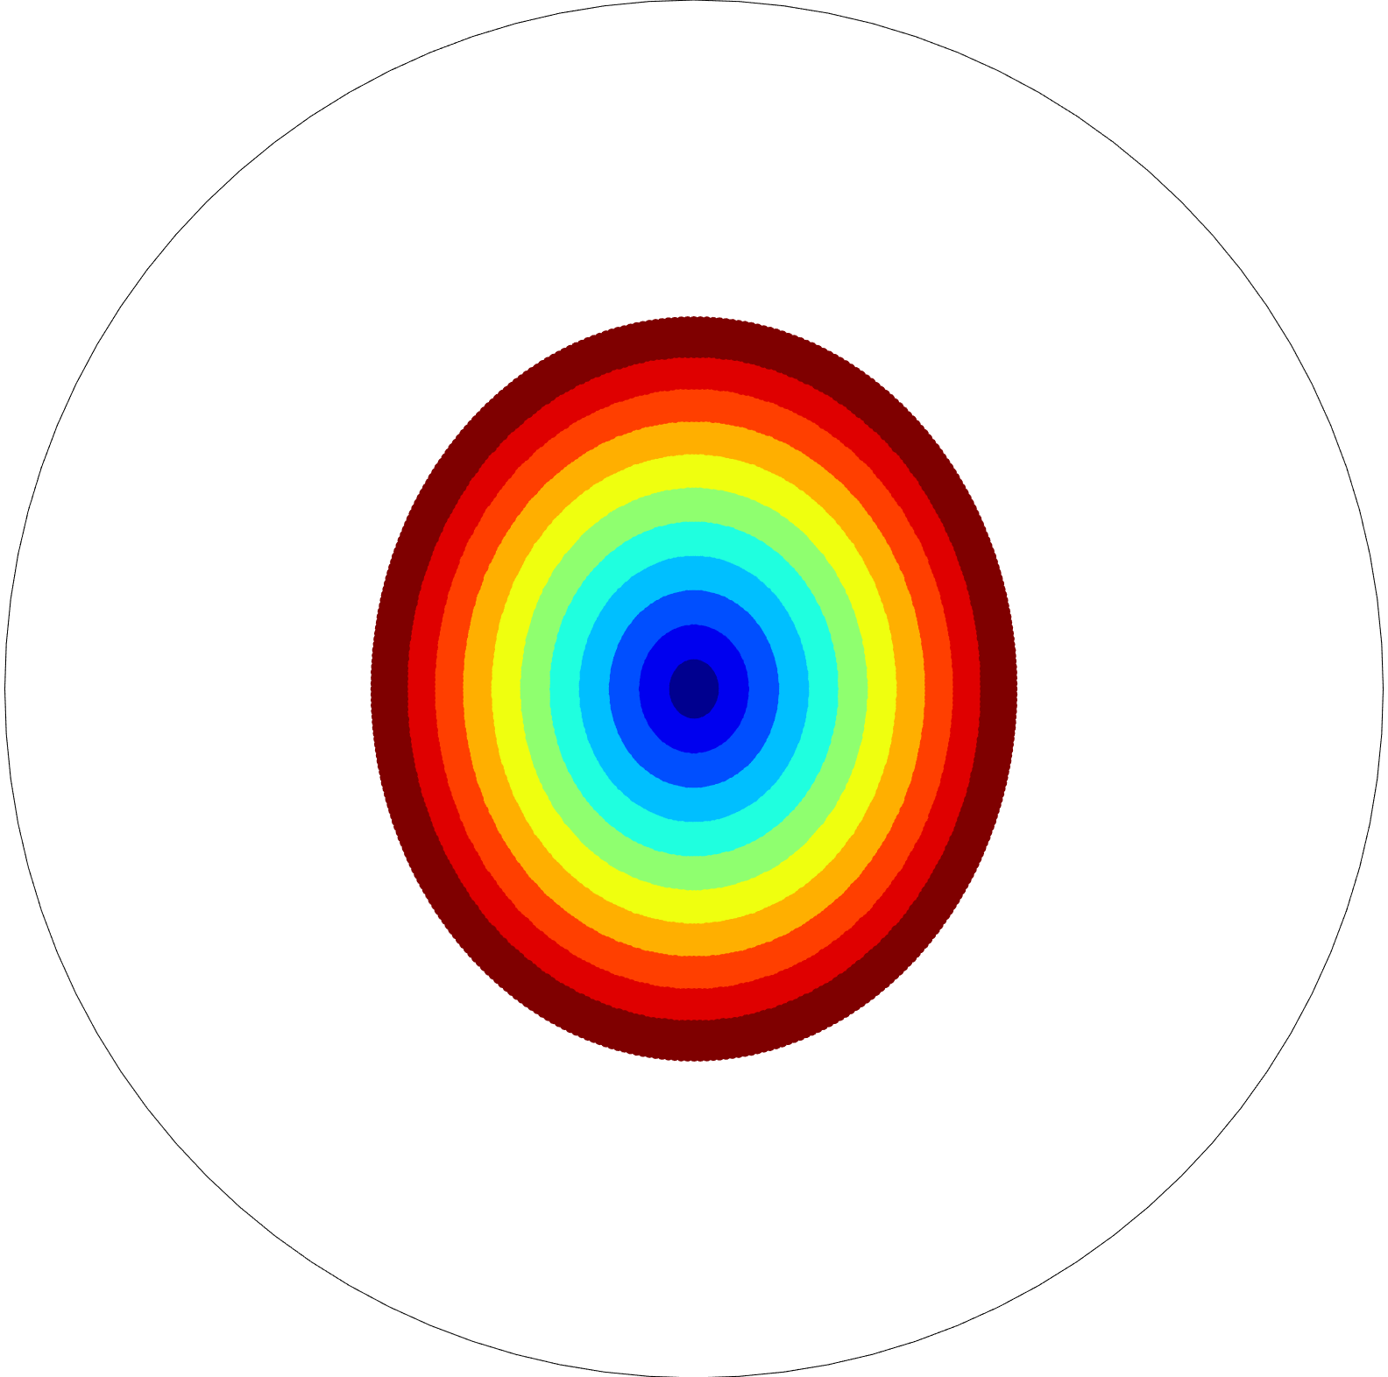
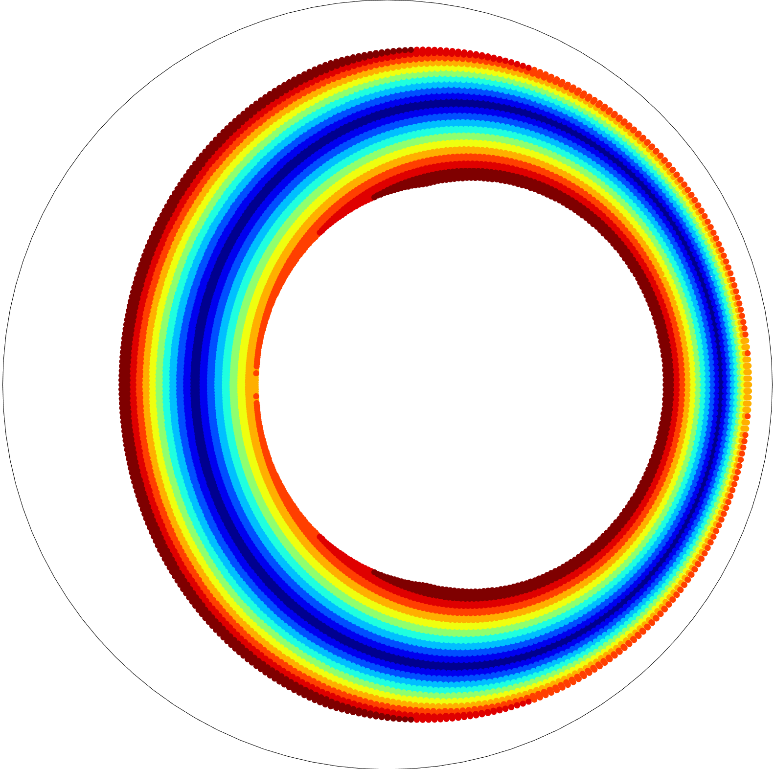
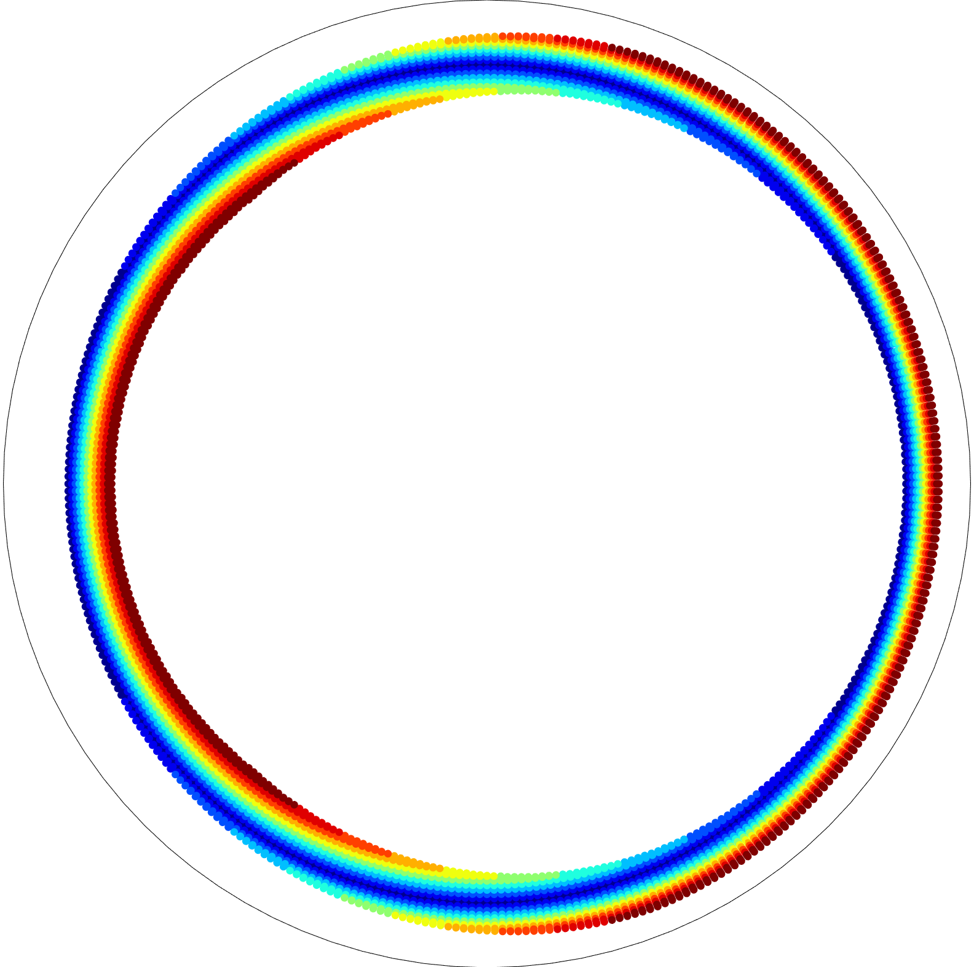
Where specular appearance comes from?
Object normal
Outgoing direction
Surface orientation
Outgoing direction
Light direction
Surface orientation
Light direction
1st bounce
2nd bounce
3rd bounce
Notes:
Hereshows the mapping between the surface orientation and outgoing direction.
What this figure means when a light hit the surface, the incident energy goes out to the same color region in outgoing domain.
So, in the first bounce case, the manifold of mapping regions in different domain is not changed.
But for multiple scattering, the V-grooves on a blue line map to one mirror direction.
So geometric property of light transport in a V-groove itself makes this singularity.

Slide 35
Projection factor
Half-way vector and surface normal are in the same plane.

Slide 36
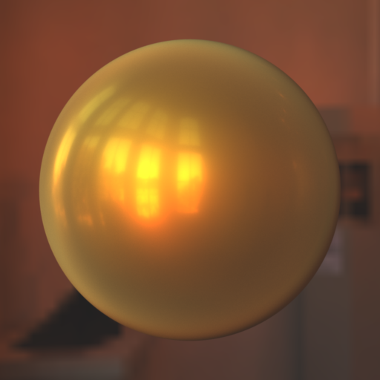
Symmetric vs. Nonsymmetric
Symmetric
V-groove
Symmetric
V-groove
Nonsymmetric V-groove
Nonsymmetric V-groove
Notes:
So, Even we use nonsymmetric V-grooves, this singularity still remains.
But, Our nonsymmetric V-groove model attenuates specular appearance compared to a symmetric V-groove.

Slide 37
Projection factor
Half-way vector and surface normal are in the same plane.

Slide 38
Projection factor
Half-way vector and surface normal are in the same plane.

Slide 39
Projection factor
Half-way vector and surface normal are in the same plane.
Symmetric:
Non-symmetric:

Slide 40
Difference with The next paper
Geometric formulization
Results of multiple importance rendering
Good visualization of the multiple scattering model
Notes:
The next talk has three different things with this talk.
They formulize the geometric term differently.
And They have nice results of multiple importance rendering.
And they do 3D simulation and 2D visualization for the analytic symmetric V-groove model and simulation results.

Slide 41
NONsymmetric V-groove
How much portion of s_{l} is with s_{r}?
Notes:
To define the distribution of nonsymmetric V-groove,
We define bivariate distribution for nonsymmetric V-groove.
We define the probability function p of right surface with respect to the left surface.
This p describes that how much portion of the left surface has the certain right surface.
So, D(sl, sr) is the area of the left surface of which right surface is sr.

Slide 42
Geometric constraint
Distribution of right surface
Total area of
Notes:
So probability function p should be carefully designed to keep geometric agreement with normal distribution.
We compute right surface distribution as integration of the left surface distribution with geometric factors.
since the right surface also belongs in the same micro-surface, the result should be same as the normal distribution.

Slide 43
Independent V-groove surface
Integrable but no analytic form for common normal distribution
Notes:
Here we derive probability function p independent from the left surface.
We derive it from the previous geometric equation.
We sample the right surface with respect to this probability function p.
this p is integrable but has no analytic form but no analytic form.
So we use lookup table for importance sampling of the right surface.
//we assume that the left surface and the right surface has no correlation.
//With this assumption, we can evaluate independent probability function p.

Slide 44
K-reflection BRDF
Integrate all contributions
1 solution for s_{l} per given s_{r}
Notes:
we try to integrate all contributions of non-symmetric V-grooves.
For nonsymmetric V-groove, we have one solution of sl for a given sr.
So we integrate all the BRDF contributions over the right surface domain.
And same as the symmetric V-groove BRDF, we sum them all to compute the total BRDF.

Slide 45
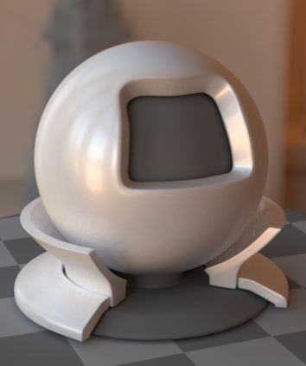
Comparison against Hietz et al.
Ours
[Heitz et al. 2016]

Slide 46
Find a V-groove axis
(a) When h≠n
(b) When h=n
u
u
u₂
i
i
u₁
v
u₁
v
s₁
h
s₂
Top-down view
n
h=n
o
u₃
u₂
u₄
o
Two solutions
Infinite solutions

Slide 47
Reflection geometry
Object normal
Surface orientation
View direction
1st virtual triangle
Light direction
Perpendicular
Plane
2nd virtual triangle
Notes:
To know it, we have to know reflection geometry of V-groove.
When a ray hit a certain surface orientation, we can define a V-grooves by mirroring the surface.
The ray reflects by two surfaces of the V-groove and finally go out.
Note that The V-groove only affects 2D direction perpendicular to V-groove axis u.
In the perpendicular plane, we compute outgoing direction for a given incoming direction and the number of bounces efficiently.
Rather than computing bounce rays for each reflection, we find the k th virtual triangle axis and compute the outgoing direction.
This virtual geometry configuration is very useful to compute other BRDF components.

Slide 48
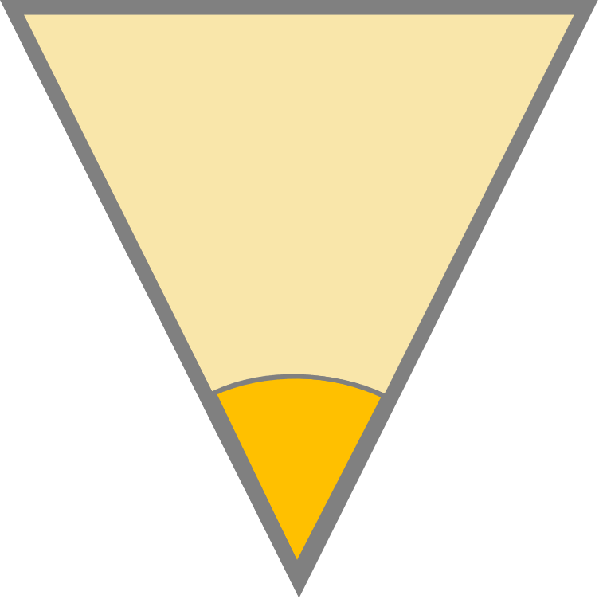
Reflection geometry
Which V-grooves reflect ray from i to o after k reflections?
Given i and o, find s.
1 solutions for
2 solution for
Infinite solution for
Notes:
Then How many V-grooves reflect ray from the given incdent direction to outgoing direction with k reflrections?
In the azimuthal domain, there is only one possible V-groove axis if outogoing direction is not mirror direction of in coming direction.
In theta domain, there are at most two possible cases: one for hitting the left surface first and one for hitting the right surface first.
So, except the case when I and o are in mirror reflection, there are at most 2 V-grooves which contribute the BRDF value rho ( I, o , k).
// the problem is which V-groove contributes BRDF from I to o.

Slide 49
RECAP: Cook-Torrance Model
Projection
factor
Fresnel
effect
Geometric attenuation
Incident energy
Notes:
Now we will evaluate the BRDF value of our model.
Before that, here we briefly review the detail of the microfacet model.
The microfacet equation consist of 4 components: incident region, geometric attenuation, Fresnel effect and projection ratio.
The red part compute how much portion of energy hit the surface.
The green part compute how much ray goes in outgoing direction o.
The blue part computes during transport how much energy is absorbed by the microfacets.
The purple part is the projection factor to correct density distortion between other domains.
//Mathematically, this equation is the process of projecting distribution from normal space to outgoing space.

Slide 50
Reflection geometry
Top view
Notes:
이제 주어진 빛 방향과 카메라 방향이 그 3D V-groove를 찾아보자.
재밌게도 V-groove는 V-groove axis component들에 영향을 주지 못한다.
따라서 오직 하나의 축만이 빛의 방향과 카메라의 V-groo axis component를 갖게한다.
하지만 빛과 카메라가 거울반사의 경우 어느축이든 V-groo axis component가 갖게되는데 이는 우리 결과와 같은 영향을 미친다.
자세한것은 논문을 참고바란다.

Slide 51
Reflection geometry
Top view
Notes:
이제 주어진 빛 방향과 카메라 방향이 그 3D V-groove를 찾아보자.
재밌게도 V-groove는 V-groove axis component들에 영향을 주지 못한다.
따라서 오직 하나의 축만이 빛의 방향과 카메라의 V-groo axis component를 갖게한다.
하지만 빛과 카메라가 거울반사의 경우 어느축이든 V-groo axis component가 갖게되는데 이는 우리 결과와 같은 영향을 미친다.
자세한것은 논문을 참고바란다.

Slide 52
Light transport
1st virtual triangle
2nd virtual triangle
k^{th} virtual triangle
[Zipin 1967]

Slide 53
Notes:
축이정해지고 나면 왼쪽면에 맞나, 오른쪽 면에 맞나에 따라 최대 두개의 솔루션이 생긴다.
자세한것은 논문을 참조하기 바란다.

