Slide 1
A Physically-Based Spatio-Temporal Sky Model
David Guimerá
Diego Gutierrez
Adrian Jarabo
Universidad de Zaragoza, I3A
CEIG 2018

Slide 2
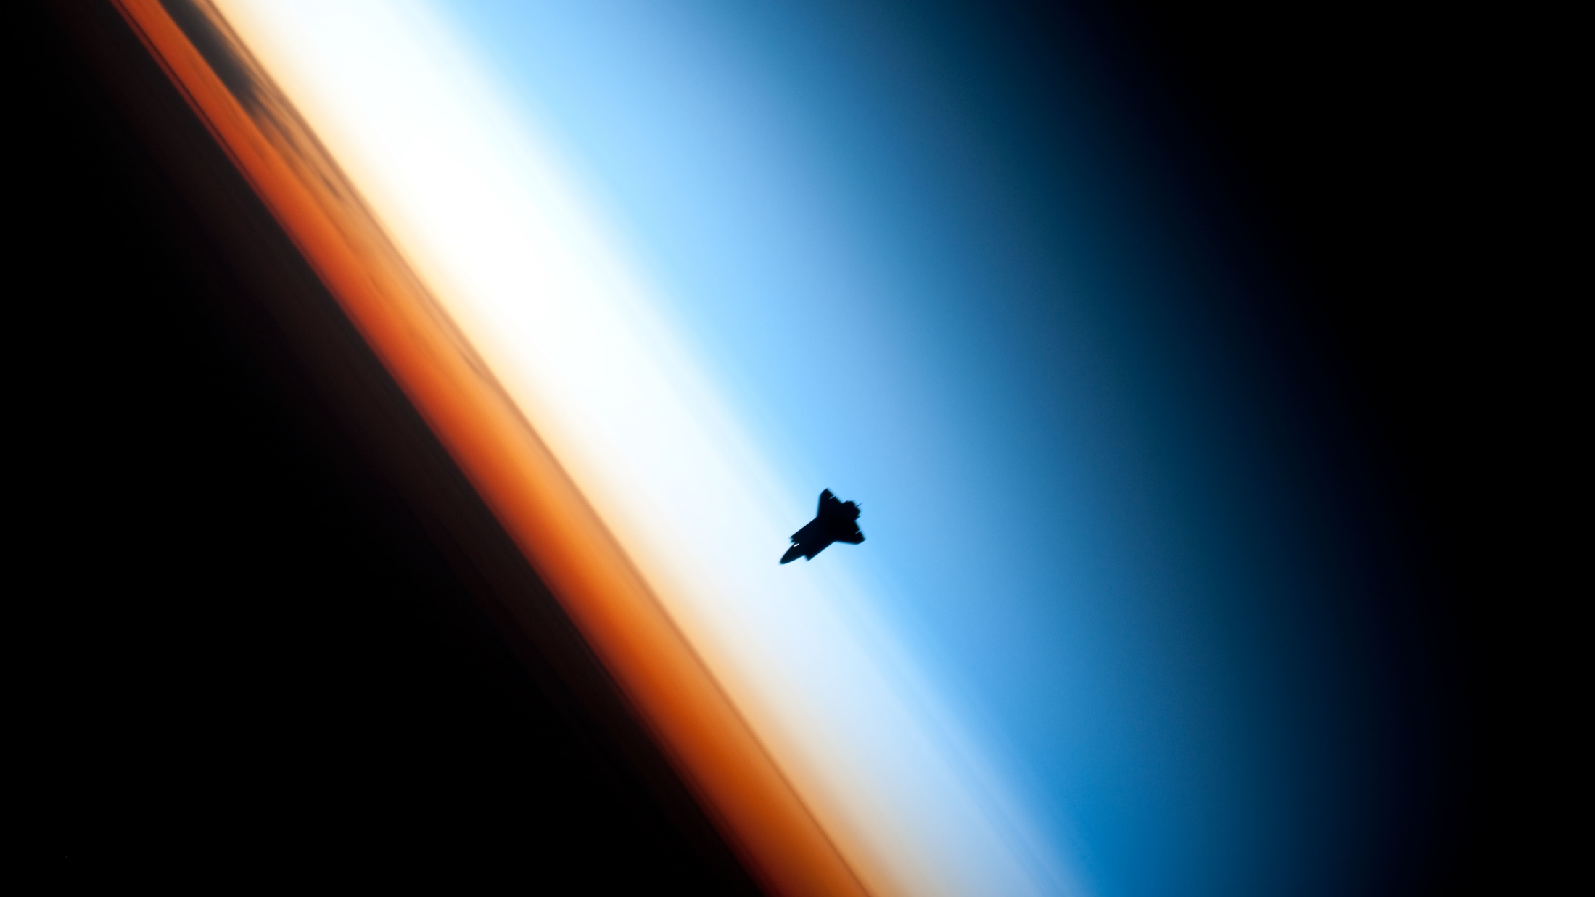
© NASA

Slide 3
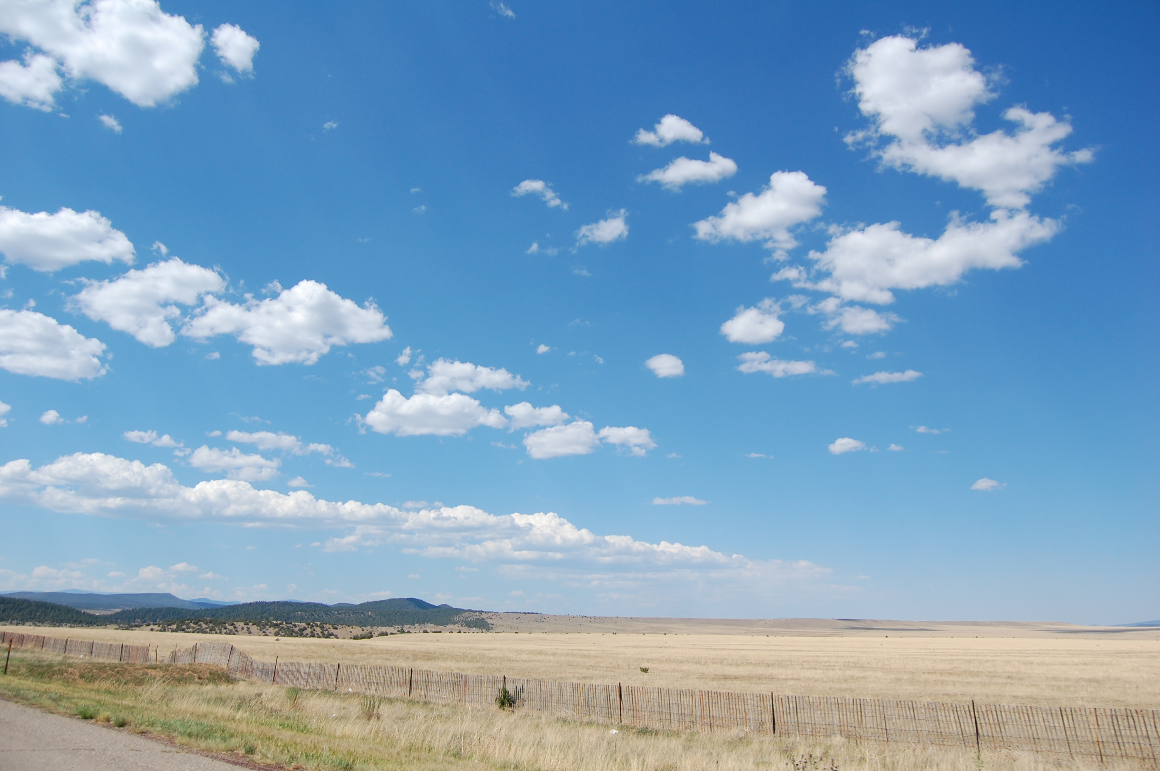

Slide 4
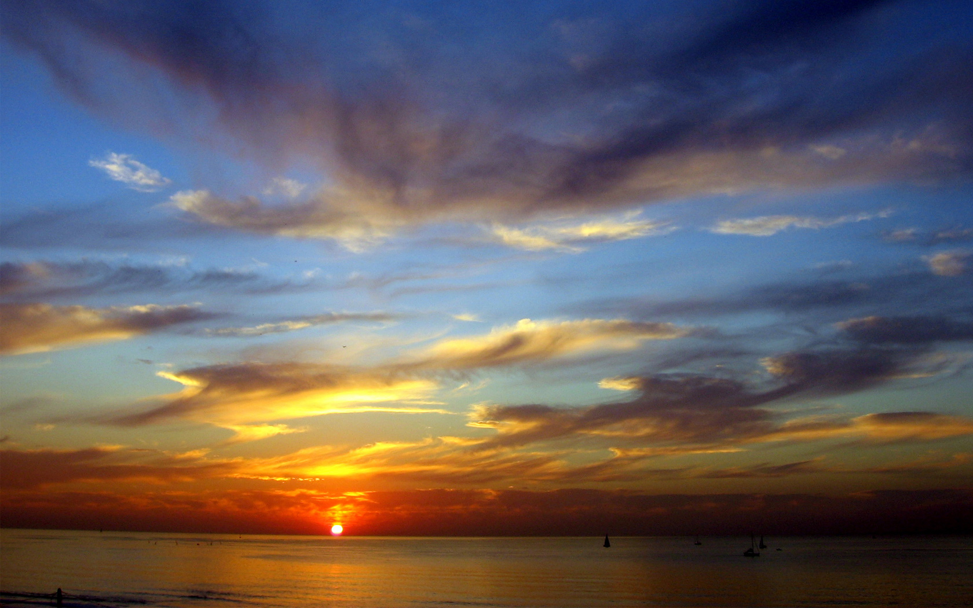

Slide 5
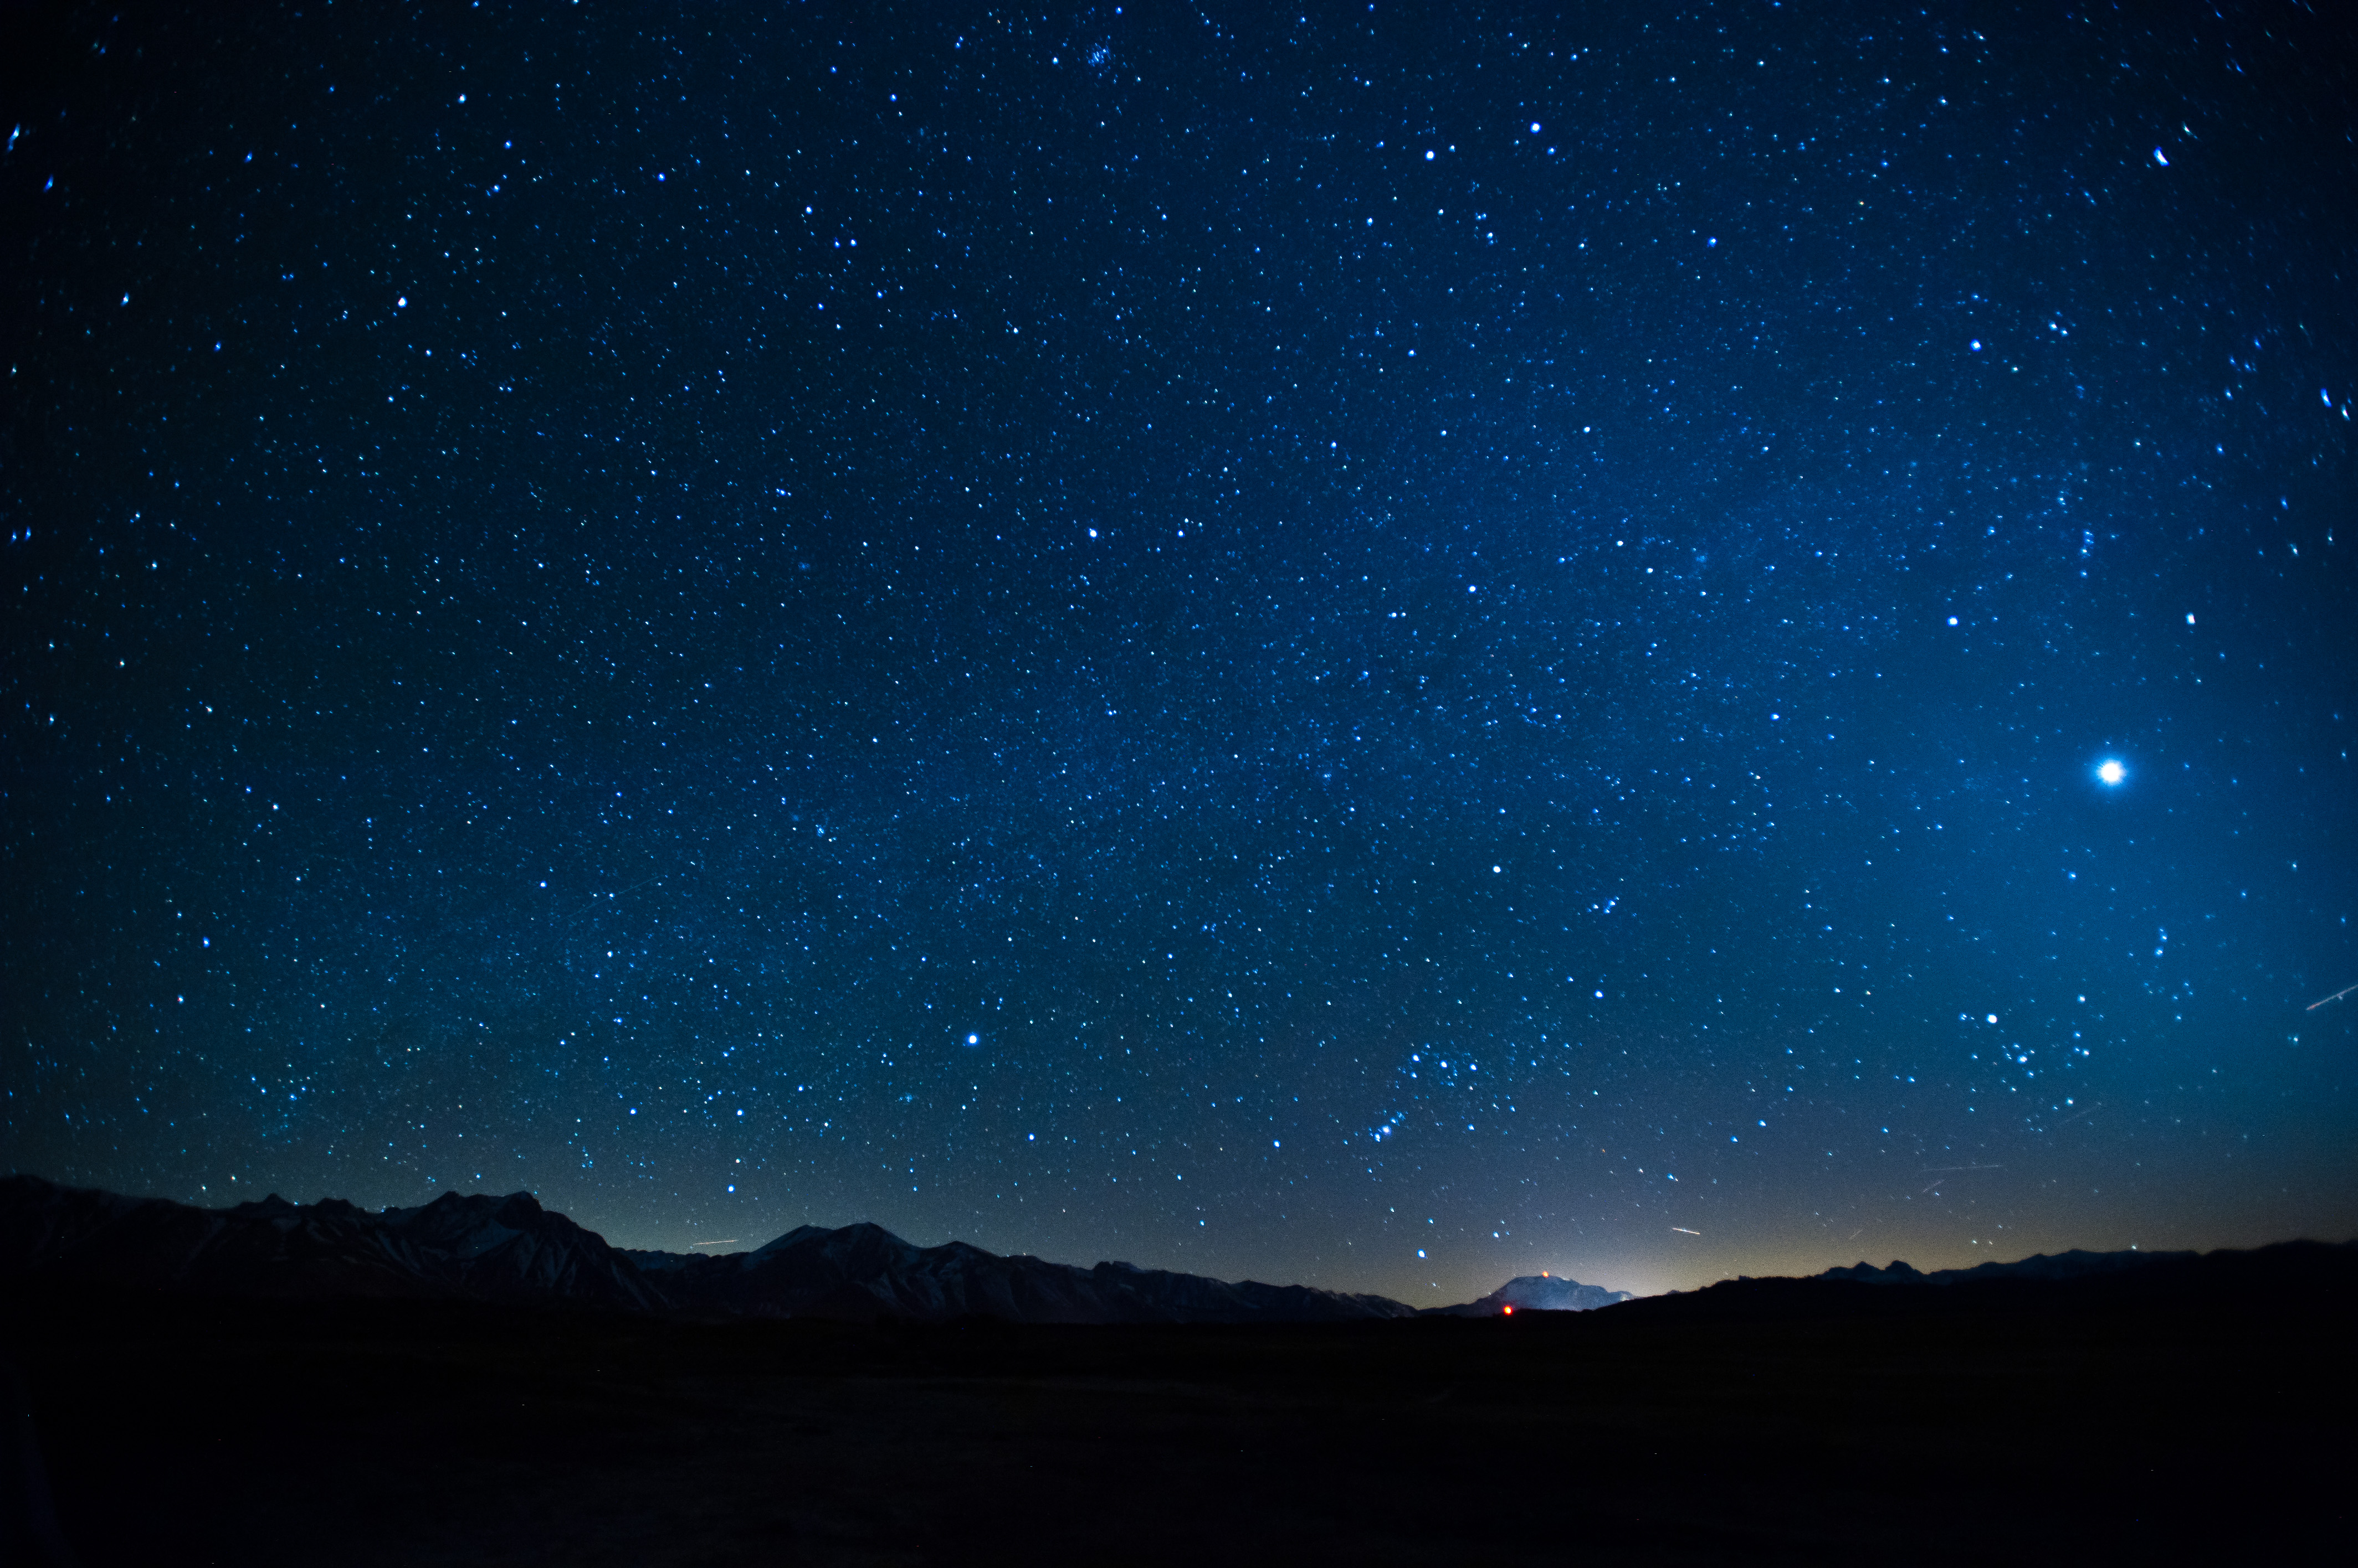

Slide 6
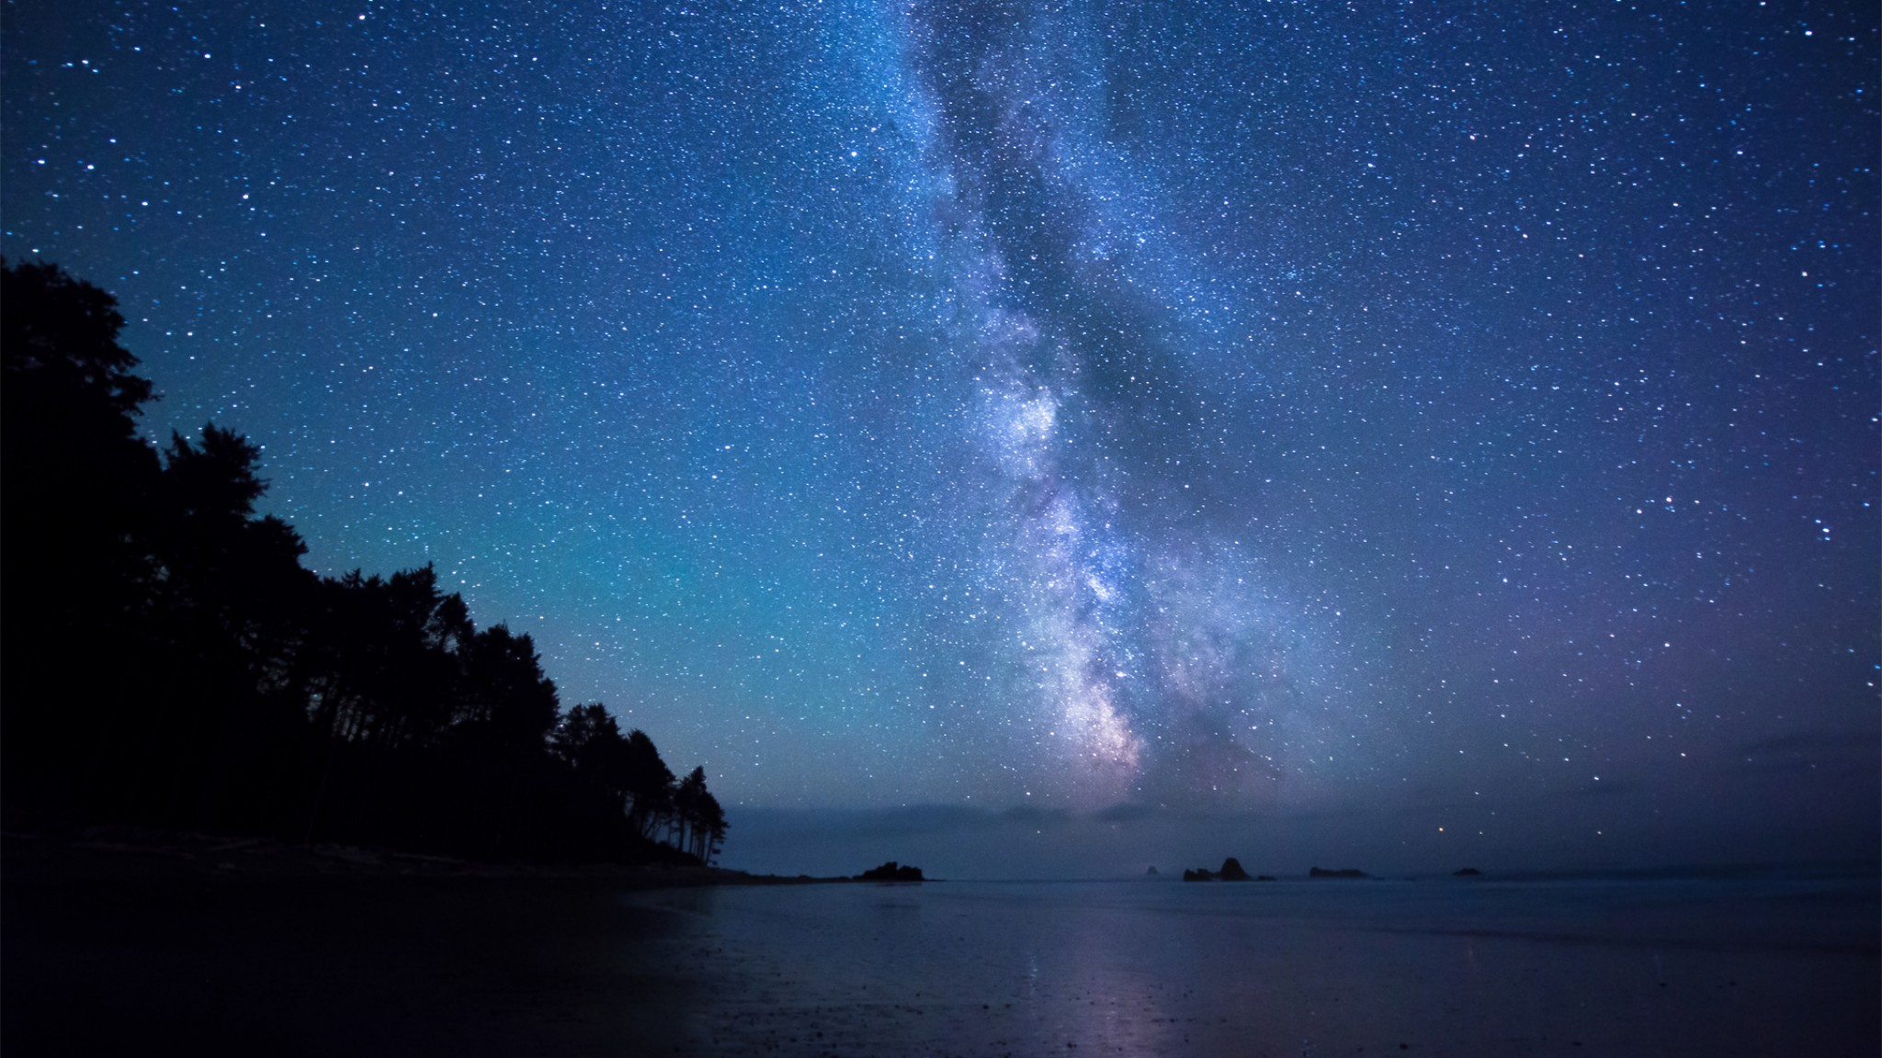

Slide 7
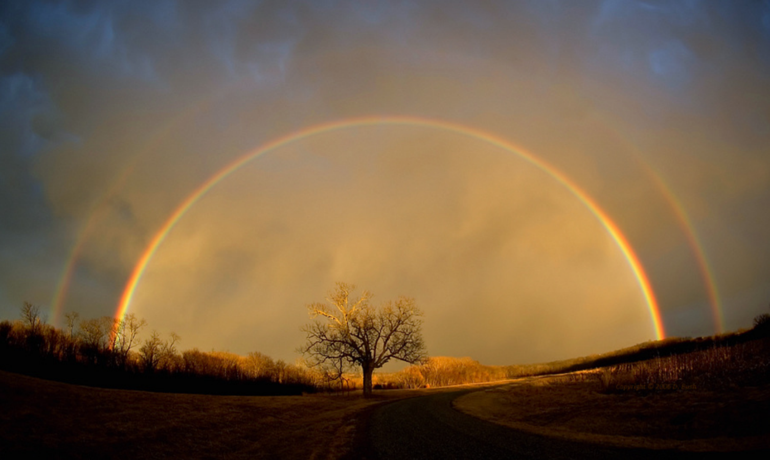
© Dan Bush

Slide 8
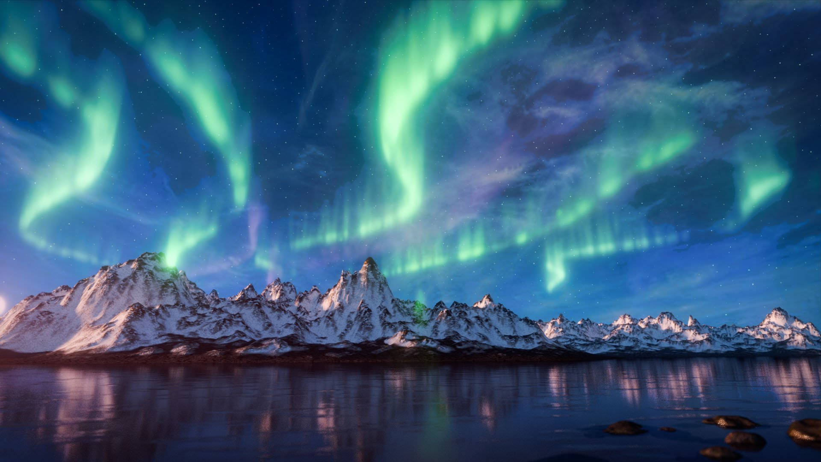

Slide 10
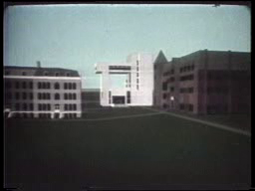
“Cornell in Perspective”, Don Greenberg et al. 1971

Slide 11
Explicit Models
Full Light Transport: Nishita [93,95], O’Neal [05], Haber [05], Kutz [13]
+ Night [Jensen 01], Mirages [Gutierrez 05]…
Precomputation: Bruneton [08], Elek [10]
Parametric Models
Perez [93], Preetham [99], Hosek-Wilkie [12, 13]
+ Polarization: Wilkie [04]

Slide 12
All assume a fixed atmosphere composition
Is there any spatial dependence?
And seasonal?

Slide 13
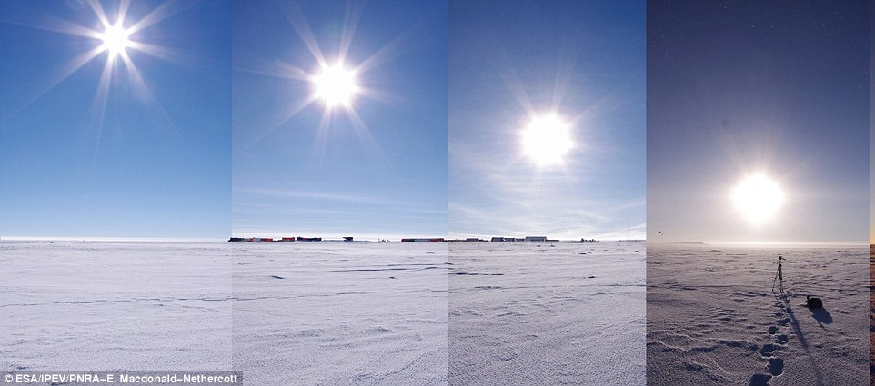
© ESA/IPEV/PNRA-E

Slide 14
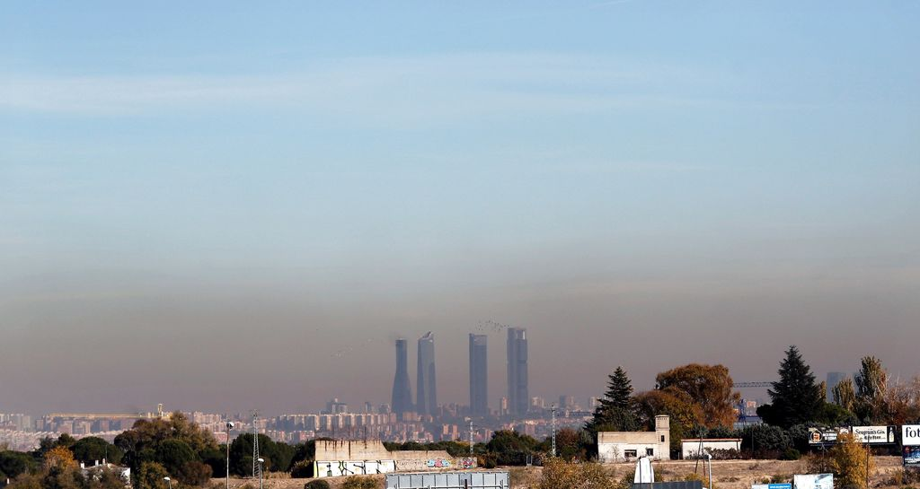
Fuente: VozPopuli

Slide 15
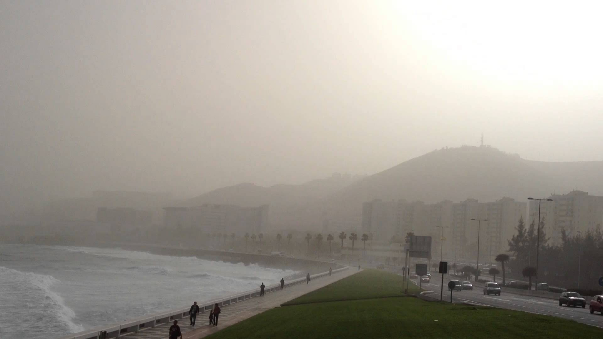

Slide 16
What’s the atmosphere?

Slide 17
Molecules
N, O2…
Ozone (O3)
Aerosols
Water
Dust, Salt
Pollution
© NASA

Slide 18
Exosphere
Mesosphere (30 Km)
Stratosphere (40 Km)
Troposphere (10 Km)
Earth
© NASA

Slide 19
Height
Molecules
Aerosols
Earth
Density (log)
© NASA

Slide 20
Light Propagation in the Atmosphere

Slide 21
Light Propagation in Media

Slide 22
Scattering Coefficient
Extinction Coefficient
Absorption Coefficient
Phase Function

Slide 23
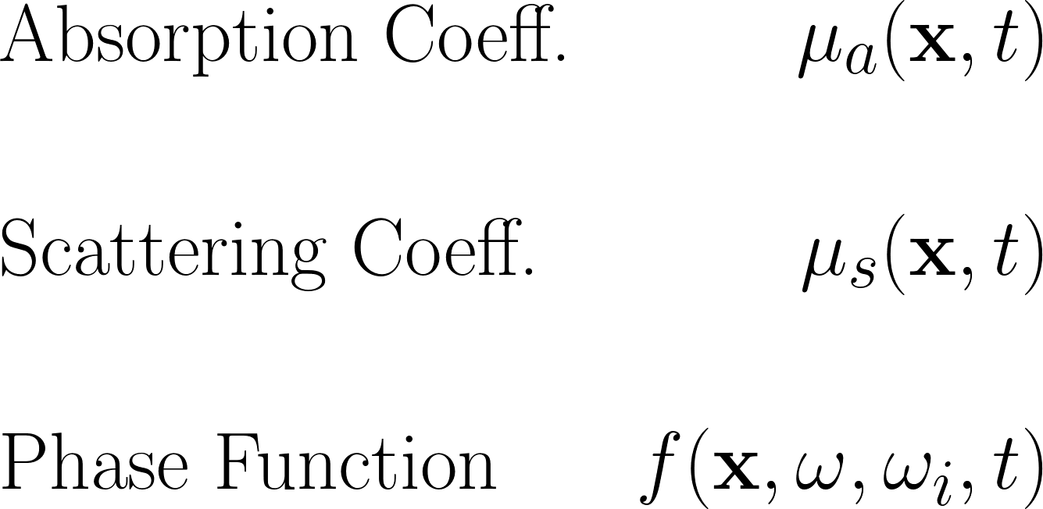
Ozone & Aerosols (Mie)
Molecules (Rayleigh) & Aerosols (Mie)
Molecules (Rayleigh) & Aerosols (Mie)

Slide 28
Ozone & Aerosols (Mie)
Molecules (Rayleigh) & Aerosols (Mie)
Molecules (Rayleigh) & Aerosols (Mie)

Slide 29
Fuente: VozPopuli

Slide 31
Ozone & Aerosols (Mie)
Molecules (Rayleigh) & Aerosols (Mie)
Molecules (Rayleigh) & Aerosols (Mie)

Slide 32
Molecules Aerosols

Slide 33
Our model

Slide 34
A Physically-Based Spatio-Temporal Sky Model
David Guimerá
Diego Gutierrez
Adrian Jarabo
Universidad de Zaragoza, I3A
CEIG 2018

Slide 35
Spatial dependence
Temporal dependence
Thorough review on Atmospheric Sciences

Slide 36
Spatial dependence
Exponential decay of density in height
Well known
Molecules are steady* along the globe
Aerosols show strong dependence on the spatial location!
Mainly close to the ground.

Slide 37
Aerosols depend on the type of surface
6 main types [Zimmerman89]:
Polar, Background, Maritime, Continental, Desert, Rural, and Urban.
Each composed by different aerosol components [Jaenicke93]:
Each component has different optical properties:
Size distribution
(Complex) index of refraction
Mie Theory

Slide 38
Temporal dependence
Aerosols vary fastly – No measurements…
Most molecules are very stable along seasons
Ozone varies a lot wrt season
Specially in the ozone layer
We use measurements from Dütch [1974].
Measured average concentration of ozone.

Slide 39
Spatial dependence
Temporal dependence
For the base atmosphere
Measurements of molecules [Bucholtz95]

Slide 40
Results

Slide 41
Spatial Variability

Slide 42
0 Elevation: oº
Urban
Rural

Slide 43
0 Elevation: 5º
Desert
Clean Maritime

Slide 44
0 Elevation: 25º
Urban
Polar Artic

Slide 45
Seasonal Variability

Slide 46
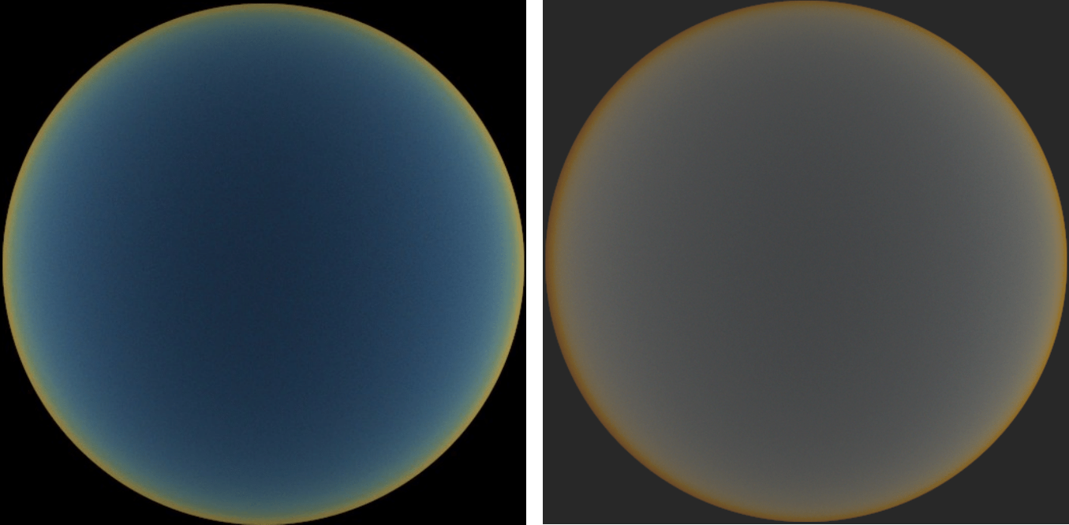
Clean Maritime
January
November

Slide 47
Comparison w\ Kider et al. [2014]

Slide 48
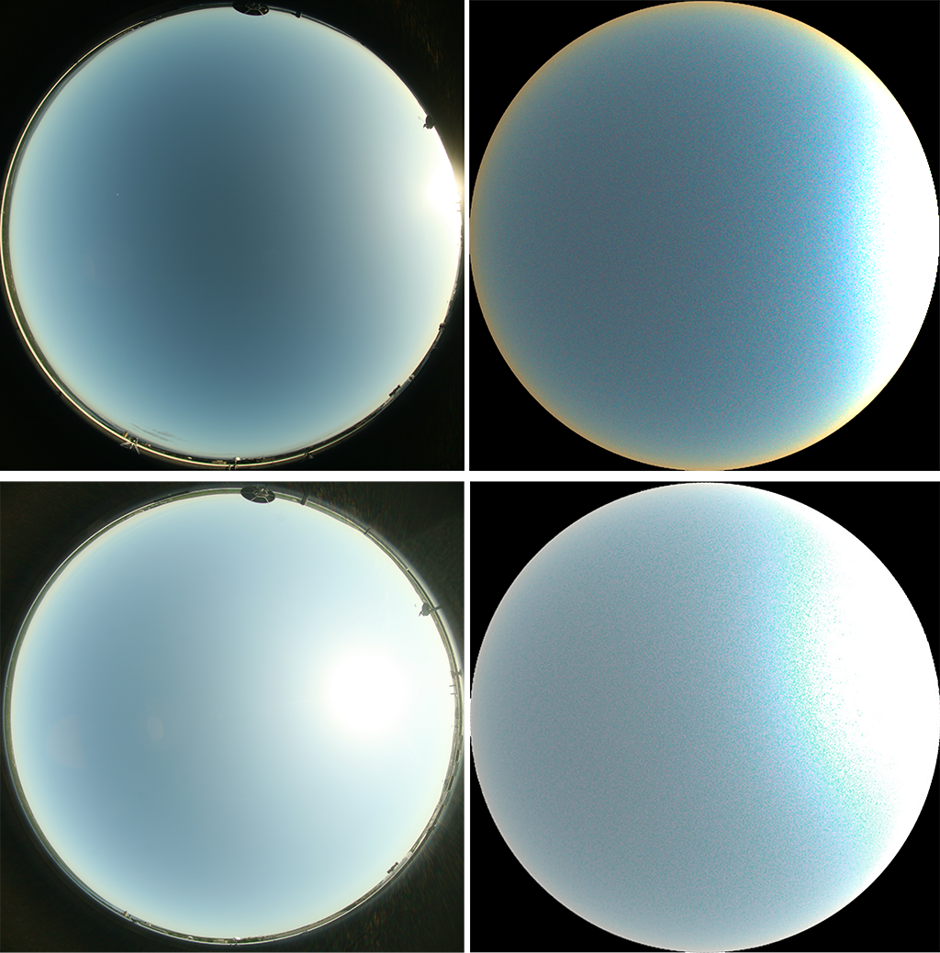

Slide 50
Limitations
AKA Opportunities for Future Work

Slide 51
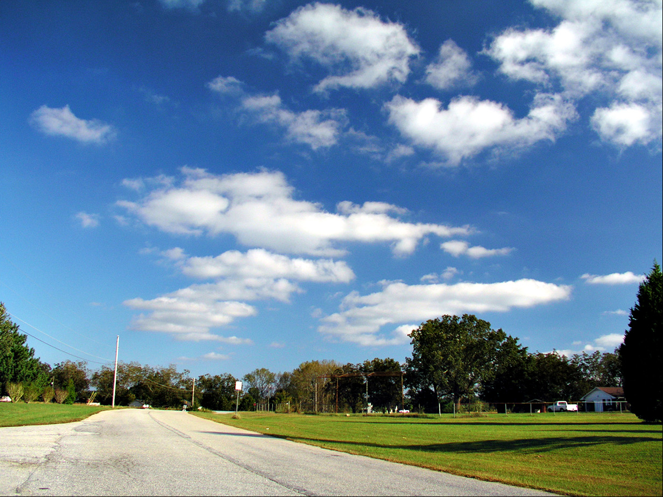

Slide 52
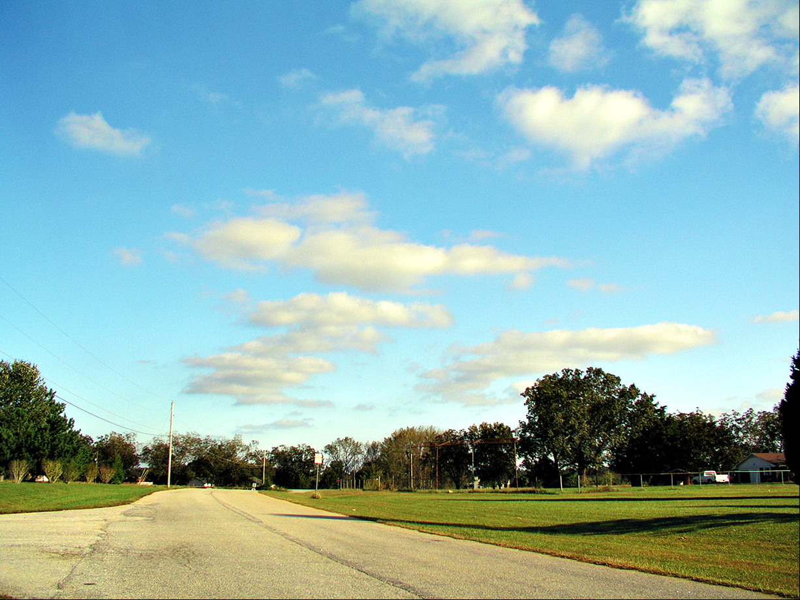

Slide 54
[Ament 2014]

Slide 55
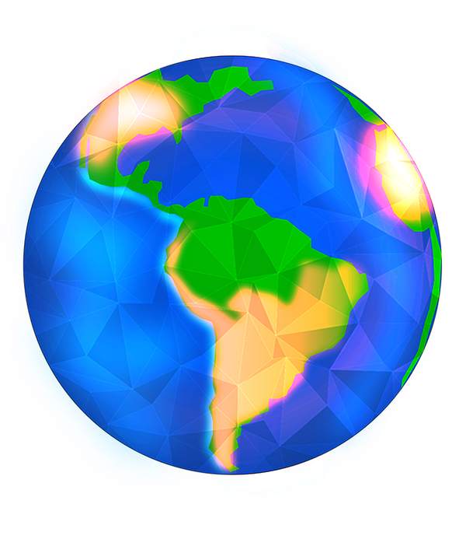
Perceived
Position
Horizon
True
Position

Slide 56
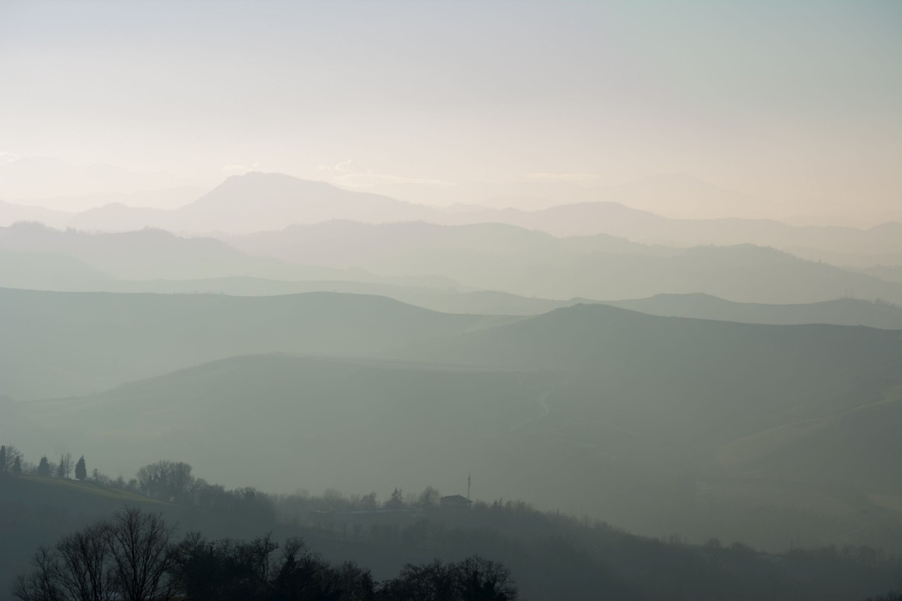

Slide 58
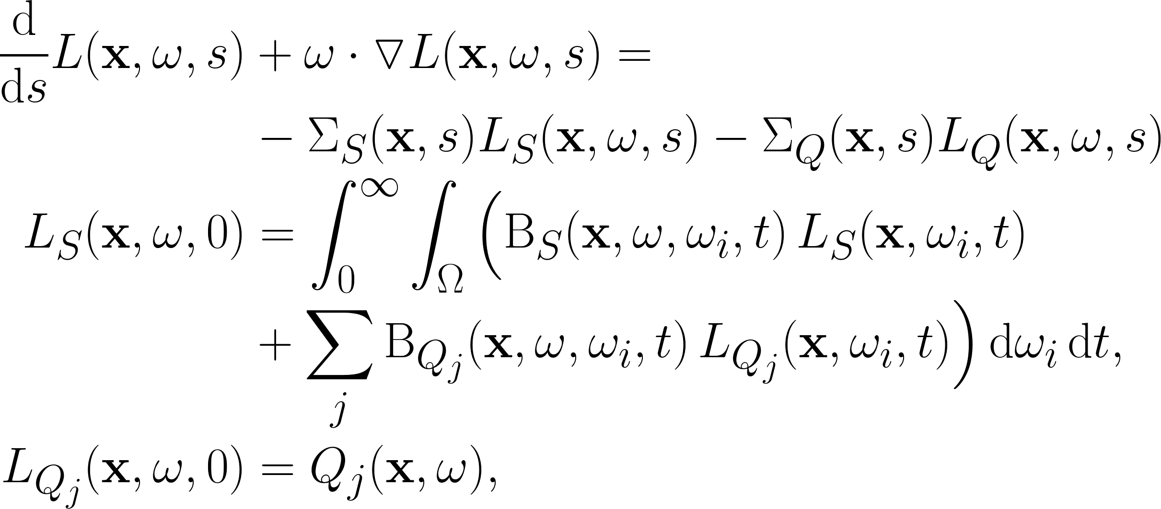
More this evening…

Slide 59
Wrapping Up

Slide 60
Physically-based optical model of the atmosphere
Based on data from Atmospheric Sciences
Includes dependence on the:
Location -> Aerosols
Season -> Ozone

