Slide 1
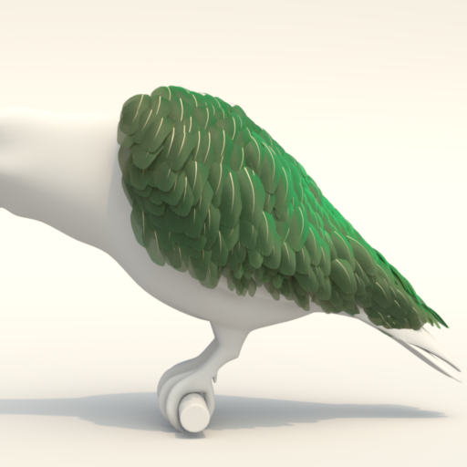
A Surface-based Appearance Model for Pennaceous Feathers
Juan Raúl Padrón-Griffe
Dario Lanza Adrián Jarabo Adolfo Muñoz
Notes:
Thanks for the introduction. In this talk, I would like to present our appearance model for pennaceous feathers.

Slide 2
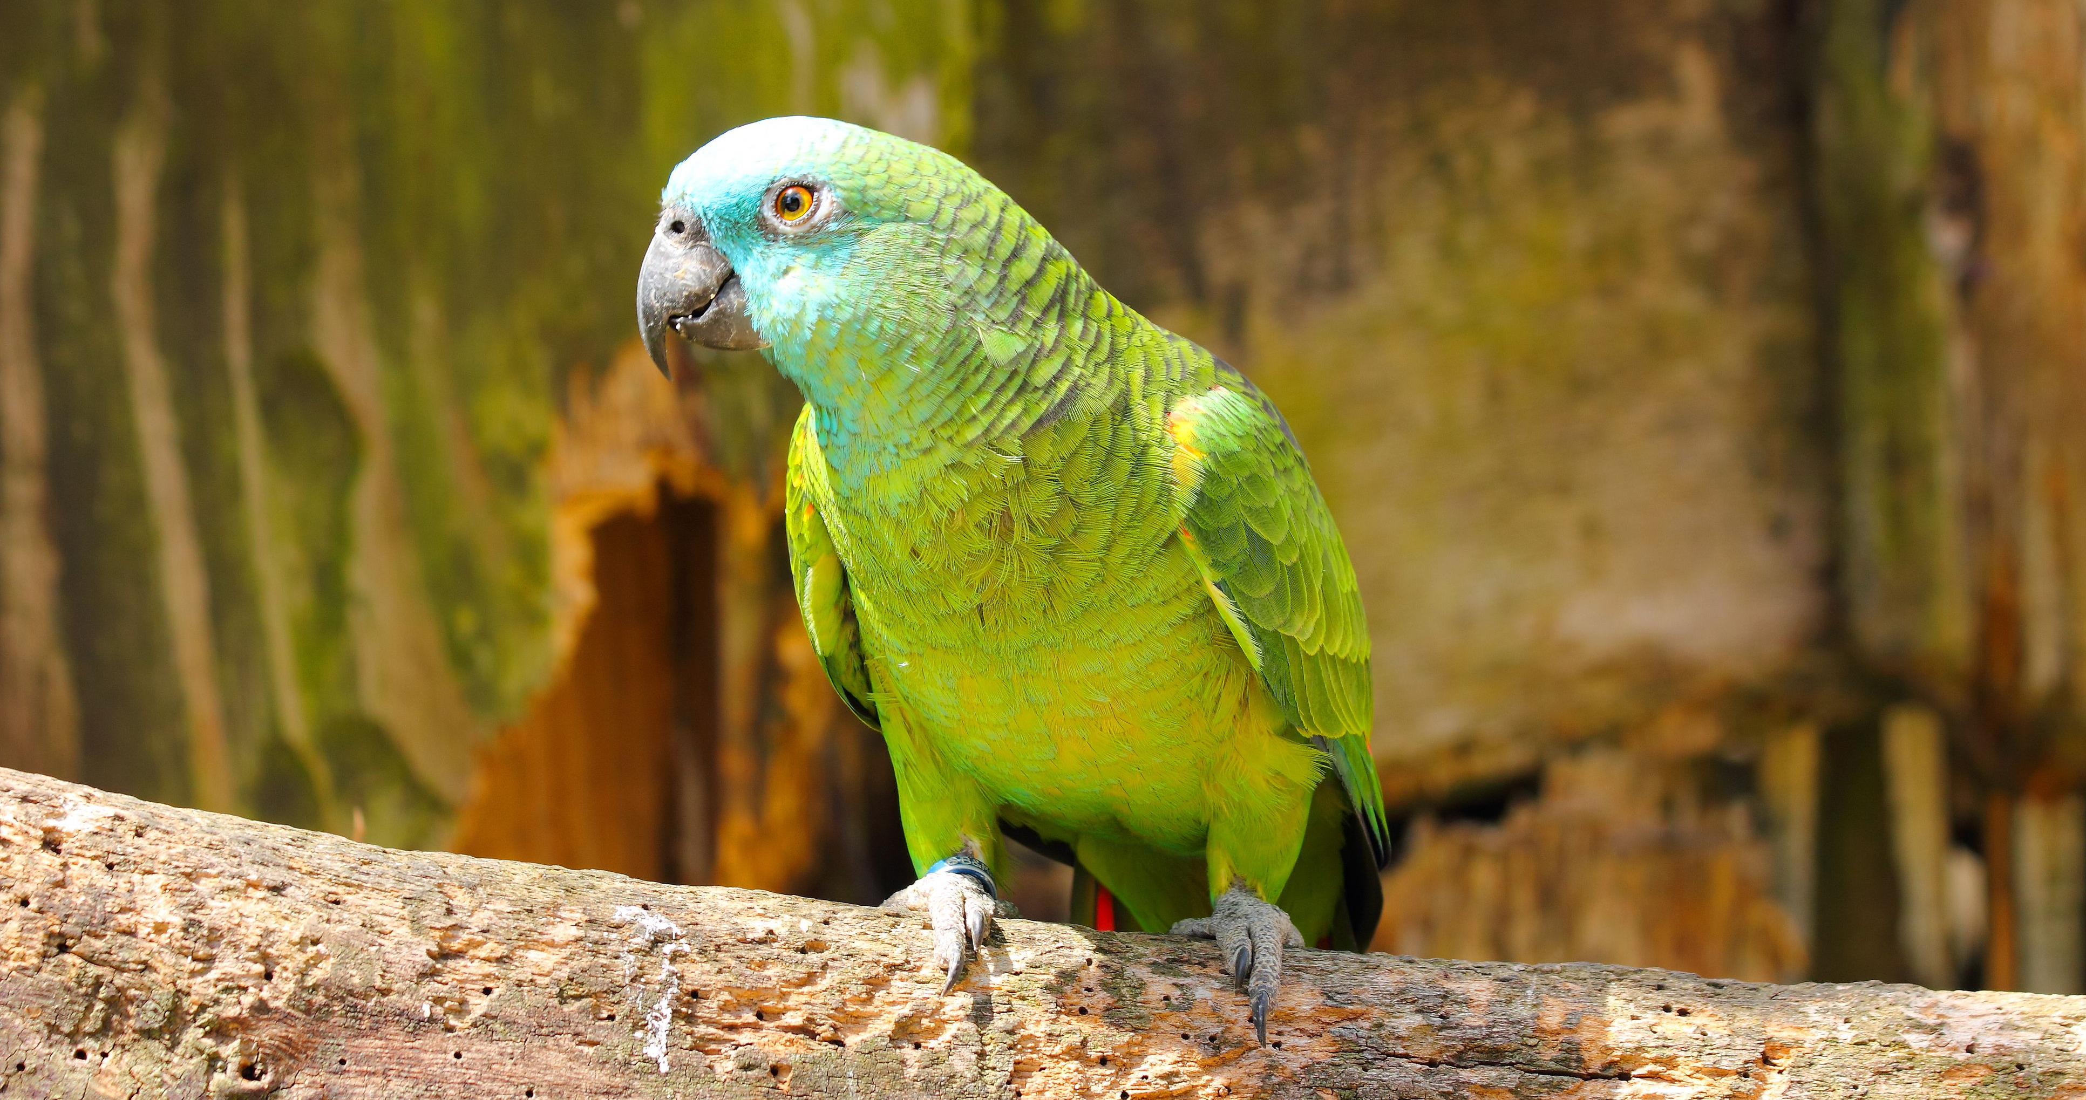
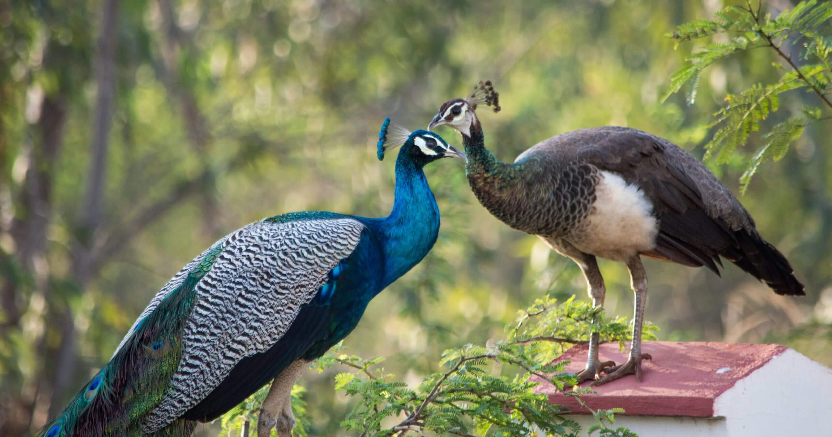
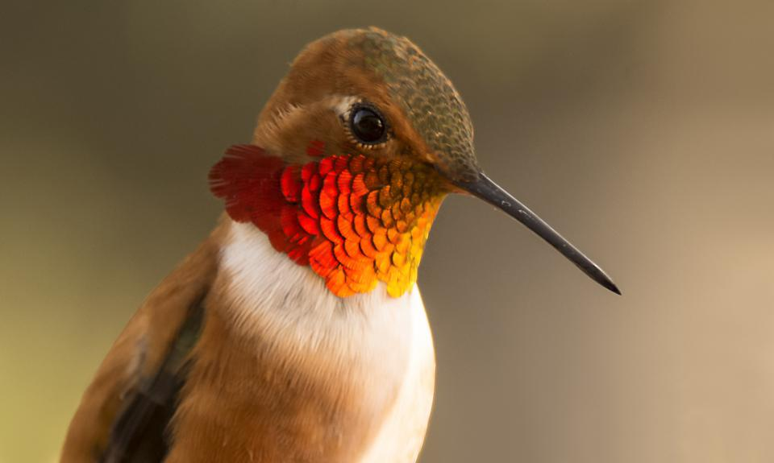
Notes:
Feathers are probably one of the most complex biological tissues found in nature with an astonishing diversity of color and patterns.
The appearance of feathers is partially explained by the geometrical complexity of their multi-scale structure
Photographs:
Blue-Fronted Amazon Parrots (Photographer Raj Kamal / Getty Images): https://www.thesprucepets.com/popular-amazon-parrot-species-390544
Peacock (Author Michael Ross): https://www.restedpaws.co.uk/male-vs-female-peacocks-how-to-tell-the-difference-with-pictures/
Verditer flycatcher (Photographer Jason Thompson): https://www.thainationalparks.com/species/verditer-flycatcher
Rufous Hummingbird (Photographer Tim Nicol): https://www.shutterbug.com/content/rufous-hummingbird-macro

Slide 3
Feather Structure
Multi-scale hierarchical structure: Vane → Barbs → Barbules
Barb and barbules are cylindrical filaments
Feather
Longitudinal Barb View
Azimuthal Barb View
Barbules
Rachis
Barb
SEM image of a feather [BDSP22]
Notes:
If we inspect a scanning-electron microscope of a feather we can find a multi-scale hierarhical structure where there is a rachis and parallel barbs emerge from this rachis.
At a smaller scale, parallel barbules emerges from each barb.
If we take a longitudinal cross section and an azimuthal cross section we can notice that barb and barbules are roughly cylindical filaments.

Slide 4
Feather Structure
Multi-scale hierarchical structure: Vane → Barbs → Barbules
Barb and barbules are cylindrical fibers
Barb
Barbules
Vanes
Rachis
Schematic of the multi-scale feather structure
Notes:
Lets consider an abstract model of this multi-scale hierarchical structure.
We have a feather composed of a rachis and two vanes. Each vane is a group of parallel barbs.
Each barb is connected with two sets of barbules called proximal and distal barbules.
If we take a cross section of a barb we notice a double cylindrical fiber.
And if we take a cross section of a barbule we can find a cylindrical fiber.

Slide 5
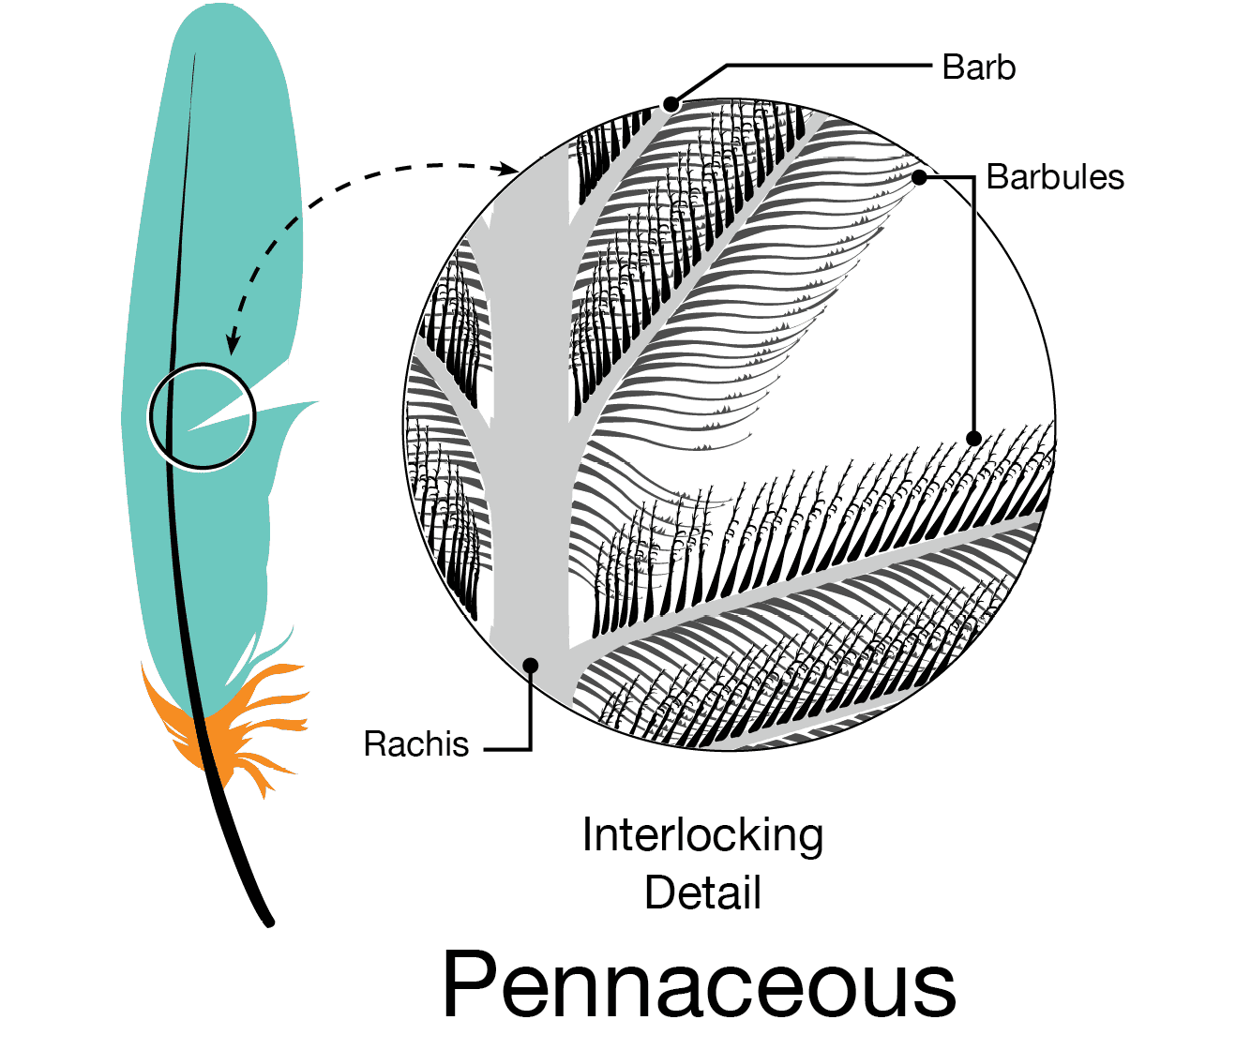
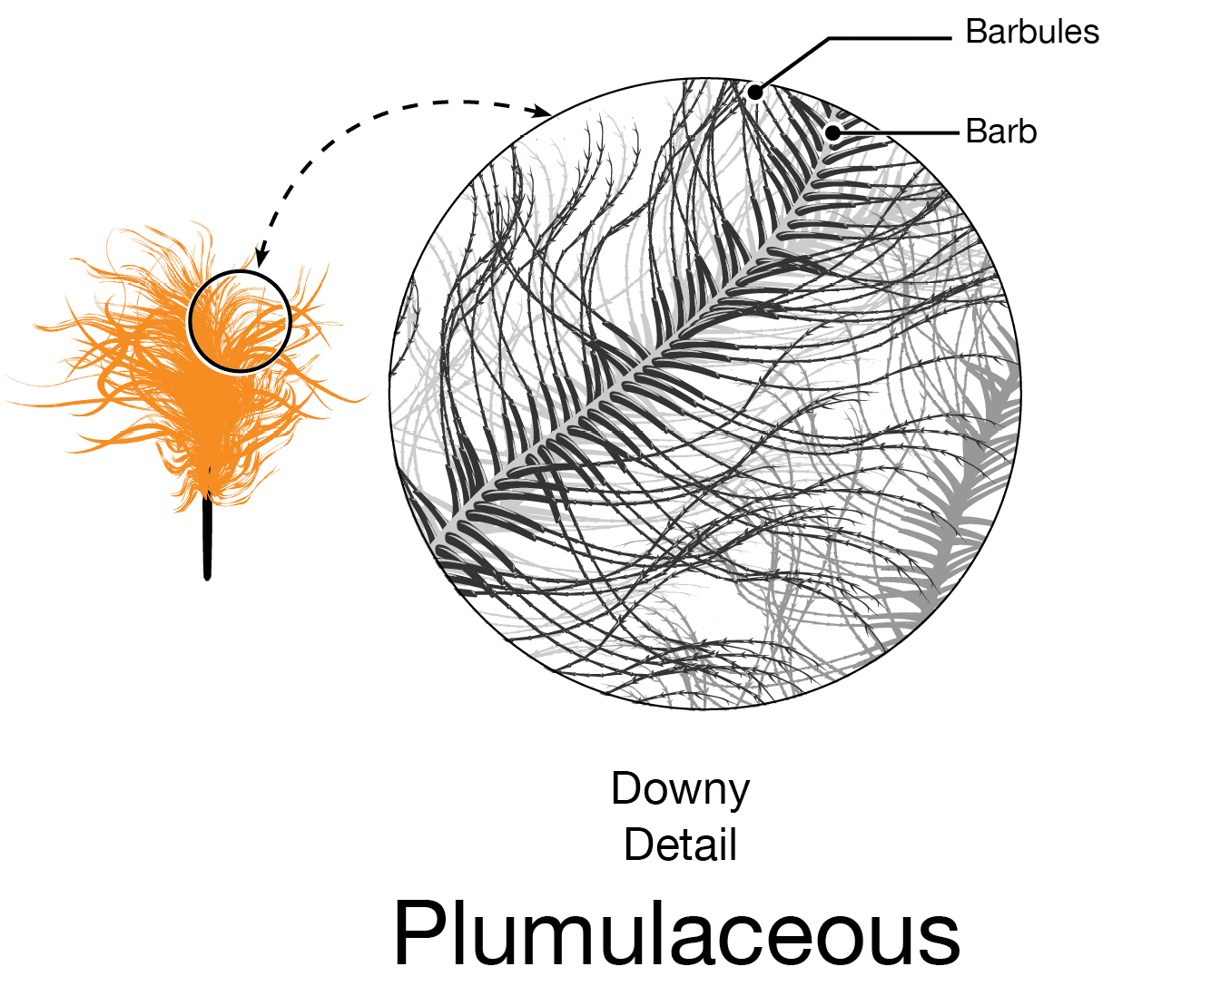
Pennaceous vs Plumulaceous
Source: Bird Academy (Cornell Lab)
Notes:
There are two main type of feathers.
Pennaceous feathers are stiff and mostly flat, where microscopic hooks on the barbules interlock the barbs to form a wind and waterproof structure that allows birds to fly and stay dry
On the other hand, plumulaceous feathers have flexible barbs and relative long barbule making the feather looks fluffy.
In this work, we exploit the regular and flat structure of pennaceous feather with a compact surface representation

Slide 6
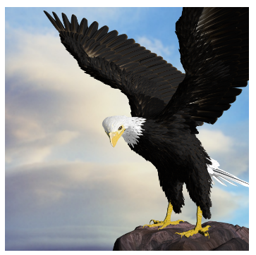
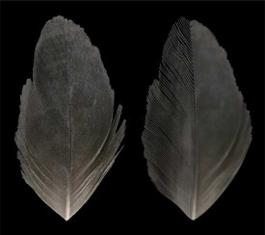
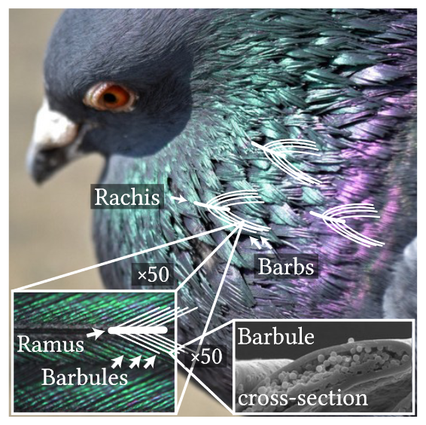
Related Work – Feathers
Relative unexplored topic, especially appearance
BTF [CXGS02]
Microstructure Shading
[BDSP22]
Iridescent Feather [HMC∗22]
Notes:
Feathers is a relatively unexplored topic, where most of the previous works have been focused on the representation and generation of the geometry.
[Chen et al. 2002] procedurallly modeled feathers using a parametric L-system and textured them with a Bidirectional Texture Function (BTF).
[Baron et al. 2022] procedurally generated feathers from an images using NURBS and propose a shading model for barb and barbules.
[Wuang at al. 2022] proposes a model for iridescent feathers based on thin film interference and a numerical masking term.

Slide 7
Related Work – Feathers
Explicit strand-based geometry up to the barb level
BTF [CXGS02]
Microstructure Shading
[BDSP22]
Iridescent Feather [HMC∗22]
Notes:
In all of these works the feather geometry up to the barb scale was represented with explicit strand-based geometry. The standard representation for hair and animal fur.
Rendering a bird with a strand-based geometry can be computational expensive if we consider that in average a bird have between 3000-5000 feathers.
Details:
The number of feathers a bird has varies greatly by bird species. The smallest bird, the bee hummingbird, has only about 940 feathers. The average bird has between 3,000 and 5,000 feathers. Most small songbirds can have between 1,500 and 3,000 feathers. The largest bird has about 30,000 feathers. Source: https://birddudes.com/how-many-feathers-does-a-bird-have/#:~:text=The%20number%20of%20feathers%20a%20bird%20has%20varies,feathers.%20The%20largest%20bird%20has%20about%2030%2C000%20feathers.

Slide 8
Related Work – Feathers
Barb appearance as a Hair BCSDF (missing medulla)
BTF [CXGS02]
Microstructure Shading
[BDSP22]
Iridescent Feather [HMC∗22]
Notes:
Any of the previous works consider the medulla inside the barbs and the internal composition responsible for the blue and green appearance of feathers. Instead they represent barb appearance with a hair (Bidirectional Curve Scattering Distribution Function) BCSDF.

Slide 9
Feather BSDF – Our Approach
A texture-based implicit representation for barbs
An analytical masking term for barbs and barbules occlusions
A BCSDF for feather barbs for non-iridescent structural coloration
Notes:
We propose a Bidiretional Scattering Distribution Function (BSDF) for pennaceous feathers. Our key contributions are:
A surface-based implicit representation for barbs encoded as 2D textures,
An analytical masking term for both barb and barbules occlusions.
A new BCSDF to approximate non-iridescent structural colors like green and blue feathers. The inclusion of a medulla introduces additional reflection paths, as well as diffusive reflectance lobes.
We show that our model produces more realistic renders than previous works and can render green and blue feathers for the first time.

Slide 10
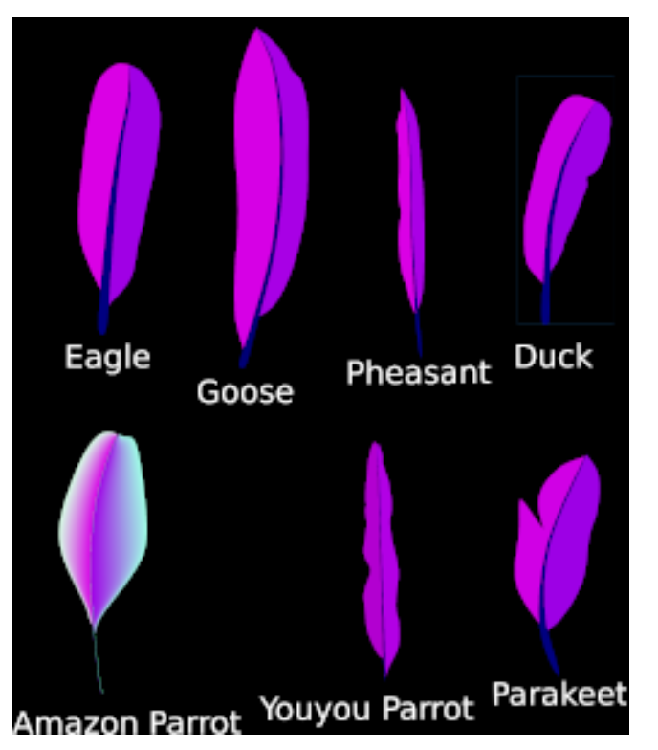
Feather Representation
Geometry information encoded in RGBA textures
red = barb angle
green = barb length
blue = feather part
Representation more compact than hair strands for barbs
Barbules modelled inside our feather BSDF
Feather examples
Notes:
We encode the feather geometry with RGBA textures
(red = barb angle, green = barb length, blue = feather part)
We only represent shaft and barbs. Barbules are considered in our feather Bidirectional Scattering Distribution Function (BSDF)
Textures can be manually designed with Gimp/Inscape or semi-automatically generated with python scripts

Slide 11
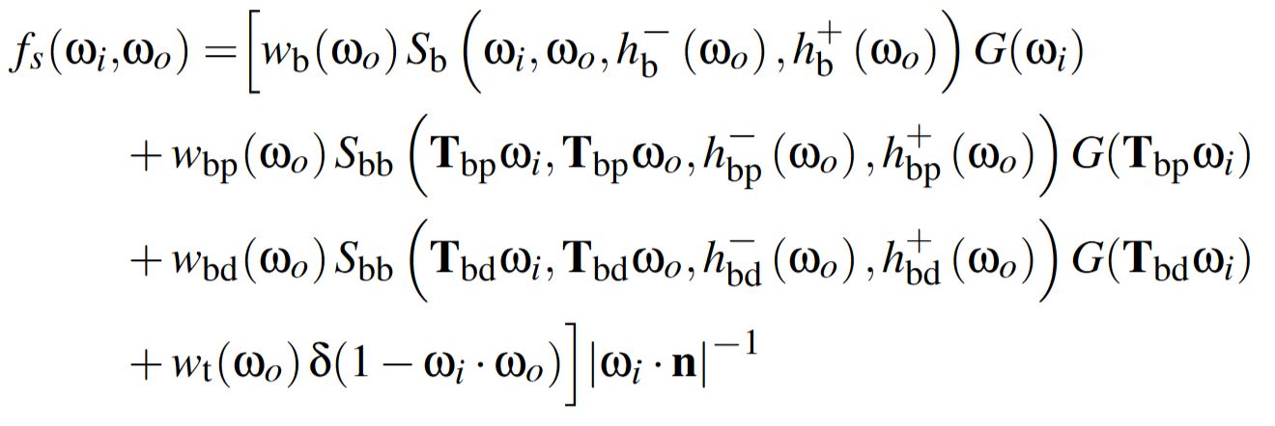
Feather BSDF
Barbs
Proximal Barbule
Distal Barbule
Transmission
Barb
Barbules
Vanes
Shaft
Notes:
Our feather BSDF is a linear combination of its multi-scale internal components including the barb, proximal barbule and distal barbule.
In addition, we consider the tranmission event when the light does not interact with any of the internal components
TO DO: We are missing a visual explanation for transmission

Slide 12
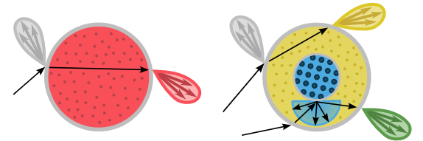
Feather BSDF
Barbs
Proximal Barbule
Distal Barbule
Transmission
Fiber Scattering Functions (BCSDF)
Notes:
The barb and barbules fibers are modelled with two different BCSDFs

Slide 13
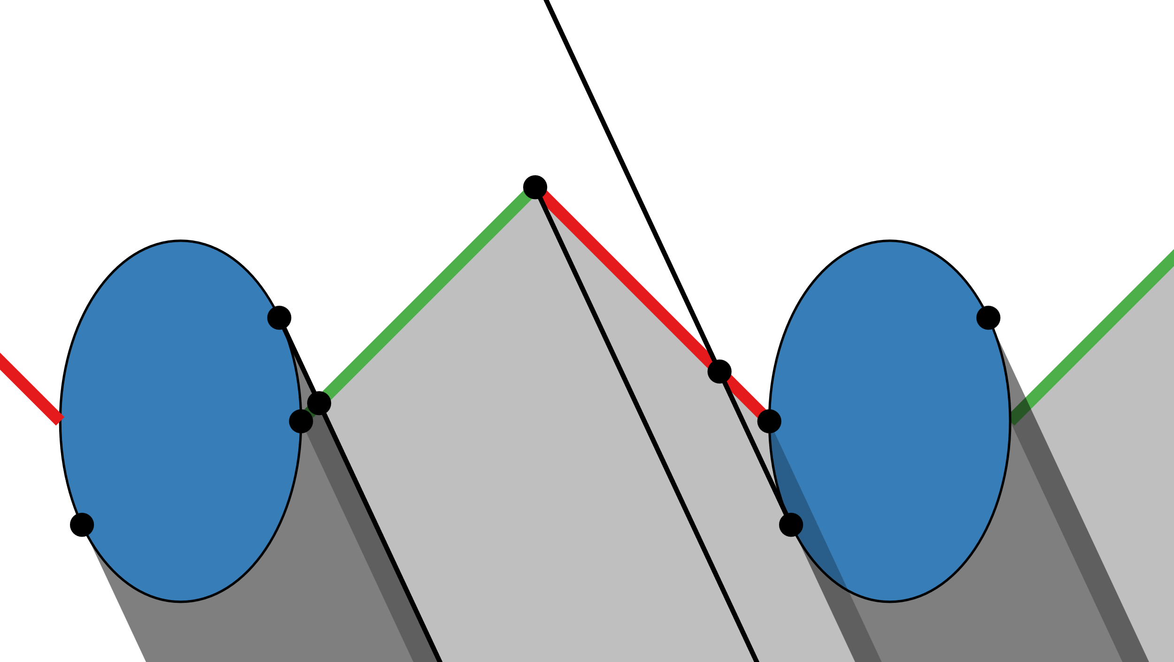
Feather BSDF
Barbs
Proximal Barbule
Distal Barbule
Transmission
Fiber Scattering Functions (BCSDF)
Feather Masking
Notes:
The weights of the linear combination are derived from the occlusion projected areas computed with our analytical masking term.
Same for the integration ranges of the fiber BCSDF.
Details:
T correspond to the coordinate system transforms from the barb space to the corresponding proximal or barbule space.
G correspond to the foreshorterning terms, basically cosine of the given direction.

Slide 14
Feather BSDF
Barbs
Proximal Barbule
Distal Barbule
Transmission
Fiber Scattering Functions (BCSDF)
Feather Masking
Notes:
Now lets focus first on the fiber scattering functions for barb and barbules

Slide 15
Fiber Scattering – Hair and Fur
Key observation: fur medulla is bigger and scatters light
Human hair
Cougar fur
SEM images of human hair and animal fur fiber [YTJR15]
Notes:
A key anatomical structure in fur is the medulla than is almost neglible for human hair but key for the appearance of realistic fur.

Slide 16
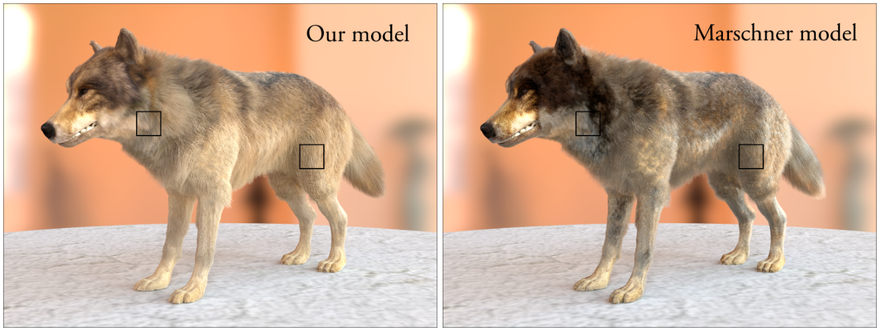
Fiber Scattering – Hair and Fur
Key observation: fur medulla is bigger and scatters light
Hair Model
Fur Model
Medulla
Cortex
Cortex
Comparison between a hair and fur reflectance model [YTJR15]
Notes:
We can see how fur has a distinct diffusive and saturated appearance (Left), that is not captured by hair models without medulla (Right).
The key difference was the nested cylinder model proposed by Yan and colleagues in 2015.

Slide 17
Fiber Scattering – Medulla Motivation
Key observations: presence of a medulla with an internal spongy structure and elliptical cross section shape
Bird
Feather
Barb
Barb (inside)
Multi-scale measurements of a Kingfisher (Alcedo atthis) [STLW11]
Notes:
Here we analyze the internal structure of a bird with blue feathers at multiple scales: bird, feather, barb and inside the barbs.
Notice the elliptical shape of the barb cross section and the presence of a medulla with an internal spongy structure
The organization and specific structure of this spongy structure lead to non-iridescent tones of blue, violet and UV [Pru99]. If the space between the holes is small lead to blue colors. As we increase the space the medulla scatters light with a longer wavelength like green or violet.
Detail:
In some cases the spongy structures generate partial iridescence for highly directional illuminations [STLW11], which disappears with lower frequency illuminations.
Figure description: (a) Kingfisher (Alcedo atthis). (b) Blue tail feather of a kingfisher. (c) Top-view SEM of a sectioned barb of the feather with
several barbules (50 μm). (d) Cross section SEM of a cut vacuole and the surrounding spongy structures (2 μm).
One source of such structural coloration are specialized keratin structures in the medulla of the barbs, which create a pseudo-ordered matrix of keratin and air bubbles, known as the spongy layer (Figure 3, d).

Slide 18
Fiber Scattering – Medulla Motivation
Key insight: spongy structures produces non-iridescent coloration dominated by back-reflectance [NLS∗10]
Bird
Feather
Barb
Barb (inside)
Multi-scale measurements of a Kingfisher (Alcedo atthis) [STLW11]
Notes:
The key observation we found from this previous work is that the scattering process of these spongy structures is dominated by back-reflectance.
This implies that forward scattering contribution is not so important for these kind of feathers and subsurface scattering contribution is not critical

Slide 19
Coloration Mechanisms
Phenomenon: pigments inside the cortex absorb particular wavelengths
Model: dielectric cylinder with absorbing media [MJC∗03]
Pigmentation
R
TT
TRT
Amazon Parrot
Notes:
Lets briefly discuss the coloration mechanisms and how we model them.
Pigmentation is the process where light is absorbed absorved by pigments. Depending on the pigmentation type and the concentration amount certain wavelengths would be more absorbed than others.
Photograph: https://pixabay.com/photos/parrot-wildlife-green-bird-tree-7507450/

Slide 20
Coloration Mechanisms
Phenomenon: medulla scattering produced by the spongy structure
Model: diffuse medulla instead of subsurface scattering [YTJR15]
Diffuse Structural Coloration
TdT
R
Amazon Parrot
Notes:
Another mechanism is non-iridescent structural coloration where the medulla inside the barbs scatters lights in particular wavelengths due to the spongy structure inside the them.
Non-iridescent structural coloration can be represented with a double cylinder [YTJR15] with a diffuse non-concentric medulla.
Photograph: https://pixabay.com/photos/parrot-wildlife-green-bird-tree-7507450/

Slide 21
Model – Barb Parameters
Barb Parameters
$$β_{m}$$
Longitudinal roughness of cortex
$$β_{n}$$
Azimuthal roughness of cortex
$$σ_{c, a}$$
Absorption coefficient in cortex
$$η_{c}$$
Refractive index of cortex
$a_{c}$ , $b_{c}$
Cortex semi-major/minor axis
$$σ_{m, a}$$
Absorption coefficient in medulla
$$d_{m}$$
Diffuse reflectance of medulla
$$η_{m}$$
Refractive index of medulla
$a_{m}$ , $b_{m}$
Medulla semi-major/minor axis
$c_{m, a}$ , $c_{m,b}$
Medulla center

Slide 22
Model – Barb Parameters
Barb Parameters
$$β_{m}$$
Longitudinal roughness of cortex
$$β_{n}$$
Azimuthal roughness of cortex
$$σ_{c, a}$$
Absorption coefficient in cortex
$$η_{c}$$
Refractive index of cortex
$a_{c}$ , $b_{c}$
Cortex semi-major/minor axis
$$σ_{m, a}$$
Absorption coefficient in medulla
$$d_{m}$$
Diffuse reflectance of medulla
$$η_{m}$$
Refractive index of medulla
$a_{m}$ , $b_{m}$
Medulla semi-major/minor axis
$c_{m, a}$ , $c_{m,b}$
Medulla center

Slide 23
Model – Barb Parameters
Barb Parameters
$$β_{m}$$
Longitudinal roughness of cortex
$$β_{n}$$
Azimuthal roughness of cortex
$$σ_{c, a}$$
Absorption coefficient in cortex
$$η_{c}$$
Refractive index of cortex
$a_{c}$ , $b_{c}$
Cortex semi-major/minor axis
$$σ_{m, a}$$
Absorption coefficient in medulla
$$d_{m}$$
Diffuse reflectance of medulla
$$η_{m}$$
Refractive index of medulla
$a_{m}$ , $b_{m}$
Medulla semi-major/minor axis
$c_{m, a}$ , $c_{m,b}$
Medulla center

Slide 24
Model – Barb Parameters
Barb Parameters
$$β_{m}$$
Longitudinal roughness of cortex
$$β_{n}$$
Azimuthal roughness of cortex
$$σ_{c, a}$$
Absorption coefficient in cortex
$$η_{c}$$
Refractive index of cortex
$a_{c}$ , $b_{c}$
Cortex semi-major/minor axis
$$σ_{m, a}$$
Absorption coefficient in medulla
$$d_{m}$$
Diffuse reflectance of medulla
$$η_{m}$$
Refractive index of medulla
$a_{m}$ , $b_{m}$
Medulla semi-major/minor axis
$c_{m, a}$ , $c_{m,b}$
Medulla center

Slide 25
Model – Barb Parameters
Barb Parameters
$$β_{m}$$
Longitudinal roughness of cortex
$$β_{n}$$
Azimuthal roughness of cortex
$$σ_{c, a}$$
Absorption coefficient in cortex
$$η_{c}$$
Refractive index of cortex
$a_{c}$ , $b_{c}$
Cortex semi-major/minor axis
$$σ_{m, a}$$
Absorption coefficient in medulla
$$d_{m}$$
Diffuse reflectance of medulla
$$η_{m}$$
Refractive index of medulla
$a_{m}$ , $b_{m}$
Medulla semi-major/minor axis
$c_{m, a}$ , $c_{m,b}$
Medulla center

Slide 26
Model – Barb Parameters
Barb Parameters
$$β_{m}$$
Longitudinal roughness of cortex
$$β_{n}$$
Azimuthal roughness of cortex
$$σ_{c, a}$$
Absorption coefficient in cortex
$$η_{c}$$
Refractive index of cortex
$a_{c}$ , $b_{c}$
Cortex semi-major/minor axis
$$σ_{m, a}$$
Absorption coefficient in medulla
$$d_{m}$$
Diffuse reflectance of medulla
$$η_{m}$$
Refractive index of medulla
$a_{m}$ , $b_{m}$
Medulla semi-major/minor axis
$c_{m, a}$ , $c_{m,b}$
Medulla center

Slide 27
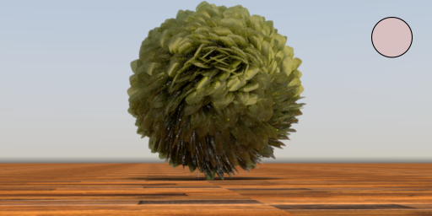
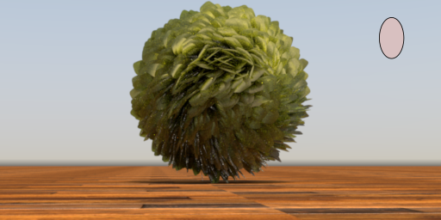
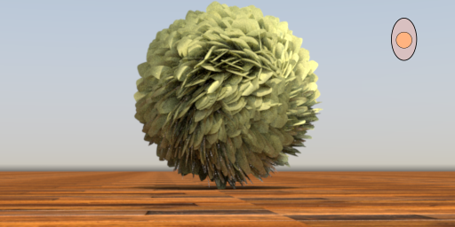
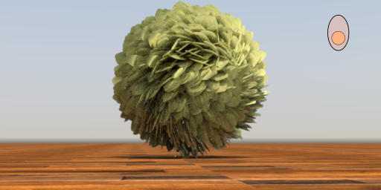
Fiber Scattering – Ablation Study
Circular Cortex
Elliptical Cortex
Concentric Medulla
Non-concentric Medulla

Slide 28
Feather BSDF
Barbs
Proximal Barbule
Distal Barbule
Transmission
Fiber Scattering Functions (BCSDF)
Feather Masking
Notes:
The weights of the linear combination are derived from the occlusion projected areas computed with our analytical masking term.
Same for the integration ranges of the fiber BCSDF.
T correspond to the coordinate system transforms from the barb space to the corresponding proximal or barbule space.
G correspond to the foreshorterning terms, basically cosine of the given direction.

Slide 29
Model – Masking Parameters
Masking Parameters
$$ϕ_{b}$$
Azimuthal barb angle
$$ϕ_{bb}$$
Azimuthal barbule angle
$$θ_{bb}$$
Longitudinal barbule angle
$$δ_{bb}$$
Barbule separation
$$l_{bb}$$
Barbule length

Slide 30
Model – Masking Parameters
Masking Parameters
$$ϕ_{b}$$
Azimuthal barb angle
$$ϕ_{bb}$$
Azimuthal barbule angle
$$θ_{bb}$$
Longitudinal barbule angle
$$δ_{bb}$$
Barbule separation
$$l_{bb}$$
Barbule length

Slide 31
Model – Masking Parameters
Masking Parameters
$$ϕ_{b}$$
Azimuthal barb angle
$$ϕ_{bb}$$
Azimuthal barbule angle
$$θ_{bb}$$
Longitudinal barbule angle
$$δ_{bb}$$
Barbule separation
$$l_{bb}$$
Barbule length

Slide 32
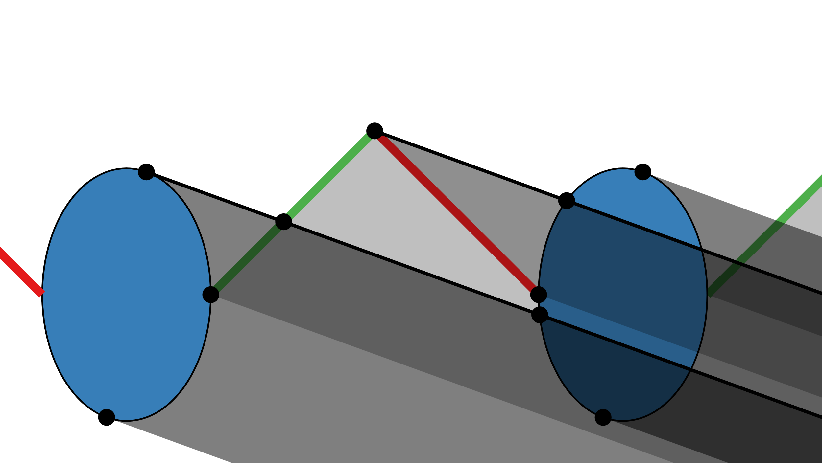
Masking – Barbs
View-dependent occlusions depending on barbules configuration
Partial transparency from barbule masking component
View Angle 25 (No occlusion)
View Angle 75 (Occlusion)
Notes:
Cross section of barbs, representing the masking between barbs at two different view inclinations. Barbules (in red and green, respectively) are partially transmitting, depending on the view direction at their particular local coordinates (see Figure 5), while barbs (in blue) are considered to be opaque.
Depending on the view direction, each element (barbs and barbules) totally or partially occludes the rest.
The limits of such occlusions are identified by tracing 2D rays (marked in black). By considering all the particular intersection ranges we obtain the weights

Slide 33
Masking – Barbs
Barbs
Proximal Barbule
Distal Barbule
Transmission
Notes:
Local weights are computed from the corresponding projected areas from the barb (click), proximal barbule (click) and distal barbule (click)

Slide 34
Masking – Barbs
Barbs
Proximal Barbule
Distal Barbule
Transmission
Notes:
Local weights are computed from the corresponding projected areas from the barb (click), proximal barbule (click) and distal barbule (click)

Slide 35
Masking – Barbs
Barbs
Proximal Barbule
Distal Barbule
Transmission
Notes:
Local weights are computed from the corresponding projected areas from the barb (click), proximal barbule (click) and distal barbule (click)

Slide 36
Masking – Barbs
Barbs
Proximal Barbule
Distal Barbule
Transmission
Notes:
Local weights are computed from the corresponding projected areas from the barb (click), proximal barbule (click) and distal barbule (click)

Slide 37
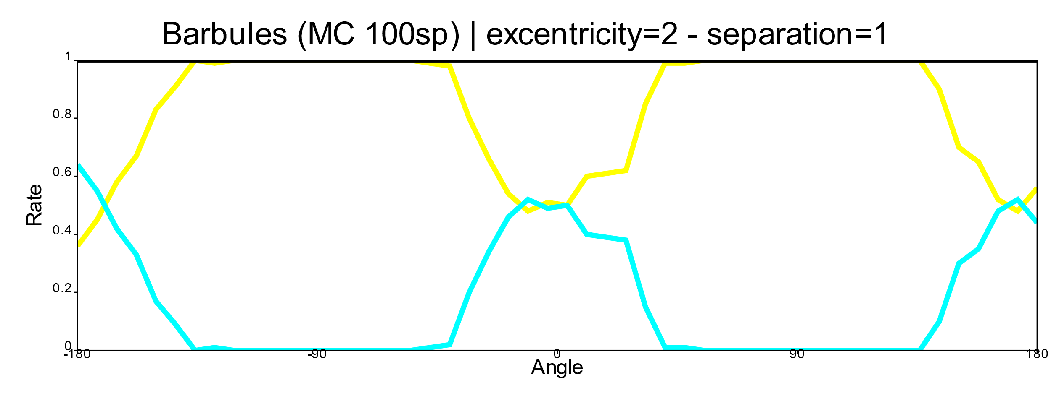
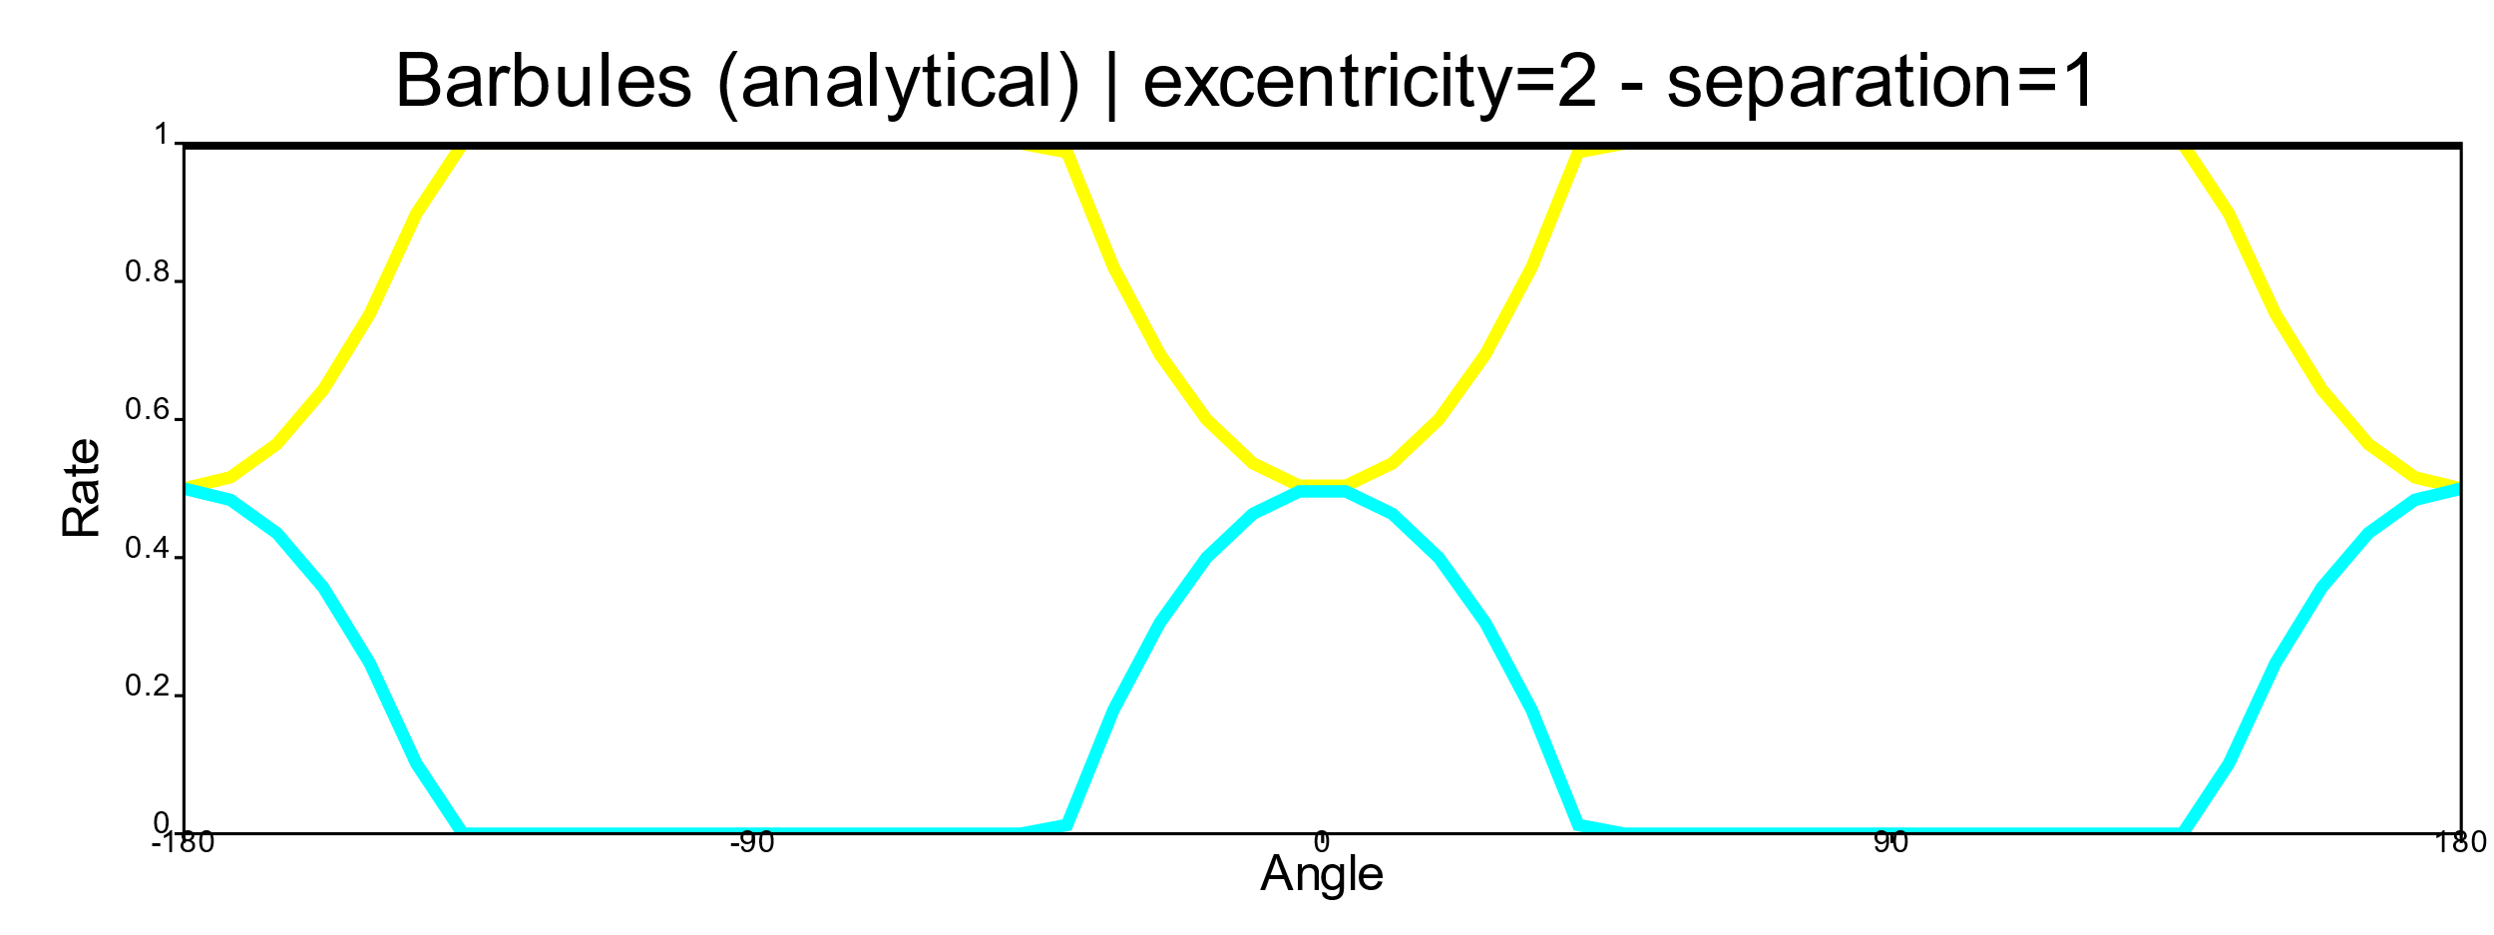
Masking – Barbules
Our masking term is analytical not stochastic
Noisy O (N)
O(1)
Notes:
A straightforward way to compute the masking term would be stochastic by throwing random rays and count how many hit the barbules. Unfortunately, this approach leads to noisy results. \\
Since the barbules are elliptical fibers, then we can compute the corresponding projected areas using the analytical implicit equation of the ellipses to compute the tangent rays.

Slide 38
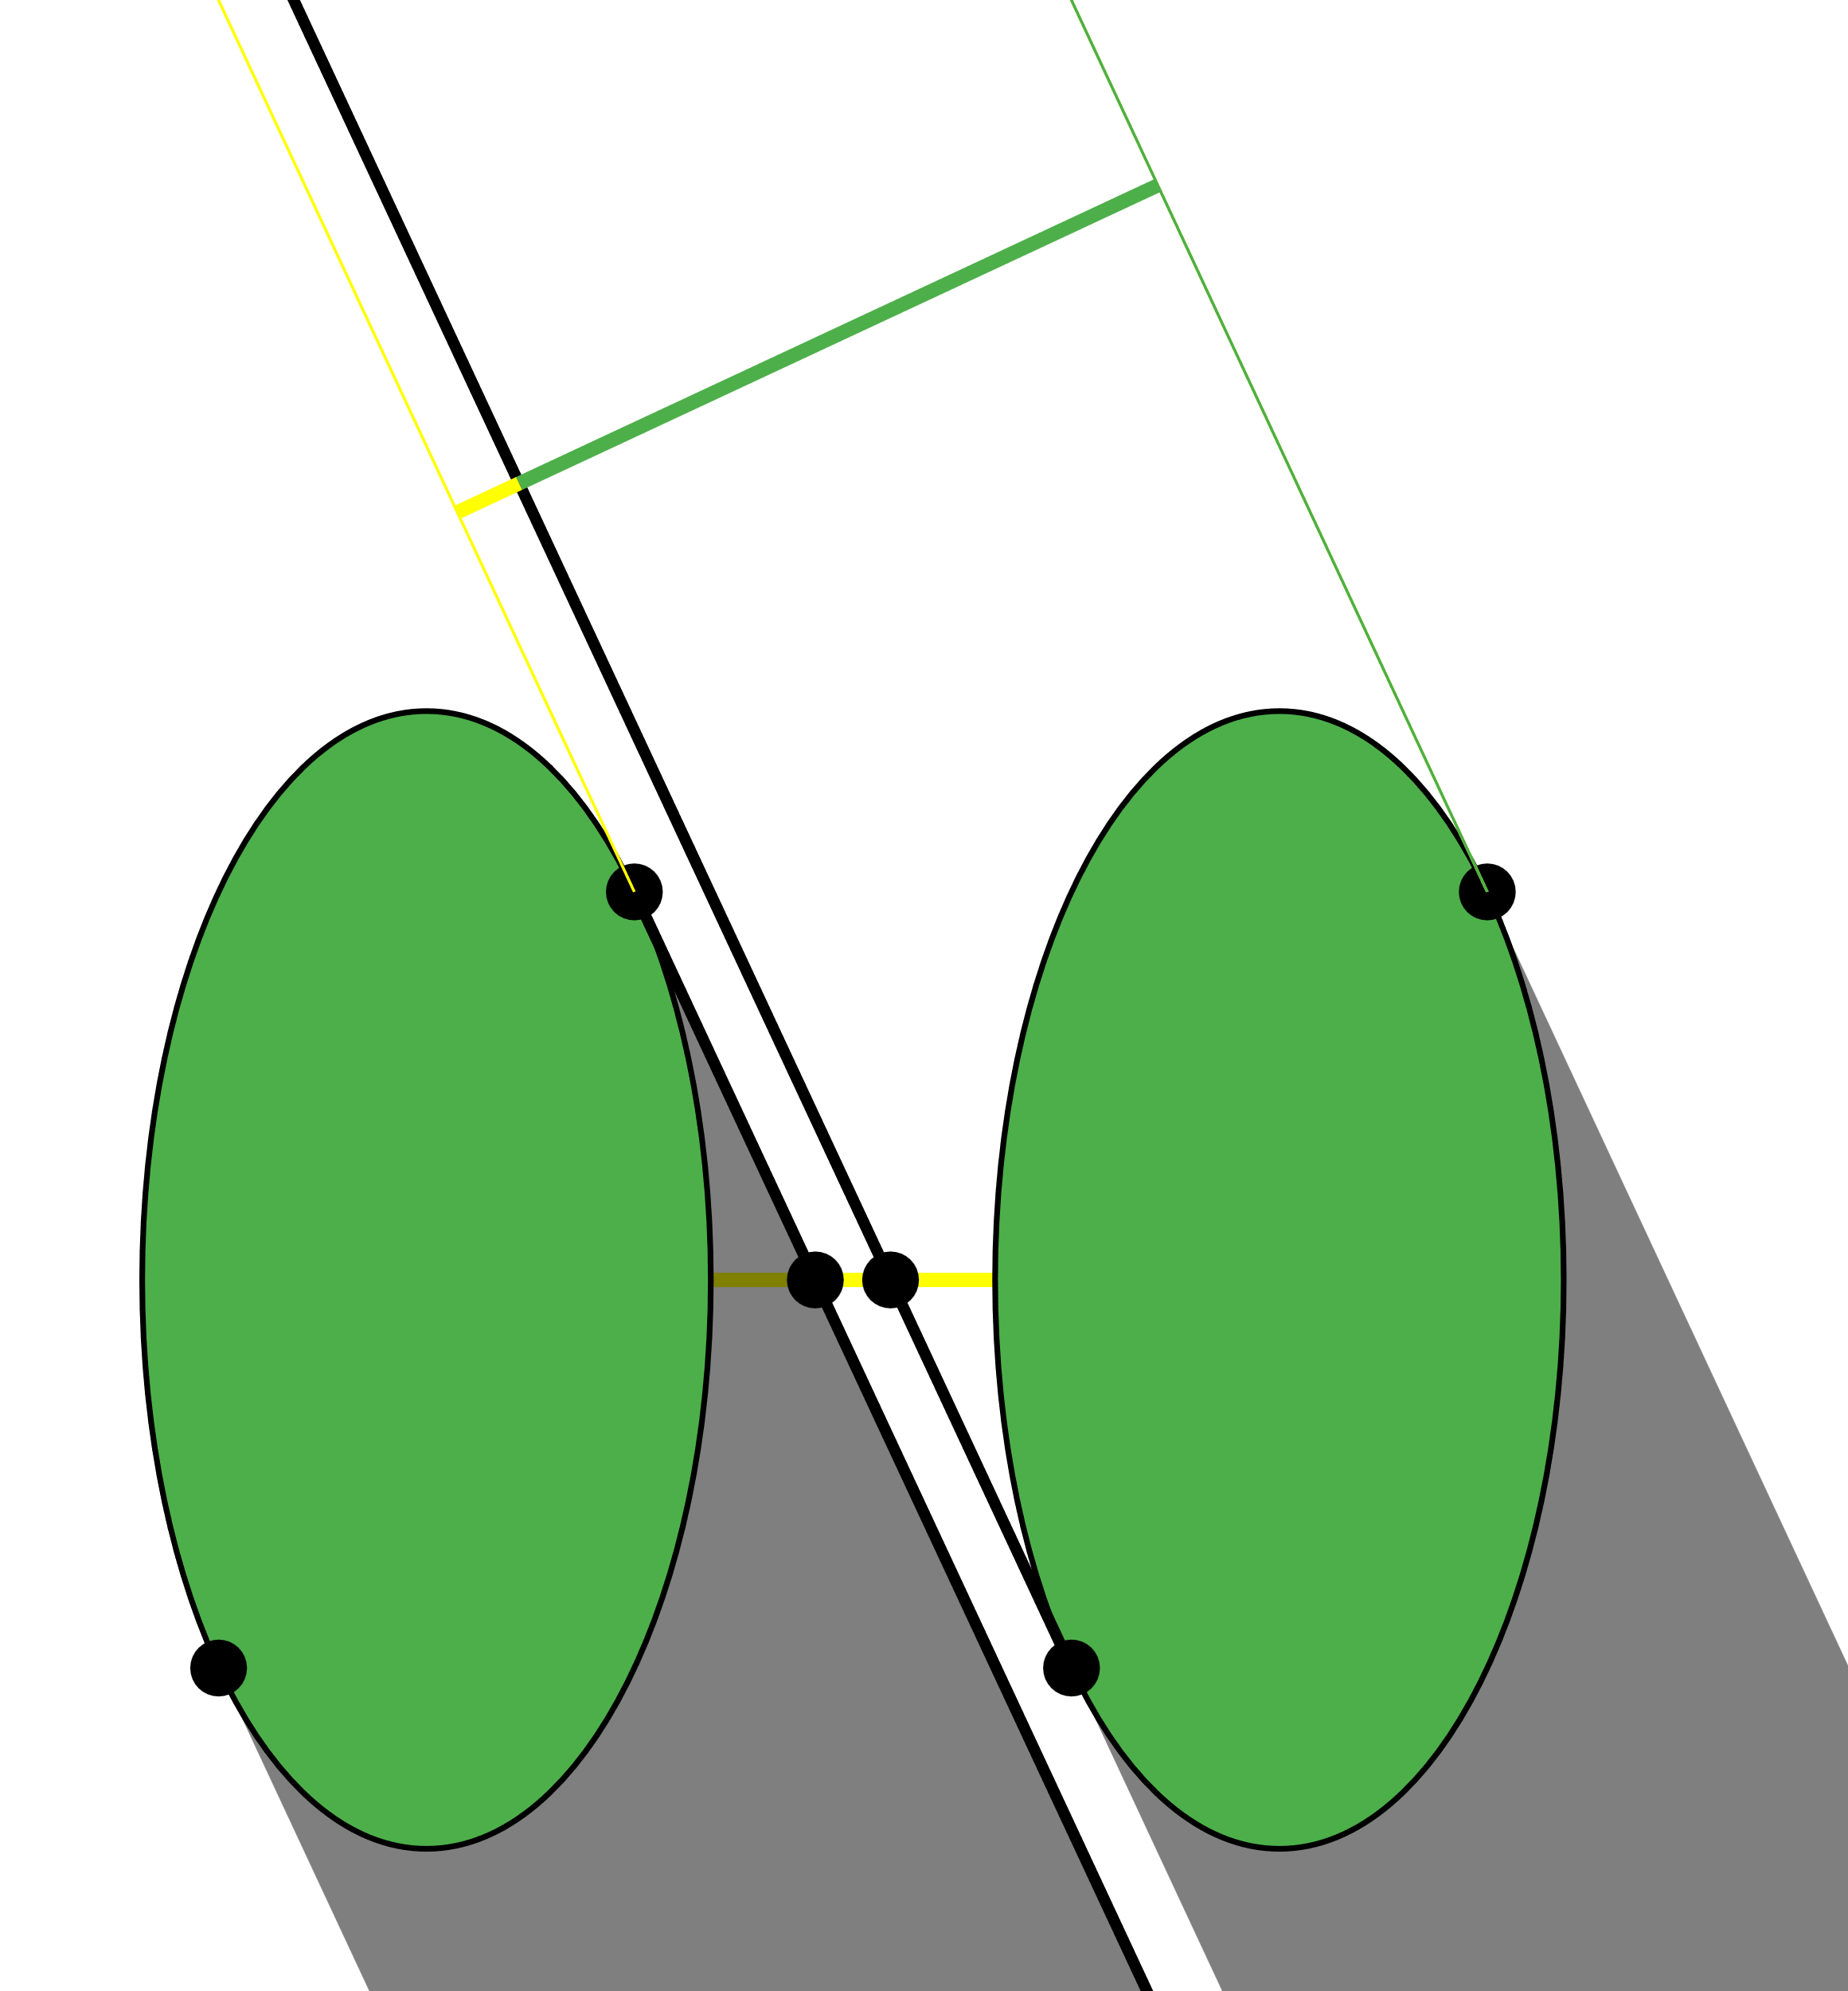
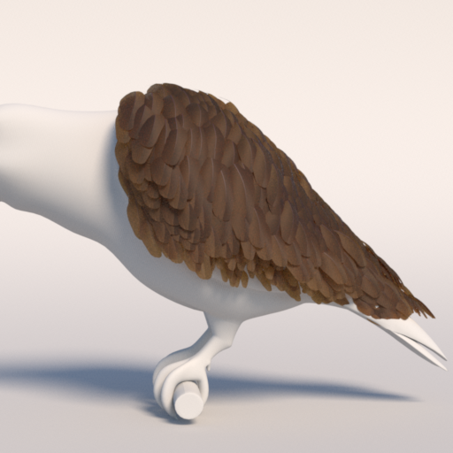
Masking – Barbules
Barbule separation affects the transmittance
Notes:
The larger the barbule separation, the larger the transmittance and small the overlapping of the projected areas as we can see in the following example where we increase the barbule separation

Slide 39
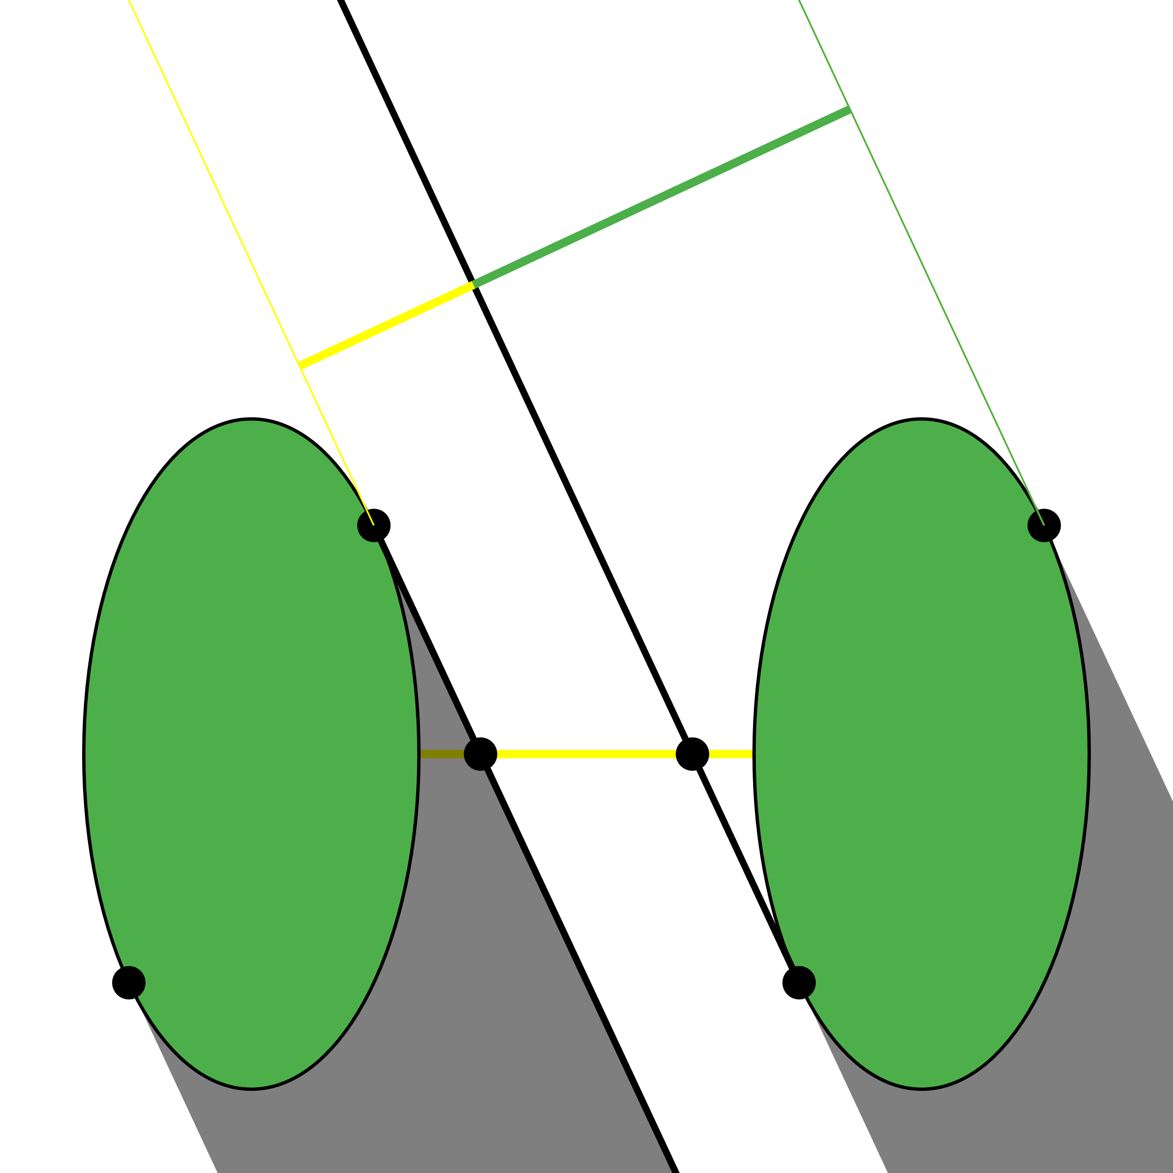
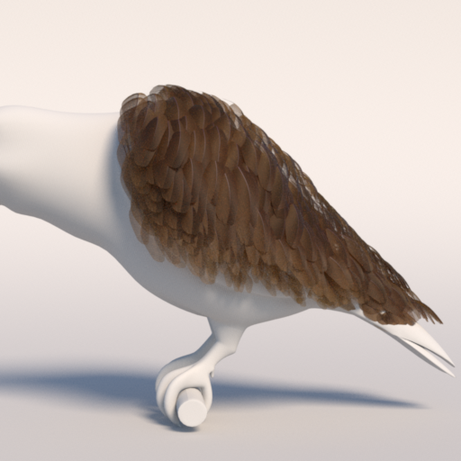
Masking – Barbules
Barbule separation affects the transmittance
Notes:
The larger the barbule separation, the larger the transmittance and small the overlapping of the projected areas as we can see in the following example where we increase the barbule separation

Slide 40
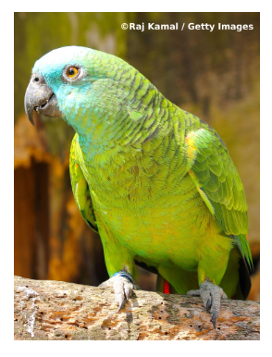
Results – Ablation Studies
Resembles blue-front amazon parrot appearance (face)
Only masking scenario is comparable to [BDSP22] (second row)
Photograph
Masking Disabled, Medulla Disabled
Masking Enabled, Medulla Disabled
Masking Enabled, Medulla Enabled

Slide 41
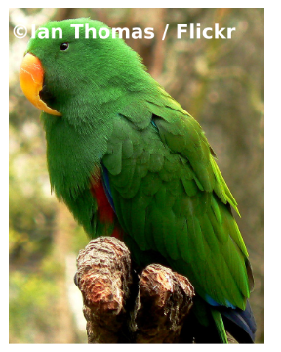
Results – Ablation Studies
Resembles eclectus parrot appearance (wing)
Only masking scenario is comparable to [BDSP22] (second row)
Photograph
Masking Disabled, Medulla Disabled
Masking Enabled, Medulla Disabled
Masking Enabled, Medulla Enabled

Slide 42
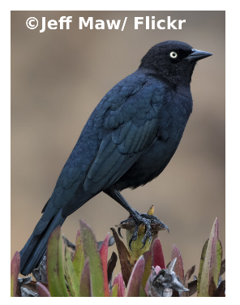
Results – Ablation Studies
Resembles Brewer’s blackbird appearance (wing)
Only masking scenario is comparable to [BDSP22] (second row)
Photograph
Masking Disabled, Medulla Disabled
Masking Enabled, Medulla Disabled
Masking Enabled, Medulla Enabled

Slide 43
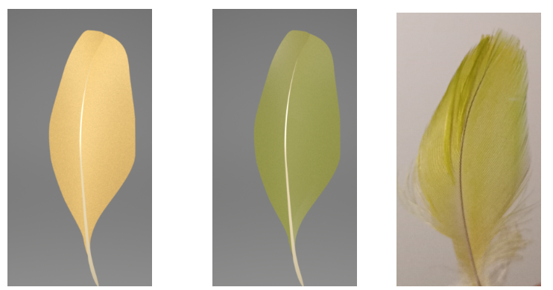
Results – Appearance Matching
Amazon Parrot Feather
Masking Disabled
Masking Enabled
Photograph
Medulla Disabled
Medulla Enabled

Slide 44
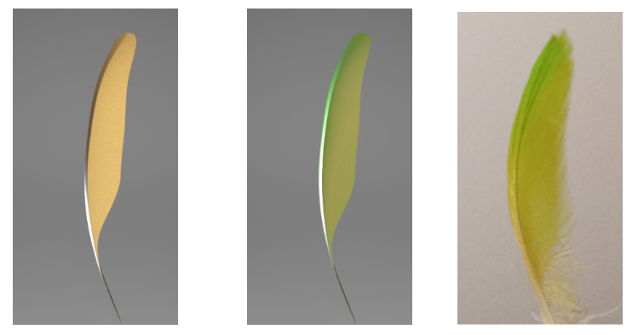
Results – Appearance Matching
Amazon Parrot Feather
Masking Disabled
Masking Enabled
Photograph
Medulla Disabled
Medulla Enabled

Slide 45
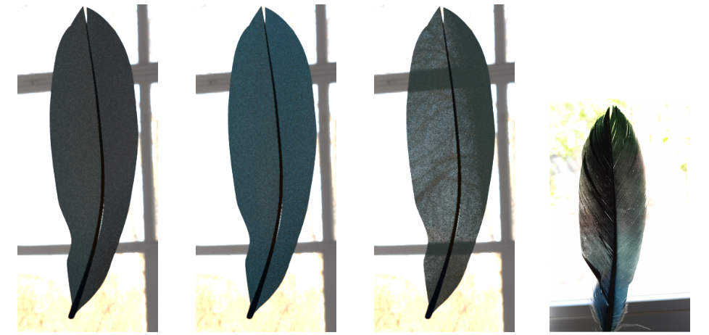
Results – Appearance Matching
Black Goose Feather
Masking Disabled
Masking Disabled
Masking Enabled
Photograph
Medulla Disabled
Medulla Enabled
Medulla Enabled

Slide 46
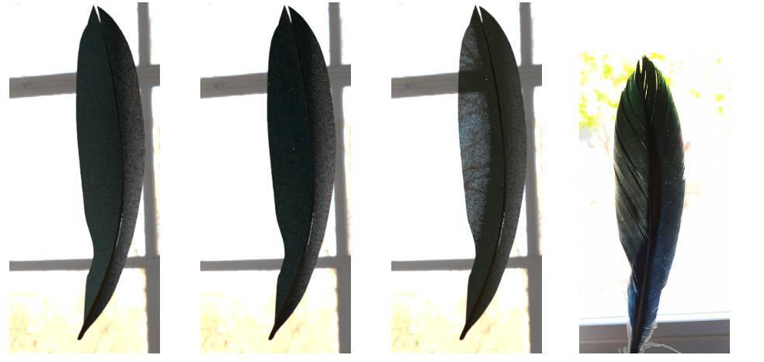
Results – Appearance Matching
Black Goose Feather
Masking Disabled
Masking Disabled
Masking Enabled
Photograph
Medulla Disabled
Medulla Enabled
Medulla Enabled

Slide 47
Results – Goniochromatic Effects
Feather Wing Relighting
Feather Rotation

Slide 48
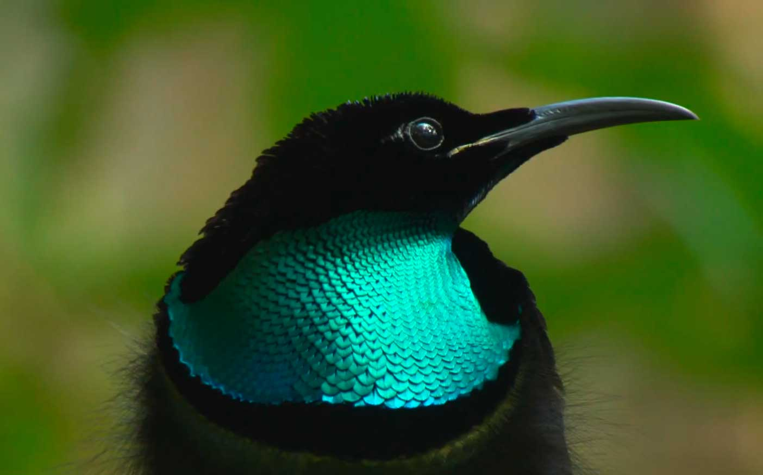
Limitations
We omit the shadowing term to simplified our feather BSDF
We cannot handle visible barbs and plumulaceous feathers
Our model ignore iridescent coloration as well as a more principled approach for diffuse structural coloration
A peacock feather
A paradise riffle bird
Notes:
Our model assumes far-field rendering of feathers, and thus is not able to capture the high frequency details of visible barbs, which are naturally handled by curve-based methods, which in the far field suffer aliasing. Extending our method to near-field appearance would require more sophisticated authored.
To simplify our BSDF we decided to omit the shadowing term, which intuitively has little effect in natural lighting conditions. This allows us to use a far-field integration of the BCSDF, instead of requiring integrating both the input and outgoing visible surfaces of the fibers, at the cost of removing some physical plausibility.
Our model omits important wave optical behavior, except for the structural coloration of the medulla, which we approximate as a diffuse reflection. Other effects such as the iridescence due to the grating-like structure of barbs and barbules, or the thin-film-like structure in barbules [HMC∗22] is omitted. Incorporating these effects, as well as a more principled definition of the medulla’s diffuse structural coloration is an interesting avenue for future work.
Photographs:
Peacock feather: https://pixabay.com/photos/peacock-feather-feather-1213066/
A rifle bird: https://academy.allaboutbirds.org/bird_biology-magnificent_riflebird_bird_of_paradise_iridescent_feather/

Slide 49
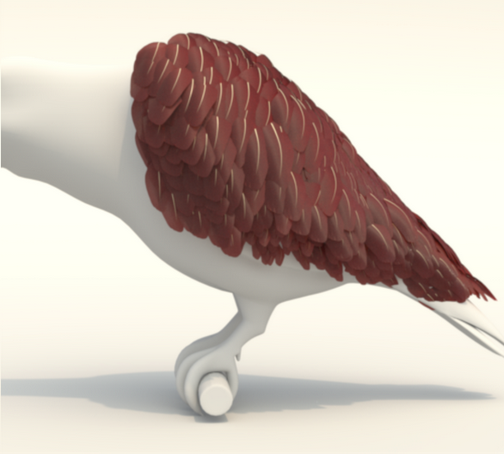
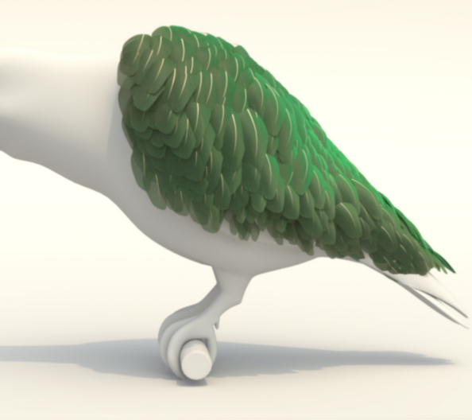
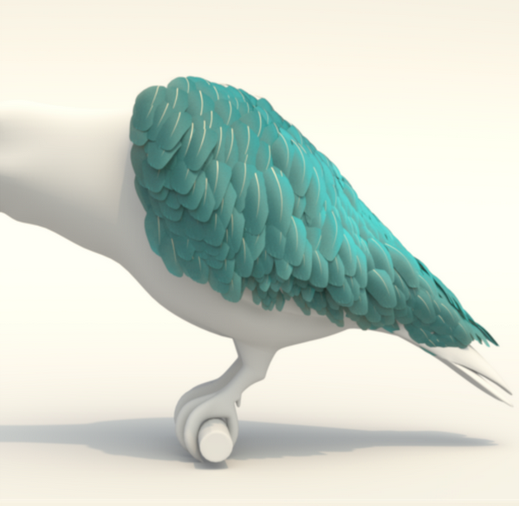
Conclusions
A reflectance model for pennaceous feather appearance
Texture-based representation practical for far field scenarios
Analytical masking term for barb and barbules
Non-iridesdecent structural coloration approximated with a diffuse medulla
Goniochromatic effects simulated with our masking term

Slide 50
https://graphics.unizar.es/projects/FeathersAppearance_2024/
Notes:
You can find more information on our project website by scanning the QR code or copying the url address on top.
And now I am happy to answer your questions.

Slide 51
Bibliography
[MJC∗03]: MARSCHNER S. R., JENSEN H. W., CAMMARANO M., WORLEY S., HANRAHAN P.: Light scattering from human hair fibers. ACM Trans. Graph. 22, 3 (jul 2003), 780–791.
[YTJR15]: YAN L.-Q., TSENG C.-W., JENSEN H. W., RAMAMOORTHI R.: Physically-accurate fur reflectance: Modeling, measurement and rendering. ACM Trans. Graph. 34, 6 (oct 2015)
[YJR17]: YAN L.-Q., JENSEN H. W., RAMAMOORTHI R.: An Efficient and Practical near and Far Field Fur Reflectance Model. ACM Trans. Graph. 36, 4 (2017).
[BDSP22]: BARON J., PATTERSON E.: Procedurally Generating Biologically Driven Feathers. Advances in Computer Graphics 11542 (2019), 342–348.
[HMC∗22]: HUANG W., MERZBACH S., CALLENBERG C., STAVENGA D., HULLIN M.: Rendering iridescent rock dove neck feathers. In ACM SIGGRAPH 2022 Conference Proceedings (New York, NY, USA, 2022).
[NLS∗10]: NOH H., LIEW S. F., SARANATHAN V., MOCHRIE S. G. J., PRUM R. O., DUFRESNE E. R., CAO H.: How noniridescent colors are generated by quasi-ordered structures of bird feathers. Advanced Materials 22, 26-27 (2010), 2871–2880.
[STLW11]: STAVENGA D. G., TINBERGEN J., LEERTOUWER H. L.,WILTS B. D.: Kingfisher feathers – colouration by pigments, spongy nanostructures and thin films. Journal of Experimental Biology 214, 23 (12 2011), 3960–3967.

Slide 52
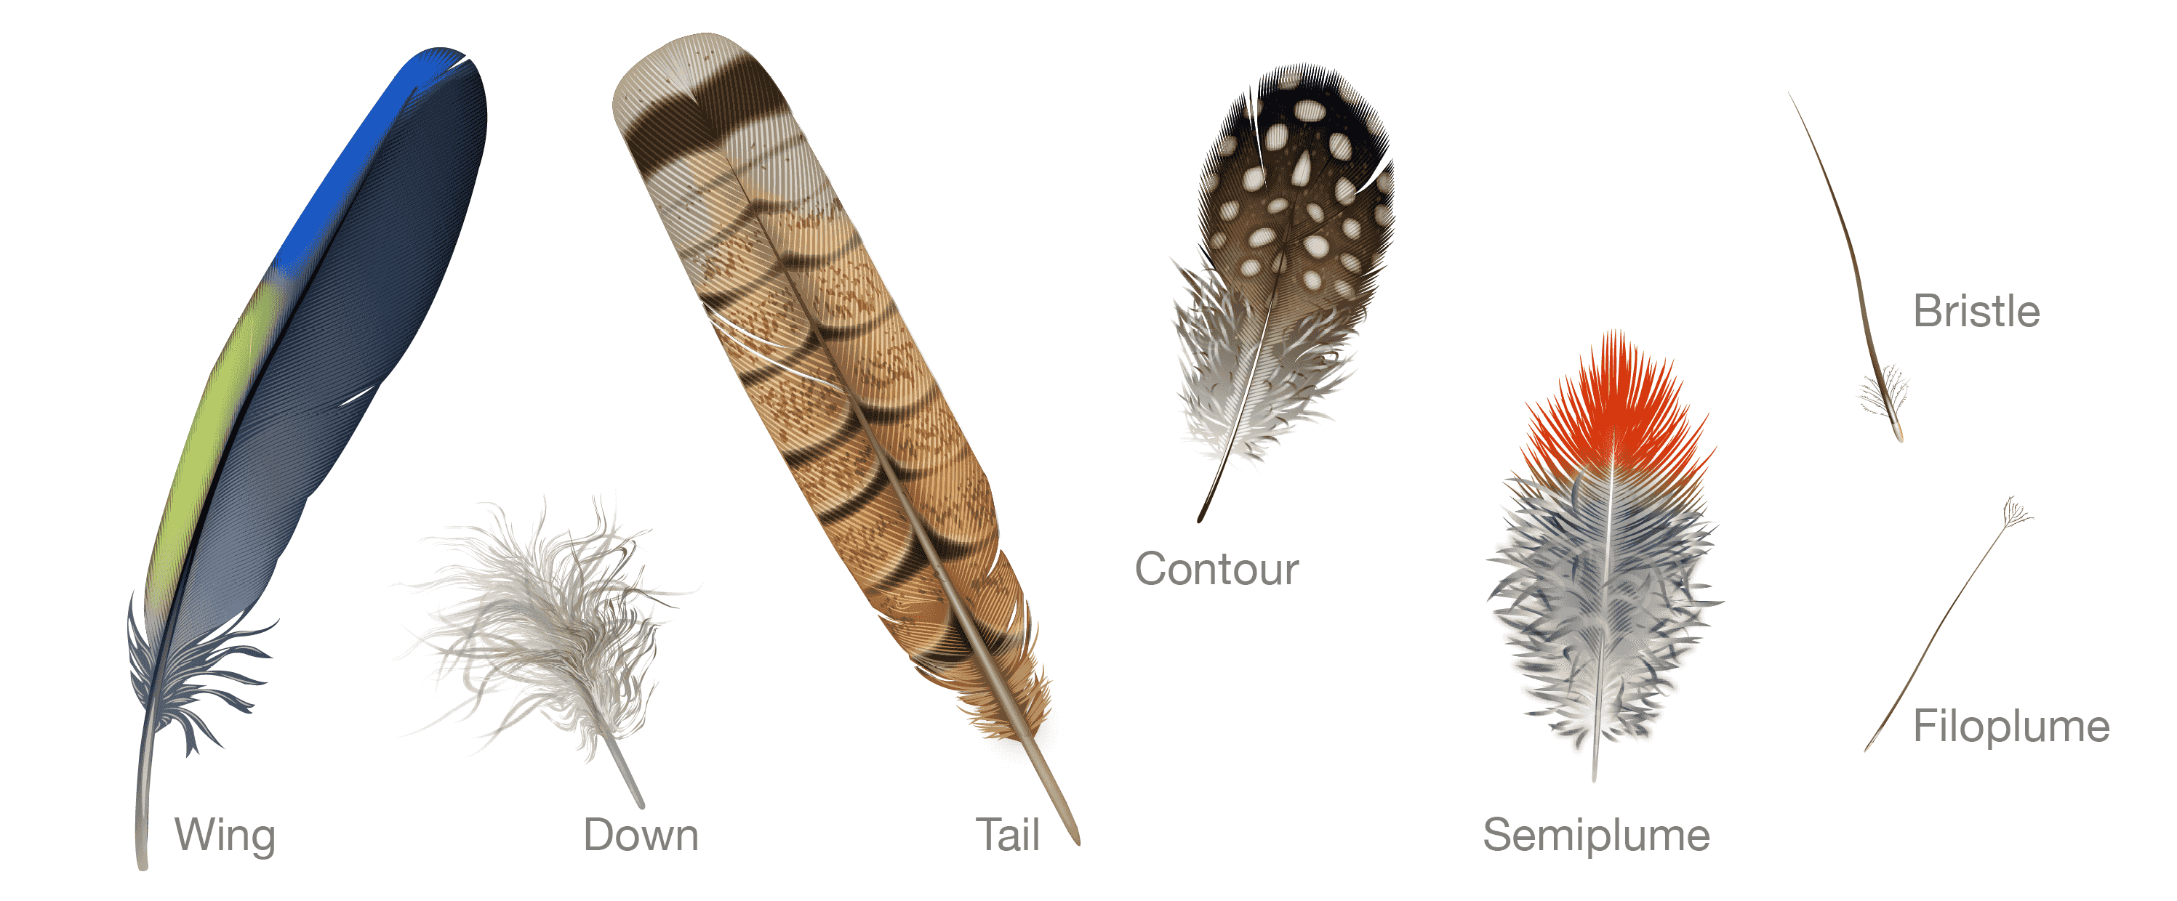
Feather Types
Source: Bird Academy (Cornel Lab)
Notes:
There are different feather types based on their structure and location on the bird’s body.
In this work, we focus on wing and tail feathers that are pennaceous feathers.

Slide 53
Model – Barb Parameters
Barb Parameters
Optical Parameters
$$σ_{c, a}$$
$$d_{m}$$
$$β_{m}$$
Longitudinal roughness of cortex
$$β_{n}$$
Azimuthal roughness of cortex
$$σ_{c, a}$$
Absorption coefficient in cortex
$$η_{c}$$
Refractive index of cortex
$a_{c}$ , $b_{c}$
Cortex semi-major/minor axis
$$σ_{m, a}$$
Absorption coefficient in medulla
Geometry Configuration
$$d_{m}$$
Diffuse reflectance of medulla
$$b_{c}$$
$$b_{m}$$
$c_{m, a}$ , $c_{m,b}$
$$η_{m}$$
Refractive index of medulla
$a_{m}$ , $b_{m}$
Medulla semi-major/minor axis
$c_{m, a}$ , $c_{m,b}$
Medulla center

Slide 54
Fiber Scattering – BCSDF
Our approach: numerical 3D path tracing with non-separable lobes
Flexible to arbitrary fiber shapes
Barbule
Longitudinal View
Azimuthal View
R
TRT
R
TRRT
Cortex
h
TT
TT
TRRT
TRT
Single cylinder model [YTJR15]

Slide 55
Fiber Scattering – BCSDF
Our approach: numerical path tracing with non-separable lobes
Flexible to arbitrary fiber shapes
Barb
Longitudinal View
Azimuthal View
Diffuse Medulla
R
TdT
TrRrt
TrRrRT
TrT
Cortex
R
TrRrt
TrRrRT
h
Single cylinder model [YTJR15]

Slide 56
Fiber Scattering – Ablation Study
Circular Cortex
Elliptical Cortex
Concentric Medulla
Non-concentric Medulla

Slide 57
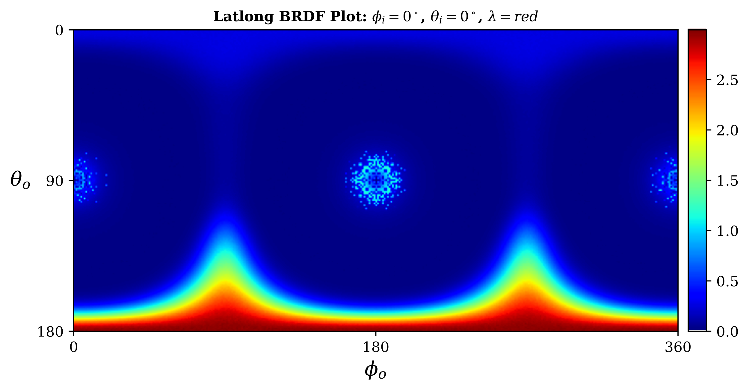
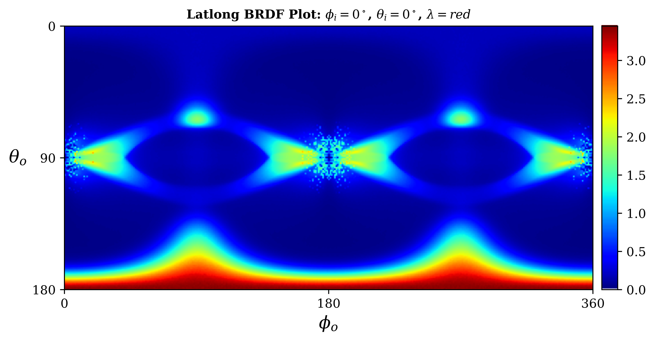
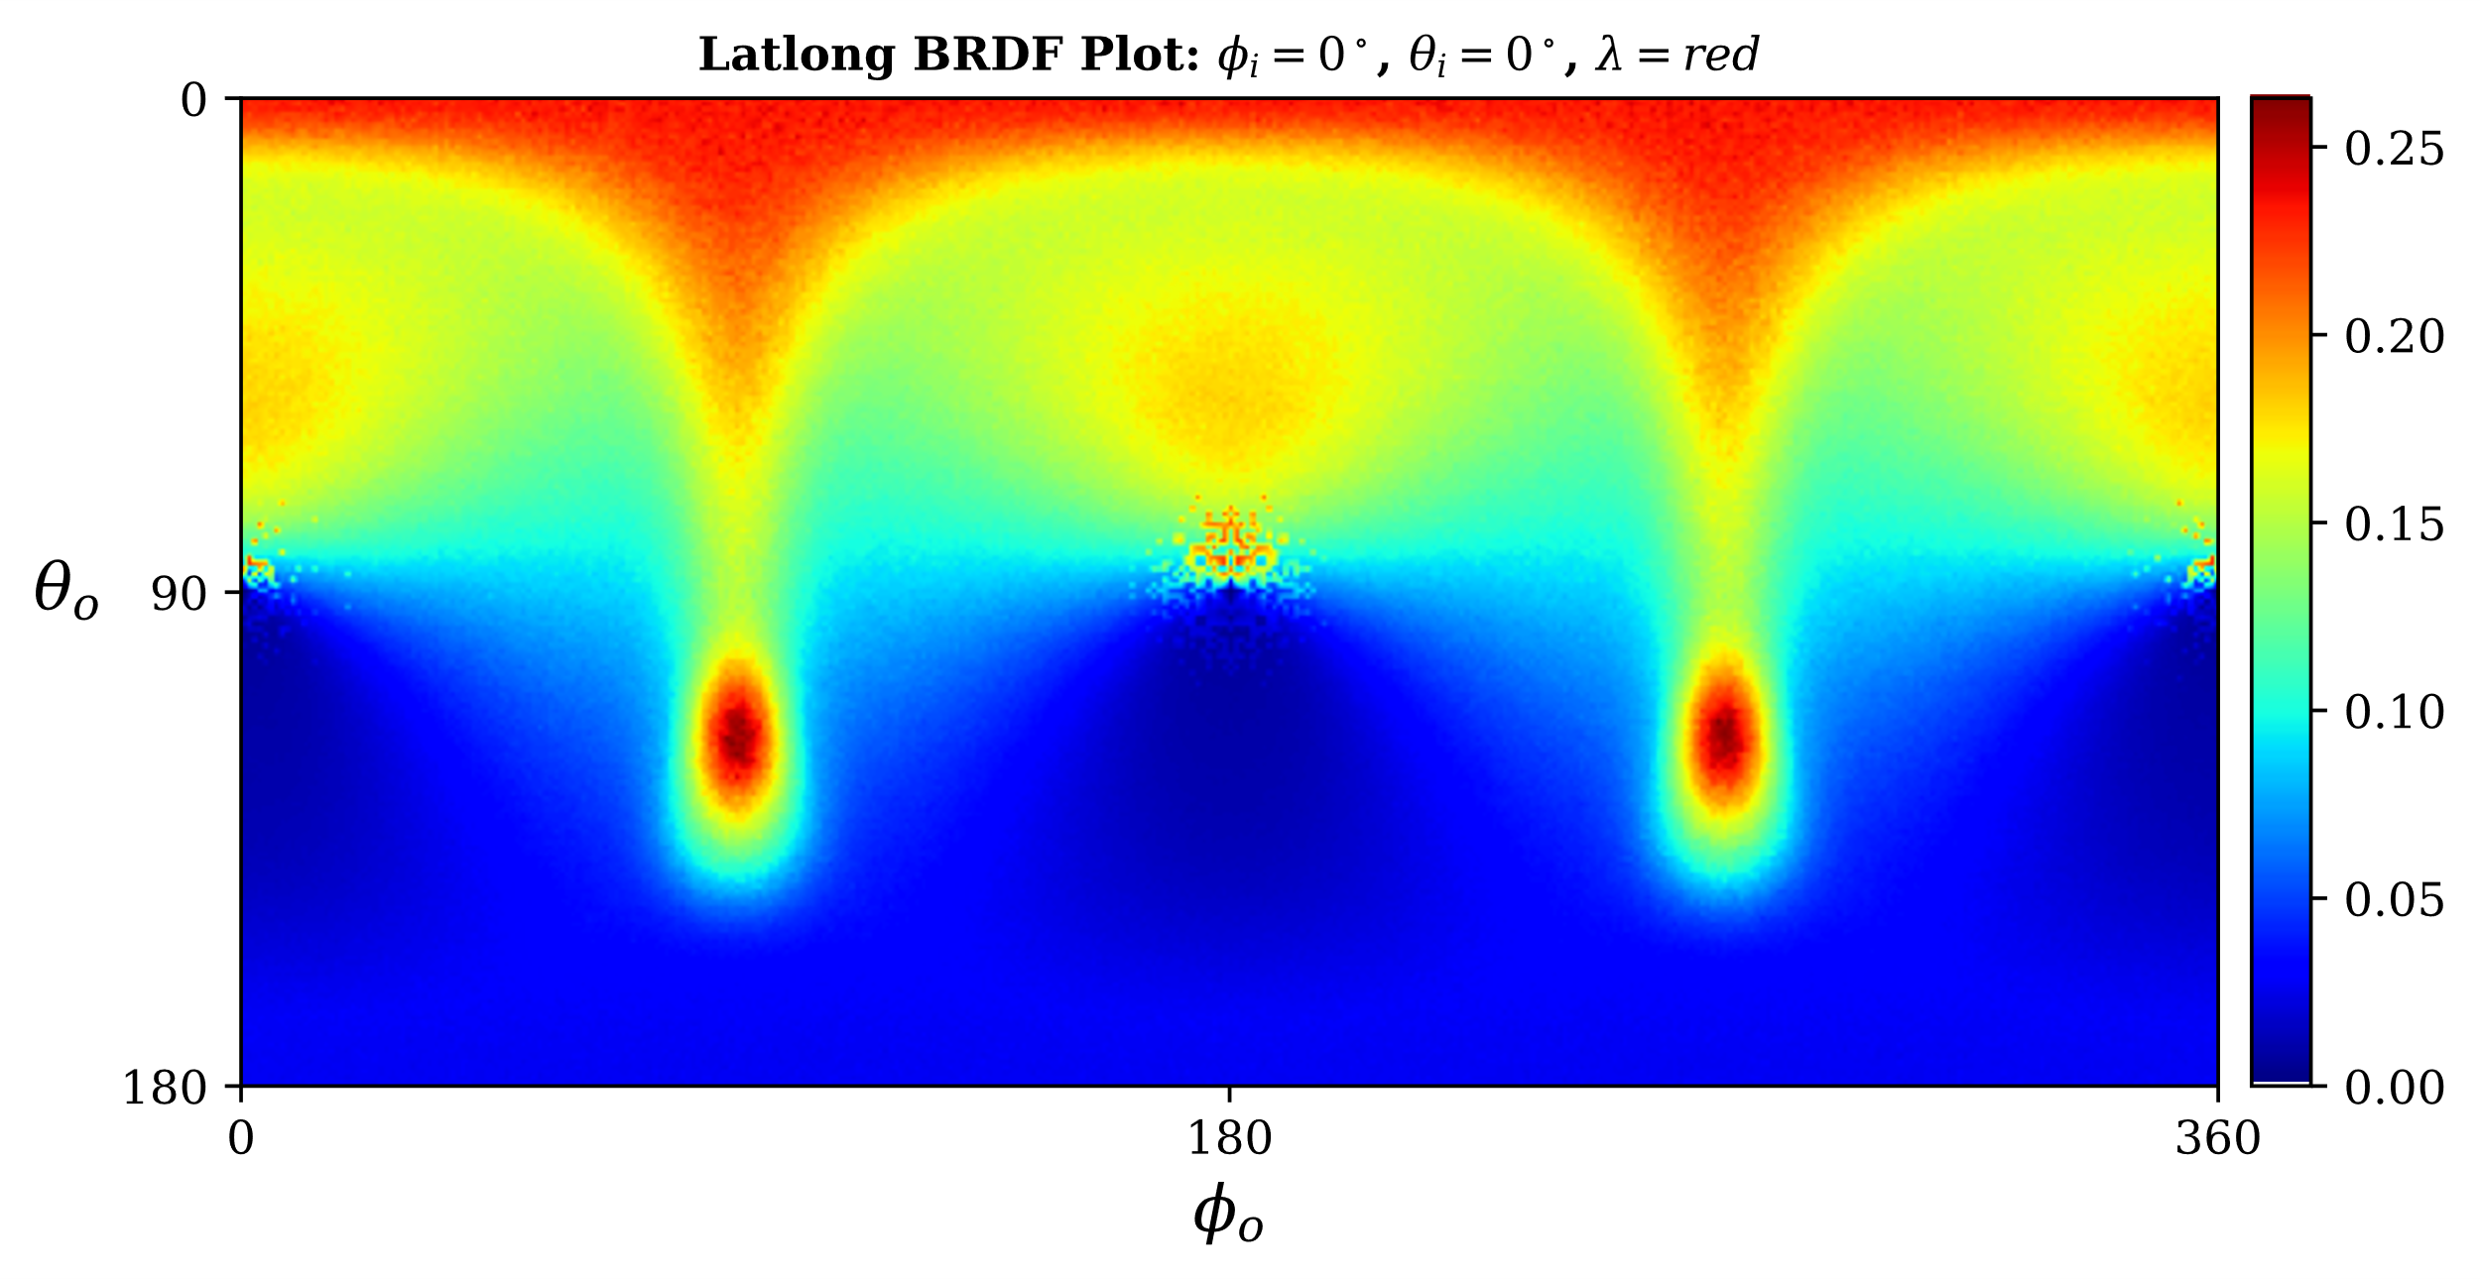
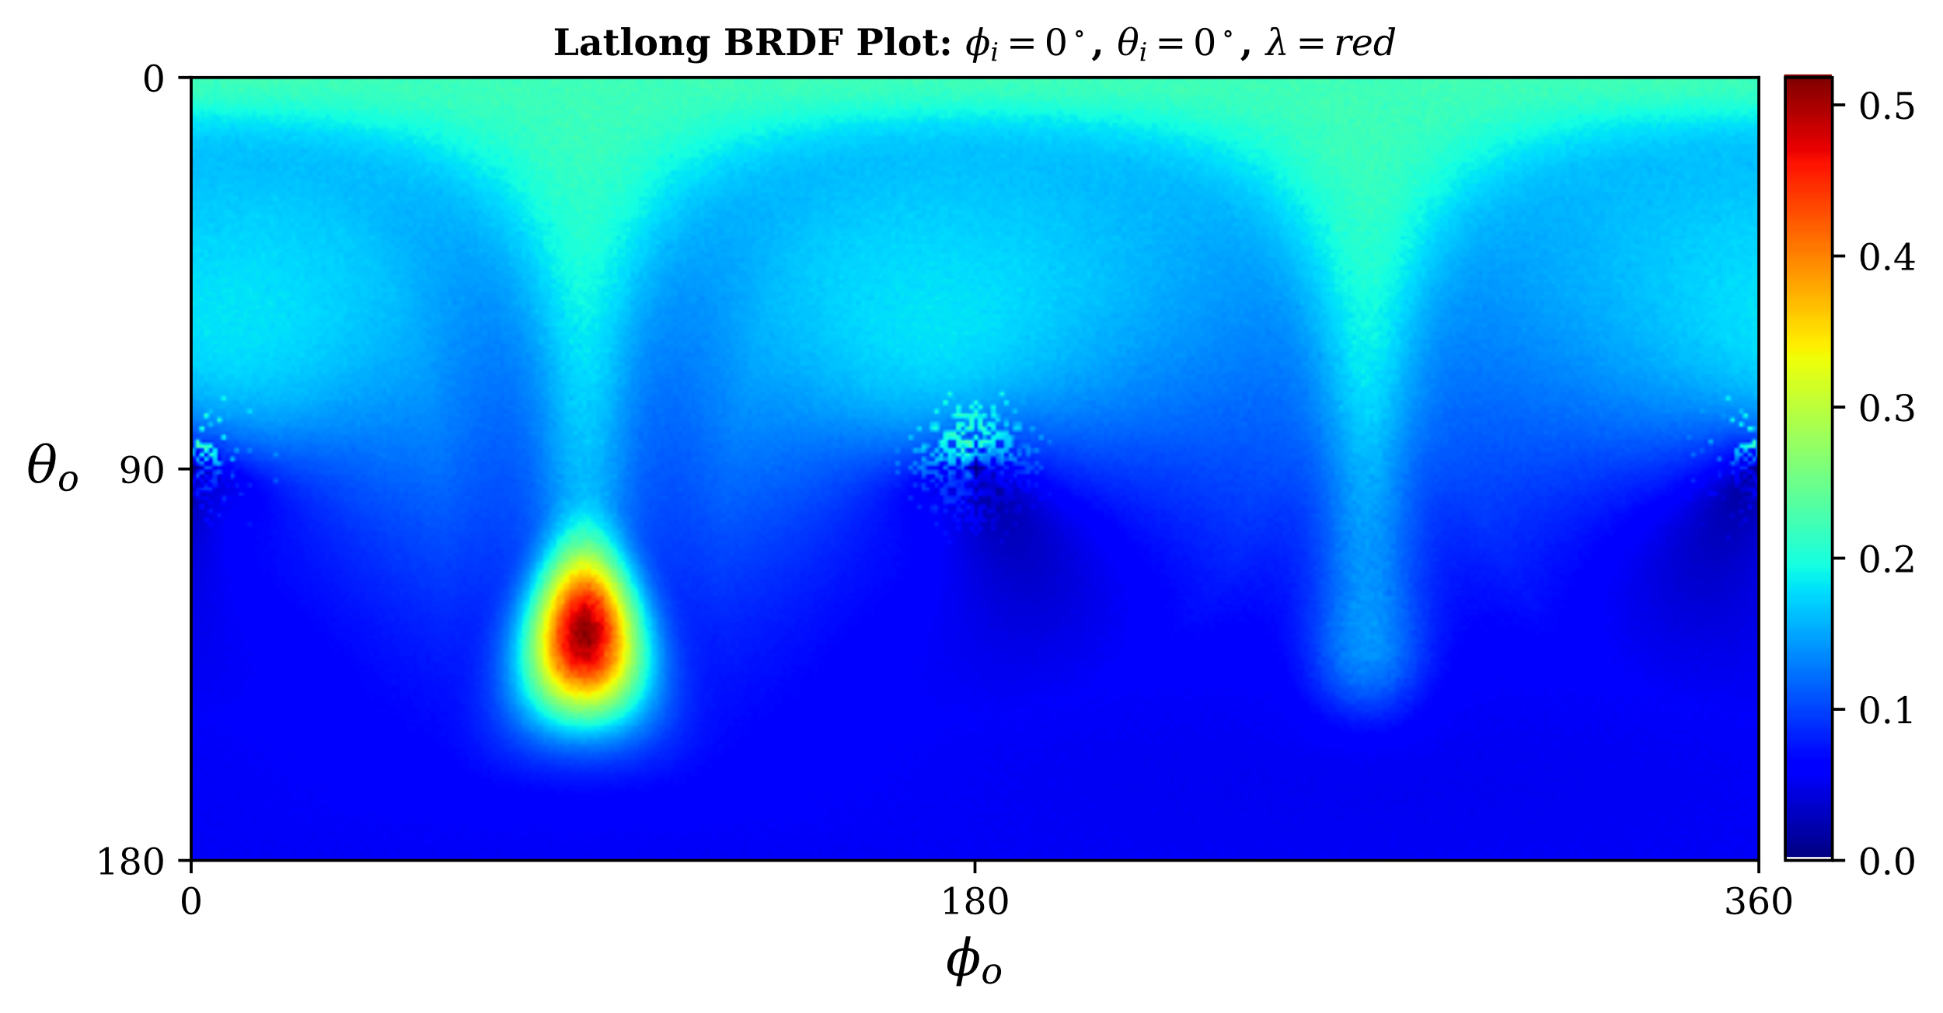
Fiber Scattering – Ablation Study
Circular Cortex
Elliptical Cortex
Concentric Medulla
Non-concentric Medulla

Slide 58
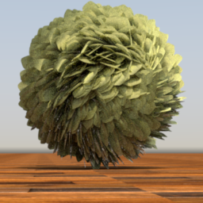
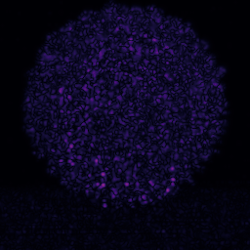
Fiber Scattering – Number of Lobes
How many lobes do we need? Roughly Five lobes
5 lobes
1000 lobes
Flip Error
Single cylinder model [YTJR15]
Notes:
How many lobes do we need? Five lobes seems to a reasonable tradeoff between accuracy and computation as we can see with the FLIP error between collecting 5 and 1000 lobes.

Slide 59
Model – Masking Parameters
$$l_{bb}$$
Masking Parameters
$$ϕ_{b}$$
Azimuthal barb angle
$$ϕ_{bb}$$
Azimuthal barbule angle
$$θ_{bb}$$
Longitudinal barbule angle
$$δ_{bb}$$
Barbule separation
$$θ_{bb}$$
$$l_{bb}$$
Barbule length
$$δ_{bb}$$
$$δ_{bb}$$

Slide 60
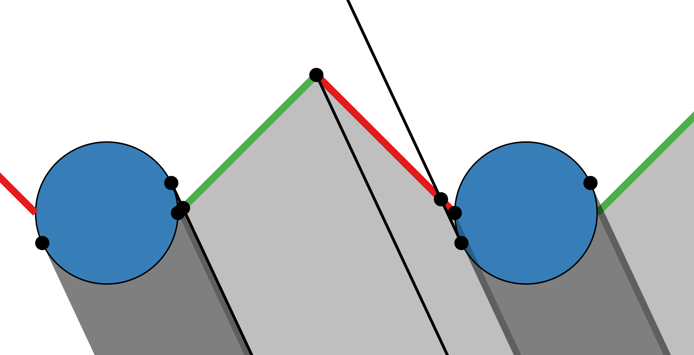
Masking – Barbs
Barb eccentricity affects the projected area
Notes:
The barb eccentricity affects the final projected area as we can see in these example where we increase the minor axis of the barb cross section

Slide 61
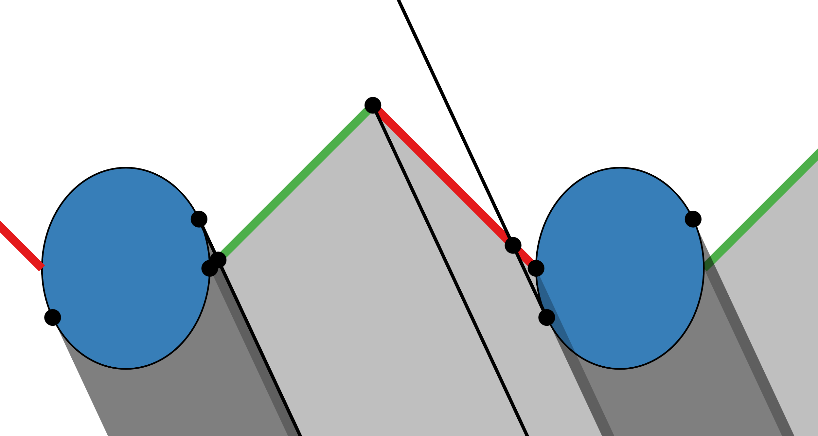
Masking – Barbs
Barb eccentricity affects the projected area
Notes:
The barb eccentricity affects the final projected area as we can see in these example where we increase the minor axis of the barb cross section

Slide 62
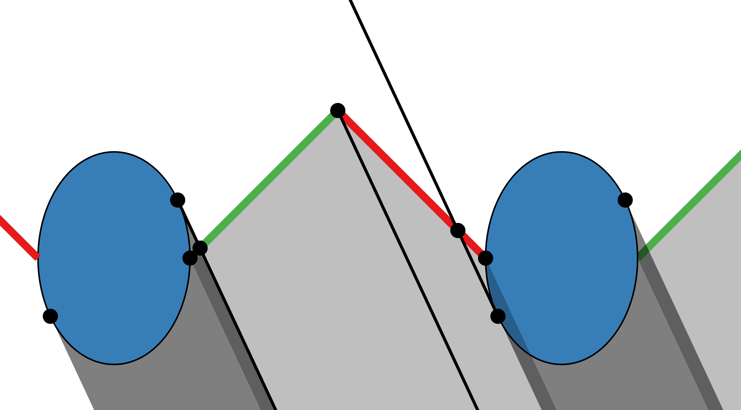
Masking – Barbs
Barb eccentricity affects the projected area
Notes:
The barb eccentricity affects the final projected area as we can see in these example where we increase the minor axis of the barb cross section

Slide 63
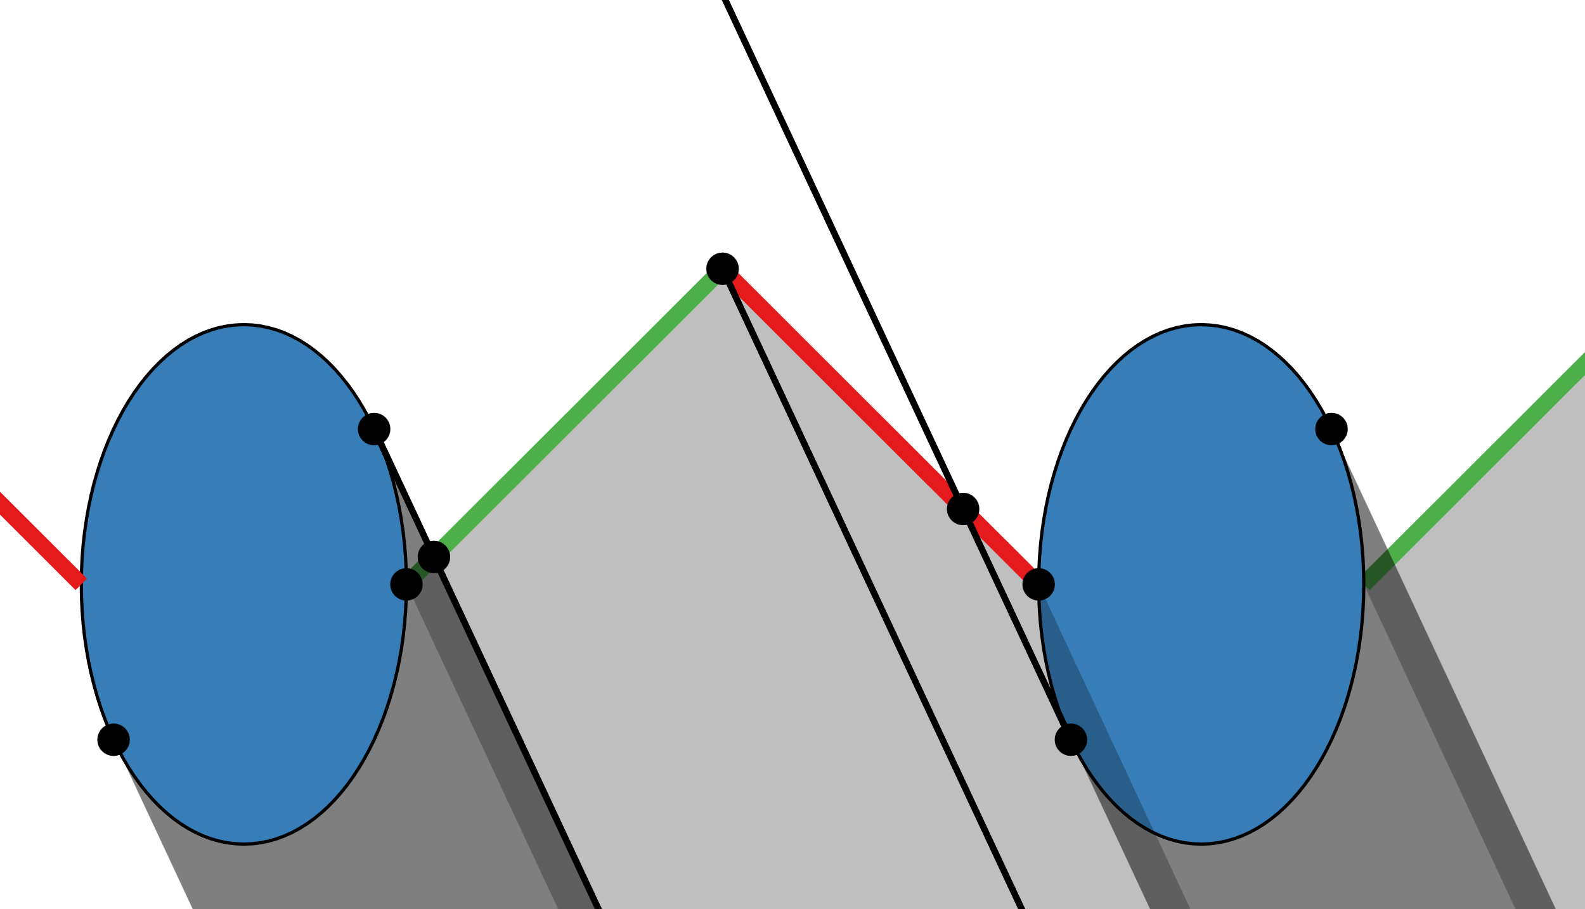
Masking – Barbs
Barb eccentricity affects the projected area
Notes:
The barb eccentricity affects the final projected area as we can see in these example where we increase the minor axis of the barb cross section

Slide 64
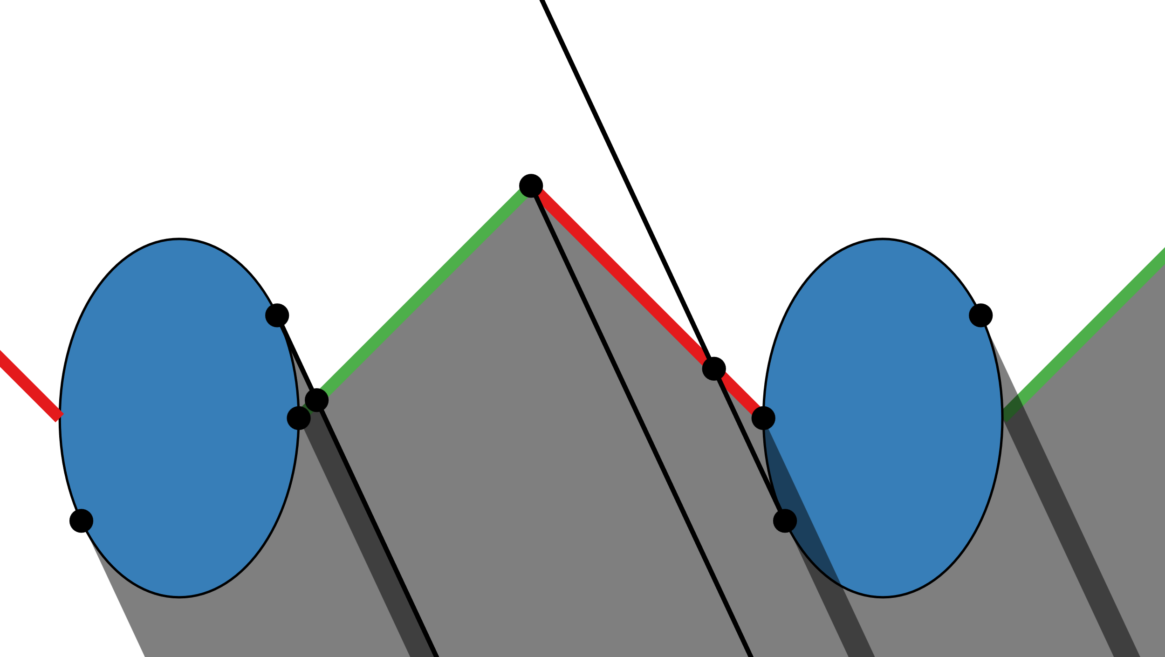
Masking – Barbs
Barbule partial transparency affects the transmitted radiance
Notes:
The barbule partial transparency derived from the configuration of the barbules affects the transmitted radiance as we can see in the following examples where we increase the transparency

Slide 65
Masking – Barbs
Barbule partial transparency affects the transmitted radiance
Notes:
The barbule partial transparency derived from the configuration of the barbules affects the transmitted radiance as we can see in the following examples where we increase the transparency

Slide 66
Masking – Barbs
Barbule partial transparency affects the transmitted radiance
Notes:
The barbule partial transparency derived from the configuration of the barbules affects the transmitted radiance as we can see in the following examples where we increase the transparency

Slide 67
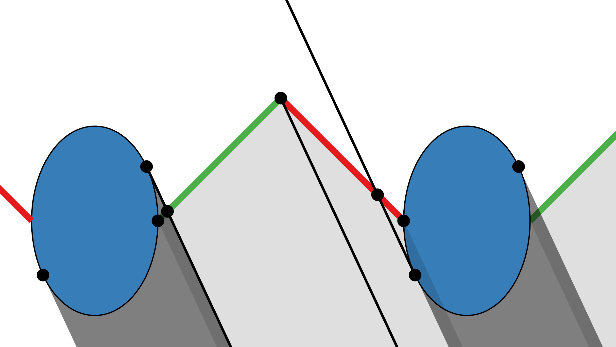
Masking – Barbs
Barbule partial transparency affects the transmitted radiance
Notes:
The barbule partial transparency derived from the configuration of the barbules affects the transmitted radiance as we can see in the following examples where we increase the transparency

Slide 68
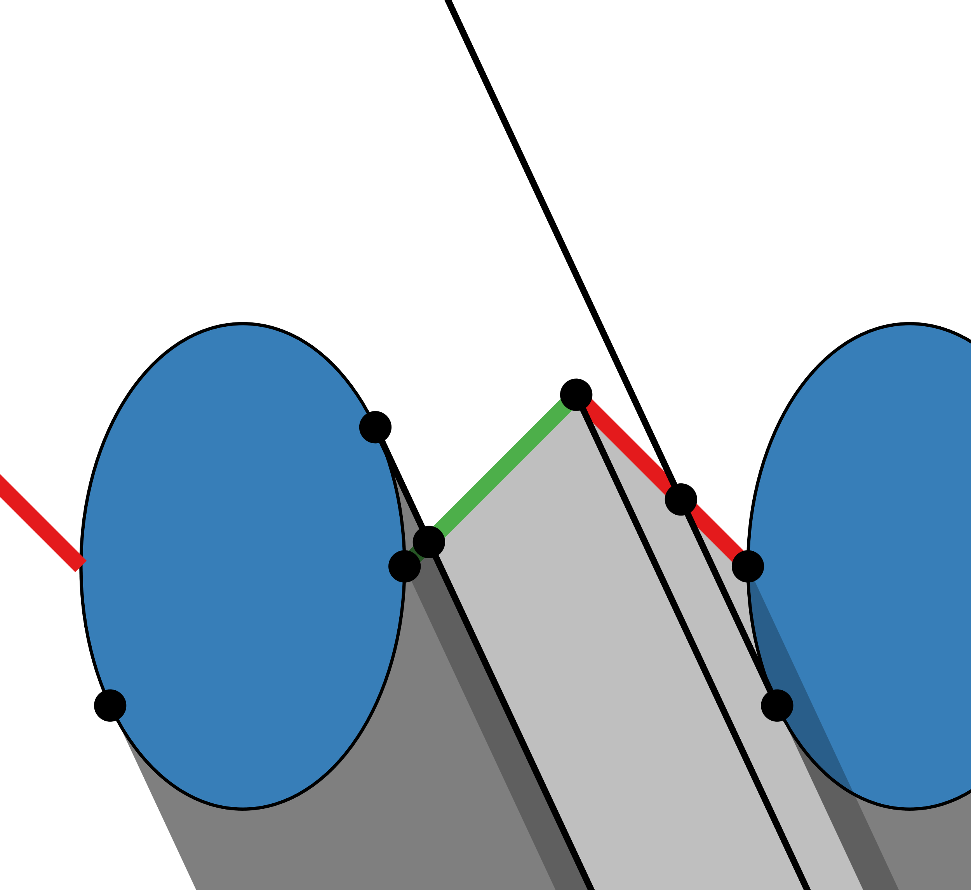
Masking – Barbs
Barbule length affects the barbules’ projected area
Notes:
The larger the barbule length, the larger is the projected area of the barbule as we can in the following example where we increase the barbule length

Slide 69
Masking – Barbs
Barbule length affects the barbules’ projected area
Notes:
The larger the barbule length, the larger is the projected area of the barbule as we can in the following example where we increase the barbule length

Slide 70
Masking – Barbs
Barbule length affects the barbules’ projected area
Notes:
The larger the barbule length, the larger is the projected area of the barbule as we can in the following example where we increase the barbule length

Slide 71
Masking – Barbs
Barbule inclination affects the barbules’ projected area
Notes:
The barbule inclination affect the projected area of the distal and proximal barbules as we can see in this example where we increase the barbule inclination from 0 to 45 degrees

Slide 72
Masking – Barbs
Barbule inclination affects the barbules’ projected area
Notes:
The barbule inclination affect the projected area of the distal and proximal barbules as we can see in this example where we increase the barbule inclination from 0 to 45 degrees

Slide 73
Masking – Barbs
Barbule inclination affects the barbules’ projected area
Notes:
The barbule inclination affect the projected area of the distal and proximal barbules as we can see in this example where we increase the barbule inclination from 0 to 45 degrees

Slide 74
Masking – Barbs
Barbule inclination affects the barbules’ projected area
Notes:
The barbule inclination affect the projected area of the distal and proximal barbules as we can see in this example where we increase the barbule inclination from 0 to 45 degrees

Slide 75
Masking – Barbules
View-dependent projected areas
Occlusions limits are identified by tracing 2D rays
View Angle 25° (No Occlusion)
View Angle 75° (Occlusion)
Notes:
Masking between two barbules at different view inclinations. Barbules (and their projected area) are marked in green. The barbule separation and traced rays are shown as yellow and black segments respectively.
Detail explanation
We first trace a ray from the tangent point pt1, generating two cases: If it intersects the other ellipse (70 o case) we need to intersect the ellipse’s diameter to identify pd and therefore h−. The separation (transparency) cannot be seen (w′ bb = 1).
If it does not intersect the other ellipse (25o case) then we need to intersect the separation segment with two tangent rays. We then calculate the local barbule weight w′ bb from the projected areas abb and as.

Slide 76
Masking – Barbules
Barbule eccentricity affects the barbules ’ projected area
Notes:
The barbule eccentricity similar to barb eccentricity affects the final projected area as we can see in these example where we increase the minor axis of the barbule cross section

Slide 77
Masking – Barbules
Barbule eccentricity affects the barbules ’ projected area
Notes:
The barbule eccentricity similar to barb eccentricity affects the final projected area as we can see in these example where we increase the eccentricity

Slide 78
Masking – Barbules
Barbule eccentricity affects the barbules’ projected area
Notes:
The barbule eccentricity similar to barb eccentricity affects the final projected area as we can see in these example where we increase the eccentricity

Slide 79
Masking – Validation
Validation against Monte Carlo simulation (100 spp) with a full explicitly modeled microgeometry
The colormap represents the weights of the different microgeometrical components
Notes:
Note how our analytical masking expression can obtain a noiseless result in a minimal fraction of the time (constant) while being accurate with respect to a fully modeled microgeometry

Slide 80
Results – Ablation Studies
Resembles northern cardinal appearance (wing)
Only masking scenario is comparable to [BDSP22] (second row)
Photograph
Masking Disabled, Medulla Disabled
Masking Enabled, Medulla Disabled
Masking Enabled, Medulla Enabled

