Slide 1





Zero-Phase Phasor Fields for Non-Line-of-Sight Imaging
International Conference on Computational Photography 2025
Toronto, Canada, July 21-23
Pablo Luesia-Lahoz, Talha Sultan, Forrest B. Peterson, Andreas Velten, Diego Gutierrez, Adolfo Muñoz

Slide 2
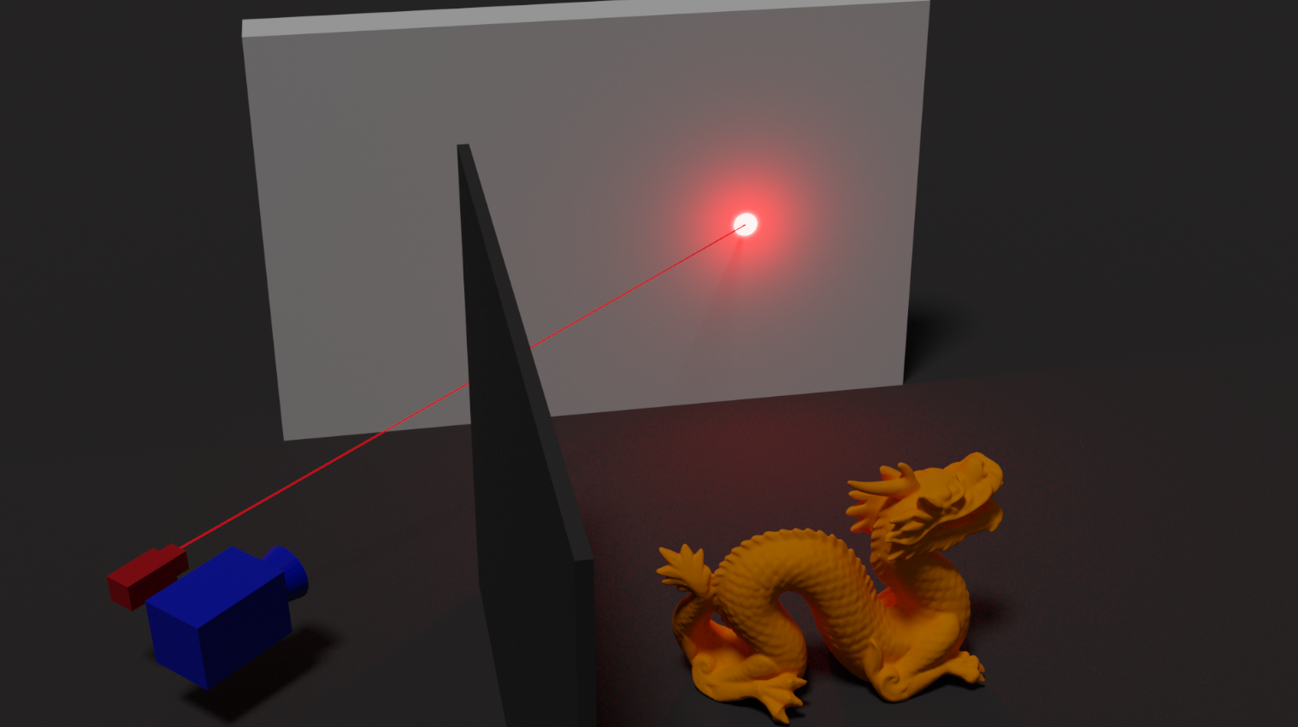
Introduction
Notes:
This is a common NLOS setup, and our target is to image this dragon around a corner

Slide 3
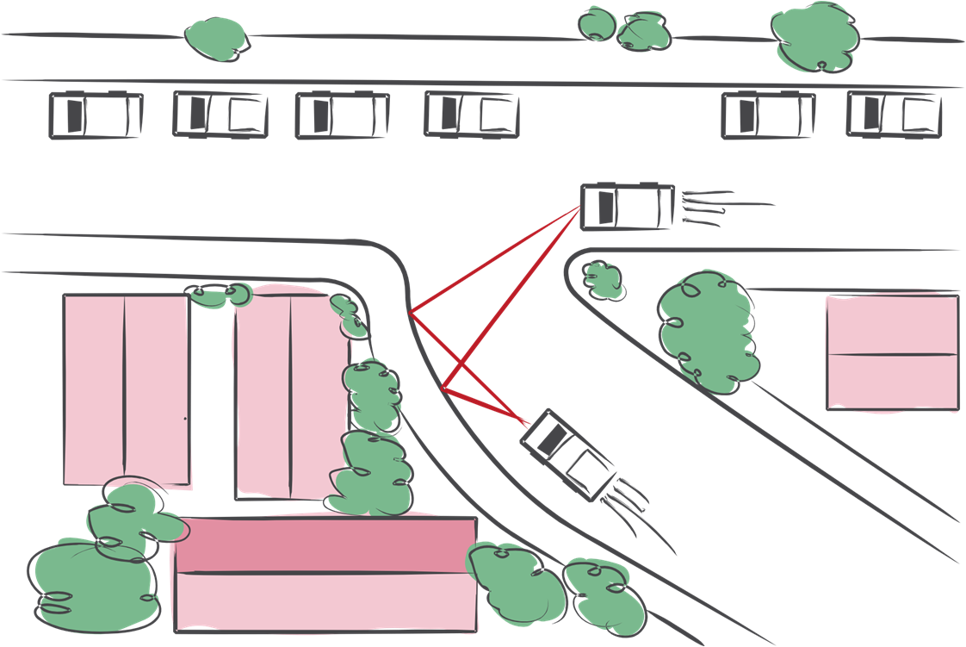
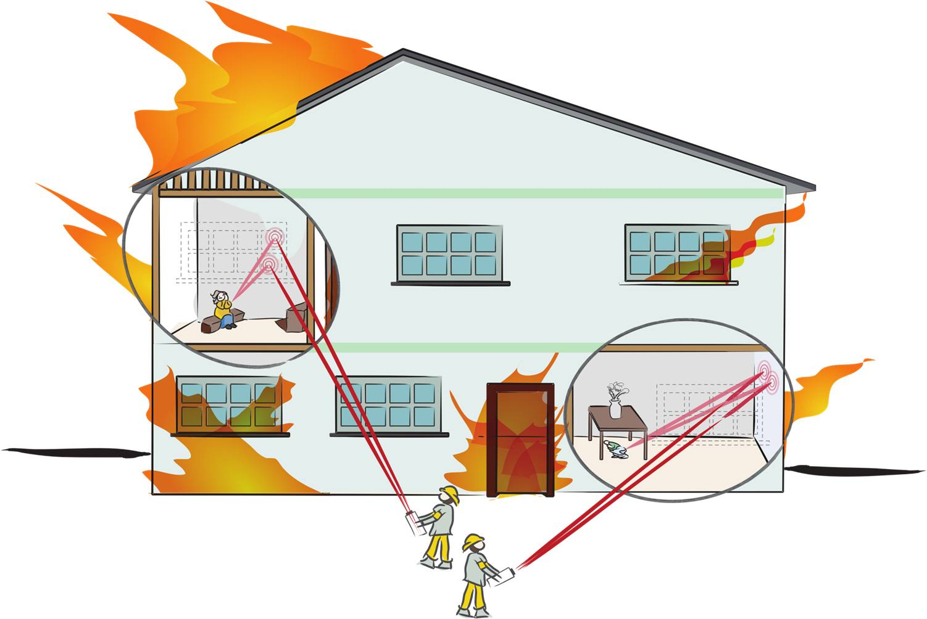
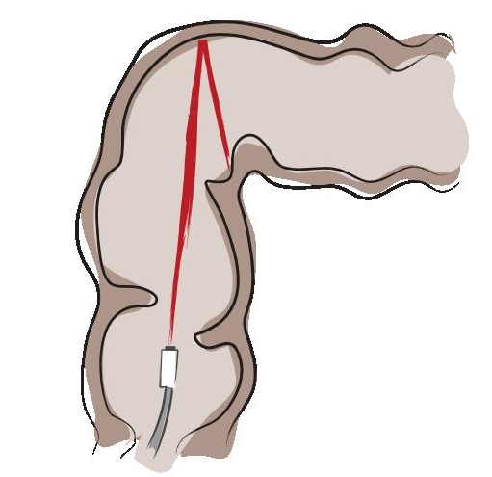
NLOS Imaging applications
Driving safety
Rescue operations
Medical imaging
Figures adapted from previous work [7]
[7] Maeda, T., Satat, G., Swedish, T., Sinha, L., & Raskar, R. (2019). Recent advances in imaging around corners. arXiv preprint arXiv:1910.05613.

Slide 4
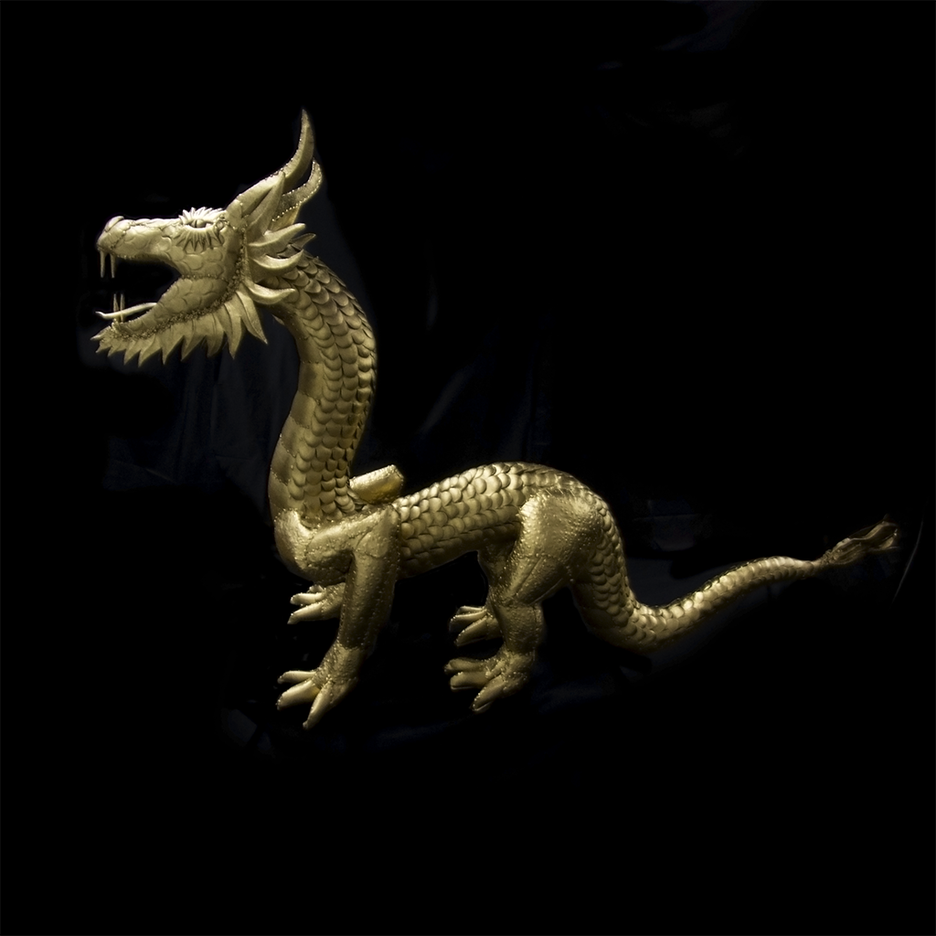
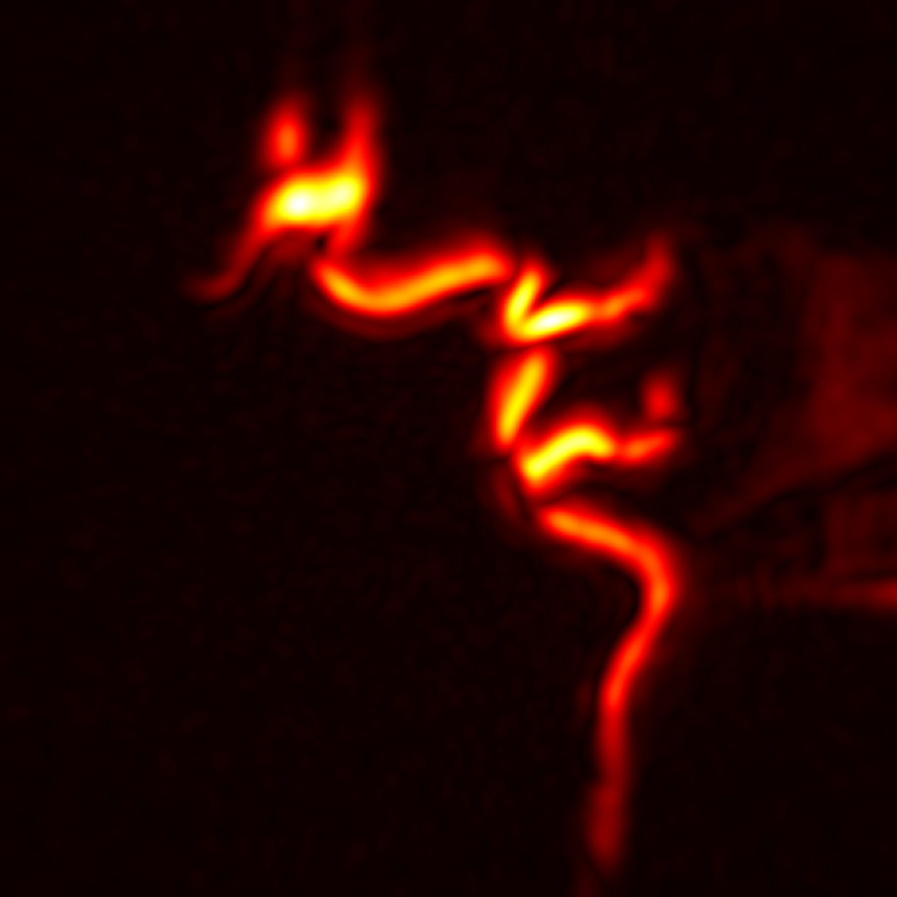
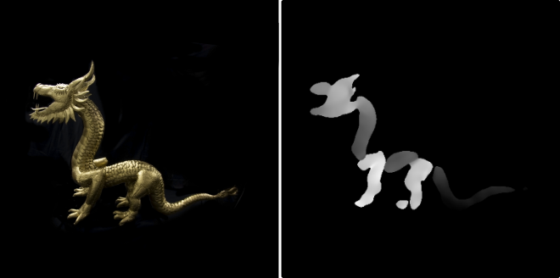
Introduction
Hidden scene
Imaged dragon
Correct depth
2’ 1''
14h 54’ 55''
Dataset from Lindell et al. 2019
Notes:
Previous NLOS have promising results
But struggles estimating depth precisely, requiring a lot of time
Our ZPPF estimates high depth precision, in efficient time

Slide 5
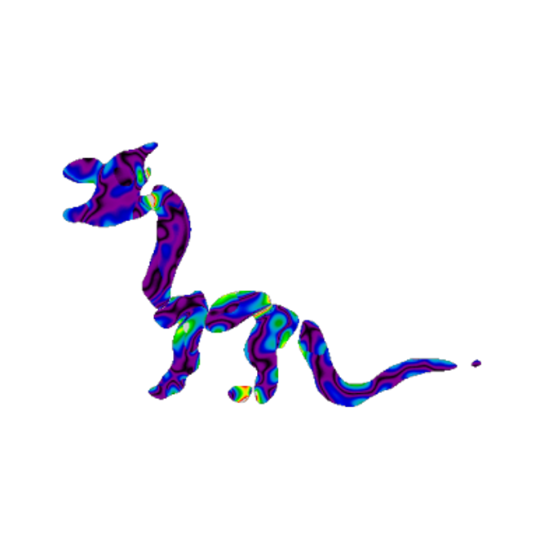
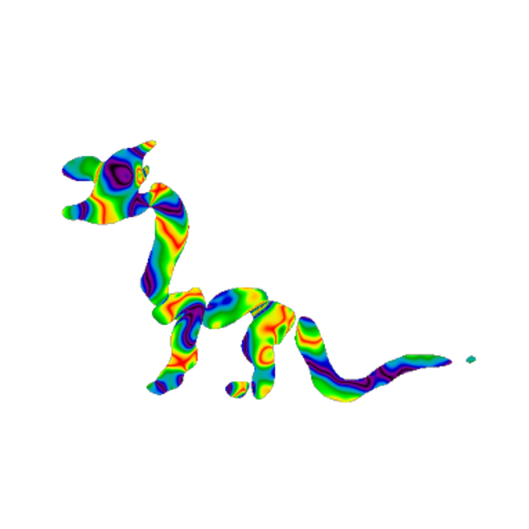
Introduction
Ours error in depth
Error in depth
Correct depth
2’ 1''
14h 54’ 55''
Dataset from Lindell et al. 2019
Notes:
Previous NLOS have promising results
But struggles estimating depth precisely, requiring a lot of time
Our ZPPF estimates high depth precision, in efficient time

Slide 6
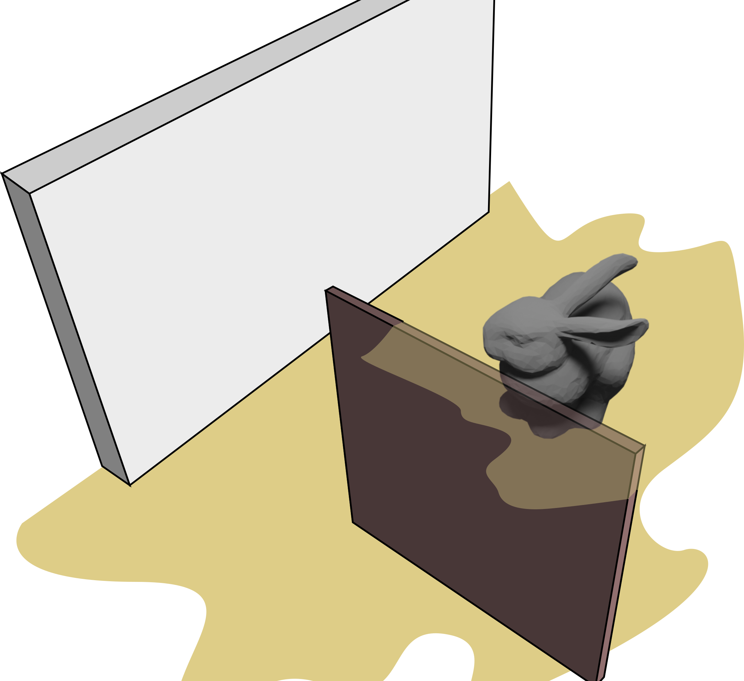

Non-Line-of-Sight (NLOS) Imaging
Relay wall
NLOS principle:
analyze the indirect illumination that reaches visible surfaces (relay wall).
Hidden scene
Occluder

Slide 7
Non-Line-of-Sight (NLOS) Imaging
Relay wall
Hidden scene
Occluder

Slide 8
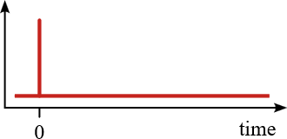

Non-Line-of-Sight (NLOS) Imaging
Light emitted
Ultra-fast laser

Slide 9
Non-Line-of-Sight (NLOS) Imaging
Light emitted

Slide 10

Non-Line-of-Sight (NLOS) Imaging
Light emitted

Slide 11
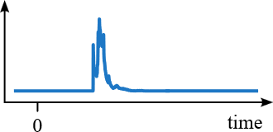
Non-Line-of-Sight (NLOS) Imaging
Confocal capture
Transient imaging: picosecond resolution; captures light in motion
Captured signal
Ultra-fast camera
Notes:
Our ultrafast camera focus on same point.
So in this work we focus in confocal capture configuration.

Slide 12
Non-Line-of-Sight (NLOS) Imaging
We capture a grid of points.

Slide 13
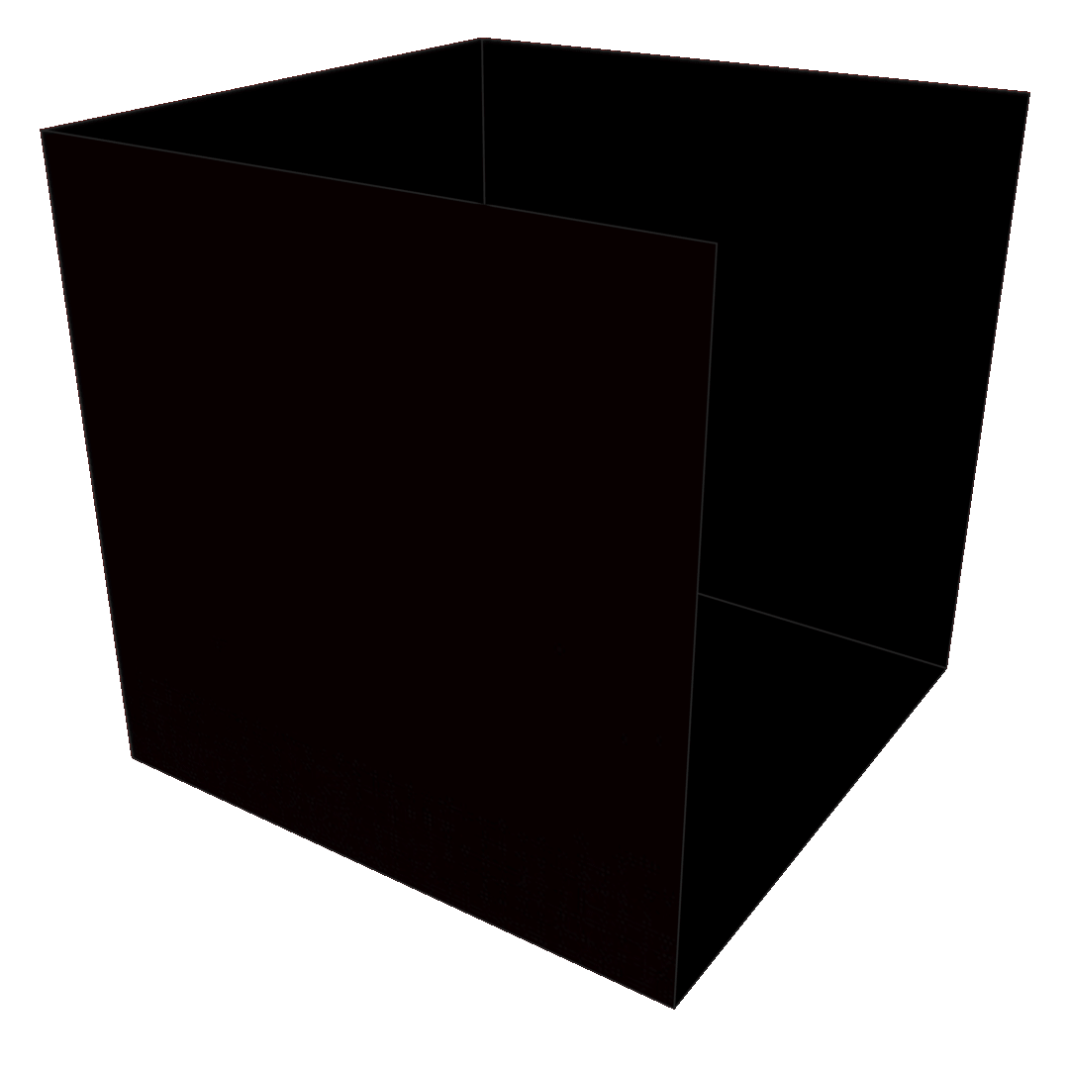
Non-Line-of-Sight (NLOS) Imaging
We capture a grid of points.
y
How to employ this?
x
Captured signal
y
time
x

Slide 14
Non-Line-of-Sight (NLOS) Imaging
NLOS methods
Filtered Back Projection [1]
Light Cone Transform [2]
F-K migration [3]
Fermat Paths [4]
Phasor Fields formulation [5]
Etc. Etc
y
x
Previous method struggle finding small depth variations in meter scale scenes
[5] Liu, X., Guillén, I., La Manna, M., Nam, J. H., Reza, S. A., Huu Le, T., ... & Velten, A. (2019). Non-line-of-sight imaging using phasor-field virtual wave optics. Nature, 572(7771), 620-623.
[4] Xin, S., Nousias, S., Kutulakos, K. N., Sankaranarayanan, A. C., Narasimhan, S. G., & Gkioulekas, I. (2019). A theory of fermat paths for non-line-of-sight shape reconstruction. In Proceedings of the IEEE/CVF conference on computer vision and pattern recognition (pp. 6800-6809).
[3] Lindell, D. B., Wetzstein, G., & O'Toole, M. (2019). Wave-based non-line-of-sight imaging using fast fk migration. ACM Transactions on Graphics (ToG), 38(4), 1-13.
[2] O’Toole, M., Lindell, D. B., & Wetzstein, G. (2018). Confocal non-line-of-sight imaging based on the light-cone transform. Nature, 555(7696), 338-341.
[1] Velten, A., Willwacher, T., Gupta, O., Veeraraghavan, A., Bawendi, M. G., & Raskar, R. (2012). Recovering three-dimensional shape around a corner using ultrafast time-of-flight imaging. Nature communications, 3(1), 745.

Slide 15
Non-Line-of-Sight (NLOS) Imaging
NLOS methods
Filtered Back Projection [1]
Light Cone Transform [2]
F-K migration [3]
Fermat Paths [4]
Phasor Fields formulation [5]
Etc. Etc
y
x

Slide 16
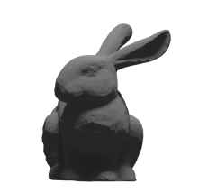
NLOS Imaging Methods
NLOS methods
Filtered Back Projection [1]
Light Cone Transform [2]
F-K migration [3]
Fermat Paths [4]
Phasor Fields formulation [5]
Etc. Etc
[5] Liu, X., Guillén, I., La Manna, M., Nam, J. H., Reza, S. A., Huu Le, T., ... & Velten, A. (2019). Non-line-of-sight imaging using phasor-field virtual wave optics. Nature, 572(7771), 620-623.
[4] Xin, S., Nousias, S., Kutulakos, K. N., Sankaranarayanan, A. C., Narasimhan, S. G., & Gkioulekas, I. (2019). A theory of fermat paths for non-line-of-sight shape reconstruction. In Proceedings of the IEEE/CVF conference on computer vision and pattern recognition (pp. 6800-6809).
[3] Lindell, D. B., Wetzstein, G., & O'Toole, M. (2019). Wave-based non-line-of-sight imaging using fast fk migration. ACM Transactions on Graphics (ToG), 38(4), 1-13.
[2] O’Toole, M., Lindell, D. B., & Wetzstein, G. (2018). Confocal non-line-of-sight imaging based on the light-cone transform. Nature, 555(7696), 338-341.
[1] Velten, A., Willwacher, T., Gupta, O., Veeraraghavan, A., Bawendi, M. G., & Raskar, R. (2012). Recovering three-dimensional shape around a corner using ultrafast time-of-flight imaging. Nature communications, 3(1), 745.

Slide 17
NLOS Imaging Methods
NLOS methods
Filtered Back Projection [1]
Light Cone Transform [2]
F-K migration [3]
Fermat Paths [4]
Phasor Fields formulation [5]
Etc. Etc

Slide 18
Background: The Phasor Fields Formulation
Lateral view of the setup
y
Relay wall
Hidden scene

Slide 19
Background: The Phasor Fields Formulation
Illumination and capture points

Slide 20
Background: The Phasor Fields Formulation
Captured signal
Notes:
Lets take the captured signal of this point

Slide 21
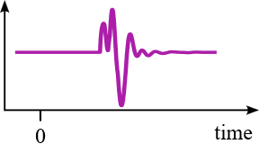
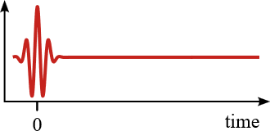
Background: The Phasor Fields Formulation
Captured signal
Virtual phasor
Virtual Gaussian wave packet
*
Notes:
Virtual Gaaussian wave packet modulate the capture
Result is a Virtual phasor

Slide 22
The Phasor Fields Formulation
Captured signal
Virtual phasor:
Scene as lit with the Gaussian wave packet
Virtual phasor
Virtual Gaussian wave packet
*
Notes:
Virtual Gaaussian wave packet modulate the capture

Slide 23
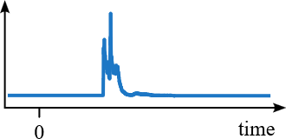
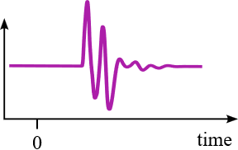
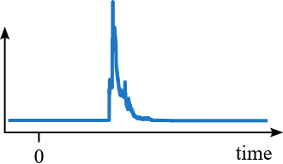
Background: The Phasor Fields Formulation
Captured signal
A phasor field
…
…
…
Notes:
We can apply the same modulation to the capture of all points
Result into a field of phasors or a phasor field
The phasor field is used to image instead

Slide 24
Background: The Phasor Fields Formulation
Image point
The imaged point is a phasor:
…
amplitude + phase
Propagation of the phasor field
Notes:
We image a point
Imaging with phasors equivalent to wavefront propagation in line of sight
The imaged point also yields a phasor: amplitude and phase

Slide 25
Background: The Phasor Fields Formulation
Image plane
Image point
Efficient Phasor Fields implementations exist to propagate plane to plane [6]
…
[6] Liu, X., Bauer, S., & Velten, A. (2020). Phasor field diffraction based reconstruction for fast non-line-of-sight imaging systems. Nature communications, 11(1), 1645.
Notes:
More efficient implementations exists for plane to plane propagation

Slide 26
Finding geometry with Phasor Fields
Bunny position
Amplitude
0
The closest plane to the surface
Notes:
We reconstruct continum depth to form line
Look at amplitude
Bunny position corresponds to maximum
To identify the amplitude:
PF employ efficient plane implementation
Distribute them in the space
Select the maximum
THE CLOSEST PLANE TO THE SURFACE

Slide 27

Finding geometry with Phasor Fields
Plane away from hidden surface
Bunny position
Amplitude
0
More resolution = more planes = more execution time
gap
gap
Notes:
There is a plane
There is a gap in bunny position and plane
Increase the depth resolution requires more planes that increases the execution time

Slide 28
Our Zero-Phase Phasor Fields
Bunny position
We employ the phase, discarded by previous methods
Amplitude
0
Phase
0
Notes:
We present now our Zero-Phase Phasor Fields
Remember we are looking at the imaged amplitude across line in depth
Imaged line contains phase and amplitude
Phase was discarded
Ours employ phase back

Slide 29

Our Zero-Phase Phasor Fields
Bunny position
Imaged plane
0
The imaged phase crosses to zero at the true surface positions
Phase
0
Notes:
We now focus on phase
In this part specifically
Here we have phase evolution, imaged plane, and bunny position
We can observe here the key observation of the paper:
PHASE CROSS TO ZERO

Slide 30
Our Zero-Phase Phasor Fields
Bunny position
Imaged plane
0
We know the phase at imaged plane
Corrected depth
Notes:
Face known at imaged plane
Look at green line crossing orange
We can correct its positioning using that

Slide 31


Summarizing methods
Our Zero-Phase Phasor Fields
Phasor Fields (PF)
Dense PF
Phase correction
Image planes, selects maximum, and corrects depth
Image planes, then select maximum in depth
Increase depth precision by increasing imaged planes
Notes:
To recap, we have phasor fields.
With this relay wall and imaged planes
Images planes and select máximum
A straight forward solution to increase depth precision is dense PF

Slide 32
Summarizing methods
Our Zero-Phase Phasor Fields
Phasor Fields (PF)
Dense PF
Phase correction
Image planes, selects maximum, and corrects depth
Image planes, then select maximum in depth
Increase depth precision by increasing imaged planes
Notes:
To recap, we have phasor fields.
With this relay wall and imaged planes
Images planes and select máximum
A straight forward solution to increase depth precision is dense PF

Slide 33
Results

Slide 34
Results
Planar patch simulation [7] under micrometer displacement
z
Patch at 1m
Patch depth | Distance to 1m between ZPPF depths
1 m | 0.0µm
1
Our ZPPF depth
PF depth
0.996
Ground truth
x
-1
0
1
[7] Royo, D., García, J., Muñoz, A., & Jarabo, A. (2022). Non-line-of-sight transient rendering. Computers & Graphics, 107, 84-92.

Slide 35
Results
Planar patch simulation [7] under micrometer displacement
z
Patch at 1m + 500 µm
Patch depth | Distance to 1m between ZPPF depths
1 m | 0.0
1m + 500µm | 492.60µm
1
Our ZPPF depth
PF depth
0.996
Ground truth
x
-1
0
1
[7] Royo, D., García, J., Muñoz, A., & Jarabo, A. (2022). Non-line-of-sight transient rendering. Computers & Graphics, 107, 84-92.

Slide 36
Results
Planar patch simulation [7] under micrometer displacement
z
Patch at 1m + 250 µm
Patch depth | Distance to 1m between ZPPF depths
1 m | 0.0µm
1m + 500µm | 492.60µm
1m + 250µm | 246.21µm
1
Our ZPPF depth
PF depth
0.996
Ground truth
x
-1
0
1
[7] Royo, D., García, J., Muñoz, A., & Jarabo, A. (2022). Non-line-of-sight transient rendering. Computers & Graphics, 107, 84-92.

Slide 37
Results
Planar patch simulation [7] under micrometer displacement
z
Patch at 1m + 125 µm
Patch depth | Distance to 1m between ZPPF depths
1 m | 0.0µm
1m + 500µm | 492.60µm
1m + 250µm | 246.21µm
1m + 125µm | 123.23µm
1
Our ZPPF depth
PF depth
0.996
Ground truth
x
-1
0
1
[7] Royo, D., García, J., Muñoz, A., & Jarabo, A. (2022). Non-line-of-sight transient rendering. Computers & Graphics, 107, 84-92.

Slide 38
Results
Planar patch simulation [7] under micrometer displacement
Correctly estimate depth variations
z
Patch at 1m + 125 µm
Patch depth | Distance to 1m between ZPPF depths
1 m | 0.0µm
1m + 500µm | 492.60µm
1m + 250µm | 246.21µm
1m + 125µm | 123.23µm
1
Our ZPPF depth
PF depth
0.996
Ground truth
x
-1
0
1
[7] Royo, D., García, J., Muñoz, A., & Jarabo, A. (2022). Non-line-of-sight transient rendering. Computers & Graphics, 107, 84-92.

Slide 39
Results
Two planar patch simulation [7], and one under small offset of micrometer
[7] Royo, D., García, J., Muñoz, A., & Jarabo, A. (2022). Non-line-of-sight transient rendering. Computers & Graphics, 107, 84-92.

Slide 40
Results
Two planar patch simulation [7], and one under small offset of micrometer
z
No offset
1
0.996
x
-1
0
1
Our ZPPF depth
PF depth
Ground truth
[7] Royo, D., García, J., Muñoz, A., & Jarabo, A. (2022). Non-line-of-sight transient rendering. Computers & Graphics, 107, 84-92.

Slide 41
Results
Two planar patch simulation [7], and one under small offset of micrometer
z
No offset
500 µm offset
1
1
0.996
0.996
x
x
-1
0
1
-1
0
1
Our ZPPF depth
PF depth
Ground truth
[7] Royo, D., García, J., Muñoz, A., & Jarabo, A. (2022). Non-line-of-sight transient rendering. Computers & Graphics, 107, 84-92.

Slide 42
Results
Two planar patch simulation [7], and one under small offset of micrometer
z
No offset
250 µm offset
1
1
0.996
0.996
x
x
-1
0
1
-1
0
1
Our ZPPF depth
PF depth
Ground truth
[7] Royo, D., García, J., Muñoz, A., & Jarabo, A. (2022). Non-line-of-sight transient rendering. Computers & Graphics, 107, 84-92.

Slide 43
Results
Two planar patch simulation [7], and one under small offset of micrometer
z
No offset
125 µm offset
1
1
0.996
0.996
x
x
-1
0
1
-1
0
1
Our ZPPF depth
PF depth
Ground truth
[7] Royo, D., García, J., Muñoz, A., & Jarabo, A. (2022). Non-line-of-sight transient rendering. Computers & Graphics, 107, 84-92.

Slide 44
Results
Two planar patch simulation [7], and one under small offset of micrometer
z
No offset
125 µm offset
1
1
0.996
0.996
x
x
-1
0
1
-1
0
1
Our ZPPF depth
PF depth
Ground truth
[7] Royo, D., García, J., Muñoz, A., & Jarabo, A. (2022). Non-line-of-sight transient rendering. Computers & Graphics, 107, 84-92.
Notes:
This is very useful for depth estimation

Slide 45
Results – simulated plane at 1 m
Depth
Top view of simulated plane
Displace half of the plane 500 µm
1
Ground truth
PF depth
Our ZPPF depth
0.996
-1
x
0
1
Notes:
We simulated a plane at 1 meter
PF place the plane here, showing this gap of around 5 mm
Ours reduce this gap
We now split the plane, and displace it 500 micrometers

Slide 46
Results – simulated plane at 1 m
Depth
Top view of simulated plane
Displace half of the plane 125 µm
Displace half of the plane 500 µm
1
Ground truth
Our method recover the micrometers depth variations
PF depth
Our ZPPF depth
0.996
-1
x
0
1
Notes:
We observe a step in gt
PF again uses same plane
Ours reduce the gap, furthermore, it shows the same step
Our results shows we can see this even in the 125 micrometer case

Slide 47
Results – simulated plane at 1 m
Depth
Top view of simulated plane
Displace half of the plane 125 µm
1
Ground truth
PF depth
Our ZPPF depth
0.996
-1
x
0
1
Notes:
This extreme case
We place this horizontal line to highlight our depth also shows this variation

Slide 48
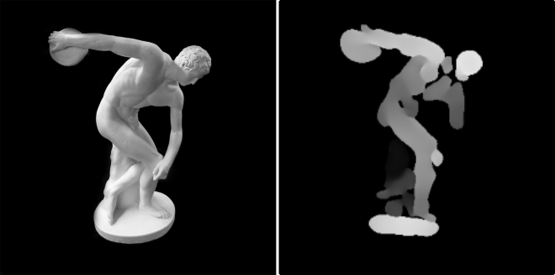
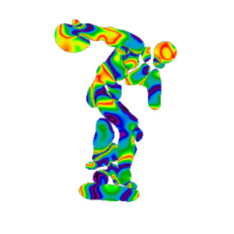
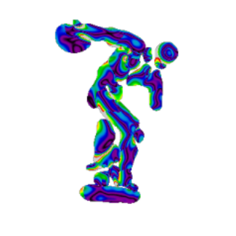
Results – Depth recovery of real dataset
Diff
(m)
1.15
0.95
0.0
0.16
Depth (m)
9h 28' 54''
2’ 4''
2’ 10''
Data from publicly available dataset [3]
Hidden scene
Dense PF depth
PF depth diff.
Ours depth diff.
[3] Lindell, D. B., Wetzstein, G., & O'Toole, M. (2019). Wave-based non-line-of-sight imaging using fast fk migration. ACM Transactions on Graphics (ToG), 38(4), 1-13.

Slide 49
Results
Imaging real captures using a publicly available dataset [3]
Depth (m)
Diff
(m)
1.15
0.16
9h 28' 54''
0.95
2’ 10''
2’ 4''
0.0
Hidden scene
Dense PF depth
PF depth diff.
Ours depth diff.

Slide 50
Results
Imaging real captures using a publicly available dataset [3]
Depth (m)
Diff.
(m)
1.40
0.16
13h 54’ 55''
1.28
2’ 1''
2’ 10''
0.0
Hidden scene
Dense PF depth
PF depth diff.
Ours depth diff.
[3] Lindell, D. B., Wetzstein, G., & O'Toole, M. (2019). Wave-based non-line-of-sight imaging using fast fk migration. ACM Transactions on Graphics (ToG), 38(4), 1-13.

Slide 51
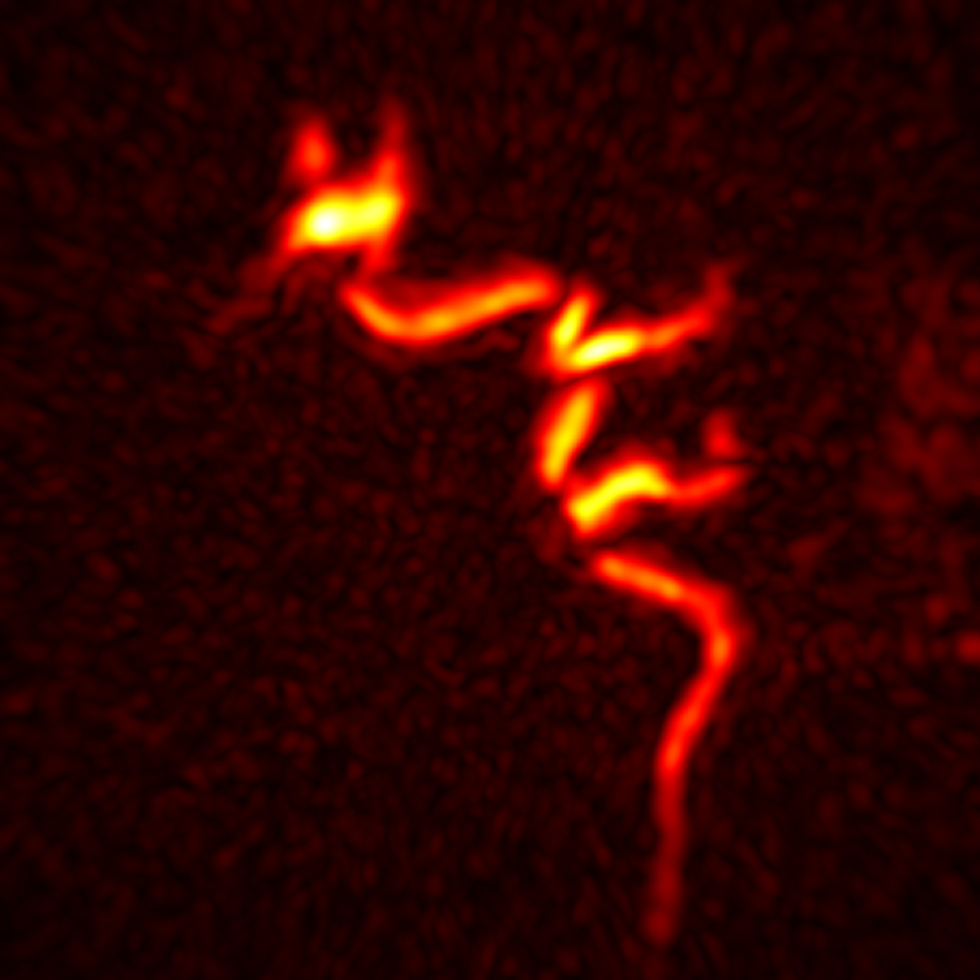
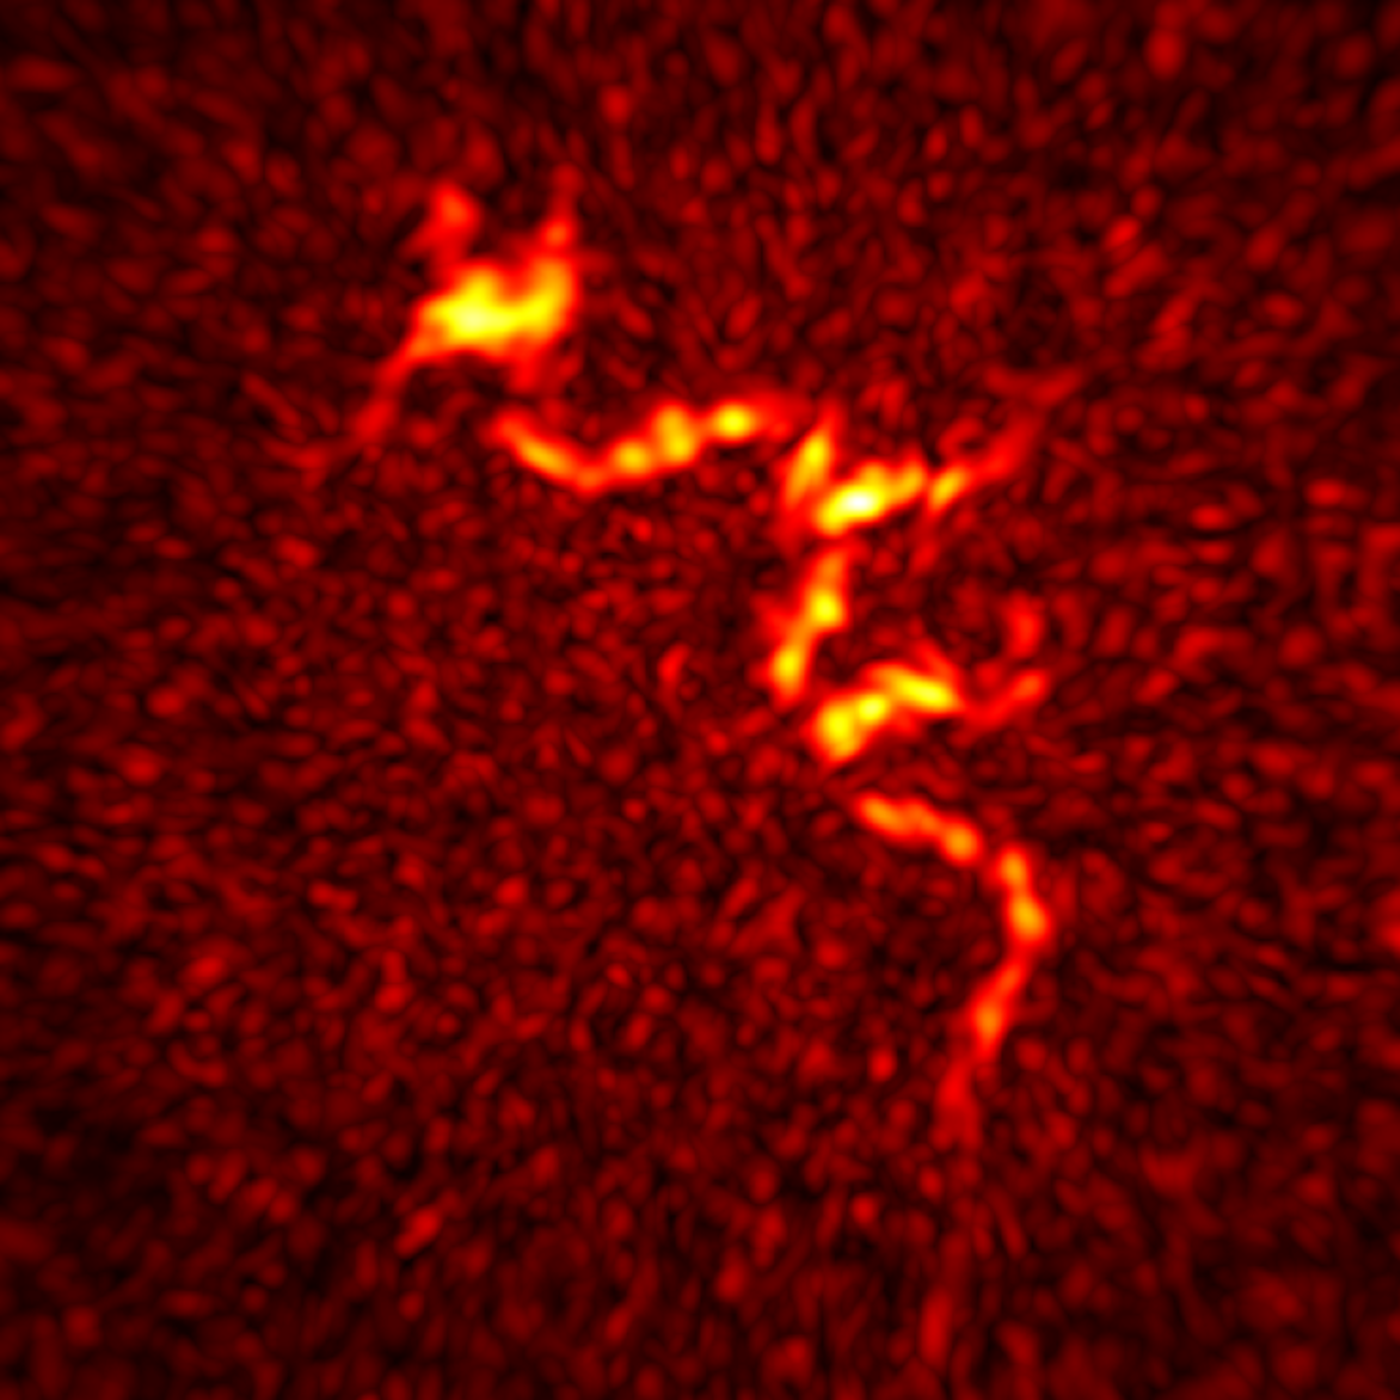
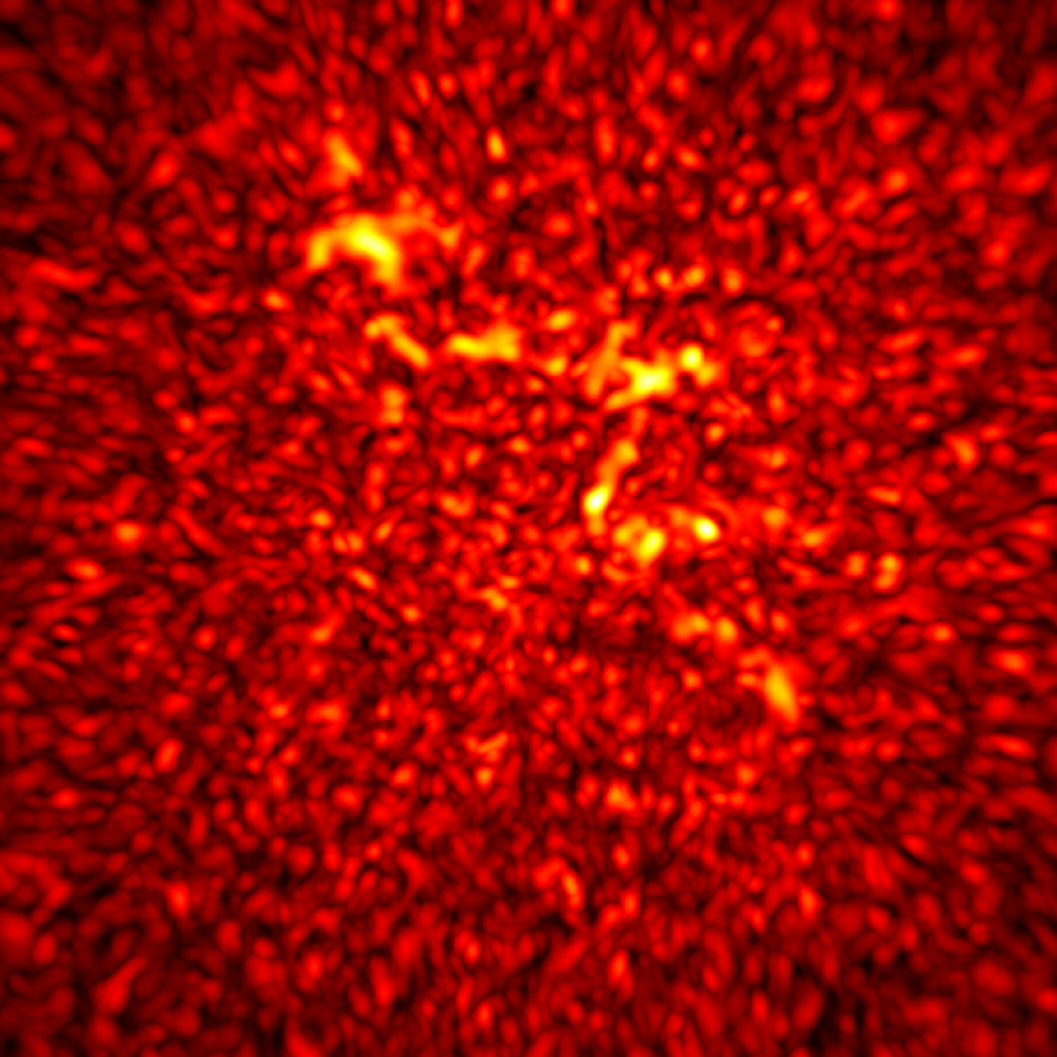
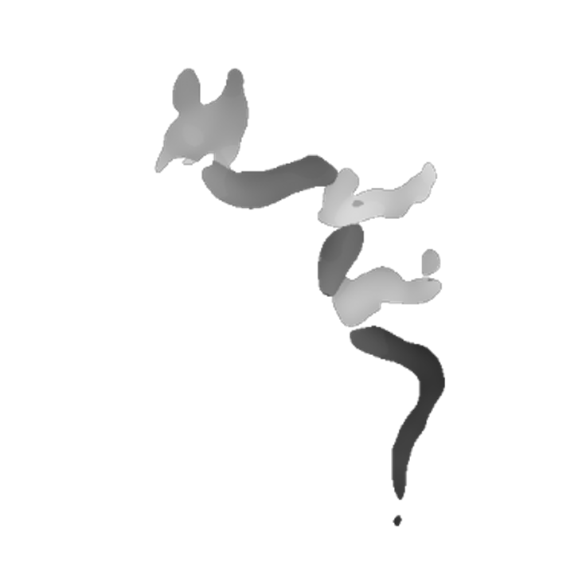

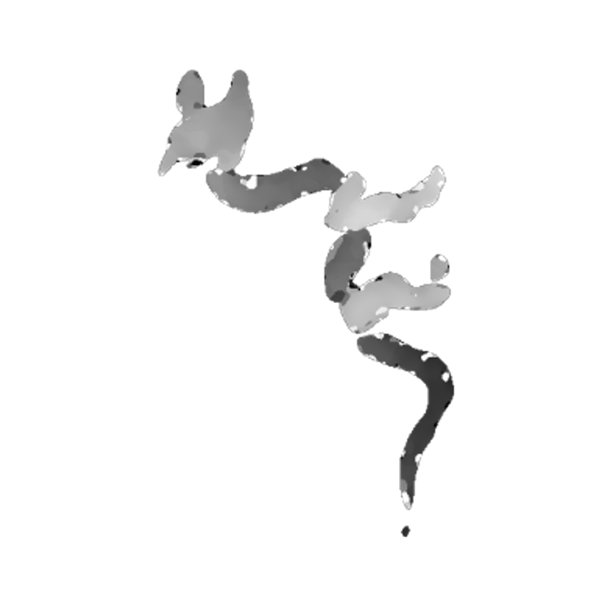
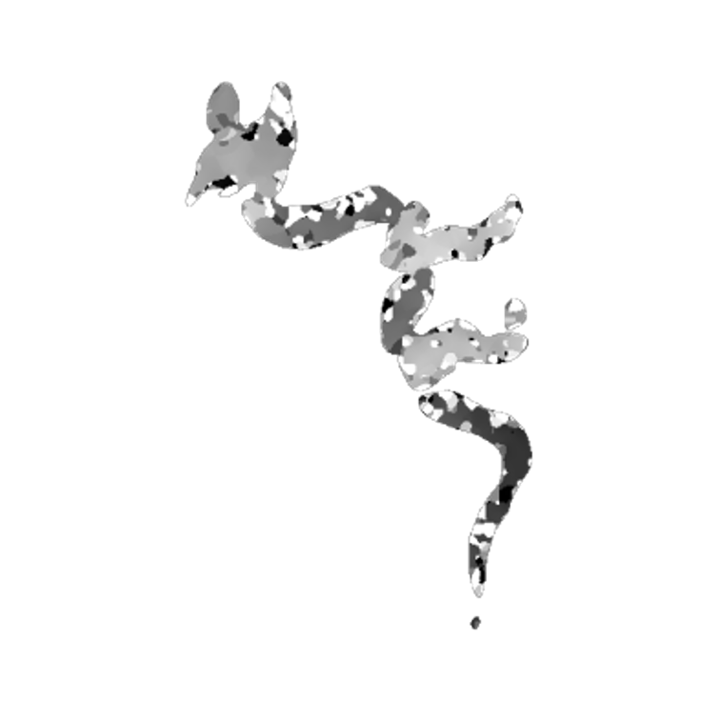
Results – decreasing signal to noise ratio
PF amplitude
Depth (m)
1.40
Ours depth
1.28
180 mins
10 mins
1 min
15 sec
Notes:
Publicly available dataset, in lowering exposure time – reduce SNR
Upper Amplitude
Amplitude dragón shape degrades with low snr
Our Depth is consistent

Slide 52
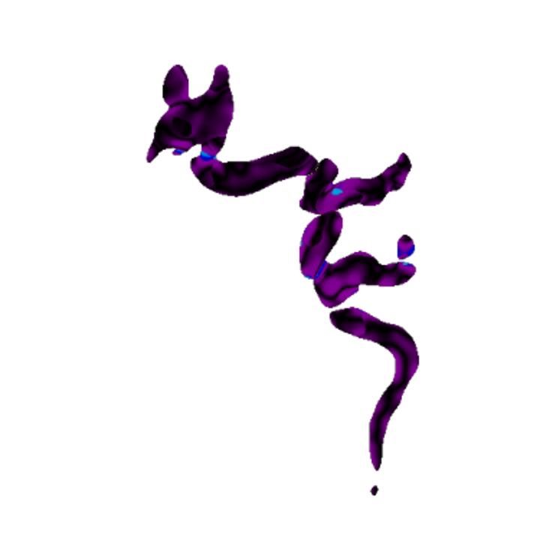
Results
Imaging real captures using a publicly available dataset [3], varying exposure time (different SNR)
180 mins of capture time
Depth (m)
Diff.
(m)
0.1
1.40
1.28
0.0
Amplitude
ZPPF depth
ZPPF diff.
[3] Lindell, D. B., Wetzstein, G., & O'Toole, M. (2019). Wave-based non-line-of-sight imaging using fast fk migration. ACM Transactions on Graphics (ToG), 38(4), 1-13.

Slide 53


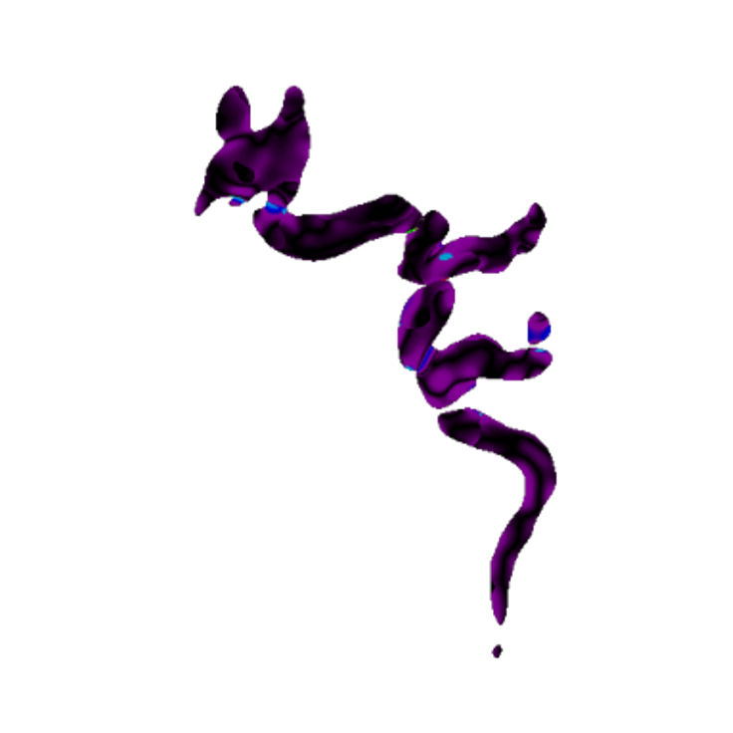
Results
Imaging real captures using a publicly available dataset [3], varying exposure time (different SNR)
30 mins of capture time
Depth (m)
Diff.
(m)
0.1
1.40
1.28
0.0
Amplitude
ZPPF depth
ZPPF diff.
[3] Lindell, D. B., Wetzstein, G., & O'Toole, M. (2019). Wave-based non-line-of-sight imaging using fast fk migration. ACM Transactions on Graphics (ToG), 38(4), 1-13.

Slide 54

Results
Imaging real captures using a publicly available dataset [3], varying exposure time (different SNR)
10 mins of capture time
Depth (m)
Diff.
(m)
0.1
1.40
1.28
0.0
Amplitude
ZPPF depth
ZPPF diff.
[3] Lindell, D. B., Wetzstein, G., & O'Toole, M. (2019). Wave-based non-line-of-sight imaging using fast fk migration. ACM Transactions on Graphics (ToG), 38(4), 1-13.

Slide 55
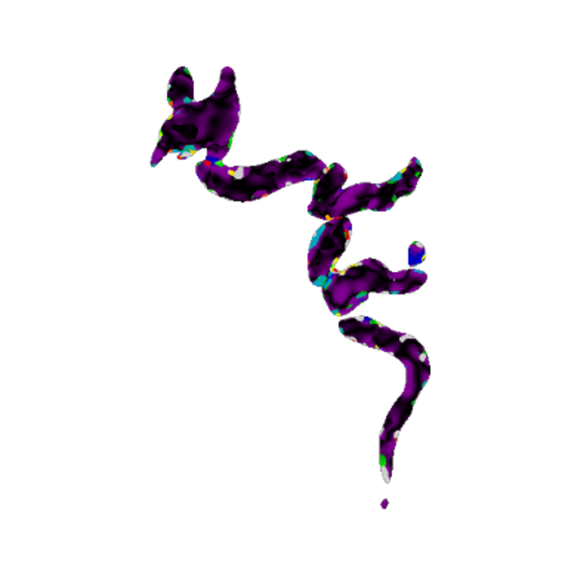
Results
Imaging real captures using a publicly available dataset [3], varying exposure time (different SNR)
1 mins of capture time
Depth (m)
Diff.
(m)
0.1
1.40
1.28
0.0
Amplitude
ZPPF depth
ZPPF diff.
[3] Lindell, D. B., Wetzstein, G., & O'Toole, M. (2019). Wave-based non-line-of-sight imaging using fast fk migration. ACM Transactions on Graphics (ToG), 38(4), 1-13.

Slide 56
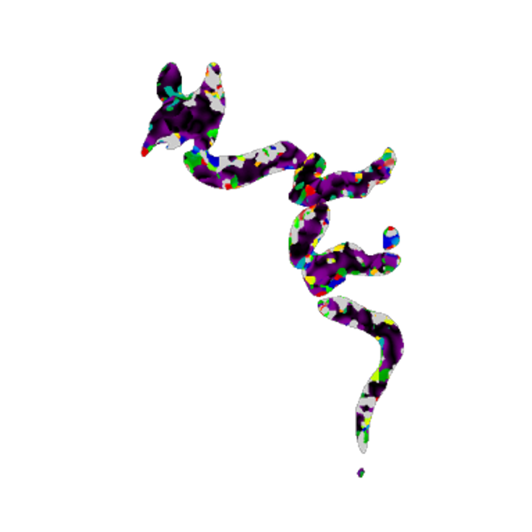
Results
Imaging real captures using a publicly available dataset [3], varying exposure time (different SNR)
15 sec of capture time
Depth (m)
Diff.
(m)
0.1
1.40
1.28
0.0
Amplitude
ZPPF depth
ZPPF diff.
[3] Lindell, D. B., Wetzstein, G., & O'Toole, M. (2019). Wave-based non-line-of-sight imaging using fast fk migration. ACM Transactions on Graphics (ToG), 38(4), 1-13.

Slide 57
Conclusions
Our Zero-Phase Phasor Fields
Phasor Fields (PF)
Dense PF
Efficient in time
Efficient memory consumption
Low depth precision
Inefficient in time
Inefficient memory consumption
High depth precision
Efficient in time
Efficient memory consumption
High depth precision
Notes:
To recap, we have phasor fields.
With this relay wall and imaged planes
Images planes and select máximum
A straight forward solution to increase depth precision is dense PF

Slide 58
Conclusions
We develop a method that efficiently estimates depth.
Depth recovery using phase is robust to noise.
Future work and limitations:
Derive for non-confocal.
Phase correction works when the imaged plane is close enough.
Small mismatches occur, possibly due to near-field diffraction.

Slide 59
Zero-Phase Phasor Fields for Non-Line-of-Sight Imaging
Pablo Luesia-Lahoz, Talha Sultan, Forrest B. Peterson, Andreas Velten, Diego Gutierrez, Adolfo Muñoz
9h 28' 54''
2’ 4''
2’ 10''
International Conference on Computational Photography 2025
Toronto, Canada, July 21-23

