Slide 1
A Biophysically-Based Model of the Optical Properties of Skin aging
José A. Iglesias-Guitián Carlos Aliaga Adrián Jarabo Diego Gutiérrez
<add list of authors/affiliations>

Slide 2
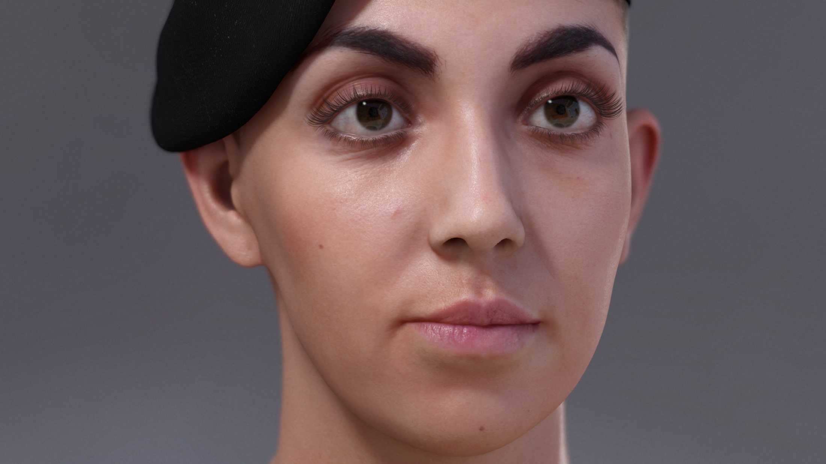
Jiménez et al. 2015
Notes:
In computer graphics, virtual humans have reach an incredible level of realism over the last years,
even in real-time frameworks such us this example from our previous work.
Among the many features involved in the generation of a convincing human, skin is a crucial part.

Slide 3
Donner and Jensen 2006
Notes:
With the technology available, we are able to simulate different skin types…

Slide 4
Donner et al. 2008
Notes:
…, per layer heterogeneities, like veins, melanin spots, or even tattoos.
But all previous works have treated the skin in a steady state way.

Slide 5
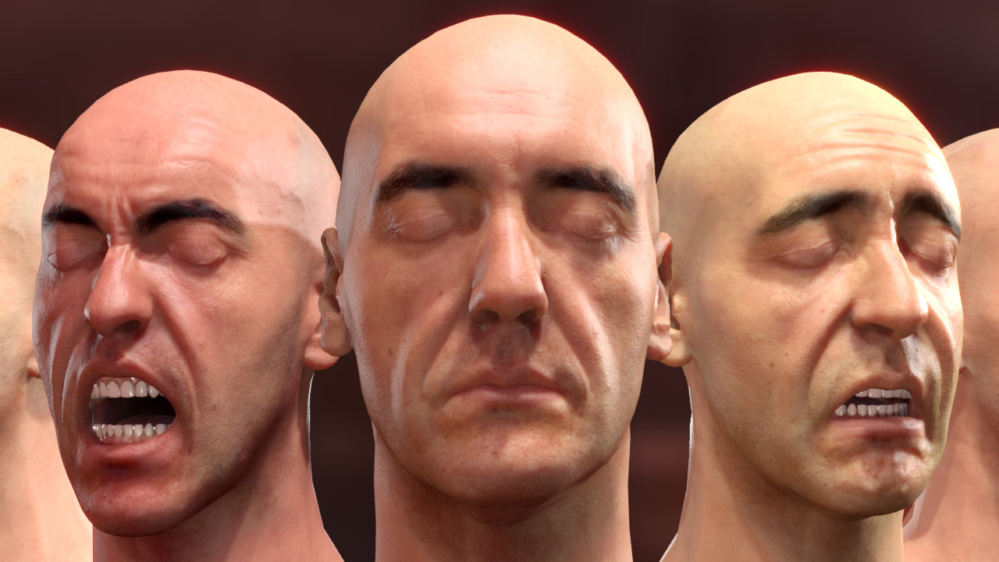
Jiménez et al. 2010
Notes:
Only a few examples handle temporal changes, like the work of Jiménez et al. 2010, which takes into account the emotional state, the blood perfusion in expressions wrinkles, or the level of exercise.
However, all those are fast changes occurring in minutes or even seconds, not taking into account long term variations occurring in the skin.

Slide 6
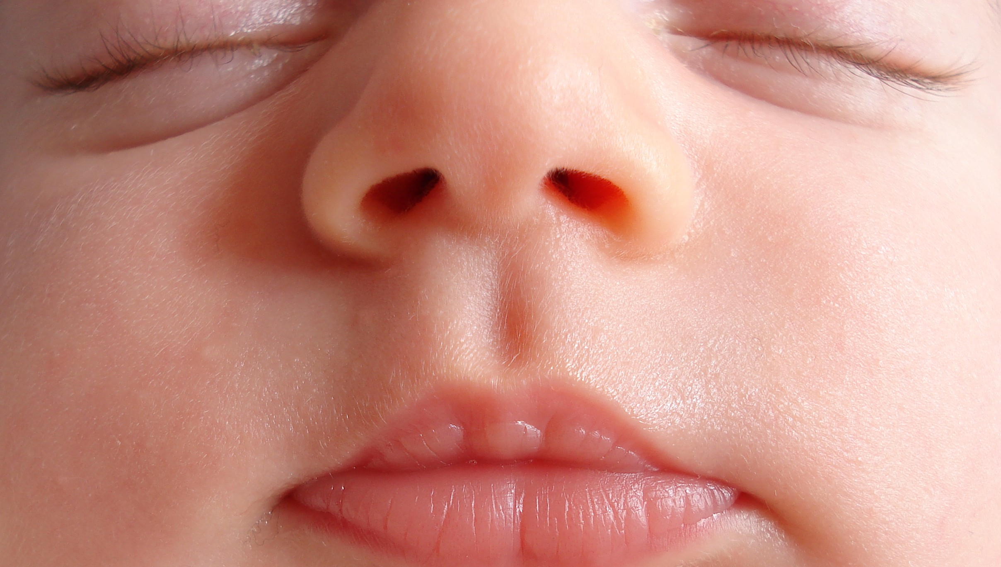
Notes:
So the problem with the steady state models is that the skin looks similar no matter the age of the subject.
As an extreme example, one can imagine how weird an adult would be if the skin look similar to this baby, very saturated and translucent.

Slide 7
Motivation
Notes:
But the skin, as any other organ, ages.
The aging process is the product of many factors. Apart from genetics, like skin type or gender, other external factors accelerate the process,
such as exposition to uv radiation, or smoking.
Probably not enough to watch our vices tough! ☺
Apart from the wrinkles, the overall appearance is different in the elderly. It looks paler, drier and thinner.
In this work we focus on all those changes in its optical properties,
which can be combined orthogonally with any framework handling morphological changes and wrinkle formations.

Slide 8
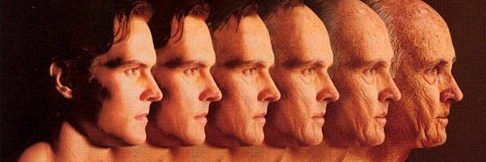
?
RENDER
Notes:
So the question is here how to address all those changes while rendering virtual humans.

Slide 9
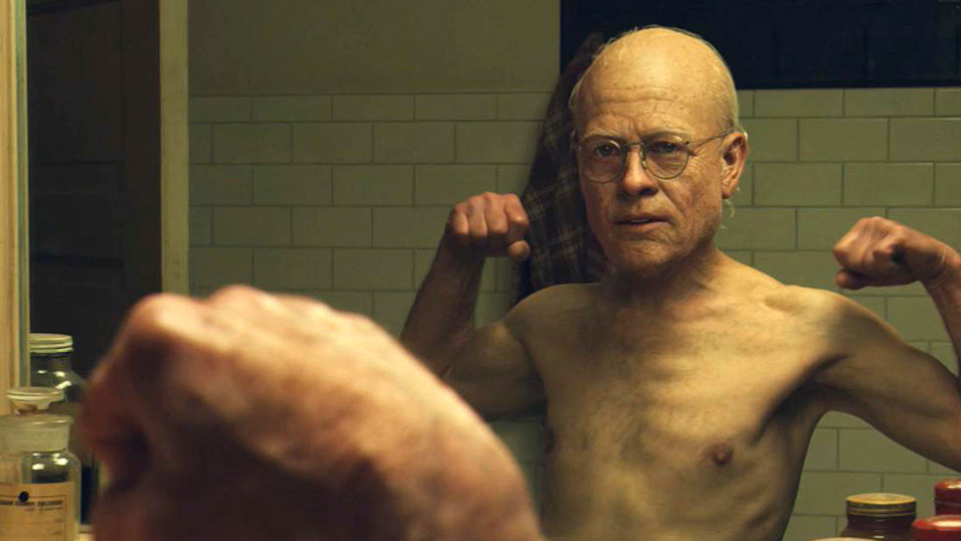
Notes:
Of course we can create realistic elder people,
and we have great examples, for instance, of perfectly integrated old humans in live action movies, like Benjamin Button.

Slide 10
RENDER
Notes:
However, for reaching this, real actors need to be captured in complex devices.
Or, at least, a person of the same age in order to mimic the desired skin appearance.

Slide 11
σ_RD
ThLE
Rz
ThSC
Bck_m
ThHD
D_abs
ThRD
ThPD
σ_LE
μ_PD
RENDER
Notes:
Most of the times, there is also a need of manual parameter tweaking, like scattering and absorption coefficients.
This is very costly, since it’s not intuitive the role each parameter plays in the final appearance of the skin.
Also, the final solution can be not based in real data, so might be pretty far from real.

Slide 12
?
Donner et al., Jiménez et al., Krishnaswamy & Baranoski
RENDER
Notes:
Our model addresses this changes in the optical properties of the aging skin
without relying in complex capture systems or the need of costly manual parameter tweaking.
Our work can be though as a biophysically-based approach inspired by previous works,
but extended to handle long-term temporal changes in the skin.

Slide 13
Input
Age,
gender,
skin type,
body location
…
Biophysically-Based Model
Literature - medicine, tissue optics
Optical Parameters
Chromophore concentrations, sublayer thicknesses, surface roughness, …
Notes:
The model takes as input high level intuitive parameters like age, gender, skin type or body location,
and then, points to the right combination of optical, composition and structural parameters,
such as the concentration of chemical components, or the sublayers thicknesses.
For this, we had pay attention to very low level features and composition of the skin,
so we dive in the literature of medicine and tissue optics to take real measurements and data.

Slide 14
Skin Optics
Notes:
Before entering in the details of the model, let’s do an overview of why the skin looks the way it looks.

Slide 15
Skin Optics
Notes:
It’s well known that skin cannot be treated as an homogeneous translucent volume,
[click]
but as a complex material where each layer interacts with light in a different way.

Slide 16
Skin Optics
Stratum corneum
Epidermis
Papillary dermis
Reticular Dermis
Hypodermis
(subcutaneous fat)
Notes:
Let’s use this symplified scheme. From top to bottom: main layers are stratum corneum, epidermis, dermis (composed by two parts) and hypodermis.

Slide 17
Skin Optics
5% surface reflectance
Stratum corneum
Epidermis
Papillary dermis
Reticular Dermis
Hypodermis
(subcutaneous fat)
Notes:
When a beam of light reaches the skin surface, only about the 5% is reflected due to the change in the index of refraction.
This is the specular white component of the reflected radiance.

Slide 18
Skin Optics
95% subsurface reflectance
Stratum corneum
Epidermis
Papillary dermis
Absorption
events
Reticular Dermis
Scattering events
Hypodermis
(subcutaneous fat)
Notes:
Then, light penetrates inside the tissue, where two types of events take place: scattering and absorsoption. After a number of these events, light is completely absorbed or goes out of the tissue again.
This subsurface scattering component is what gives the color and translucent look to the skin,
and is dependent on many factors such as the structure and the chemical composition of each layer.

Slide 19
Skin Aging. Changes in the Optical Properties.
Notes:
For now, we’re going to walk through every part of the model,
mainly grouped by changes in the structure and the composition of the skin.
Bear with me from now on,
beacuse we’re going to dive into some details that are of very low level
but needed for the model.

Slide 20
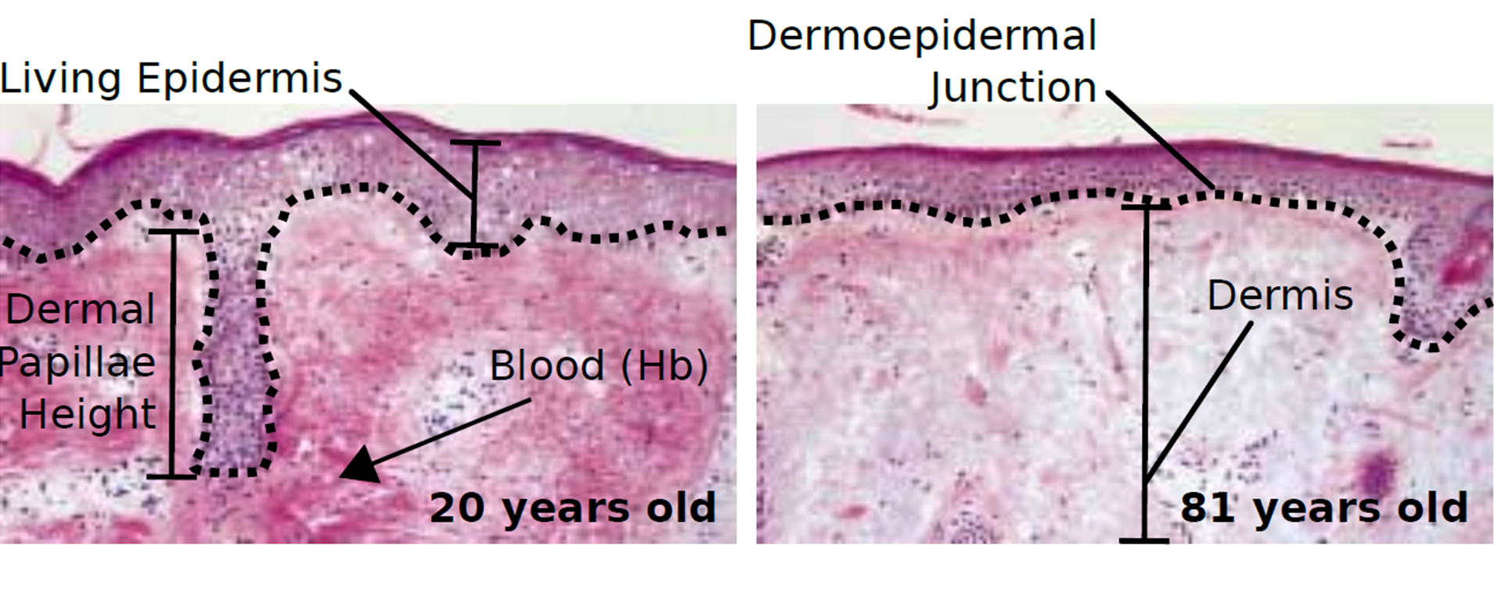
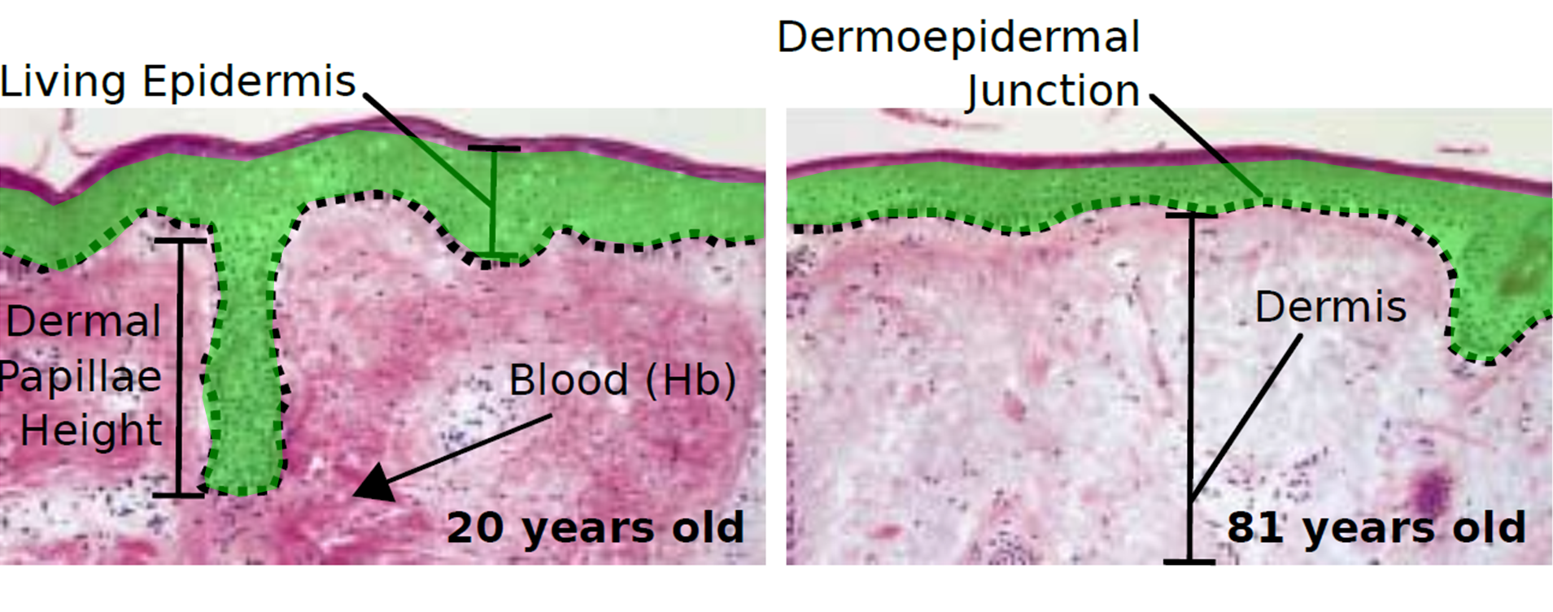
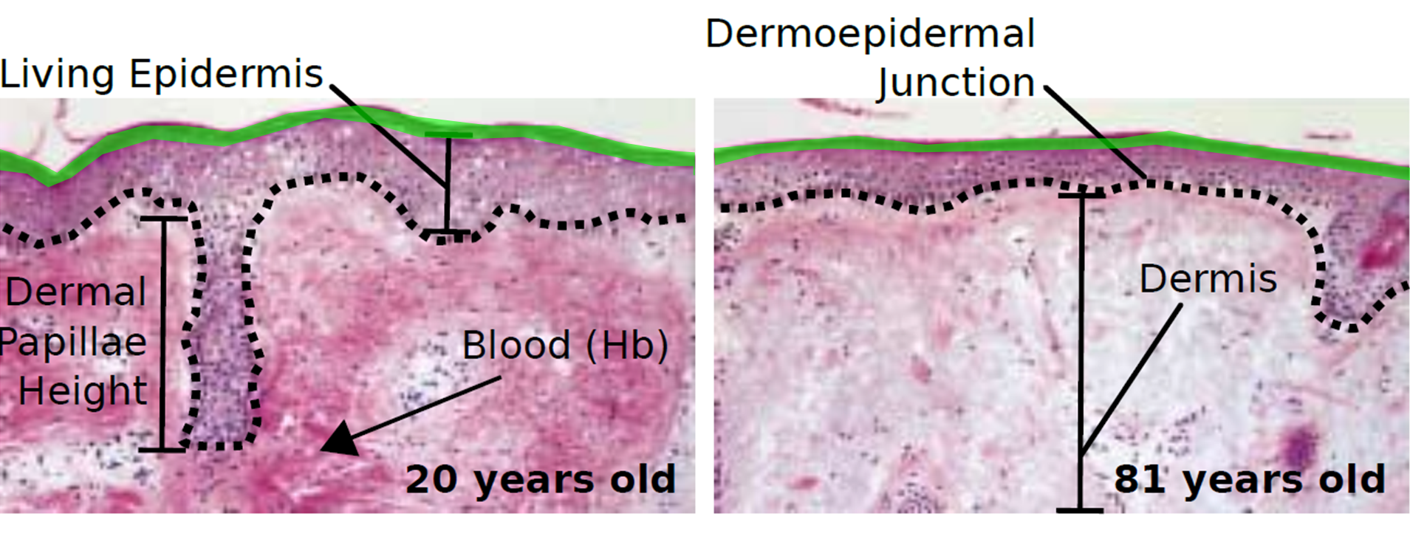
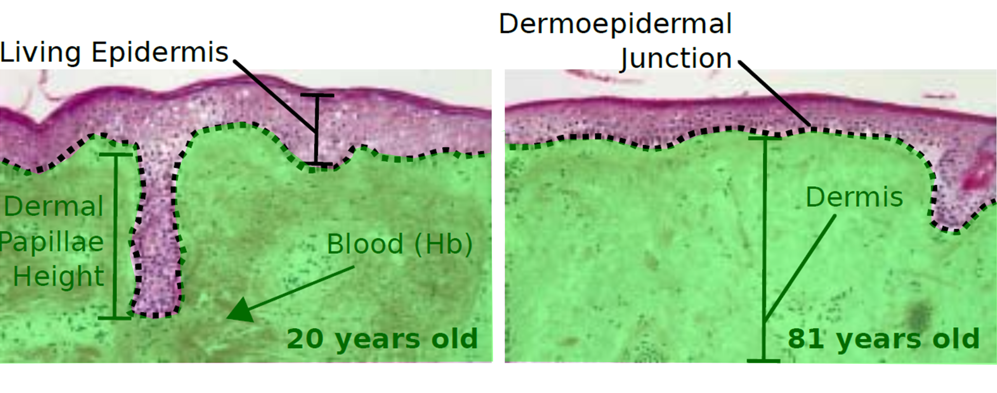
Skin Aging
Notes:
The first question is what really happens when skin ages?
These histological images show a section of the skin under the microscope,
with enhanced colours to visualize the details.
On the left a 20 years old person, on the right an 81 years old.
[click]
The outermost layer is the stratum corneum, and is mainly composed by dead cells.
[click]
The following layer is the epidermis, which penetrates inside the dermis through those fingerlike formations known as papillary dermis.
[click]
And then, the dermis.

Slide 21
Skin Aging
Notes:
So what are the main differences that we see here?
1) First, there is an overall thickness loss,
in every layer except the stratum corneum in some cases, due to the accumulation of dead cells.
This progressions are roughly linear decreases, different for each layer.
2) Second, the interface between the dermis and the epidermis flattens.
3) And third, we can see also how pigments decrease.
In this case, all these reddish coloration of the dermis is due to the haemoglobin in blood,
and it is really noticeable how it looses concentration in the old skin on the right.

Slide 22
Skin Aging. Changes in the Structure.
Notes:
Let’s focus first on the changes in structure,
Here, we have two main effects:
The flattening of the interface between dermis and epidermis
The changes in skin surface

Slide 23
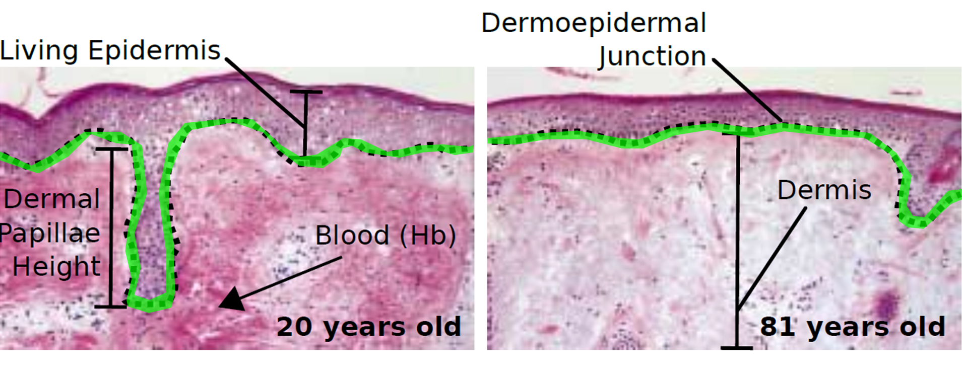
Skin Aging. Changes in the Structure
Notes:
As we saw before, the junction between the dermis and the epidermis flattens,
[click]
and we model this with a periodic surface where we vary the frequency and amplitude to change the roughness.

Slide 24
Skin Aging. Changes in the Structure
30
80
Notes:
Another key structural changes affect the surface reflection. Main effects are two: - the surface roughness of the stratum corneum
- and the thickness of the oily layer on top.
Although these cannot be appreciated in these histological images,
surface roughness increases when people age.
And, at the same time, fat production diminishes.
[click]
These two changes together make the specular lobe to spread …

Slide 25
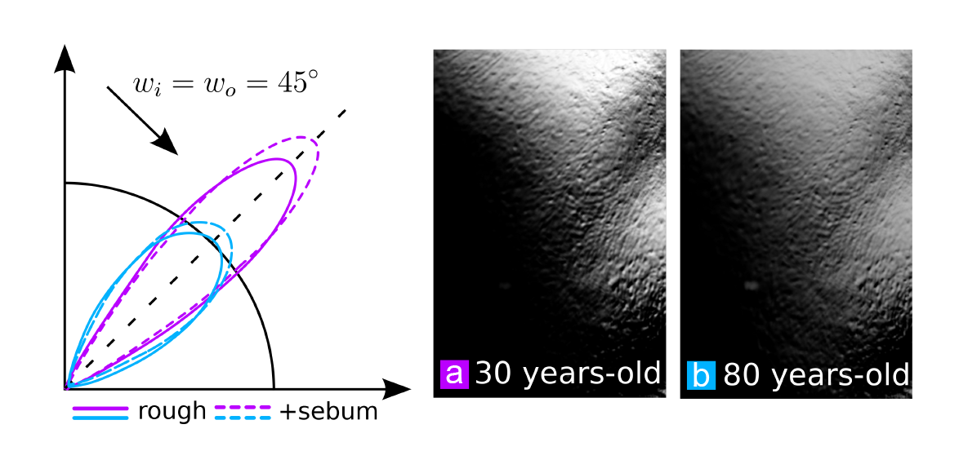
Skin Aging. Changes in the Structure
Notes:
…which gives the characteristic rough and dry look of elder skin.
Remember that purple lobe belongs to the 30 years old man, and blue one to the 80 years old person.
The graph represents the specular lobe of a skin patch for an incoming light of 45 degrees.
Dashed lines are including the changes in fat production in the skin surface,
added to the effect of the increasing surface roughness with age.
Images on the right show how the 80 years old specular reflection is less shinny and more diffuse.

Slide 26
Skin Aging. Changes in the Composition.
Notes:
Together with the structural changes, variations in the composition contributes highly to the final appearance of the skin.

Slide 27
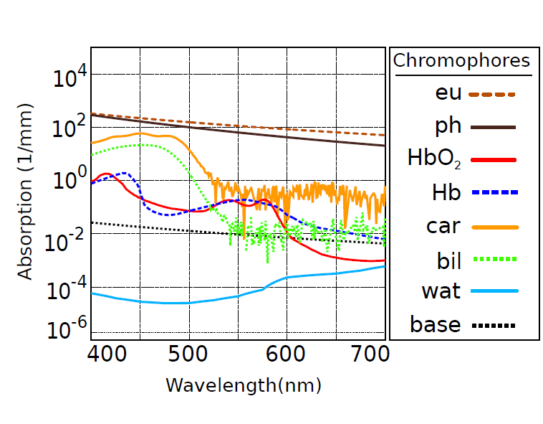
Skin Aging. Changes in the Composition
Notes:
Apart from many types of fibers and cells, each layer is composed by chemical components called chromophores
These chemicals are responsible of absorving light in a wavelength dependent way.
The x axis are the wavelengths from 4 to 7 hundred nanometers,
The y axis are the absorption coefficients, in events per milimeter.
In the order displayed on the legend, chromophores in the skin are:
The 2 types of melanins, 2 types of haemoglobins, the beta carotene, the bilurrubine, the water,
and a baseline of non pigmented skin.
The complex interplay of the these chromophores and their concentrations is what contributes the most to the color and translucency of the skin.

Slide 28
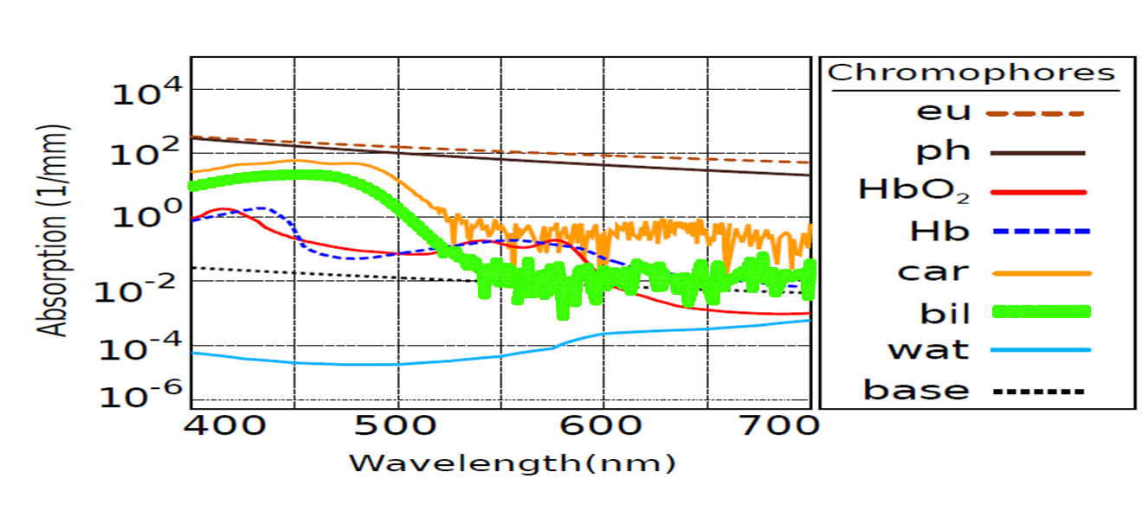
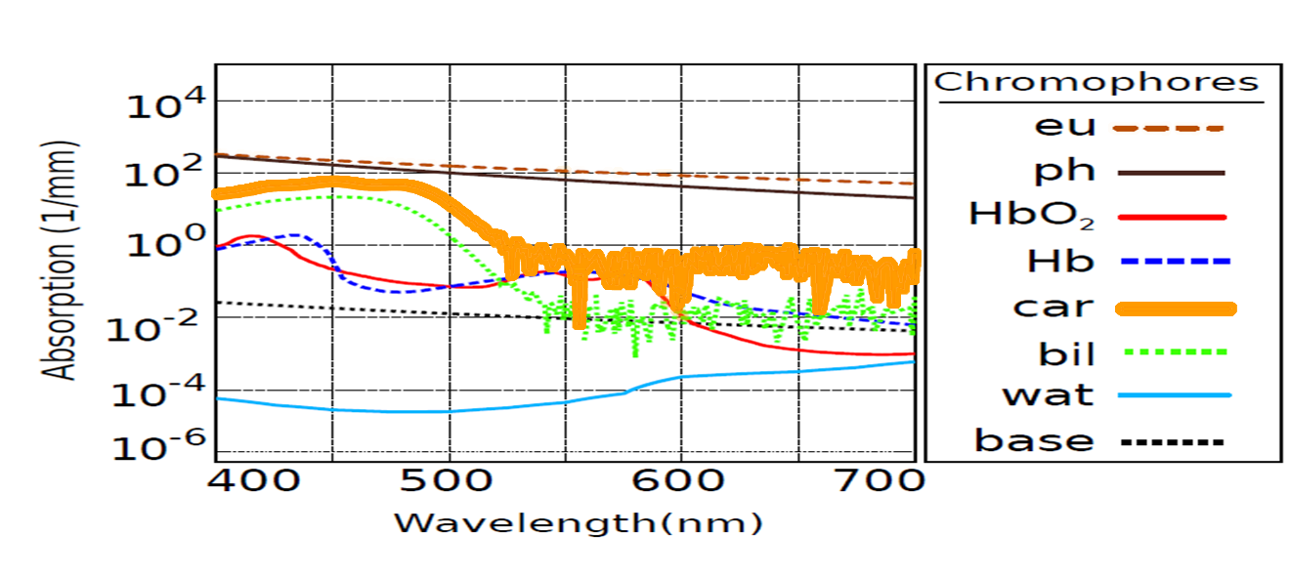
Skin Aging. Changes in the Composition
Notes:
All these chromophores are taken into account by the model.
Actually, we can simulate [click] the orangish colour typical from high level carotene consumption, ….
or [click] high bilirrubine levels associated to some kind of illnesses.
[click] But the ones that appear in more concentration rates in the skin are the two types of melanin and the two types of haemoglobin.
Melanins present in the epidermis, hemoglobins present in the dermis.
Thus, we focus on those two, since they are also the ones that vary the most when aging.

Slide 29
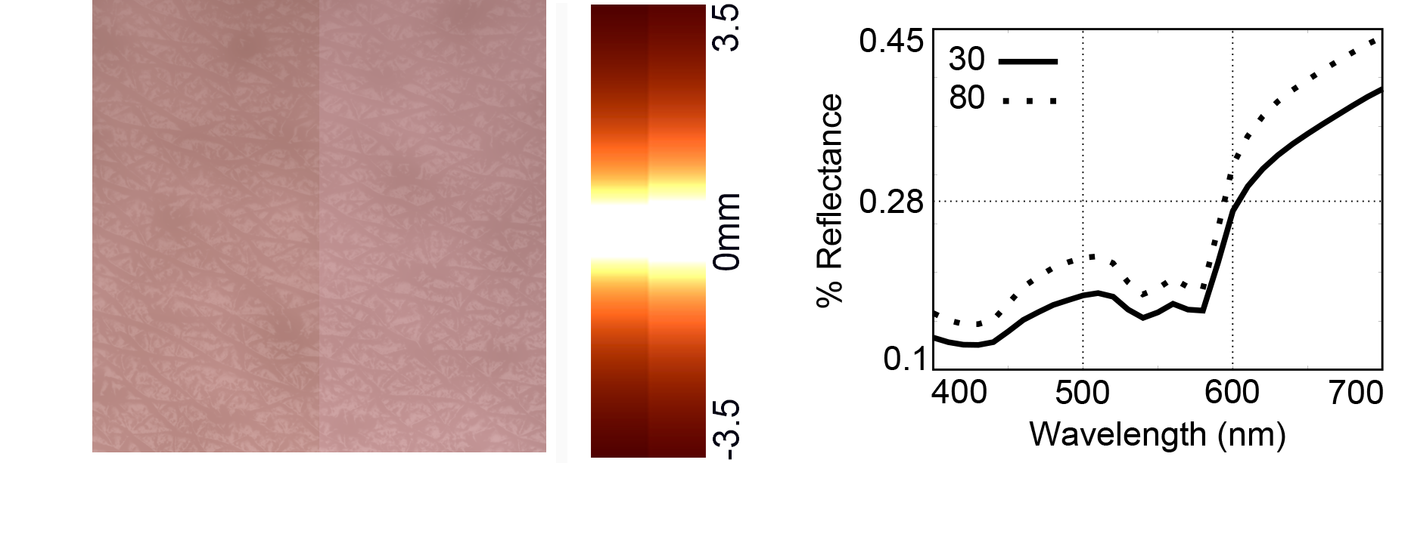
Skin Aging. Changes in the Composition
Notes:
In this samples, we focus on melanin variations, fixing everything else to see the effect isolated.
Please, for better comparison, look at the images on the online version of the paper.
Because these changes are all very subtle to be seen in a projector.
[click]
We see here the comparison from 30 to 80 years old for a very light skin patch.
We can appreciate the pigment loss, even in these types of skin with very low melanin concentration.
In this light skin sample, the small proportion of melanins with respect hemoglobins confers that increasingly pinky appearance.

Slide 30
Skin Aging. Changes in the Composition
Notes:
…here, the diffussion profiles from zero to 3.5 mm
where we see how the light travels further in the old sample, when less absorbers are present

Slide 31
Skin Aging. Changes in the Composition
Notes:
… and on the right, the reflected light per wavelength.
The x axis are again the wavelengths in the visible range,
In the y axis is the percentage of reflected light.
The dotted line is the old skin.
We can see how more light is reflected because there are less chromophores absorbing light. It’s interesting how the first peak in the curve, located in the blue-ish wavelengths, increases in the 80 sample,
This is what makes the skin to look more pinky. The reason is that the loss of melanin makes more noticeable the effect of haemoglobin.

Slide 32
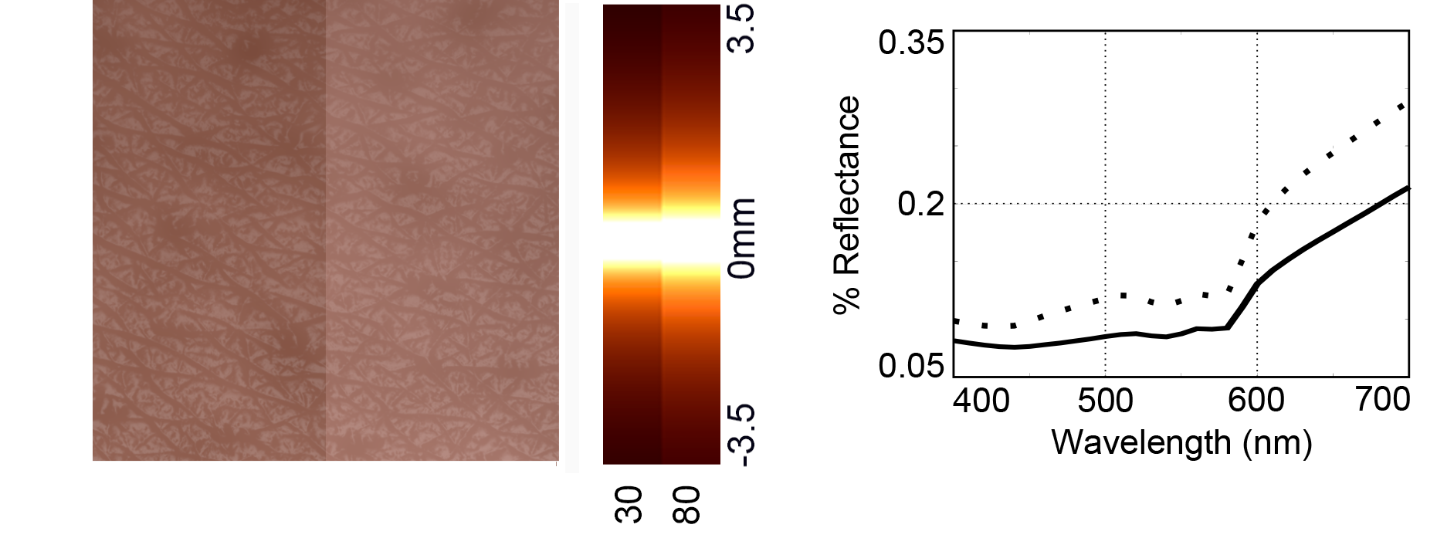
Skin Aging. Changes in the Composition
Notes:
This is other example of a darker skin of about 5 % of melanin concentrarion.
The ratio of pigment loss in the epidermis is more noticeable in skin types where there is a big the contentration of that chromophore,
so aging changes become more visible here.
Also, we can see how the effect of haemoglobin are masked by melanins,
since looking at the curves, there is no peak at the blue-ish wavelengths and the colour is closer to brown.

Slide 33
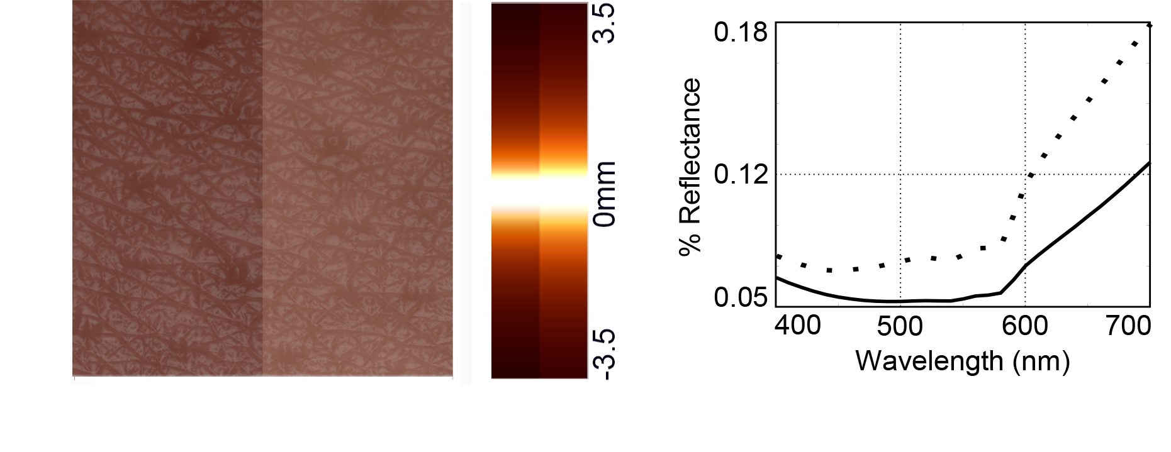
Skin Aging. Changes in the Composition
Notes:
Here, another example with even more melanin concentration.

Slide 34
Skin Aging. Changes in the Composition
Notes:
The other big change in composition is related with the blood concentration in the dermis.
Remember we just saw before in the histological images how the concentration of haemoglobin decreases within age.

Slide 35
Skin Aging. Changes in the Composition
Notes:
This image shows again the evolution of the same skin patch, this time isolating the hemoglobin.
We chose a very light skin to better show the effect.
The reason is that in highly pigmented skins, melanin imposes its effect over haemoglobin, as we saw.
Although less prominent, the loss of blood concentration makes the skin to reflect more light,
thus less light is absorved, resulting in a paler appearance.
This can be also seen in the profiles: the 80 sample is wider and less saturated.

Slide 36
Skin Aging. Changes in the Structure
Notes:
Finally, another typical sign of aging are the changes suffered by the collagen fibers.
These fibers are responsible of the elasticity of the skin, but they are also the main scatterers.
Although this is not visible in the histological images we showed,
the number of colagen fibers decreases with aging, and they become thicker and disorganised.
We model this variations based on medical literature,
assuming the number and diameter of the fibers follow skewed normal distributions that change with age, as shown in the table. This affects the per wavelength scattering coefficient of each layer, specially the Mie scattering component.

Slide 37
Results
Notes:
Now, we’re gonna see some results taking into account all the effects together.

Slide 38
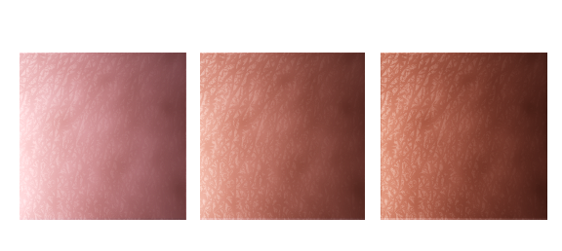
Results
Skin Types Scale [Fitzpatrick ]
I
II
III
30 years old
Notes:
These are three skin patches of types 1,2 and 3 of a scale widely used in dermatology…

Slide 39
Results
Skin Types Scale [Fitzpatrick ]
I
II
III
30 years old
Notes:
Apart from the overall less color and saturation of elder skin,
we can see how specular reflection is less shiny but spreads further.

Slide 40
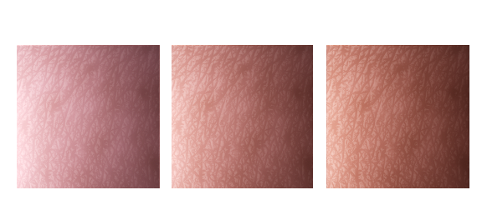
Results
Skin Types Scale [Fitzpatrick ]
I
II
III
80 years old

Slide 41
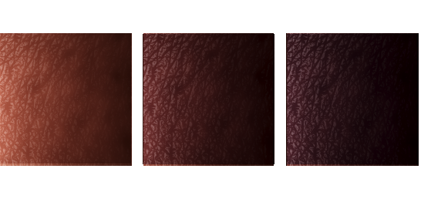
Results
Skin Types Scale [Fitzpatrick ]
IV
V
VI
30 years old
Notes:
And here is the same with the rest of the skin types

Slide 42
Results
Skin Types Scale [Fitzpatrick ]
IV
V
VI
30 years old
Notes:
And here is the same with the rest of the skin types

Slide 43
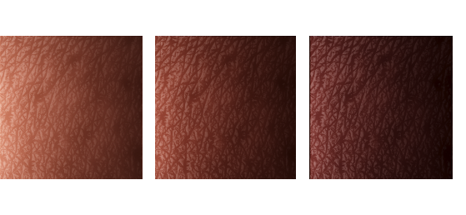
Results
Skin Types Scale [Fitzpatrick ]
IV
V
VI
80 years old
Notes:
And here is the same with the rest of the skin types

Slide 44
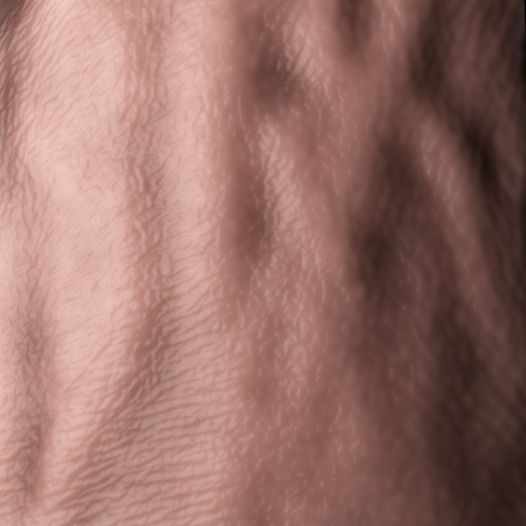
Results
30 years old
Back of the hand
Skin type III
5% melanin
5% haemoglobin
Notes:
Another important feature of the model is that we take into account different body locations.
That is, depending on the part of the body, the structure and composition of the skin can be very different,
So they suffer differently from the aging process.
This is an example of the forehand of a 30 years old person, evolved to 80 years old.

Slide 45
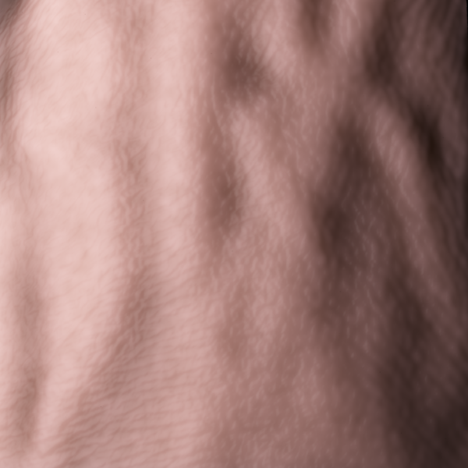
Results
80 years old
Back of the hand
Skin type III
5% melanin
5% haemoglobin

Slide 46
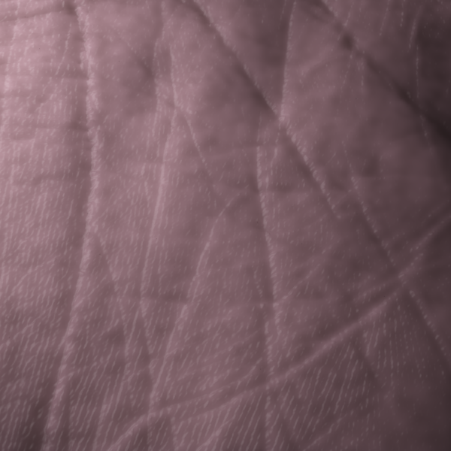
Results
30 years old
Palm
Skin type III
5% melanin
5% haemoglobin
Notes:
In this example, we see the palm of the hand.
Since the skin is much thinner in the forehand we showed before,
we can see how aging effects are more visible there…
than here, where the pale and the dry look of the aged hand is not that obvious.

Slide 47
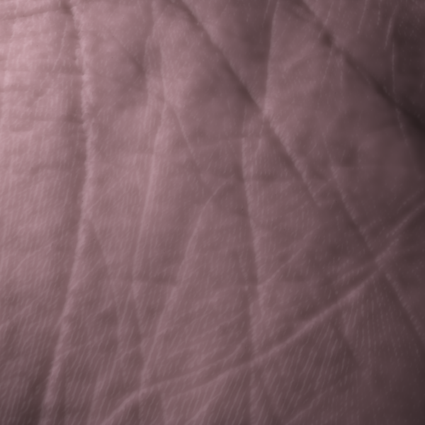
Results
80 years old
Palm
Skin type III
5% melanin
5% haemoglobin

Slide 48
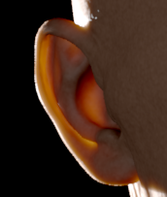
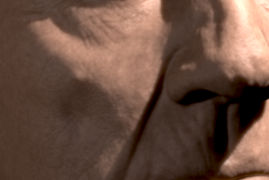
Results
Notes:
Here another example, where we keep the geometry of an elder man,
And we just vary the optical properties. The increased translucency is very noticeable in the ears on the left
On the right, the overall coloration decreases a lot whithin aging, where skin looks paler and drier.

Slide 49
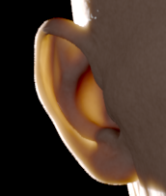
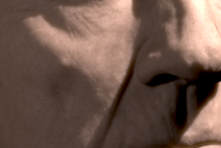
Results

Slide 50
80
30
Skin Type III
(mediterranean)
Notes:
To finnish, we show the effects of aging on the faces of two man,
and two woman, since aging also depends on gender. Notice that they have exactly the same skin type three,
the only differences are the changes occuring due to aging.
Notice also that we only change the optical properties of the skin,
the geometrical variations are done by an artist.

Slide 51
80
30
Skin Type I
(light caucasian)
Notes:
The same evolution here for two female of the same skin type, in this case a very light type I.
The loss of pigments and the rough look of the elder woman is still very visible,
although less prominent than in the case of the skin typ II males.

Slide 52
Notes:
Here, we can see the four heads, and the corresponding diffussion profiles,
A, B, C, and D from left to right. Diffussion profiles are also useful to see hoe the light travels further in the elder samples,
and the gradient is also less saturated than the young ones.

Slide 53
Conclusions
Biophysically based model for simulating aging
Notes:
Concluding,
We have presented a biophysically based model for simulating the optical properties of skin aging

Slide 54
Conclusions
Biophysically based model for simulating aging
Exhaustive compilation of medical and tissue optics data of skin measurements.
Notes:
We based the model in biophysical changes occuring in the skin,
For this, we had explore in depth what happens at a very low level in the skin components,
and we dive in the tissue optics and medicine literature.

Slide 55
Conclusions
Intuitive input parameters such us age, gender, skin type and skin care.
Notes:
For the model to be practical, we have three points:
First, it only relies in very intuitive parameters as input,
such as age, gender, skin type or body location,
instead of complex biophysical, optical or structural parameters.

Slide 56
Conclusions
Intuitive input parameters such us age, gender, skin type and skin care.
Off the shelf model suitable for any rendering framework, even real-time.
Notes:
Second, the model can be used in any rendering framework, even in real time once we obtain the diffussion profiles.

Slide 57
Conclusions
Intuitive input parameters: age, gender, skin type, body location, skin care…
Off the shelf model suitable for any rendering framework, even real-time.
All gathered data is available on the web.
Notes:
And third, all the amount of colleceted data that builds the model is available on the web.

Slide 58
Discussion and Future Work
Interesting for other fields like cosmetics or medical simulation.
Notes:
To finnish, we hope that our model could be useful and inspiring for other fields than computer graphics,
such as cosmetics or medical simulation.

Slide 59
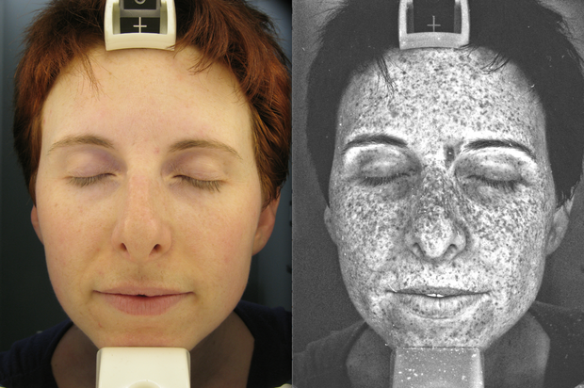
Discussion and Future Work
Interesting for other fields like cosmetics or medical simulation.
Heterogeneities. Melanins, capillars…
Notes:
And as future work: The main next step would be to take into account the heterogeneities evolution over time,
specially the melanin spots.
For that, medicine still does not known yet how the synthesis of melanin exactly works…
[click] but an statistical model based on captured faces through the uv range could be a good starting point.
Directionality:
Knowing the skin becomes more translucent and thinner with age,
probably the single scattering would be more dominant,
and depending on the angle of incoming light the appearance of the skin might vary a bit.

Slide 60
http://giga.cps.unizar.es/~ajarabo/pubs/skinAgingEG15/
Notes:
And that’s all, thank you all for your attention.

