Slide 1
Crowd Light: Evaluating the Perceived Fidelity of Illuminated Dynamic Scenes
Adrian Jarabo¹ Tom Van Eyck² Veronica Sundstedt³
Kavita Bala⁴ Diego Gutierrez¹ Carol O’Sullivan²
¹Universidad de Zaragoza ²Trinity College Dublin
³Blekinge Institute of Technology ⁴Cornell University

Slide 2
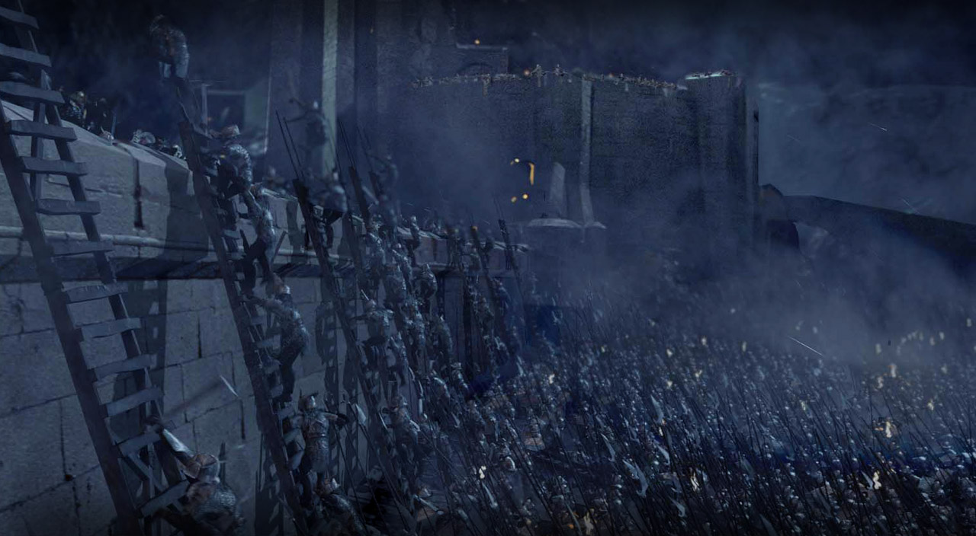
Why Crowd Lighting?
LOTR: The Two Towers (2002) © 2002 New Line Productions, Inc

Slide 3
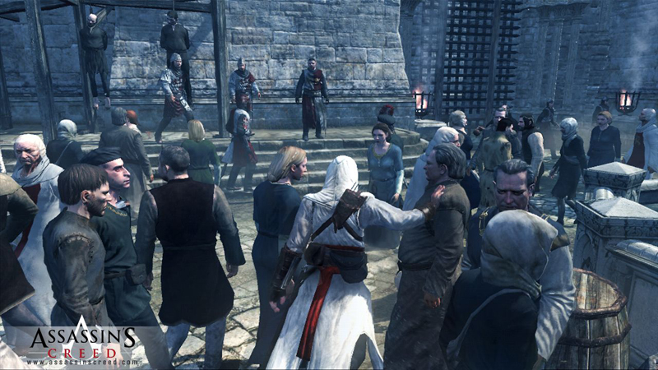
Why Crowd Lighting?
Assassins Creed (2007) © 2007 Ubisoft

Slide 4
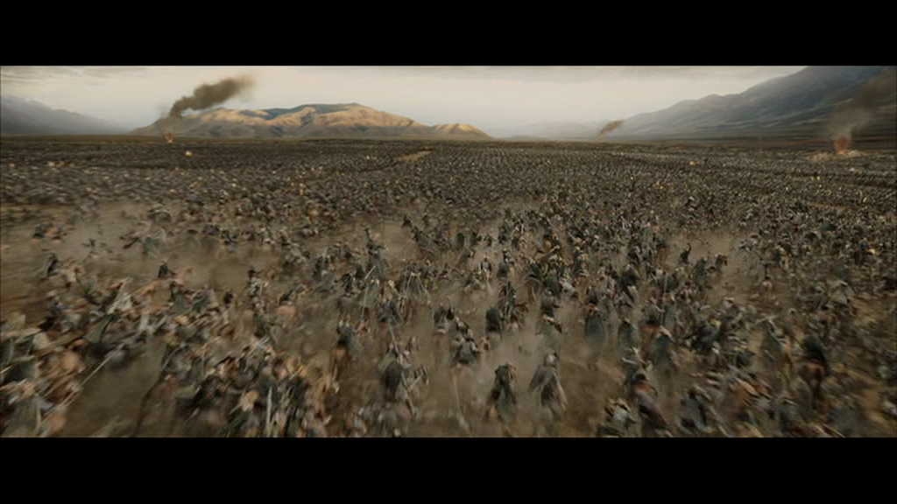
Why Crowd Lighting?
LOTR: The Return of the King (2003) © 2003 New Line Productions, Inc

Slide 5
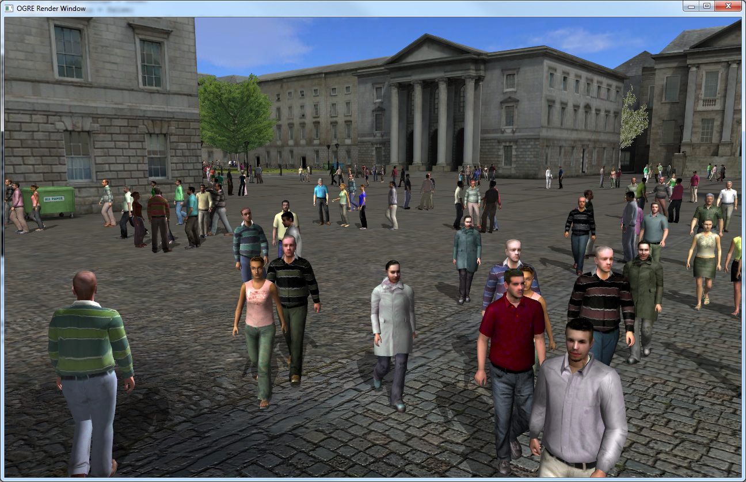
Why Crowd Lighting?
Metropolis - Supercrowds for Multisensory Urban Simulations

Slide 6
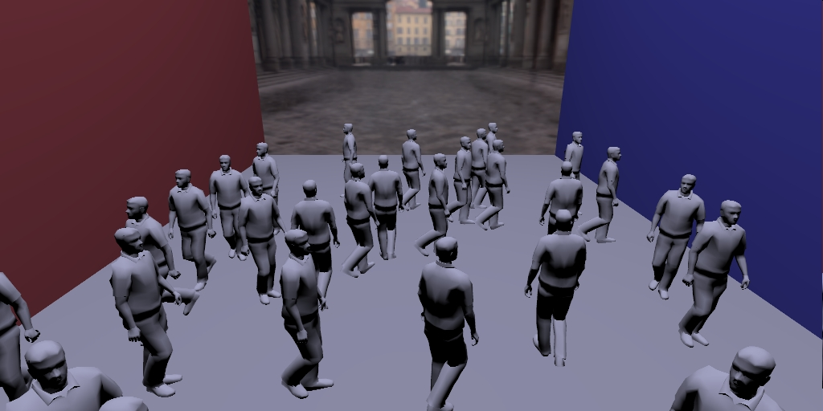
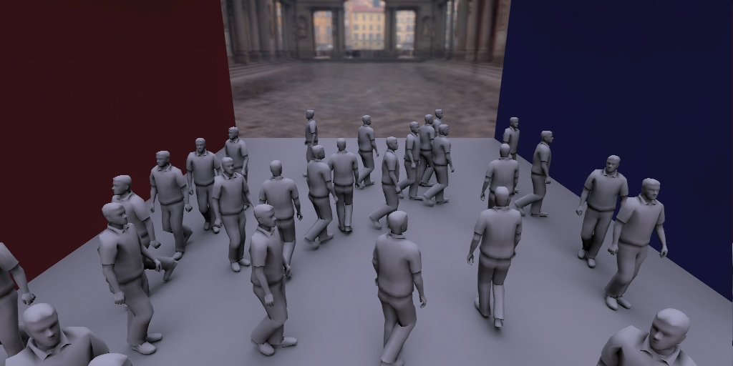
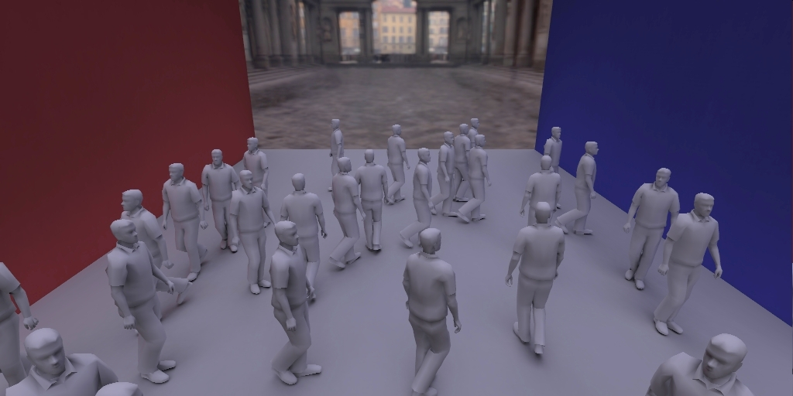
Why Crowd Lighting?

Slide 7
Why Crowd Lighting?
Crowds + GI
Crowds
Huge Cost
+
Realism
=
+
Approx. GI
Realism
…or Perceived Fidelity

Slide 8
An example…

Slide 9
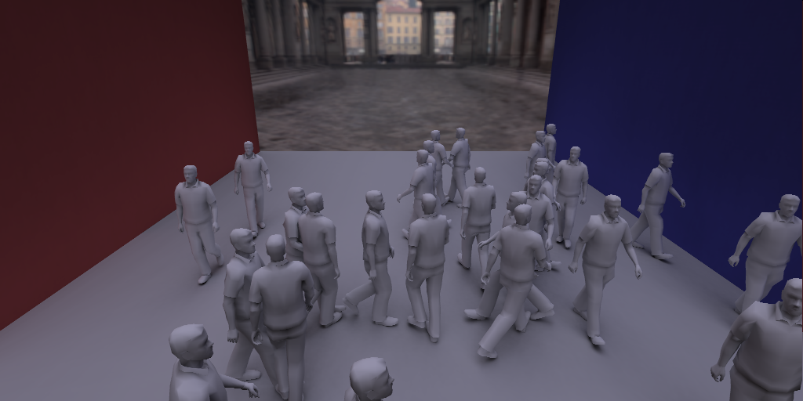
An example…
Second video rendered 3.64 times faster

Slide 10
Related Work
Perceptual rendering:
Visible Difference Predictor
[Bolin and Meyer 95/98, Myszkowski et al. 01, …]
Illumination components
[Stokes et al. 04; Debattista et al. 05]
Approximated Visibility
[Kozlowski and Kautz 07, Yu et al. 09, Ritschel et al. 08]
Visual attention
[Yee et al. 01, Ferwerda and Pellacini 03, Sundstedt et al. 07, Hasic and Chalmers 09]

Slide 11
Related Work
Perception in crowds:
Perception of general aggregates
[Ramanarayanan et al. 08]
Perception of crowd variety
[McDonnell et al. 08]
Visual Equivalence:
[Ramanarayanan et al. 07, Ramanarayanan et al. 08, Vangorp et al. 09, Krivanek et al. 10]

Slide 12
Our goal
Evaluate and understand the perceived fidelity of illumination in scenes with complex dynamic crowds.

Slide 13
Our goal – Questions to answer
Q1. Does the complexity of the crowd affect perceived quality of illumination?
Q2. Are errors in direct or indirect lighting more salient?
Q3. What effect does colour have on the perceived ﬁdelity of illuminated crowd scenes?

Slide 14
Illumination
Experiments
Comparison with Video Quality Metric

Slide 15
Illumination
Experiments
Comparison with Video Quality Metric

Slide 16
Illumination
x

Slide 17
Illumination
x1
x
x1
light transport in the scene: direct + GI + SSS

Slide 18
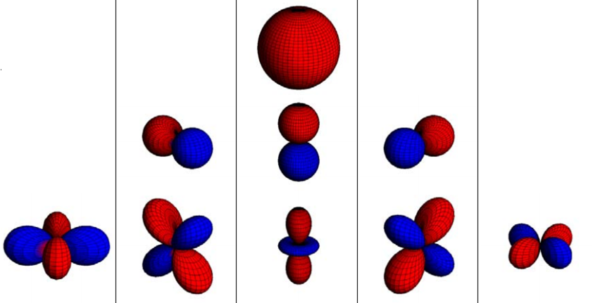
Illumination – SH
Huge vector modeling T(x,ω,ω_{o})
After [Sloan08]
SH Coefficients [Sloan02]

Slide 19
Illumination – SH
Used in Film Production [Pantaleoni11]:

Slide 20
Illumination – Interpolation
t
SH Coefficients [Sloan02]

Slide 21
Illumination – Interpolation
Frame n
Frame i
Frame n+5
Frame i = lerp(Frame n, Frame n+5)
Notes:
The number of frames we delete are saved frames: we can use this interval length to measure the quality of approximation

Slide 22
Illumination
Experiments
Comparison with Video Quality Metric

Slide 23
Experiments
Question:
“Is the illumination in the scene being evaluated the same quality as in the gold standard?”

Slide 24
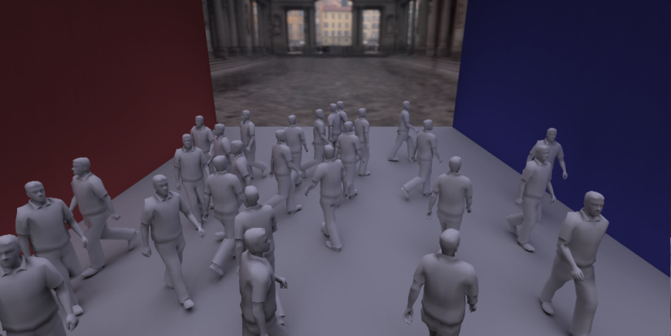
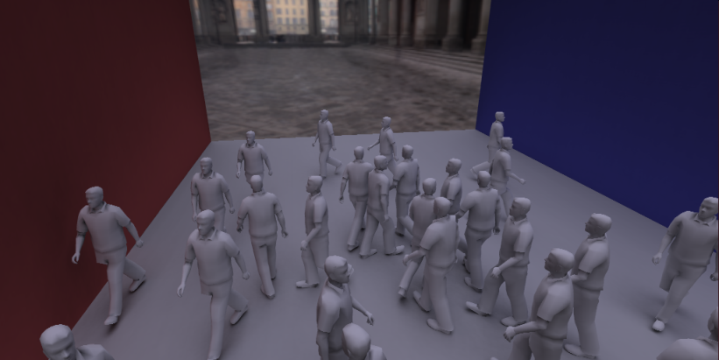
Experiments – Methods
Two screens
One shows test video.
Other shows reference from different PoV and desynchronized.
Avoid side-by-side comparison

Slide 25
Experiment 1
Q1. Does the complexity of the crowd affect perceived quality?
Q2. Are errors in direct or indirect lighting more salient?
Q3. What effect does colour have on the perceived ﬁdelity of illuminated crowd scenes?

Slide 26
Experiment 1 – Variables
Character Object (OBJ): Pawn & Human

Slide 27
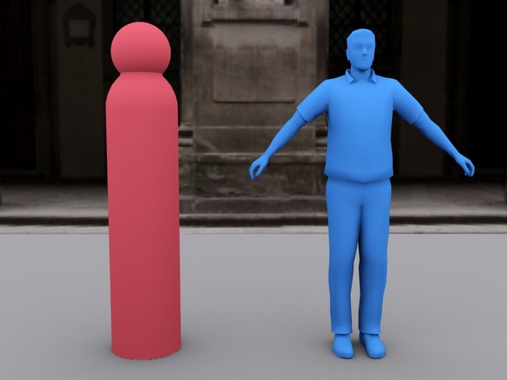
Variables – Character Object
Pawn
Static
Smooth
Human
Animated
Sharp gradients
Self-occlusions

Slide 28
Experiment 1 – Variables
Character Object (OBJ): Pawn & Human
Crowd Movement (MOV): Army & Random

Slide 29
Variables – Crowd Movement
Army
Random

Slide 30
Experiment 1 – Variables
Character Object (OBJ): Pawn & Human
Crowd Movement (MOV): Army & Random
Illumination Setup (ILL): Visibility only & Full GI

Slide 31
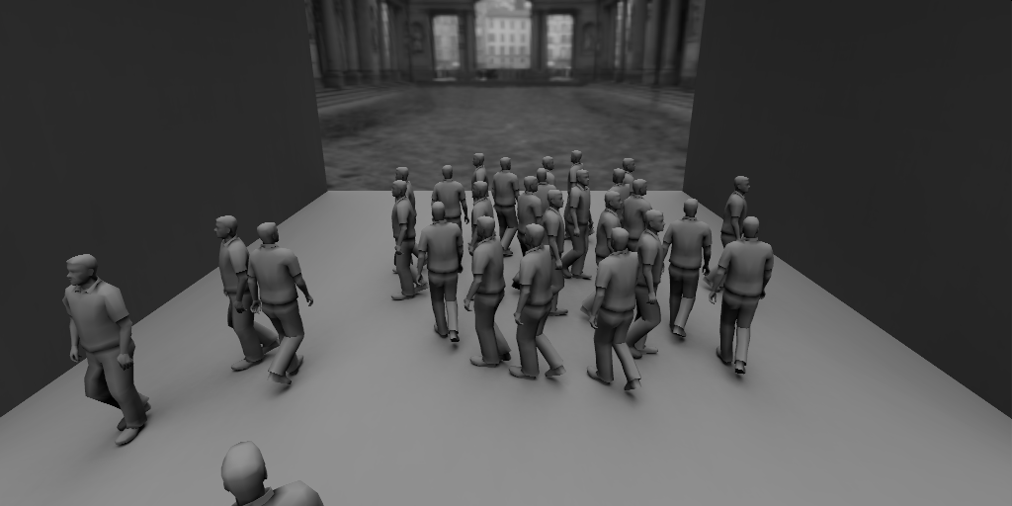
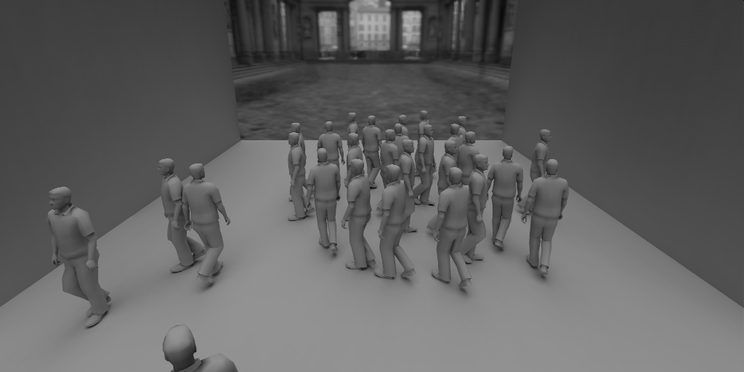
Variables – Illumination Setup
Visibility only
Full GI

Slide 32
Experiment 1 – Variables
Character Object (OBJ): Pawn & Human
Crowd Movement (MOV): Army & Random
Illumination Setup (ILL): Visibility only & Full GI
Interpolation Intervals (INT) : [GS, 2, 3, 4]

Slide 33
Illumination – Interpolation
Frame n
Frame n+5
Notes:
The number of frames we delete are saved frames: we can use this interval length to measure the quality of approximation

Slide 34
Experiment 1 – Variables
Character Object (OBJ): Pawn & Human
Crowd Movement (MOV): Army & Random
Illumination Setup (ILL): Visibility only & Full GI
Interpolation Intervals (INT) : [GS, 2, 3, 4]
32 combinations

Slide 35
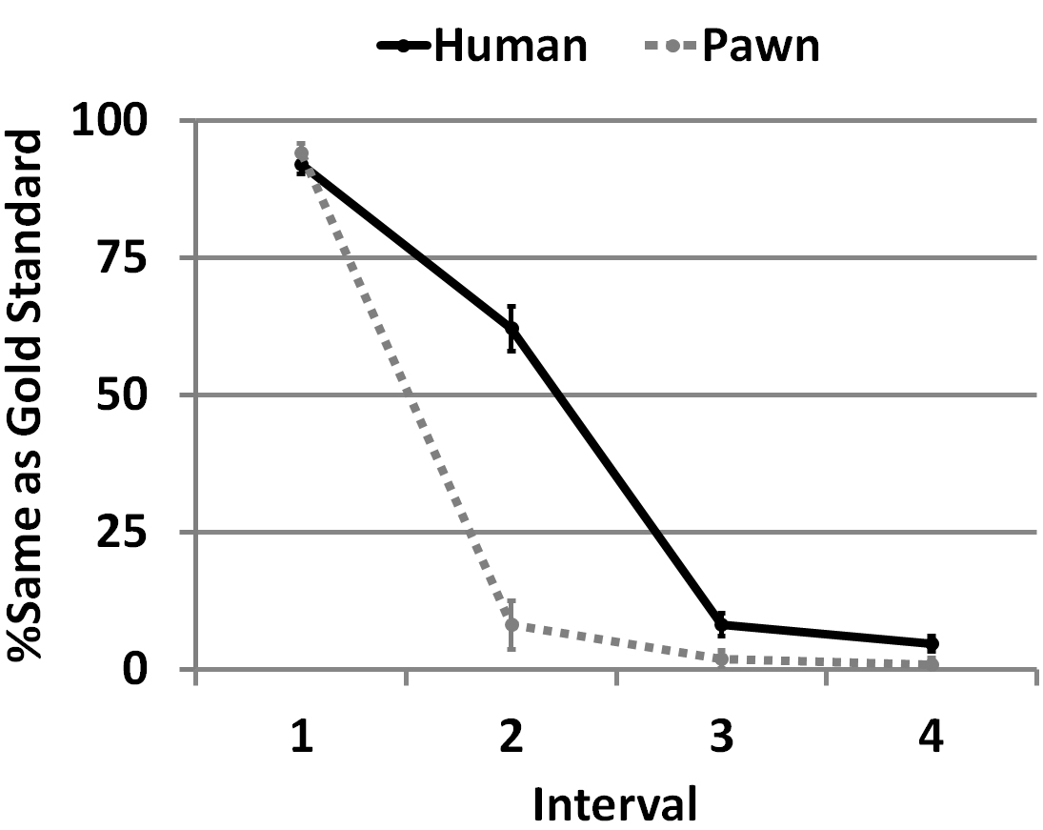
Experiment 1 – Results
Equivalent to GS
Visible Differences

Slide 36
Experiment 1 – Discussion
Local artifacts are not masked by global complexity.
Interpolating direct lighting coefficients creates unacceptable artifacts in most cases.

Slide 37
Experiment 1
Q1. Does the complexity of the crowd affect perceived quality?
Q2. Are errors in direct or indirect lighting more salient?

Slide 38
Experiment 2
Q1. Does the complexity of the crowd affect perceived quality?
Q3. What effect does colour have on the perceived ﬁdelity of illuminated crowd scenes?

Slide 39
Experiment 2 – Variables
Character Object (OBJ): Pawn & Human
Crowd Movement (MOV): Army & Random
Illumination Setup (ILL): Visibility only & Full GI

Slide 40
Experiment 2 – Variables
Character Object (OBJ): Pawn & Human
Crowd Movement (MOV): Army & Random
Color (COL): Color & No Color
Interpolation Type (TYP): Motion-based & GI-based

Slide 41
Variables – Interpolation Type
Motion-based
T(x_{dyn}, ω, ωo)
Dynamic
Frame n+5
T(x_{sta}, ω, ωo)
Static
Frame n+5
Notes:
The number of frames we delete are saved frames: we can use this interval length to measure the quality of approximation

Slide 42
Variables – Interpolation Type
Motion-based
GI-based
T_{dir}(x, ω, ω_{o})
T_{ind}(x, ω, ω_{o})
Frame n+5
Frame n+5
T(x, ω, ω_{o})
T_{dir}(x, ω, ω_{o})
T_{ind}(x, ω, ω_{o})
Notes:
The number of frames we delete are saved frames: we can use this interval length to measure the quality of approximation

Slide 43
Experiment 2 – Variables
Character Object (OBJ): Pawn & Human
Crowd Movement (MOV): Army & Random
Color (COL): Color & No Color
Interpolation Type (TYP): Motion-based & GI-based
Interpolation Intervals (INT) : [GS, 2, 5, 10, 30, 60]
48 combinations

Slide 44
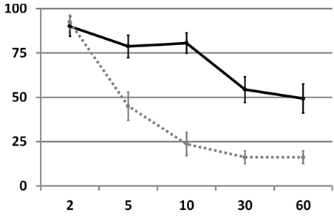
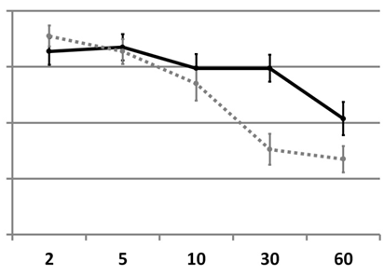
Experiment 2 – Results
Equivalent to GS
GI-based, Colour, Army
GI-based, Colour, Random
Visible Differences

Slide 45
Experiment 2 – Results
Video GI-based, Army, Human, INT = 10

Slide 46
Experiment 2 – Results
Video GI-based, Random, Human, INT = 30

Slide 47
Experiment 2 – Discussion
Complexity masks artifacts produced by approximating GI:
Human allows more approximation than Pawn.
Random allows more approximation than Army.
We can interpolate up to 10 frames for human crowds with structured motion, and 30 for the un-structured random motion.

Slide 48
Performance
Timings and Speed Up for Human crowds:
Speed-Ups are bounded by 1.19x and 4x for Intp.Type Motion-based and GI-based respectively.
Motion | Intp. Type | N | Time/frame | Speed-Up
Army | Motion-based | 5 | 4’18’’ | 1.15x
Crowd | Motion-based | 5 | 4’18’’ | 1.15x
Army | GI-based | 10 | 1’36’’ | 3.08x
Crowd | GI-based | 30 | 1’21’’ | 3.64x

Slide 49
Illumination
Experiments
Comparison with Video Quality Metric

Slide 50
Comparison with Video Quality Metric
State of the art VQM [Aydin et al. 10]

Slide 51
Comparison with Video Quality Metric
State of the art VQM [Aydin et al. 10]

Slide 52
Comparison with Video Quality Metric
State of the art VQM [Aydin et al. 10]

Slide 53
Comparison with Video Quality Metric
State of the art VQM [Aydin et al. 10]
VQM focus on low-level vision (pixels):
Too conservative
Introducing high-level vision knowledge allows more aggressive approximations.

Slide 54
Conclusion
Presented a framework to evaluate the perceived fidelity of approximated illumination solutions in dynamic crowds.
Errors in illumination can be masked by the aggregate characteristics.
Faster rendering even with naïve approximations.
Compared against VQM. Show that using scene properties would improve these metrics.

Slide 55
Conclusion – Questions to answer
Q1. Does the complexity of the crowd affect perceived quality of illumination?
More complex crowds allows approximating more the illumination when approximating GI.
Q2. Are errors in direct or indirect lighting more salient?
Errors in direct lighting are more salient.
Q3. What effect does colour have on the perceived ﬁdelity of illuminated crowd scenes?
The most acceptable approximation for human crowds is to interpolate indirect illumination in colour scenes.

Slide 56
Future Work
Explore other aggregate properties.
E.g. numerosity, variety, LoD…
Explore new approximation algorithms for rendering.
Account for scene properties in objective video quality metrics.

Slide 57
Thank you!
Acknowledgments
Martin Prazak
Science Foundation Ireland (Metropolis)
European Commission, 7th Framework Programme (GOLEM & VERVE)
Spanish Ministry of Science
National Science Foundation
CAI Programa Europa
Experiment participants
http:\\giga.cps.unizar.es\~ajarabo\pubs\CrowdsEG12

Slide 58
Crowd Light: Evaluating the Perceived Fidelity of Illuminated Dynamic Scenes
Adrian Jarabo¹ Tom Van Eyck² Veronica Sundstedt³
Kavita Bala⁴ Diego Gutierrez¹ Carol O’Sullivan²
¹Universidad de Zaragoza ²Trinity College Dublin
³Blekinge Institute of Technology ⁴Cornell University
http:\\giga.cps.unizar.es\~ajarabo\pubs\CrowdsEG12

