Slide 1
Effects of Approximate Filtering on the Appearance of Bidirectional Texture Functions
Adrian Jarabo, Hongzhi Wu, Julie Dorsey,
Holly Rushmeier, Diego Gutierrez

Slide 2
Bidirectional Texture Function
[Filip et al.11]

Slide 3
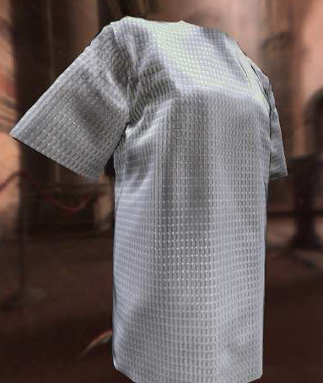
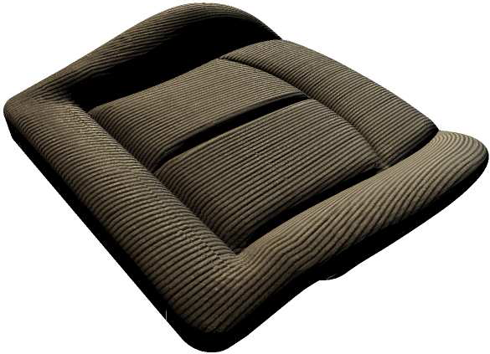
Bidirectional Texture Function
[Settler et al. 05]

Slide 4
Bidirectional Texture Function
[Schwartz et al.11]

Slide 7
Bidirectional Texture Function
View- and light-dependent textures
Encoding:
Complex reflectances
Parallax
Shadows
GI + local SSS
[Filip et al.11]

Slide 8
Bidirectional Texture Function
[Schwartz et al.11]

Slide 9
BTF – The problem of filtering
Undersampling (Aliasing)
Over-smooth (Blur)

Slide 10
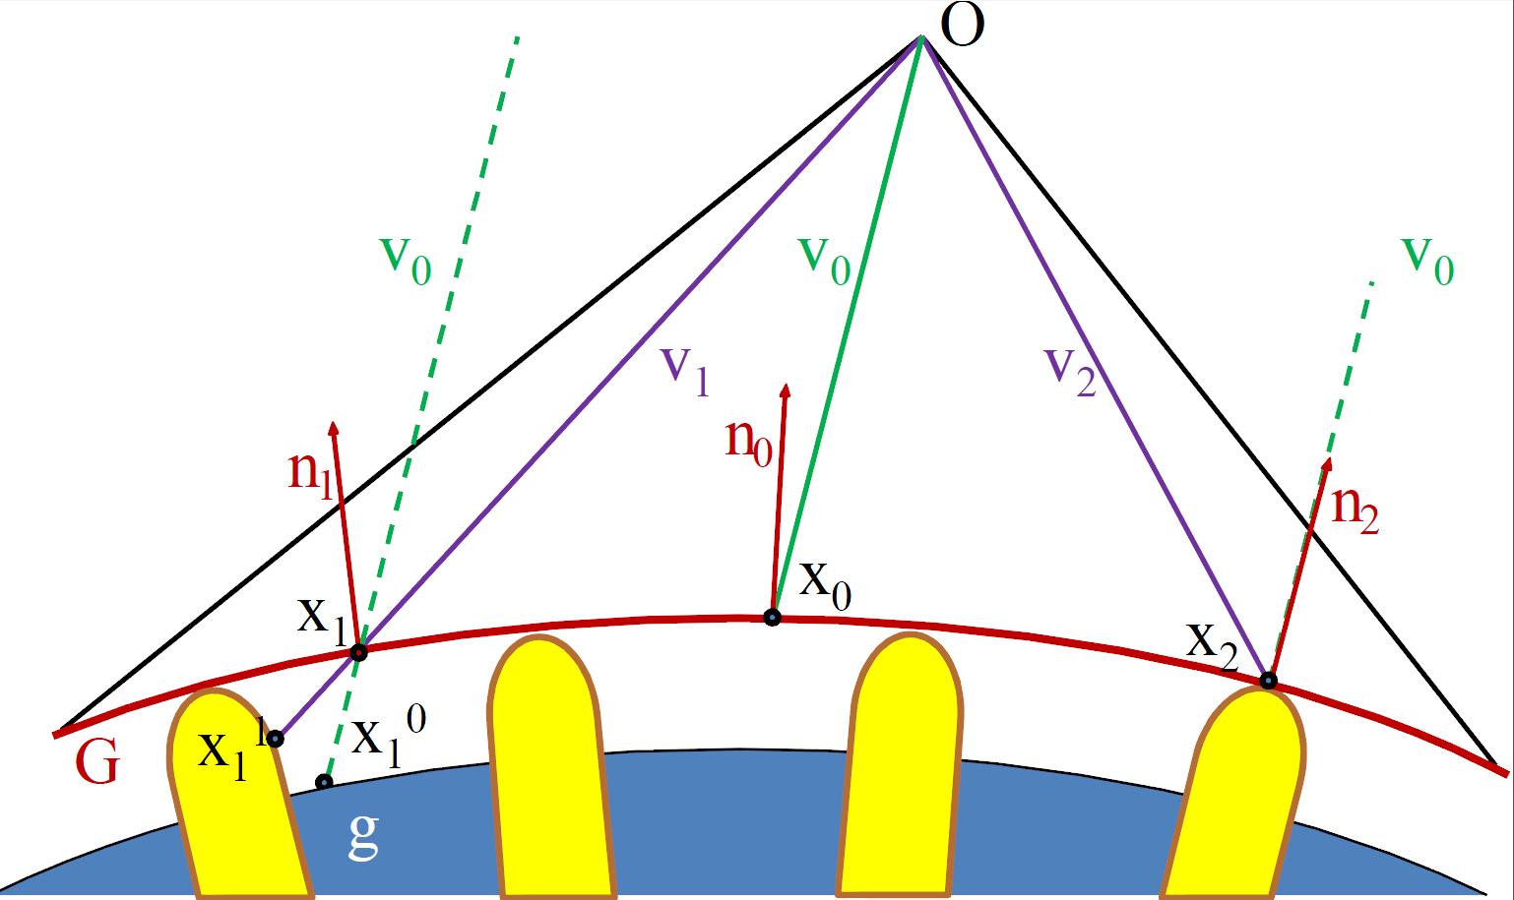
BTF – The problem of filtering

Slide 11
BTF – The problem of filtering
Undersampling (Aliasing)
Over-smooth (Blur)

Slide 12
Bidirectional Texture Function
Angular-dependent textures
[Filip et al.11]

Slide 13
BTF – The problem of filtering
Undersampling (Aliasing)
Over-smooth (Blur)

Slide 14
BTF – The problem of filtering
So you can:
Throw many rays to sample accurately the BTF (expensive)
Or prefilter the BTF, and then only throw one sample
Undersampling (Aliasing)
Over-smooth (Blur)

Slide 15
Our goal
Evaluate under which conditions an approximately pre-filtered BTF is considered visually equivalente to the ground truth.

Slide 16
Our goal
Is it possible to pre-filter BTFs maintaining visual equivalence to the reference solution?
What kind of artifacts (e.g. aliasing, blur) are more easily accepted? Under which conditions?
Does distance or motion affect visual equivalence?
Is this visual equivalence correlated with high-level visual properties of the surface?

Slide 17
Perceptual Experiments
Static and dynamic experiments
Static light and camera, moving light & moving camera

Slide 18
Perceptual Experiments
Static and dynamic experiments
Several BTFs representing different materials
Each BTF has assigned a set of high-level visual properties: e.g. glossy, structured, relief

Slide 19
Perceptual Experiments

Slide 20
Perceptual Experiments
Static and dynamic experiments
Several BTFs representing different materials
Analysis of filtering angular and spatial domains separately

Slide 21
Perceptual Experiments
Spatial domain
Undersampling (Aliasing)
Over-smooth (Blur)

Slide 22
Perceptual Experiments
Angular domain
Undersampling (Aliasing)
Over-smooth (Blur)

Slide 23
Perceptual Experiments
Static and dynamic experiments
Several BTFs representing different materials
Analysis of filtering angular and spatial domains separately
Test different geometries and illumination

Slide 24
Perceptual Experiments

Slide 25
Perceptual Experiments
Static and dynamic experiments
Several BTFs representing different materials
Analysis of filtering angular and spatial domains separately
Test different geometries and illumination
Use MTurk to get participants (~3000)

Slide 26
Analysis
Check consistency between results on Mturk and controlled in-situ experiments.
N-Ways ANOVA seeking for main and interaction effects.
Tukey-Kramer post-hoc analysis.

Slide 27
Experiments Results (I)
Aliasing (contrast) is preferred in static scenes…
… in contrast, oversmooth appearance is preferred for dynamic scenes.
The angular domain supports for more aggresively pre-filter than the spatial domain.

Slide 28
Experiments Results (II)
High-level descriptors of the surfaces relate with the results: their visual properties affect the level of blur or aliasing accepted.
Low-level BTF statistics correlate with high-level visual descriptors.
Our results generalize to geometries and illumination with several levels of complexity.

Slide 29
Applications
In rendering, BTF compression or filtering:
When a prefiltered approximation can be used for BTFs?

Slide 30
Applications
In rendering, BTF compression or filtering:
When a prefiltered approximation can be used for BTFs?

Slide 31
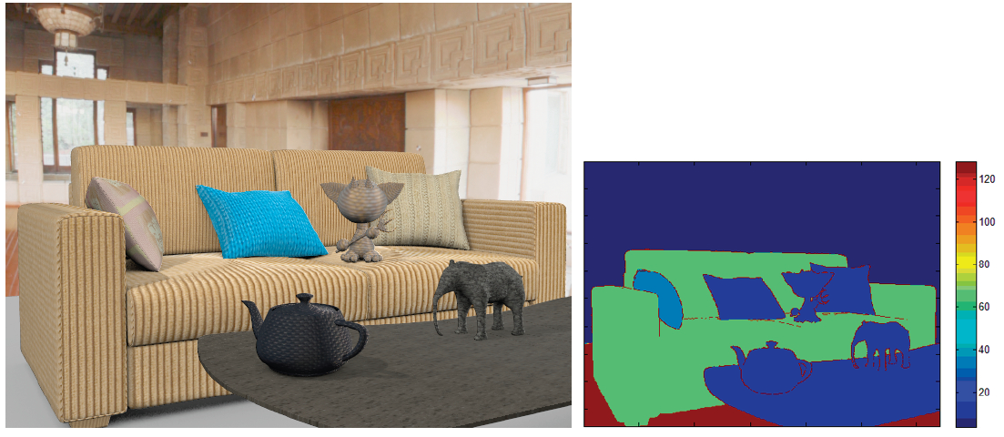
Applications
In rendering, BTF compression or filtering:
Adaptive rendering based on material props.
Speed-up: x2.5

Slide 32
Conclusions
Approximate pre-filtering can be applied to BTF without sacrificing visual quality.
We can filter the angular domain more aggresively than the spatial domain.
High-level features can be used to determine optimal parameters for BTF filtering. And they correlate with low-level statistics!

Slide 33
Conclusions
Approximate pre-filtering can be applied to BTF without sacrificing visual quality.
We can filter the angular domain more aggresively than the spatial domain.
High-level features can be used to determine optimal parameters for BTF filtering. And they correlate with low-level statistics!

Slide 34
Conclusions
Approximate pre-filtering can be applied to BTF without sacrificing visual quality.
Shown several applications for BTF rendering, filtering and compression.

Slide 35
Conclusions
Approximate pre-filtering can be applied to BTF without sacrificing visual quality.
Shown several applications for BTF rendering, filtering and compression.
Future work: extrapolate findings and procedure to other material models?
e.g. SV-BRDFs

Slide 36
Thanks!
Data at:
http://giga.cps.unizar.es/~ajarabo/pubs/btfTVCG14/

