Slide 1
A Radiative Transfer Framework for Spatially-Correlated Materials
Adrián Jarabo¹ Carlos Aliaga^{1,2} Diego Gutierrez¹
¹Universidad de Zaragoza, I3A ²Desilico Labs

Slide 2
[Jakob 2010]
Notes:
The motivation of our work is to accurately model light transport in volumetric representations of materials with structure, such as cloth…

Slide 3
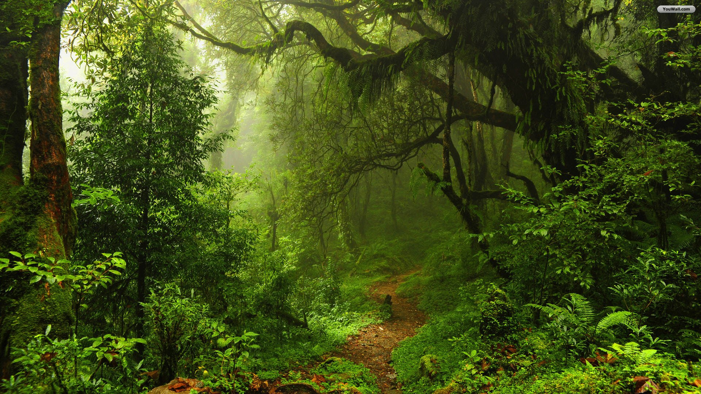
Notes:
… foliage and trees…

Slide 4
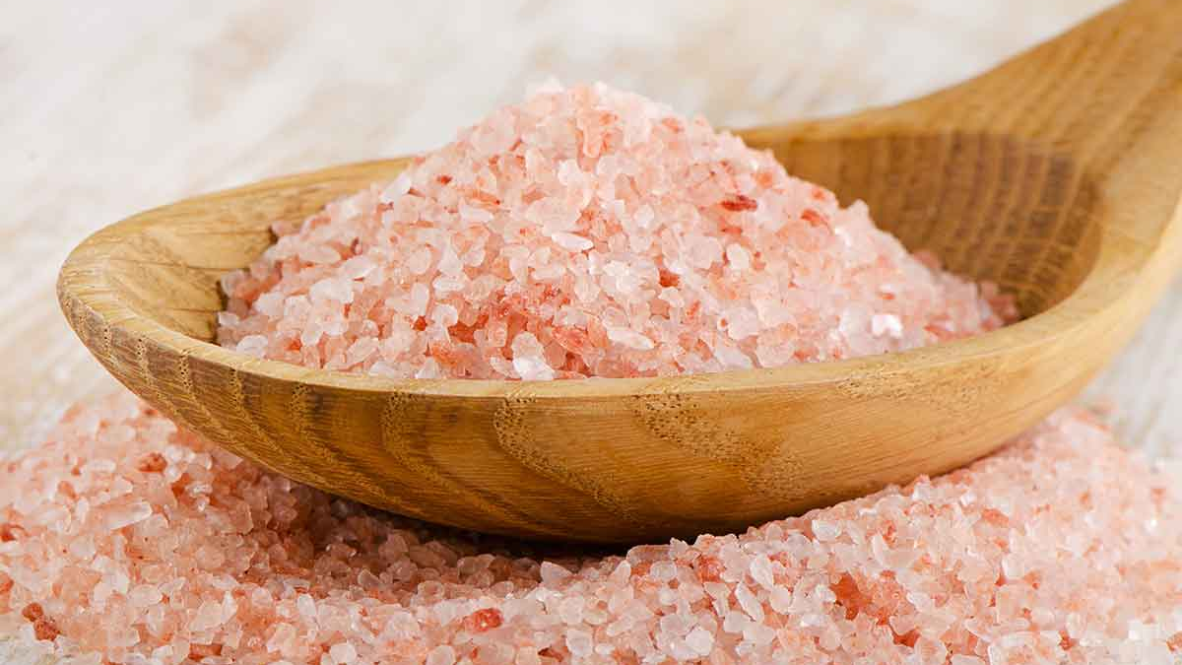
Notes:
… particulate media…

Slide 5
Fir0002/Flagstaffotos
Notes:
… or even clouds. Let’s take clouds, for example.

Slide 6
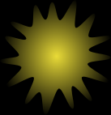
Radiative Transport (RTE)
Fir0002/Flagstaffotos
Notes:
In general, when rendering media, we compute the light transport by solving the <click> radiative transfer equation.

Slide 7
Radiative Transport (RTE)
Perfectly
Uncorrelated
x
Fir0002/Flagstaffotos
Notes:
This equation assumes that for a differential volume at point x <click> the scattering particles are perfectly uncorrelated. Unfortunately <click>

Slide 8
Radiative Transport (RTE)
Perfectly
Uncorrelated
x
Fir0002/Flagstaffotos
Notes:
… this is not true, and the scatterers in a cloud present spatial correlation between them <click>, forming clusters of droplets. Therefore, the assumption of uncorrelation of the RTE is no longer valid <click>.

Slide 9
Notes:
And this correlation doesn’t exist only in clouds; following the previous examples, positive correlation of scatterers in form of clustering can also be found in <click> foliage and <click> cloth; while scatterers in particulate media <click> present negative correlation.

Slide 10
RTE
RTE
RTE
Negative Correlation
Uncorrelated
Positive Correlation
0
Degree of Correlation
Notes:
So before we continue, let us revise what we mean by spatial correlation. The classic RTE assumes that each particle <click> has a position completely random, and uncorrelated with respect to the other particles in the volume. On the other hand, in media with positive correlation <click>, the scatterers tend to form clusters <click>, resulting on areas with low concentration, and therefore higher transmittance. Finally, scatterers negatively correlated <click> tend to repulse each others, so that they tend to not shadow. <click> There is then a continuum of correlation, where only <click> a 0-correlation is accurately represented by the RTE.

Slide 11
Uncorrelation
Pos. Correlation
path-length distribution log[p(s)]
Neg. Correlation
0
4
8 [mfp]
distance since last interaction s
Notes:
And how this correlation affects light transport? Well, the effect of correlation manifests on the probability of a photon to be extincted after travelling uncollided after an interaction, shown in the y-axis in log-scale as: the <click> uncorrelated media has the well-known exponential probability of extinction, as opposed to <click> positively, and <click> negatively correlated media.

Slide 12
Uncorrelation
Pos. Correlation
Transmittance log[T(s)]
Neg. Correlation
0
4
8 [mfp]
distance since last interaction s
Notes:
And of course, this different path-length distribution affects transmittance, shown again in log scale in the y-axis: While the <click> uncorrelated media has the classic exponential transmittance predicted by Beer-Lambert law, possitively correlated media <click> present slower-than exponential transmittance, and <click> media with perfect negative correlation have a linear, faster-than-exponential transmittance.

Slide 13
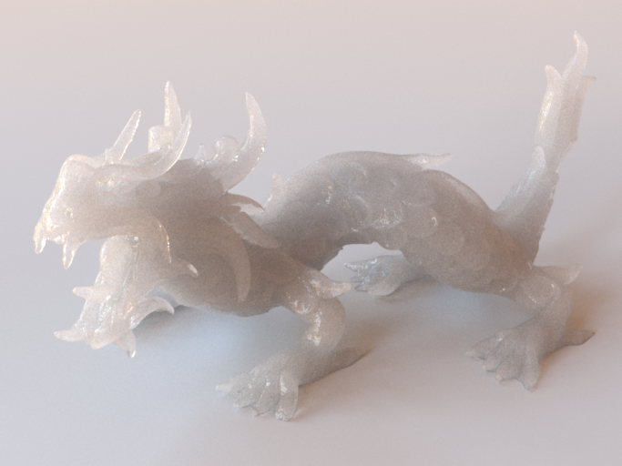
Uncorrelation (Classic RTE)
Pos. Correlated
Neg. Correlated
Notes:
This has a significant effect on appearance. As an example, we render this translucent dragon assuming <click> an homgeneous uncorrelated medium <click>.

Slide 14
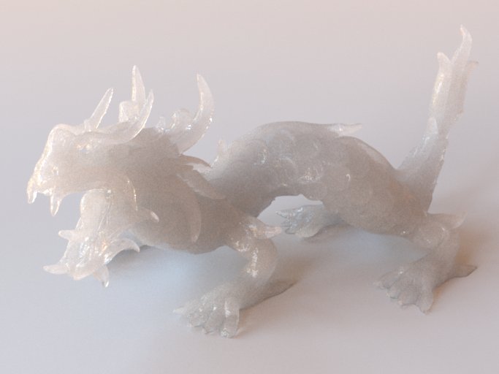
Positive Correlation
Notes:
… however, if we assume positive correlation, given its slower-than-exponential transmittance, we can see that the appearance becomes more translucent with the same average extinction.

Slide 15
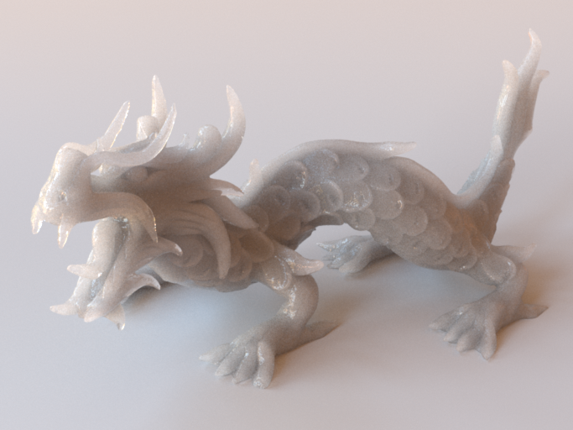
Negative Correlation
Notes:
… while negative correlation results into very strong extinction…

Slide 16
Uncorrelation (Classic RTE)
Pos. Correlated
Neg. Correlated
Notes:
… compared with classic transport.

Slide 17
Atmospheric Sciences
[Newman 1995, Davis 1999, Davis 2004]
Thermal Propagation
[Coquard 2006, Taine 2010]
Nuclear Transport
[Larsen 2007, Frank 2010]
General Transport
[d’Eon 2014, d’Eon 2016]
[Meng 2015;
Müller 2016]
[Moon 2007]
[d’Eon 2014]
Notes:
This observation is not new, and non-exponential correlated media have been observed in different fields.
Within graphics, however, it has received less attention, with the notable exceptions of <click> the works by Moon et al. and Meng et al. modeling particulate media, and closer to us <click> the work by d’Eon directly applying Larsen’s non-classical transport to render. However, none of these works attempt to provide a general radiative model for rendering correlated media.

Slide 18
In the following…
Radiative framework for spatially-correlated materials (for graphics)
Intuitive model for positively-correlated media
Notes:
So, in the rest of the talk we will speak about a new radiative model for spatially-correlate materials that can be used in rendering; then, we will discuss how to model the appearance for positively correlated media.

Slide 19
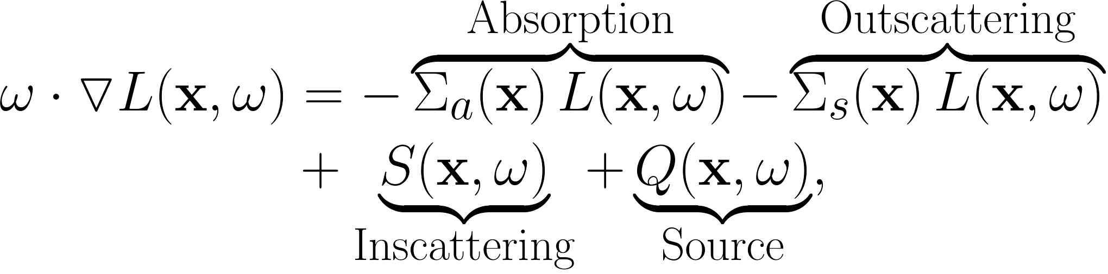
Radiative Transfer Equation
Notes:
First of all, let’s start from the uncorrelated RTE, but for simplicity <click> let’s assume for now purely absorbing media.

Slide 20
Differential Probability
of Absorption
Free-Path Distribution
Absorption Coefficient
Notes:
In this form, the differential of energy is negative, and this energy loss is <click> modeled by the differential probability of absorption, defined <click> as a function of the path-length distribution. In the case of uncorrelated exponential media <click> it is a constant defined by the absorption coefficient.

Slide 21
Uncorrelation
Pos. Correlation
path-length distribution log[p(s)]
Neg. Correlation
0
4
8 [mfp]
distance since last interaction s
Notes:
However, as we saw before, correlation has a significant effect on the path-length distribution, and media with different degrees of correlation don’t have exponential probability of extinction…

Slide 22
Uncorrelation
Pos. Correlation
Differential Prob. Extinction [Σ(s)]
Neg. Correlation
0
4
8 [mfp]
distance since last interaction s
Notes:
… thus , as opposed to uncorrelated media <click> where the Sigma is a constant, media with positive <click> and negative correlation <click> have a depth-dependent sigma.

Slide 23
Notes:
In such cases, sigma is no longer a constant…

Slide 24
Dependence on the distance
since last interaction s
Notes:
… but a function depending on the distance since last collision s, so light traveling different distances s since last interaction have different differential extinction probability.

Slide 25
Dependence on the distance
since last interaction s
Non-zero energy rate
GBE [Larsen 2007, 2011]
Notes:
This results in a non-zero energy rate, as opposed to the classic steady-state RTE, since the energy equilibrium is reached when integrating over all path lengths.
This equation, plus the inscattering and source terms, was first proposed by Larsen in the context of neutron transport as the Generalized Bolzmann Equation.

Slide 26
Is it usable for rendering?
Nop… it assumes:
Same correlation between scatterers, sources…
Infinite media (no boundaries)
Not mixtures of scattereres, homogeneity…
Notes:
Then, the question is whether we can use directly Larsen’s equation for rendering.
Unfortunately, <click> this is not the case, given the set of assumptions imposed in the original definition:
First, Larsen’s GBE <click> assumes that scatterers and sources have equal correlation, which is only possible if they are the exact same particles.
Second, <click> no boundaries are considered.
And third, <click> Larsen’s GBE assumes that all particles are the same…
Let’s focus on the first one <click>…

Slide 27
Sources vs Scatterers
path-length distribution log[p(s)]
0
4
8 [mfp]
distance since last interaction s
Notes:
… in particular in the positively correlated medium illustrated in the figure. For this medium, <click> the path length distribution of light rays starting from the scatterers are shown here in yellow. If all scatterers here were also emissive, then the path length for sources would be exactly the same.
However, if we introduce a source with different correlation with the scatterers <click>, then the path length of rays starting at this source would neccesarily be different from the scatterers <click>.

Slide 28
GBE [Larsen 2007, 2011]
Notes:
Since Larsen’s only considers a single differential extinction probability, this difference in path length is ignored.

Slide 29
Extinction from Scatterers
Extended GBE (E-GBE) [Ours]
Extinction from Sources
Notes:
To solve that, we need to take into account that light that has been scattered from the particles in the medium <click> is extincted differently from light emitted by sources <click>. This introduces different energy loses in the GBE, as well as the need to keep track on whether the light is emitted, or scattered.

Slide 30
Is it usable for rendering?
Nop… it assumes:
Same correlation between scatterers, sources…
Infinite media (no boundaries)
Not mixtures of scattereres
Notes:
The second main assumption of Larsen’s GBE is that the media being rendered is infinite <click>, and therefore there are no boundaries.

Slide 31
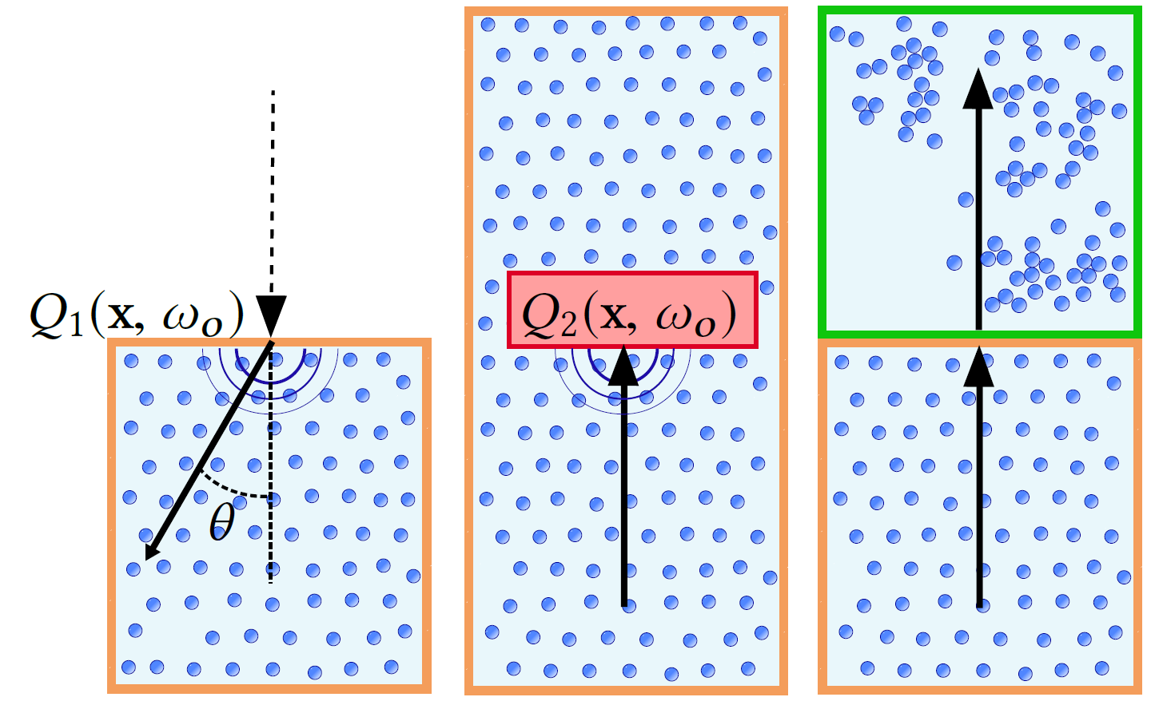
Boundary Analysis
Vacuum-to-Medium
Medium-to-Boundary
Medium-to-medium
Notes:
In order to analyze the effect of boundaries, we conducted a set of many simulations of procedurally generated media, analyzing changes of medium, as well as the effect of reflection at boundaries.

Slide 32
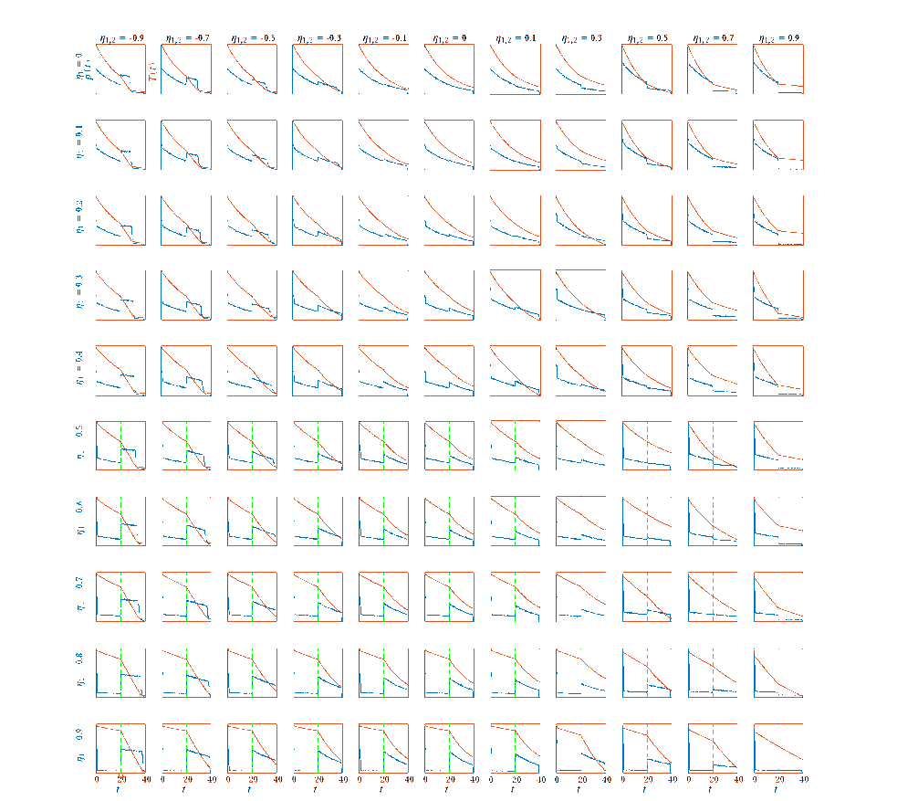
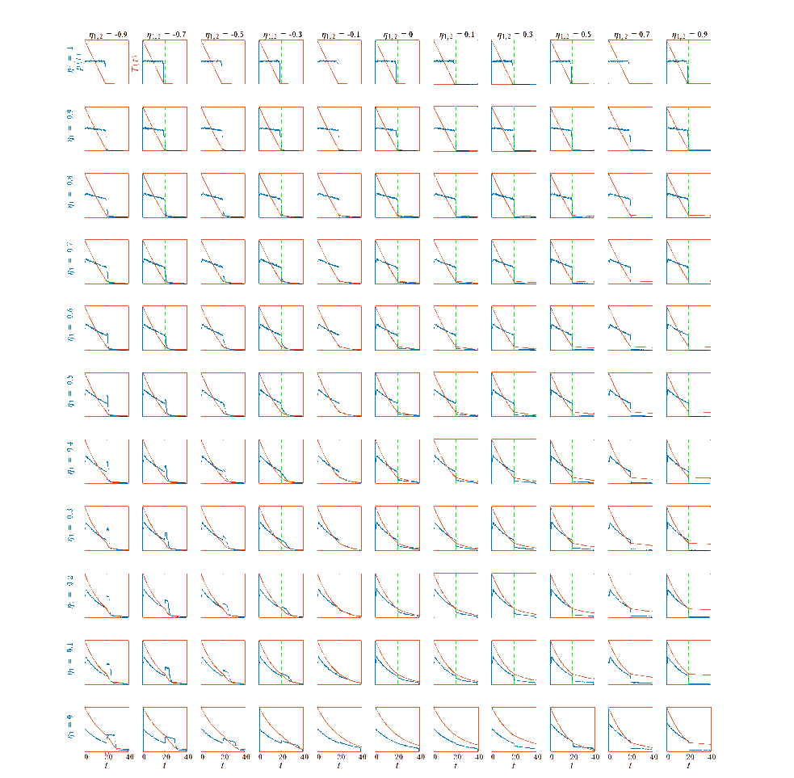
Boundary Analysis
Details in the paper and supplemental
Notes:
We averaged several thousands of simulations for each case, for a wide range of degrees of correlation. I won’t enter in much detail <click> on the particular behaviours observed…

Slide 33
Boundary Analysis
Observations:
Interactions at boundaries become new sources
The behavior at Medium-to-Medium boundaries depends on the correlation between media.
Notes:
And focus on the two main observations we found. The fist one <click> is that interactions at boundaries act as uncorrelated sources, so that light reflected at boundaries have its own path-length distirbution.
The second one <click> relates with the medium-to-medium boundaries, were its behaviour depends no only on the local correlation of each individual media, but also on the correlation between the two of them. This interaction between media properties is important to heterogeneous media, but how to handle it is left as future work.

Slide 34
Extinction from Scatterers
Extended GBE (E-GBE) [Ours]
Extinction from Sources
(and Boundaries)
Notes:
So, the nice thing of these observations is that, in order to model boundaries, we just need to stick with the extended GBE presented before that accounts for different extinction for sources and scatterers, taking into account that reflection at boundaries are simply modeled as a source term.

Slide 35
Is it usable for rendering?
Nop… it assumes:
Same correlation between scatterers, sources…
Infinite media (no boundaries)
Not mixtures of scattereres
Notes:
Finally, we remove the remaining assumptions by incorporating path length dependence on phase function and albedo. Please see the paper for details.

Slide 36
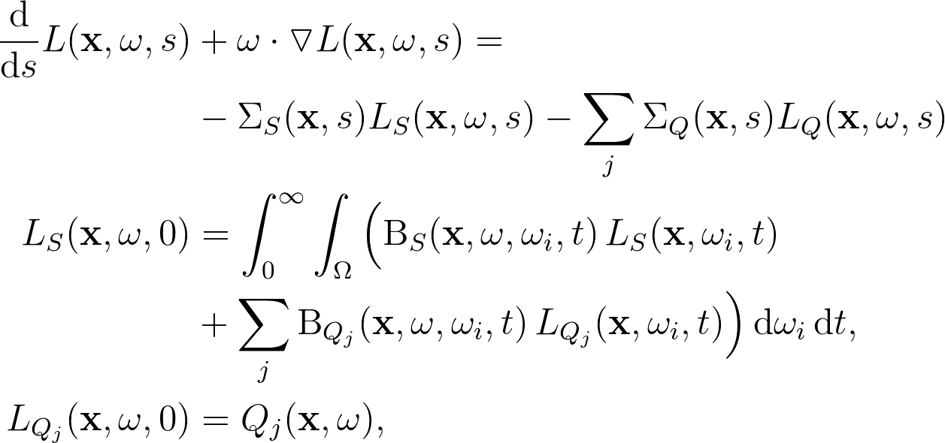
Scattered Radiance
Emitted Radiance
Scattering Operator
E-GBE [Ours]
Notes:
So in summary, this is the final look of our Extended GBE, with two initial conditions for the scattered and source radiance at the interaction.
The first one is rather obvious <click>, and accounts for the radiance due to sources.
The inscattering <click>, on the other hand, is more complex, and integrates the scattered light from all possible path lengths <click>, again with a different path-length-dependent scattering operator for inscattered radiance <click>, and for radiance from sources <click>.

Slide 37
Results
Notes:
So lets see what’s the effect of different path lengths distributions using our Extended GBE.

Slide 38
Negative Correlation (linear extinction)
Positive Correlation (power law extinction)
Negative Correlation (gamma extinction)
Distance
Distance
Distance
Notes:
Here we show three examples of a scattering medium with similar average extinction but different path length distributions.
The first example is modeled with a constant path length distribution, as shown in the plot below, where the blue curve is the path length distribution, and the orange one is the transmittance.
The dragon in the middle <click> is defined by using a power-law extinction. Finally, <click> the image on the right uses a gamma path length distribution.

Slide 39
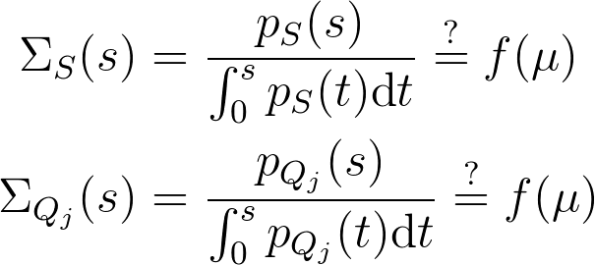
How to define the media properties?
Intuitive?
Unrelated with optical properties.
Notes:
So now the question is how do we define the media properties.
For the previous examples we just defined a given path-length distribution <click>, and derived the differential extinction probability out of it. However, we found that this was not very intuitive <click> to work with, in part because it was not very related with optical properties of the medium <click>.
So, <click> what we would like to have is some functional relationship between the media optical properties such as particles cross-section and concentration, and the differential extinction probability.

Slide 40
Intuitive modeling of Positively-Correlated Media
Notes:
To do that, we focused on media with positive correlation.

Slide 41
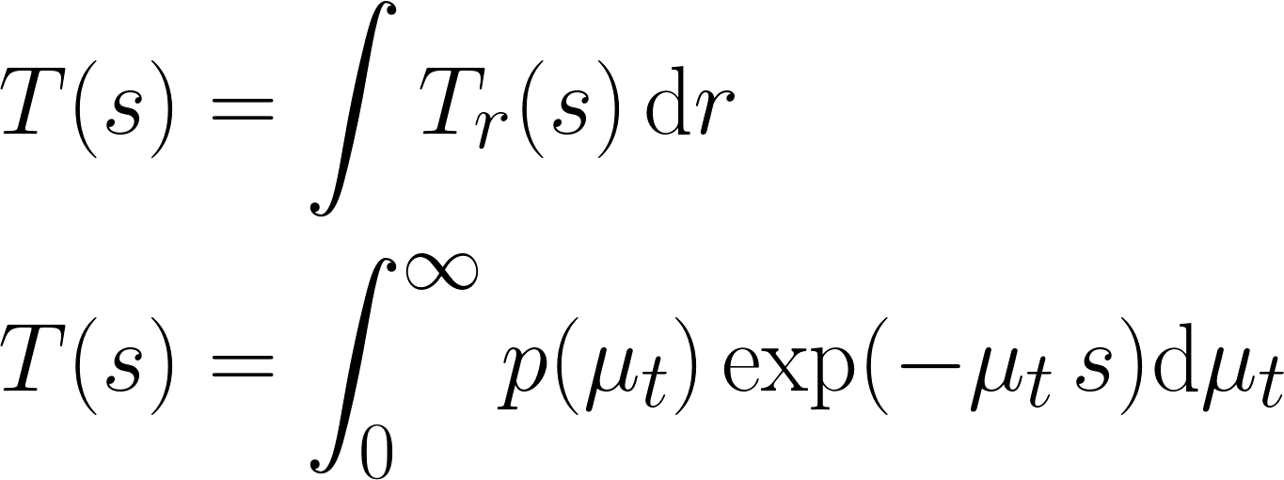
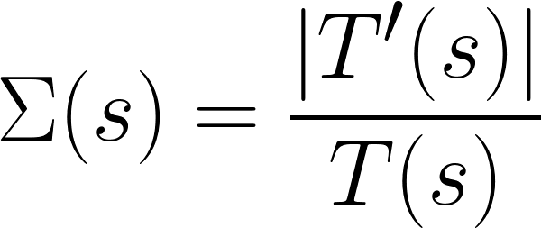
≈p(µ_{t})
ds
Notes:
The intuitive idea is that, for a differential point, particles cluster together leading to some areas with higher particles concentration <click>, leaving others with very low concentration <click>.
This means that for a incoming beam of light <click>, some rays within the beam will extinct with higher probability than others.
The total transmittance of the beam is then the integral of the transmittance of all rays <click>.
So, assuming that we can approximate the concentration of particles with a distribution, we can skip the integral over all rays in the beam, and <click> simplt integrate over the densities on the differential point.
Finally, <click> we can just compute the differential extinction coefficient based on the transmittance.

Slide 42
Directionally-Dependent
Variance (anisotropy)
- Ellipsoid representation
Gamma Distribution
Var(C,w)
Notes:
So, the question now is what probability distribution should we use. Based on various tests on voxelized cloth volumes, we found out that the gamma distribution <click> works well approximating this type of structured media. This allow us to model the distribution of particles simply by the mean and the variance of the particles’ concentration. <click> Also, this definition allows us to introduce anisotropy, by defining variance as a function of direction.
Intuitively, <click> the variance controls how much positive correlation exists in the volume, so that higher variance results into higher correlation <click>.
<click>This formulation allows us to compute the differential extinction analytically; please check the paper for details.

Slide 43
Mean(C) = 1
Var(C)=2
Var(C)=1
Var(C)=0.5
Transmittance log[T(s)]
Var(C)=0.05
0
4
8 [mfp]
distance since last interaction s
Notes:
The effect of increasing variance results into slower-than-exponential transmittance. A zero-variance distribution <click> converges to the classic uncorrelated behaviour. However, <click> as we increase variance, we can see that transmittance deviates more and more from the exponential.

Slide 44
Results

Slide 45
Uncorrelated
(Classic)
Pos. Correlated
(Ours)
Degree of Correlation
Notes:
Here we see different scattering media, rendered using uncorrelated media on the top and our model for positive correlation on the bottom, andour Extended GBE. As we move to the right, <click> the degree of correlation, and therefore variance, increases <click>, resulting in brighter appearances given the super-exponential transmittance.

Slide 46
Anisotropic Correlation
Notes:
Finally, by using a directionally-dependent variance we can model directional correlation.

Slide 47
Light
Direction
Notes:
This absorbing cylinder is placed in front of an area light, and its <click> correlation is aligned with the main light direction, as depicted in the illustrative inset. As we rotate the cylinder, <click> we can observe how the slower-than-exponential transmittance converges <click> to exponential transmittance when the direction of correlation is perpendicular to the light direction.

Slide 48
In summary…
New radiative framework for spatially-correlated materials (for graphics)
Sources, boundaries, mixtures…
Intuitive model for positively-correlated media
Based on (potentially anisotropic) distributions of concentration
Notes:
Wrapping up:
We have presented a new radiative framework for spatially correlated materials, that extends the GBE including sources, boundaries or mixtures of particles. This model can be used with any arbitrary path length distribution, supporting negative and positive correlation of scatterers.
And we have proposed a closed form analytical model to define positively correlated media based on its optical properties, based on using distributions of particles concentration.

Slide 49
Limitations & Future Work
Heterogeneous media:
How do we model it? What numerical methods?
Are all sampling techniques in classic media valid for the E-GBE?
Intuitive modeling negatively–correlated media?
Volumetric LOD, similarity theory…

Slide 50
A Radiative Transfer Framework for Spatially-Correlated Materials
Adrián Jarabo¹ Carlos Aliaga^{1,2} Diego Gutierrez¹
¹Universidad de Zaragoza, I3A ²Desilico Labs

Slide 52
Is there any “similarity” theory between RTE and E-GBE?

Slide 53
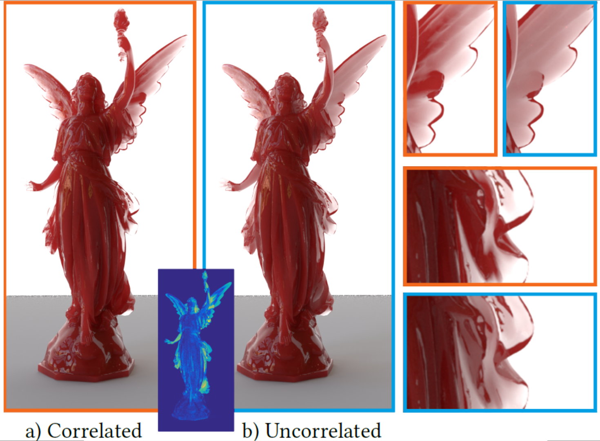

Slide 54
Effect of Albedo

Slide 55
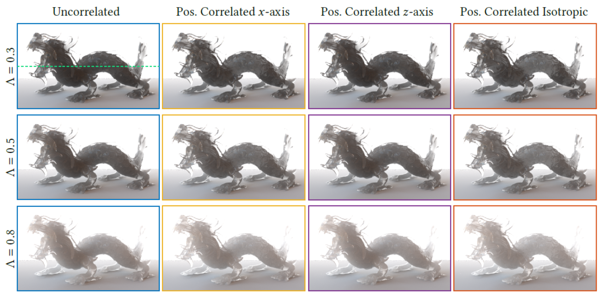

Slide 56
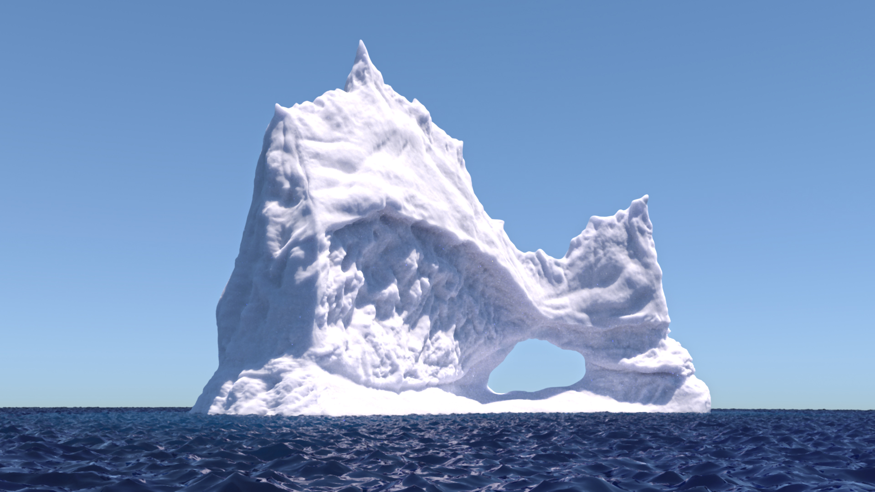

Slide 58
Dependence on the path-length s
Non-zero particles rate
[Larsen 2007, 2011]
s1
Σ(s)
L(x,w,s1)
x
L(x,w,s2)
s2

Slide 59
Light Source
Medium
Observer

Slide 60
Light Source
Medium
Observer

Slide 61
p(s) = exp(-u s)

Slide 63
Medium

